Slide 1
Loops

Slide 2
The Increment and Decrement Operators
++ is the increment operator. It adds one to a variable.
val++; is the same as val = val + 1;
++ can be used before (prefix) or after (postfix) a variable:
++val; val++;

Slide 3
The Increment and Decrement Operators
-- is the decrement operator. It subtracts one from a variable.
val--; is the same as val = val - 1;
-- can be also used before (prefix) or after (postfix) a variable:
--val; val--;

Slide 4
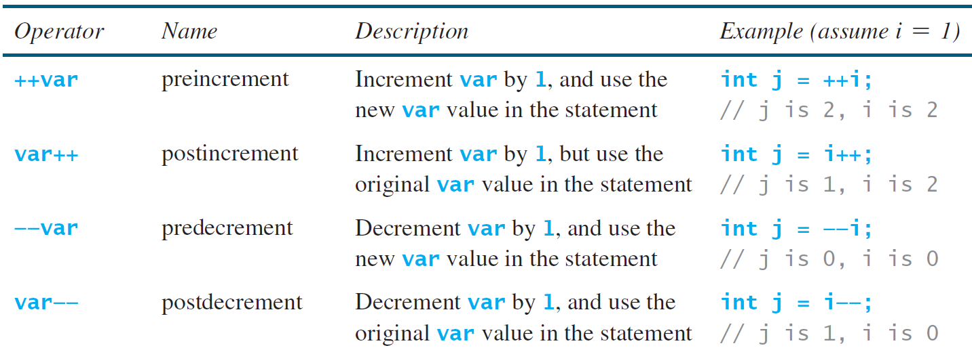
Increment and Decrement Operators

Slide 5
Increment and Decrement Operators

Slide 6
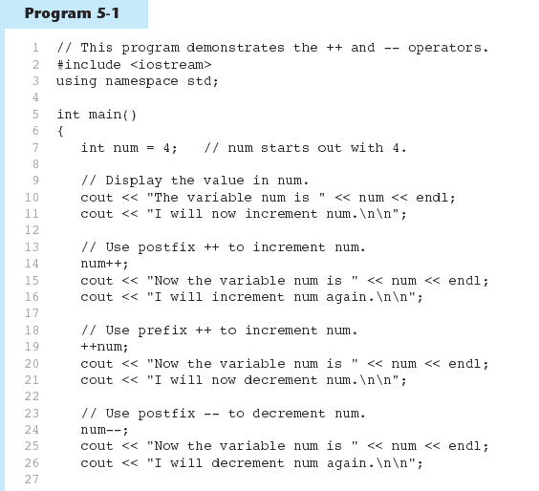
Increment and Decrement Operators in Program 5-1
Continued…

Slide 7
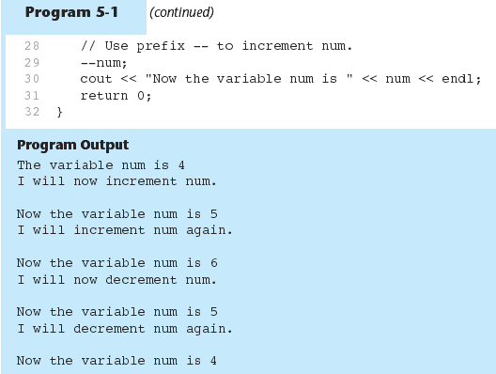
Increment and Decrement Operators in Program 5-1

Slide 8
Prefix vs. Postfix
++ and -- operators can be used in complex statements and expressions
In prefix mode (++val, --val) the operator increments or decrements, then returns the value of the variable
In postfix mode (val++, val--) the operator returns the value of the variable, then increments or decrements

Slide 9
Prefix vs. Postfix - Examples
int num, val = 12;
cout << val++; // displays 12,
// val is now 13;
cout << ++val; // sets val to 14,
// then displays it
num = --val; // sets val to 13,
// stores 13 in num
num = val--; // stores 13 in num,
// sets val to 12

Slide 10
Notes on Increment and Decrement
Can be used in expressions:
result = num1++ + --num2;
Must be applied to something that has a location in memory. Cannot have:
result = (num1 + num2)++;
Can be used in relational expressions:
if (++num > limit)
pre- and post-operations will cause different comparisons

Slide 11
5.2
Introduction to Loops: The while Loop

Slide 12
Motivations
Suppose that you need to print a string (e.g., "Welcome to C++!") a hundred times. It would be tedious to have to write the following statement a hundred times:
Cout << ("Welcome to C++!");
Liang, Introduction to Java Programming, 11th Edition, (c) 2018 Pearson Education, Inc. All rights reserved.

Slide 13
Motivations
How do you solve this problem?
Liang, Introduction to Java Programming, 11th Edition, (c) 2018 Pearson Education, Inc. All rights reserved.

Slide 14
Motivations
while loop
do-while loop
for loop
Liang, Introduction to Java Programming, 11th Edition, (c) 2018 Pearson Education, Inc. All rights reserved.

Slide 15
Motivations
while loop
Liang, Introduction to Java Programming, 11th Edition, (c) 2018 Pearson Education, Inc. All rights reserved.

Slide 16
Introducing while Loops
int count = 0;
while (count < 100) {
cout << "Welcome to C++";
count++;
}
Liang, Introduction to Java Programming, 11th Edition, (c) 2018 Pearson Education, Inc. All rights reserved.

Slide 17
Introducing while Loops
int count = 0;
while (count < 100) {
cout << "Welcome to C++";
count++;
}
int count = 0;
if (count < 100) {
cout << "Welcome to C++";
count++;
}
if statement executes only once if the condition is true.
while statement keeps on iterating until the condition becomes false.
Liang, Introduction to Java Programming, 11th Edition, (c) 2018 Pearson Education, Inc. All rights reserved.

Slide 18
Introduction to Loops: The while Loop
Loop: a control structure that causes a statement or statements to repeat
General format of the while loop:
while (expression)
statement;
statement; can also be a block of statements enclosed in { }

Slide 19
The while Loop – How It Works
while (expression)
statement;
expression is evaluated
if true, then statement is executed, and expression is evaluated again
if false, then the loop is finished and program statements following statement execute

Slide 20
The while loop Flowchart
true
boolean
expression?
statement(s)
false

Slide 21
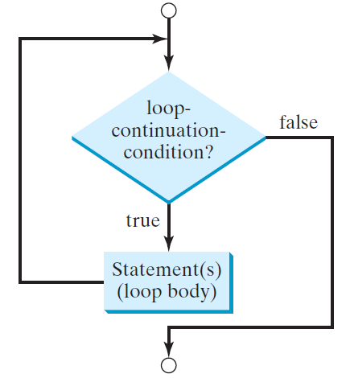
while Loop Flow Chart
while (loop-continuation-condition) {
// loop-body;
Statement(s);
}
Liang, Introduction to Java Programming, 11th Edition, (c) 2018 Pearson Education, Inc. All rights reserved.

Slide 22
The while Loop (1 of 2)
The while loop has the form:
while(condition)
{
statements;
}
While the condition is true, the statements will execute repeatedly.
The while loop is a pretest loop, which means that it will test the value of the condition prior to executing the loop.

Slide 23
The while Loop (2 of 2)
Care must be taken to set the condition to false somewhere in the loop so the loop will end.
Loops that do not end are called infinite loops.
A while loop executes 0 or more times. If the condition is false, the loop will not execute.

Slide 24
Infinite Loops (1 of 3)
In order for a while loop to end, the condition must become false. The following loop will not end:
int x = 20;
while(x > 0)
{
cout << "x is greater than 0";
}
How do you fix this?

Slide 25
Infinite Loops (2 of 3)
In order for a while loop to end, the condition must become false. The following loop will not end:
int x = 20;
while(x > 0)
{
cout << "x is greater than 0";
}
The variable x never gets decremented so it will always be greater than 0.
Adding the x-- above fixes the problem.

Slide 26
Infinite Loops (3 of 3)
This version of the loop decrements x during each iteration:
int x = 20;
while(x > 0)
{
cout << "x is greater than 0";
x--;
}

Slide 27
Block Statements in Loops
Curly braces are required to enclose block statement while loops. (like block if statements)
while (condition)
{
statement;
statement;
statement;
}

Slide 28
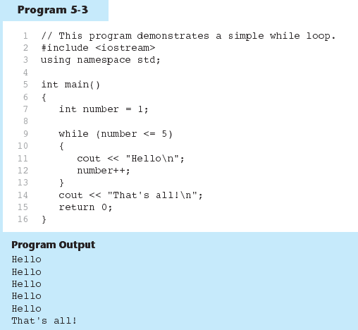
The while loop in Program 5-3

Slide 29
Trace while Loop
animation
Initialize count
int count = 0;
while (count < 2)
{
cout << "Welcome to C++!";
count++;
}

Slide 30
Trace while Loop, cont.
animation
(count < 2) is true
int count = 0;
while (count < 2)
{
cout << "Welcome to C++!";
count++;
}

Slide 31
Trace while Loop, cont.
animation
Print Welcome to C++
int count = 0;
while (count < 2)
{
cout << "Welcome to C++!";
count++;
}

Slide 32
Trace while Loop, cont.
animation
Increase count by 1
count is 1 now
int count = 0;
while (count < 2)
{
cout << "Welcome to C++!";
count++;
}

Slide 33
Trace while Loop, cont.
animation
(count < 2) is still true since count is 1
int count = 0;
while (count < 2)
{
cout << "Welcome to C++!";
count++;
}

Slide 34
Trace while Loop, cont.
animation
Print Welcome to C++
int count = 0;
while (count < 2)
{
cout << "Welcome to C++!";
count++;
}

Slide 35
Trace while Loop, cont.
animation
Increase count by 1
count is 2 now
int count = 0;
while (count < 2)
{
cout << "Welcome to C++!";
count++;
}

Slide 36
Trace while Loop, cont.
animation
(count < 2) is false since count is 2 now
int count = 0;
while (count < 2)
{
cout << "Welcome to C++!";
count++;
}

Slide 37
Trace while Loop
animation
The loop exits. Execute the next statement after the loop.
int count = 0;
while (count < 2)
{
cout << "Welcome to C++!";
count++;
}

Slide 38
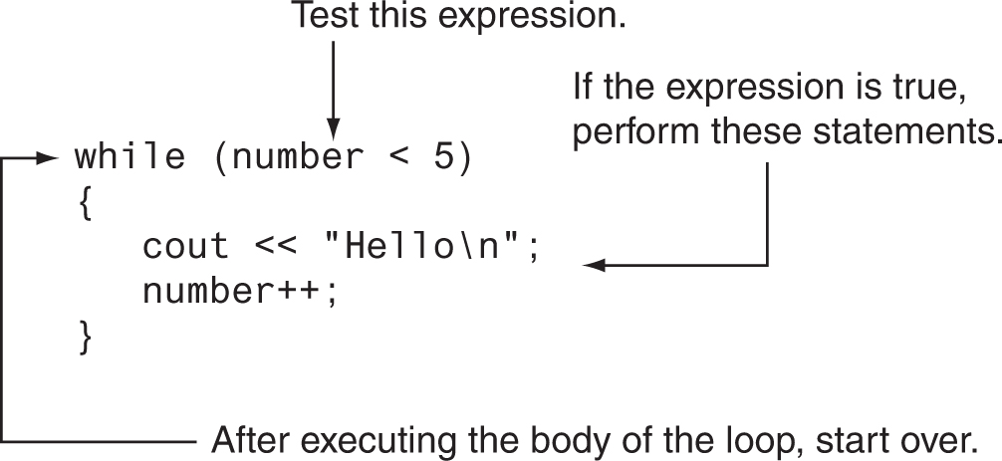
How the while Loop in Program 5-3 Lines 9 through 13 Works

Slide 39
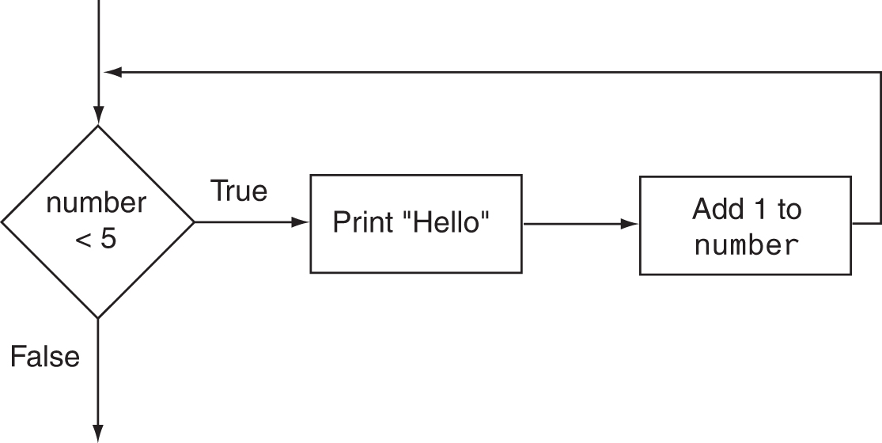
Flowchart of the while Loop in Program 5-3

Slide 40
The while Loop is a Pretest Loop
expression is evaluated before the loop executes. The following loop will never execute: int number = 6; while (number <= 5) { cout << "Hello\n"; number++; }

Slide 41
Repeat Additions - Class exercise
Generate 2 random integers and ask the user to input the correct added value of 2 integers. If the answer is wrong display with a comment, “Your answer is wrong. What should the value be ?”.
Output:
What is 23 + 100? 23
Wrong answer. Try again. What is 23 + 100? 112
Wrong answer. Try again. What is 23 + 100? 123
You got it!

Slide 42
Repeat Additions - Class exercise
Generate 2 random integers(one within 50 and the next one within 100) and ask the user to input the correct added value of 2 integers. Try to generate 10 questions randomly. Display the correct count. the If the answer is wrong display the correct answer with a comment, “Your answer is wrong. The correct answer is ….”.

Slide 43
Repeat Additions - Output:
What is 30 + 79? 109
What is 4 + 81? 85
What is 23 + 50? 73
What is 48 + 39? 34
Wrong answer.
Your correct answer is 87
What is 25 + 54? 79
What is 6 + 16? 22
What is 29 + 47? 65
Wrong answer.
Your correct answer is 76
What is 41 + 67? 34
Wrong answer.
Your correct answer is 108
What is 10 + 63? 73
What is 42 + 86? 128
Your have answered 7 questions correctly.

Slide 44
Case Study: Guessing Numbers
Write a program that randomly generates an integer between 0 and 100, inclusive. The program prompts the user to enter a number continuously until the number matches the randomly generated number. For each user input, the program tells the user whether the input is too low or too high, so the user can choose the next input intelligently. Here is a sample run:

Slide 45
Case Study: Guessing Numbers
Guess a magic number between 0 and 100
Enter your guess: 56
Your guess is too low
Enter your guess: 78
Your guess is too high
Enter your guess: 72
Your guess is too high
Enter your guess: 62
Your guess is too high
Enter your guess: 58
Your guess is too low
Enter your guess: 60
Your guess is too low
Enter your guess: 61
Yes, the number is 61

Slide 46
Watch Out for Infinite Loops
The loop must contain code to make expression become false
Otherwise, the loop will have no way of stopping
Such a loop is called an infinite loop, because it will repeat an infinite number of times

Slide 47
Example of an Infinite Loop
int number = 1; while (number <= 5) { cout << "Hello\n"; }

Slide 48
5.3
Using the while Loop for Input Validation

Slide 49
Using the while Loop for Input Validation
Input validation is the process of inspecting data that is given to the program as input and determining whether it is valid.
The while loop can be used to create input routines that reject invalid data, and repeat until valid data is entered.

Slide 50
Using the while Loop for Input Validation
Here's the general approach, in pseudocode:
Read an item of input. While the input is invalid Display an error message. Read the input again. End While

Slide 51
Input Validation Example
cout << "Enter a number less than 10: ";
cin >> number;
while (number >= 10)
{
cout << "Invalid Entry!" << "Enter a number less than 10: ";
cin >> number;
}

Slide 52
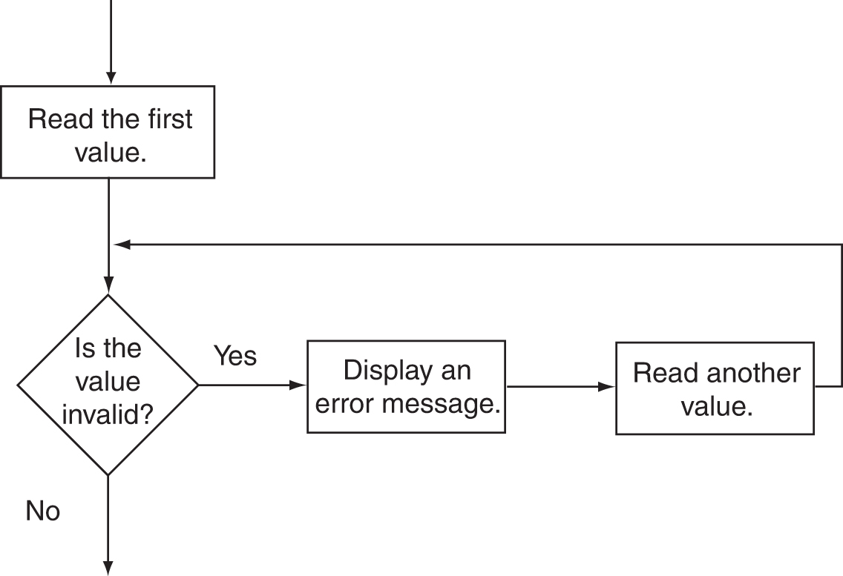
Flowchart for Input Validation

Slide 53
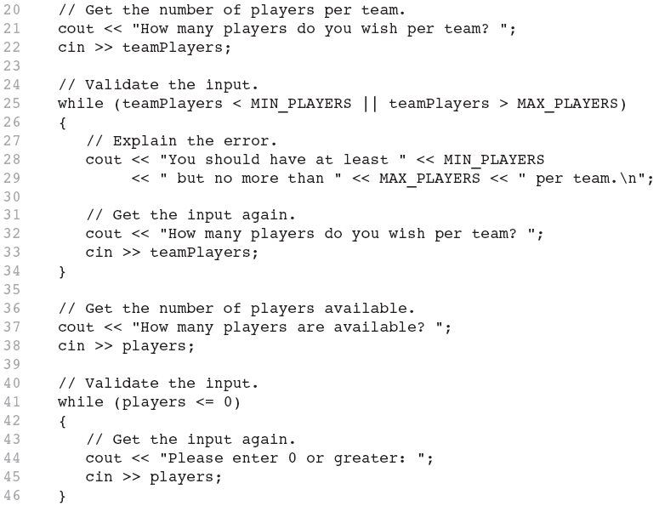
Input Validation in Program 5-5

Slide 54
Bagel problem
What happens if someone inputs an invalid number?
With if?
While for input validation? BagelShopInputValidation.cpp
BagelShopWithWhile

Slide 56
5.4
Counters

Slide 57
Counters
Counter: a variable that is incremented or decremented each time a loop repeats
Can be used to control execution of the loop (also known as the loop control variable)
Must be initialized before entering loop

Slide 58
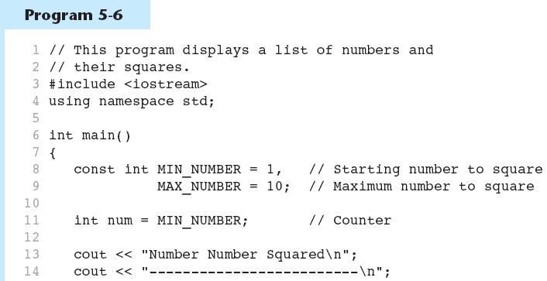
A Counter Variable Controls the Loop in Prog 5-6
Continued…

Slide 59
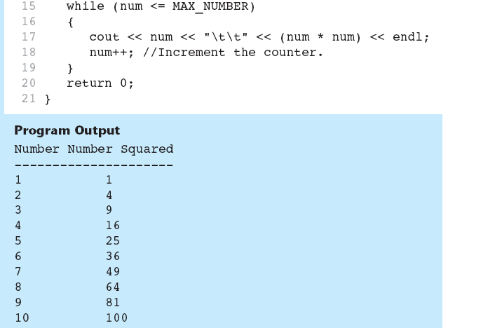
A Counter Variable Controls the Loop in Prog 5-6

Slide 60
5.5
The do-while Loop

Slide 61
The do-while Loop
do-while: a posttest loop – execute the loop, then test the expression
General Format:
do
statement; // or block in { }
while (expression);
Note that a semicolon is required after (expression)

Slide 62
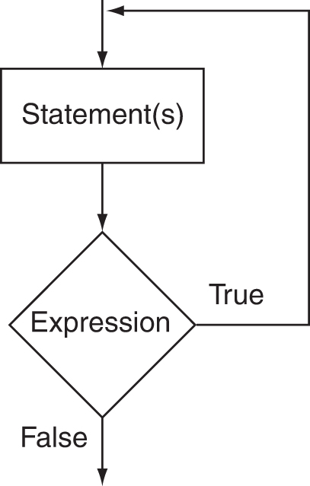
The Logic of a do-while Loop

Slide 63
An Example do-while Loop
int x = 1; do { cout << x << endl; } while(x < 0);
Although the test expression is false, this loop will execute one time because do-while is a posttest loop.

Slide 64
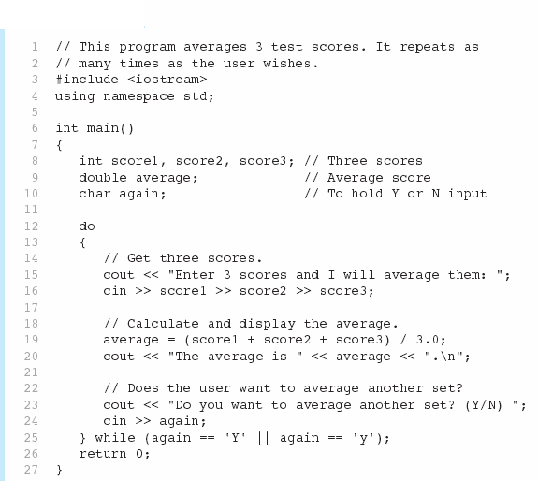

A do-while Loop in Program 5-7
Continued…

Slide 65
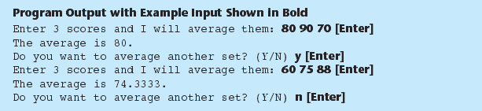
A do-while Loop in Program 5-7

Slide 66
do-while Loop Notes
Loop always executes at least once
Execution continues as long as expression is true, stops repetition when expression becomes false
Useful in menu-driven programs to bring user back to menu to make another choice (see Program 5-8 on pages 245-246)
5.8

Slide 67
Bagel Shop Checkout Counter
Write a program to calculate the amount a customer should pay in a self checkout counter for his purchases in a bagel shop. The products sold are everything bagels, garlic bagels, blueberry bagels, cream cheese, and coffee. Using doWhile loops write the program to display the menu of the Bagel shop. Make the user buy multiple items of different choices. Finally display the total amount for the purchases
Paste your output using different choices and different counts. Also choose a choice not in Menu
BagelShopDoWhile.java p7

