Slide 1
Day 3

Slide 2
4.9
Checking Numeric Ranges with Logical Operators

Slide 3
Checking Numeric Ranges with Logical Operators
Used to test to see if a value falls inside a range:
if (grade >= 0 && grade <= 100)
cout << "Valid grade";
Can also test to see if value falls outside of range:
if (grade <= 0 || grade >= 100)
cout << "Invalid grade";
Cannot use mathematical notation:
if (0 <= grade <= 100) //doesn’t work!

Slide 4
4.10
Menus

Slide 5
Menus
Menu-driven program: program execution controlled by user selecting from a list of actions
Menu: list of choices on the screen
Menus can be implemented using if/else if statements

Slide 6
Menu-Driven Program Organization
Display list of numbered or lettered choices for actions
Prompt user to make selection
Test user selection in expression
if a match, then execute code for action
if not, then go on to next expression
4.18

Slide 7
4.11
Validating User Input

Slide 8
Validating User Input
Input validation: inspecting input data to determine whether it is acceptable
Bad output will be produced from bad input
Can perform various tests:
Range
Reasonableness
Valid menu choice
Divide by zero
BagelValidation.cpp

Slide 9
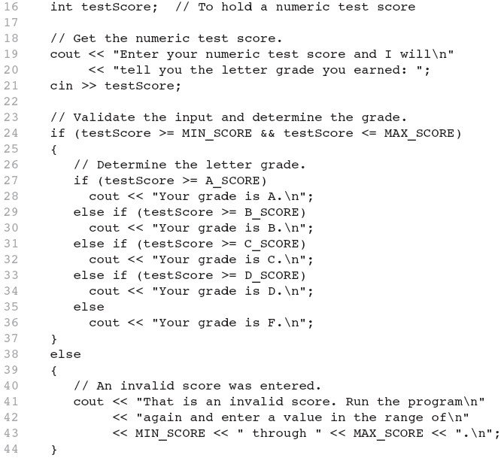
Input Validation in Program 4-19

Slide 10
4.12
Comparing Characters and Strings

Slide 11
Comparing Characters
Characters are compared using their ASCII values
'A' < 'B’
The ASCII value of 'A' (65) is less than the ASCII value of 'B'(66)
'1' < '2'
The ASCII value of '1' (49) is less than the ASCI value of '2' (50)
Lowercase letters have higher ASCII codes than uppercase letters, so 'a' > 'Z'

Slide 12
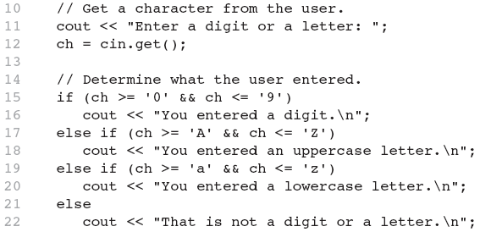
Relational Operators Compare Characters in Program 4-20

Slide 13
Comparing string Objects
Like characters, strings are compared using their ASCII values
string name1 = "Mary";
string name2 = "Mark";
The characters in each string must match before they are equal
name1 > name2 // true
name1 <= name2 // false
name1 != name2 // true
name1 < "Mary Jane" // true

Slide 14
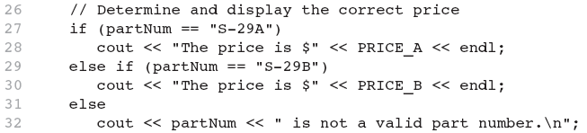
Relational Operators Compare Strings in Program 4-21

Slide 15
4.13
The Conditional Operator

Slide 16
The Conditional Operator (1 of 3)
The conditional operator is a ternary (three operand) operator.
You can use the conditional operator to write a simple statement that works like an if-else statement.

Slide 17
The Conditional Operator (2 of 3)
The format of the operators is:
BooleanExpression ? Value1 : Value2
This forms a conditional expression.
If BooleanExpression is true, the value of the conditional expression is Value1.
If BooleanExpression is false, the value of the conditional expression is Value2.

Slide 18
The Conditional Operator (3 of 3)
Example:
z = x > y ? 10 : 5;
This line is functionally equivalent to:
if(x > y)
z = 10;
else
z = 5;

Slide 19
The Conditional Operator
Can use to create short if/else statements
Format: expr ? expr : expr;
x<0 ? y=10 : z=20;
First Expression:
Expression to be
tested
2nd Expression:
Executes if first
expression is true
3rd Expression:
Executes if the first
expression is false

Slide 20
Conditional Operators
if (num % 2 == 0)
cout << num << “is even”;
else
cout << num << “is odd”;
(num % 2 == 0)? cout << num << " is even" : cout << num <<
" is odd";
Liang, Introduction to Java Programming, 11th Edition, (c) 2018 Pearson Education, Inc. All rights reserved.

Slide 21
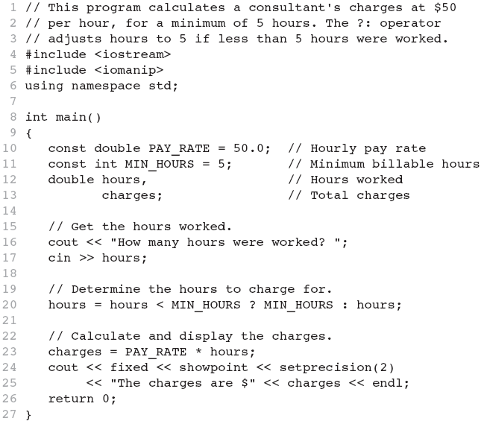
The Conditional Operator in Program 4-22

Slide 22
4.14
The switch Statement

Slide 23
The switch Statement
Used to select among statements from several alternatives
In some cases, can be used instead of if/else if statements

Slide 24
switch Statements
Syntax for switch statement
switch (switch-expression) {
case value1: statement(s) 1;
break;
case value2: statement(s) 2;
break;
….
case valueN: statement(s) N;
break;
default: cout << "Errors: invalid status";
}
See example: SwitchDemo.cpp w5

Slide 25
switch Statement Rules
The switch-expression must yield a value of char, byte, short, or int type and must always be enclosed in parentheses.
switch (switch-expression) {
case value1: statement(s)1;
break;
case value2: statement(s)2;
break;
…
case valueN: statement(s)N;
break;
default: statement(s)-for-default;
}
The value1, ..., and valueN must have the same data type as the value of the switch-expression. The resulting statements in the case statement are executed when the value in the case statement matches the value of the switch-expression.

Slide 26
switch Statement Rules
The keyword break is optional, but it should be used at the end of each case in order to terminate the remainder of the switch statement. If the break statement is not present, the next case statement will be executed.
switch (switch-expression) {
case value1: statement(s)1;
break;
case value2: statement(s)2;
break;
…
case valueN: statement(s)N;
break;
default: statement(s)-for-default;
}
The default case, which is optional, can be used to perform actions when none of the specified cases matches the switch-expression.
When the value in a case statement matches the value of the switch-expression, the statements starting from this case are executed until either a break statement or the end of the switch statement is reached.

Slide 27
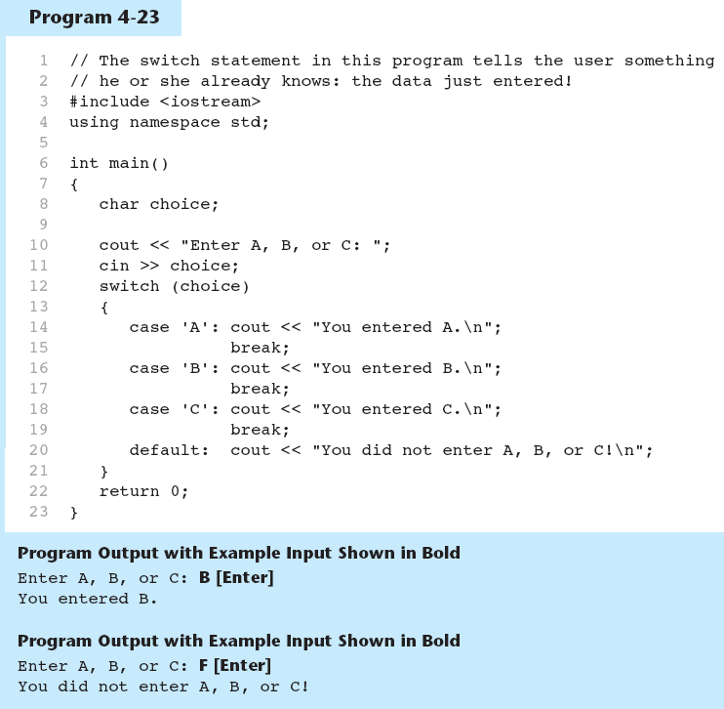
The switch Statement in Program 4-23

Slide 28
switch Statement Requirements
Expression must be an integer variable or an expression that evaluates to an integer value.
exp1 through expn must be constant integer expressions or literals, and must be unique in the switch statement
default is optional but recommended

Slide 29
The case Statement
The break statement ends the case statement.
The break statement is optional. If a case does not contain a break, then program execution continues into the next case.
See example: NoBreaks.cpp w5

Slide 30
The break Statement
Used to exit a switch statement
Omitting the break statement for a case will cause the statements within the next case to be executed. Such "falling through" to the next case can be useful when multiple cases, such as cases 0, 1, and 2, should execute the same statements
See example: PetFood.cpp w5
The default section is optional and will be executed if no CaseExpression matches the SwitchExpression.

Slide 31
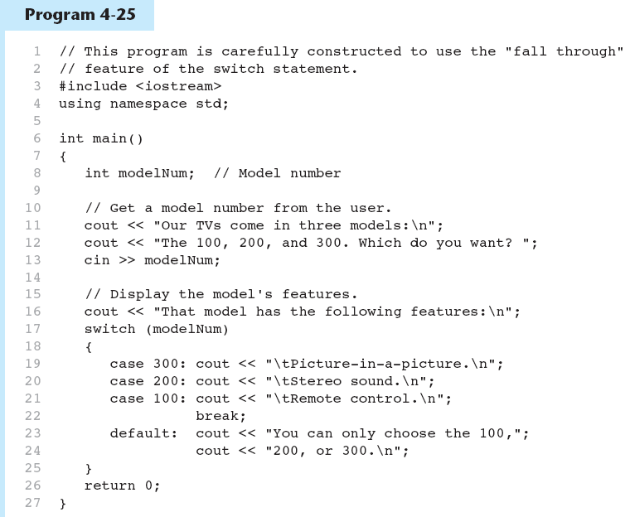
break and default statements in Program 4-25
Continued…

Slide 32
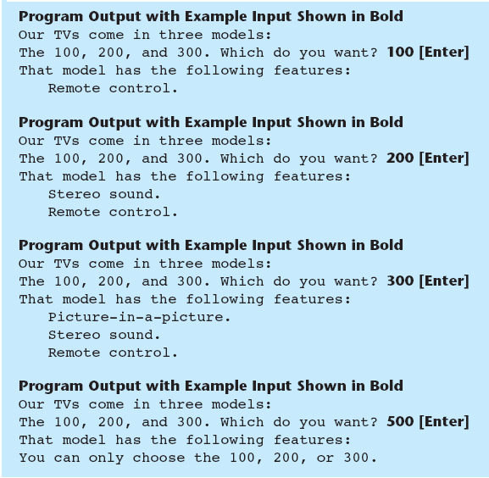
break and default statements in Program 4-25

Slide 33
Classroom Exercise
Get a user number from 1 to 10 and output the corresponding Roman numeral using switch statements w5

Slide 34
Using switch in Menu Systems
switch statement is a natural choice for menu-driven program:
display the menu
then, get the user's menu selection
use user input as expression in switch statement
use menu choices as expr in case statements

Slide 35
Do the bagel problem with Menu using switch statements W5

Slide 36
4.15
More About Blocks and Scope

Slide 37
More About Blocks and Scope
Scope of a variable is the block in which it is defined, from the point of definition to the end of the block
Usually defined at beginning of function
May be defined close to first use

Slide 38
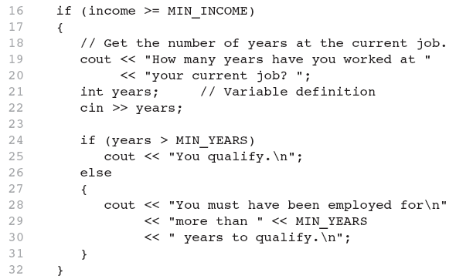
Inner Block Variable Definition in Program 4-29

Slide 39
Variables with the Same Name
Variables defined inside { } have local or block scope
When inside a block within another block, can define variables with the same name as in the outer block.
When in inner block, outer definition is not available
Not a good idea

Slide 40
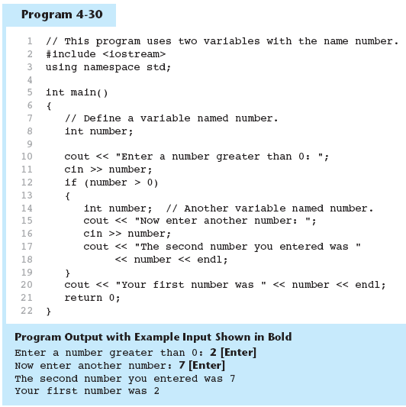
Two Variables with the Same Name in Program 4-30

Slide 41
Rock-Scissor-Paper
Write a program that plays the popular rock-scissor-papergame. A scissor can cut a paper, a rock can knock a scissor and a paper can wrap a rock. Use a random generator and generate one number for 0,1,2 representing scissor, rock , paper. Input from user a value as scissor (0), rock (1), paper (2). Determine if User or computer wins. Make sure you validate the input( if the input is invalid send an error message

