Slide 1
1.1
Why Program?

Slide 2
Why Program?
Computer – programmable machine designed to follow instructions
Program – instructions in computer memory to make it do something
Programmer – person who writes instructions (programs) to make computer perform a task
SO, without programmers, no programs; without programs, a computer cannot do anything

Slide 3
1.2
Computer Systems: Hardware and Software

Slide 4
Main Hardware Component Categories:
Central Processing Unit (CPU)
Main Memory
Secondary Memory / Storage
Input Devices
Output Devices

Slide 5
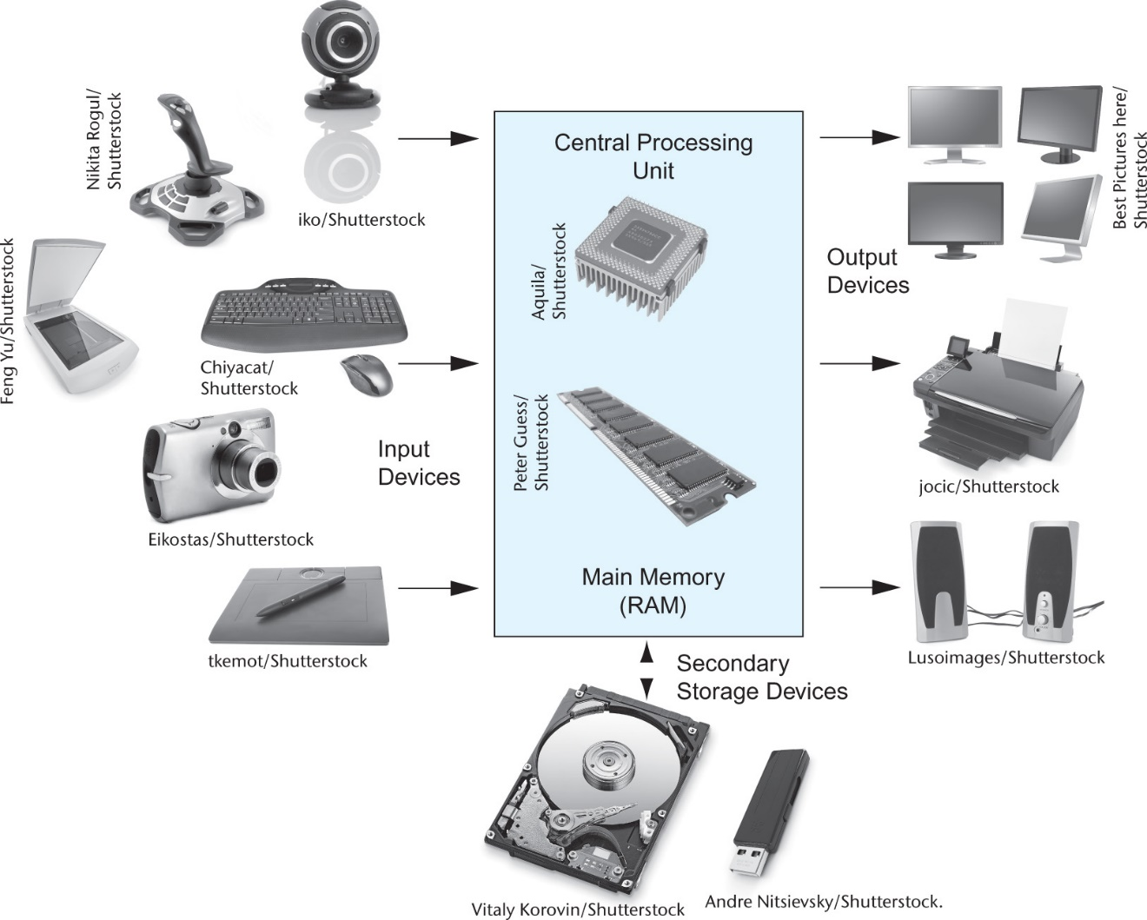
Main Hardware Component Categories
Figure 1-2

Slide 6
Central Processing Unit (CPU)
Comprised of:
  Control Unit
    Retrieves and decodes program instructions
    Coordinates activities of all other parts of computer
  Arithmetic & Logic Unit
    Hardware optimized for high-speed numeric calculation
    Hardware designed for true/false, yes/no decisions

Slide 7
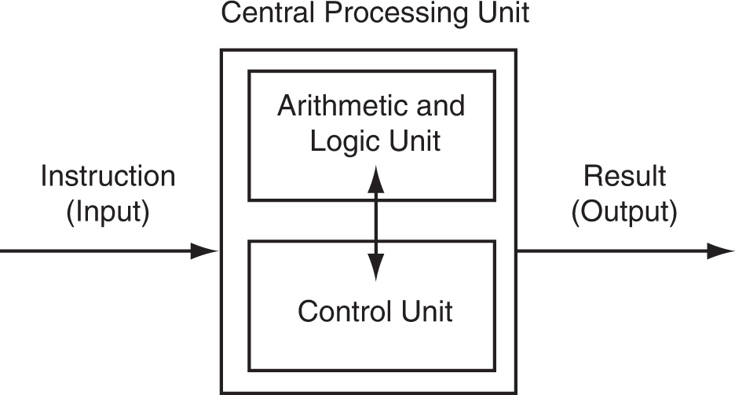
CPU Organization
Figure 1-5

Slide 8
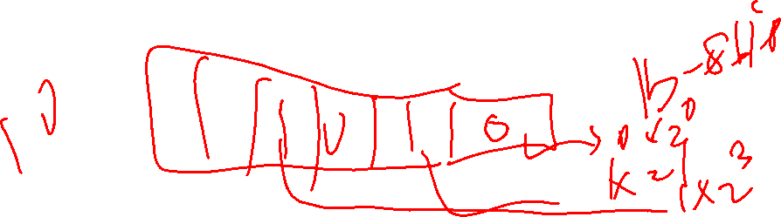
Main Memory
It is volatile. Main memory is erased when program terminates or computer is turned off
Also called Random Access Memory (RAM)
Organized as follows:
  bit: smallest piece of memory. Has values 0 (off, false) or 1 (on, true)
  byte: 8 consecutive bits. Bytes have addresses.

Slide 9
Main Memory
Addresses – Each byte in memory is identified by a unique number known as an address.

Slide 10
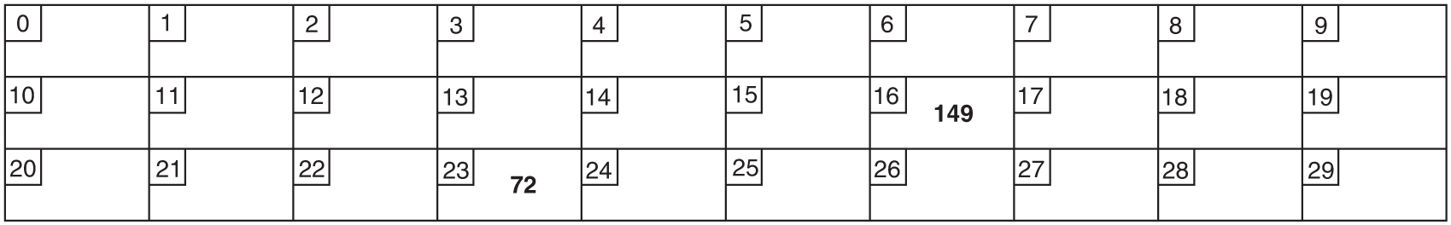
Main Memory
In Figure 1-6, the number 149 is stored in the byte with the address 16, and the number 72 is stored at address 23.

Slide 11
Secondary Storage
Non-volatile: data retained when program is not running or computer is turned off
Comes in a variety of media:
  magnetic: traditional hard drives that use a moveable mechanical arm to read/write
  solid-state: data stored in chips, no moving parts
  optical: CD-ROM, DVD
  Flash drives, connected to the USB port

Slide 12
Input Devices
Devices that send information to the computer from outside
Many devices can provide input:
  Keyboard, mouse, touchscreen, scanner, digital camera, microphone
  Disk drives, CD drives, and DVD drives

Slide 13
Software-Programs That Run on a Computer
Categories of software:
  System software: programs that manage the computer hardware and the programs that run on them.
    Examples: operating systems, utility programs, software development tools
  Application software: programs that provide services to the user.
    Examples : word processing, games, programs to solve specific problems

Slide 14
1.3
Programs and Programming Languages

Slide 15
Programs and Programming Languages
A program is a set of instructions that the computer follows to perform a task
We start with an algorithm, which is a set of well-defined steps.

Slide 16
Example Algorithm for Calculating
Gross Pay
Display a message on the screen asking “How many hours did you work?”
Wait for the user to enter the number of hours worked. Once the user enters a number, store it in memory.
Display a message on the screen asking “How much do you get paid per hour?”
Wait for the user to enter an hourly pay rate. Once the user enters a number, store it in memory.
Multiply the number of hours by the amount paid per hour, and store the result in memory.
Display a message on the screen that tells the amount of money earned. The message must include the result of the calculation performed in Step 5.

Slide 17
Machine Language
Although the previous algorithm defines the steps for calculating the gross pay, it is not ready to be executed on the computer.
The computer only executes machine language instructions

Slide 18
Machine Language
Machine language instructions are binary numbers, such as
1011010000000101
Rather than writing programs in machine language, programmers use programming languages.

Slide 19
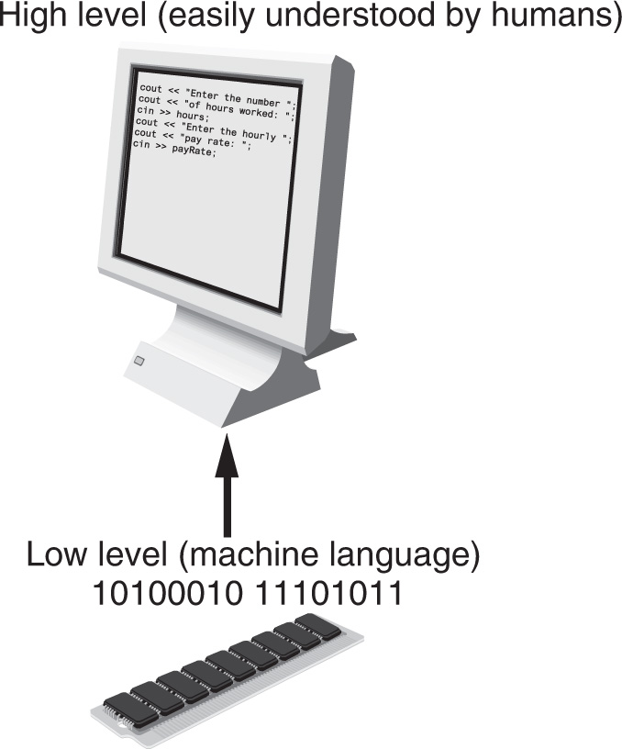
Programs and Programming Languages
Types of languages:
  Low-level: used for communication with computer hardware directly. Often written in binary machine code (0’s/1’s) directly.
  High-level: closer to human language

Slide 20
Some Well-Known Programming Languages (Table 1-1 on Page 10)
C++
BASIC
Ruby
Java
FORTRAN
Visual Basic
C#
COBOL
JavaScript
C
Python

Slide 21
From a High-Level Program to an Executable File
Create file containing the program with a text editor.
Run preprocessor to convert source file directives to source code program statements.
Run compiler to convert source program into machine instructions.
Run linker to connect hardware-specific code to machine instructions, producing an executable file.
Steps b–d are often performed by a single command or button click.
Errors detected at any step will prevent execution of following steps.

Slide 22
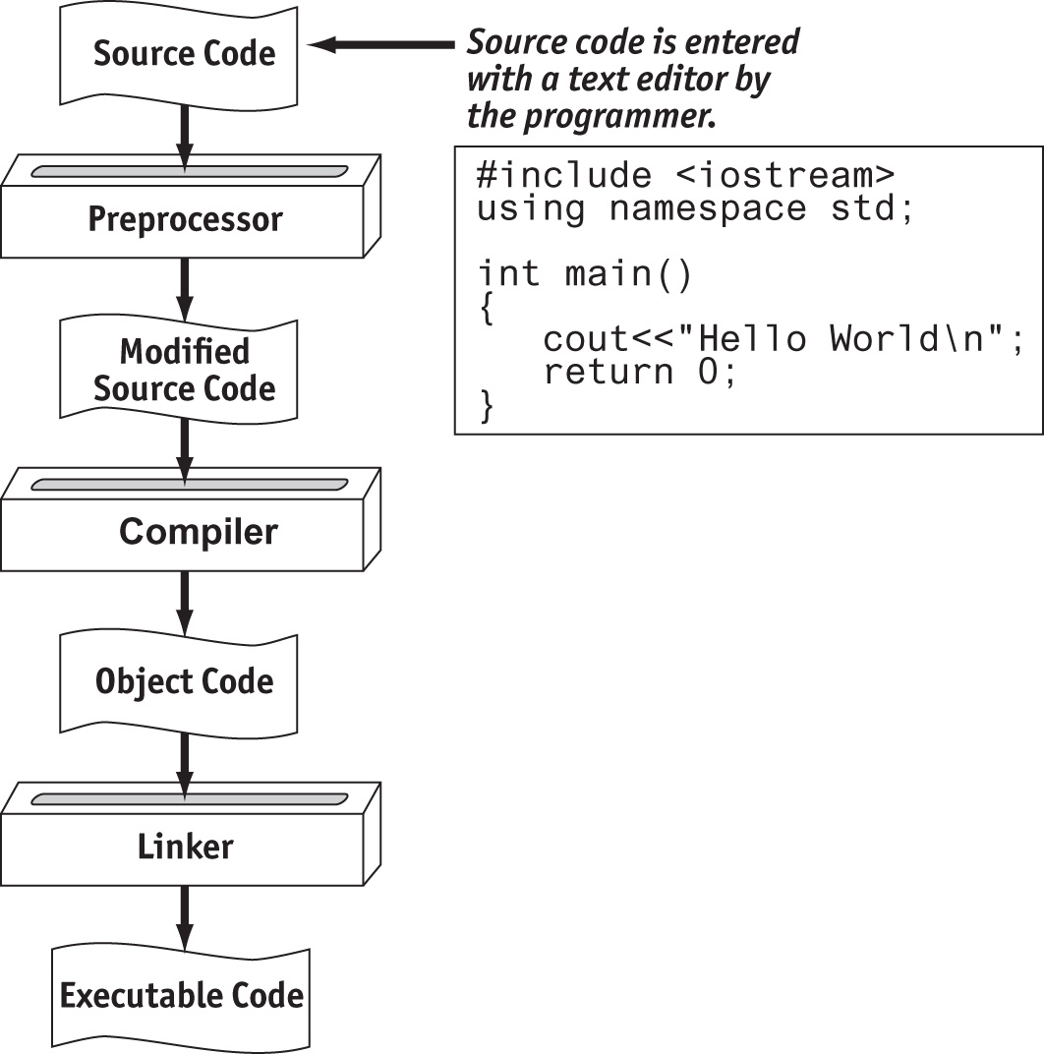


From a High-Level Program to an Executable File

Slide 23
Integrated Development Environments (IDEs)
An integrated development environment, or IDE, combine all the tools needed to write, compile, and debug a program into a single software application.
Examples are Microsoft Visual C++, Turbo C++ Explorer, CodeWarrior, etc.

Slide 24
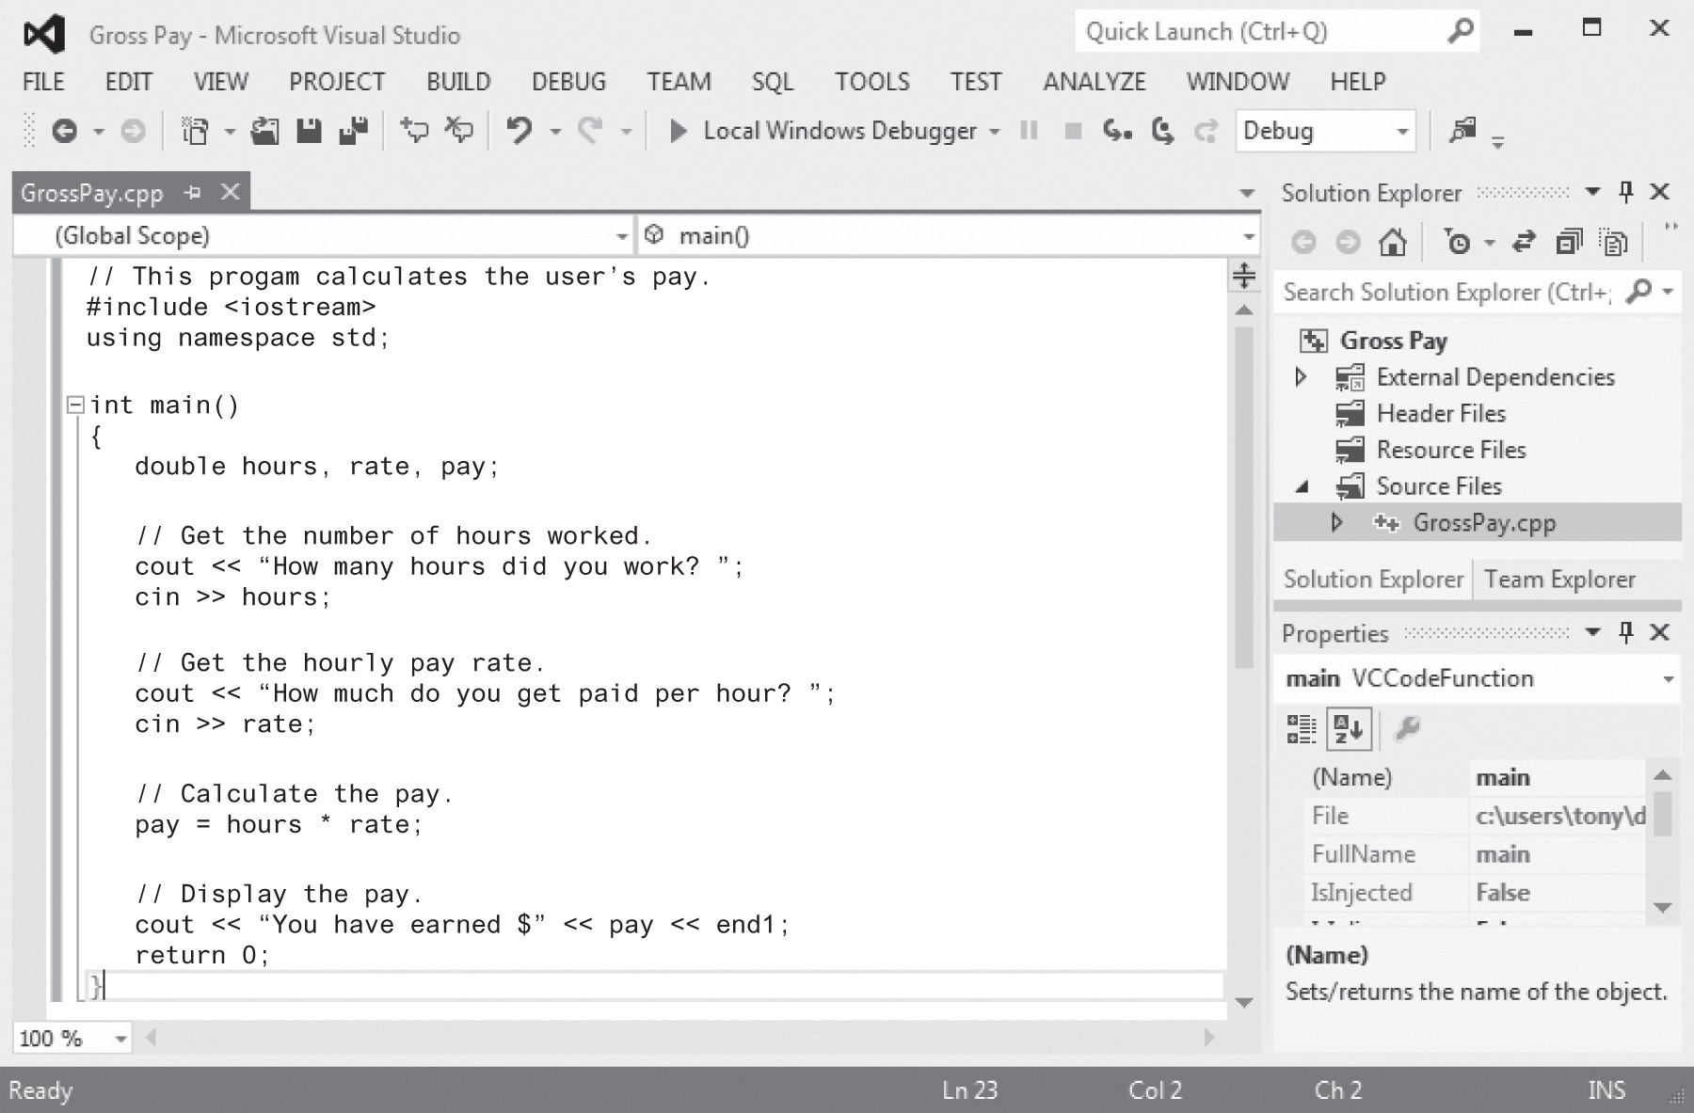
Integrated Development Environments (IDEs)

Slide 25
1.4
What is a Program Made of?

Slide 26
What is a Program Made of?
Common elements in programming languages:
  Key Words
  Programmer-Defined Identifiers
  Operators
  Punctuation
  Syntax

Slide 27
Example Algorithm for Calculating
Gross Pay
Display a message on the screen asking “How many hours did you work?”
Wait for the user to enter the number of hours worked. Once the user enters a number, store it in memory.
Display a message on the screen asking “How much do you get paid per hour?”
Wait for the user to enter an hourly pay rate. Once the user enters a number, store it in memory.
Multiply the number of hours by the amount paid per hour, and store the result in memory.
Display a message on the screen that tells the amount of money earned. The message must include the result of the calculation performed in Step 5.

Slide 28
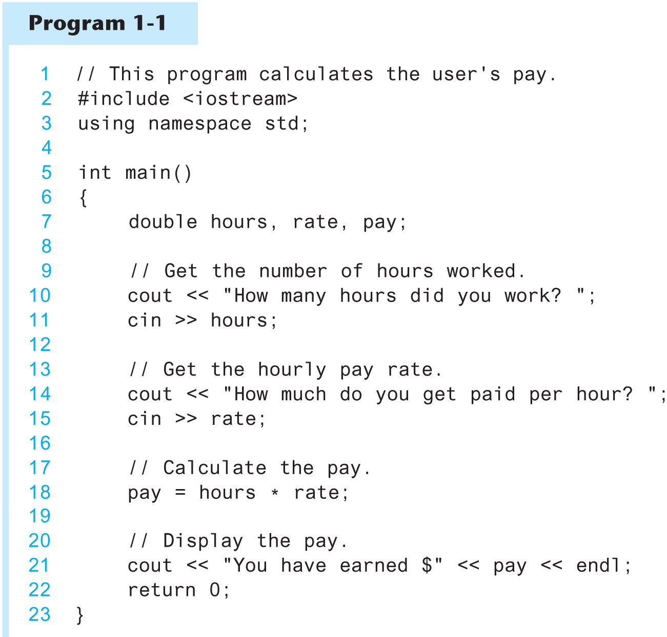
Program 1-1

Slide 29
Key Words
Also known as reserved words
Have a special meaning in C++
Can not be used for any other purpose
Key words in the Program 1-1: using, namespace, int, double, and return

Slide 30
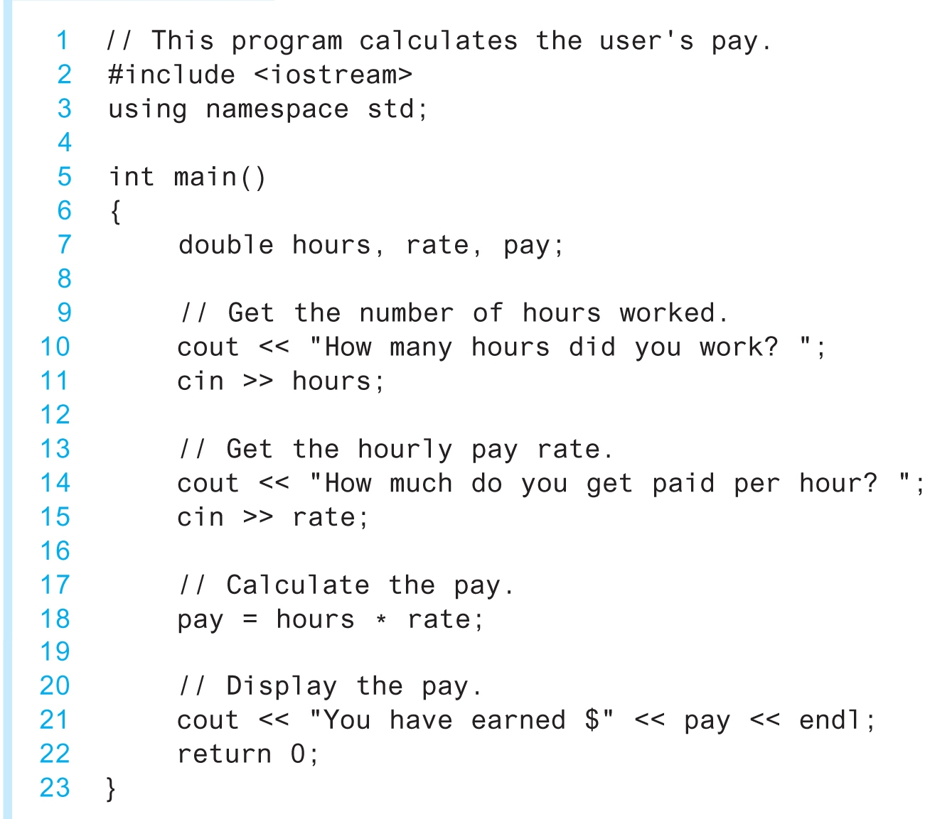
Key Words

Slide 31
Programmer-Defined Identifiers
Names made up by the programmer
Not part of the C++ language
Used to represent various things: variables (memory locations), functions, etc.
In Program 1-1: hours, rate, and pay.

Slide 32
Operators
Used to perform operations on data
Many types of operators:
  Arithmetic - ex: +,-,*,/
  Assignment – ex: =
Some operators in Program1-1:
<< >> = *
Notes:
>>” is extraction operator because “it extract data enter by user from console or input screen to some storage location identified by variable”.
<< is the insertion operator. The arrows are pointing to the stream. You're inserting the text into the stream.

Slide 33
Operators

Slide 34
Punctuation
Characters that mark the end of a statement, or that separate items in a list
In Program 1-1: , and ;

Slide 35
Punctuation

Slide 36
Syntax
The rules of grammar that must be followed when writing a program
Controls the use of key words, operators, programmer-defined symbols, and punctuation

Slide 37
Variables
A variable is a named storage location in the computer’s memory for holding a piece of data.
In Program 1-1 we used three variables:
  The hours variable was used to hold the hours worked
  The rate variable was used to hold the pay rate
  The pay variable was used to hold the gross pay

Slide 38
Variable Definitions
To create a variable in a program you must write a variable definition (also called a variable declaration)
Here is the statement from Program 1-1 that defines the variables:
double hours, rate, pay;

Slide 39
Variable Definitions
There are many different types of data, which you will learn about in this course.
A variable holds a specific type of data.
The variable definition specifies the type of data a variable can hold, and the variable name.

Slide 40
Variable Definitions
Once again, line 7 from Program 1-1:
double hours, rate, pay;
The word double specifies that the variables can hold double-precision floating point numbers. (You will learn more about that in Chapter 2)

Slide 41
1.5
Input, Processing, and Output

Slide 42
Input, Processing, and Output
Three steps that a program typically performs:
  Gather input data:
    from keyboard
    from files on disk drives
  Process the input data
  Display the results as output:
    send it to the screen
    write to a file

Slide 43
1.6
The Programming Process

Slide 44
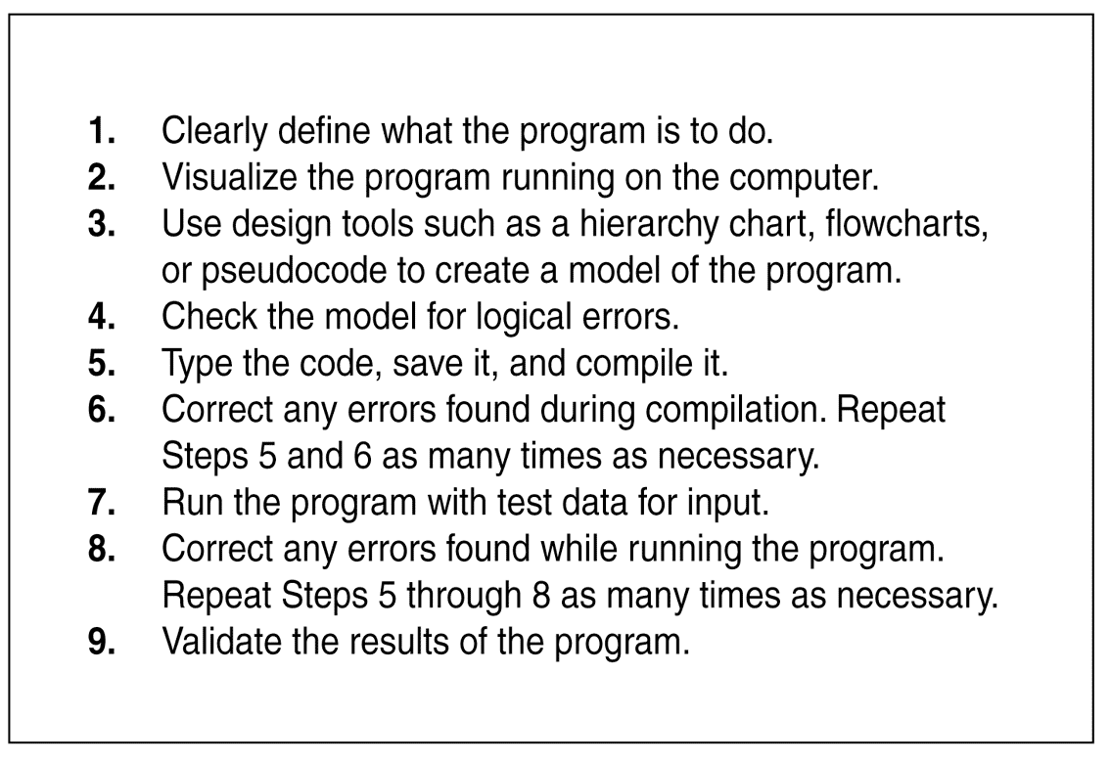
The Programming Process

Slide 45
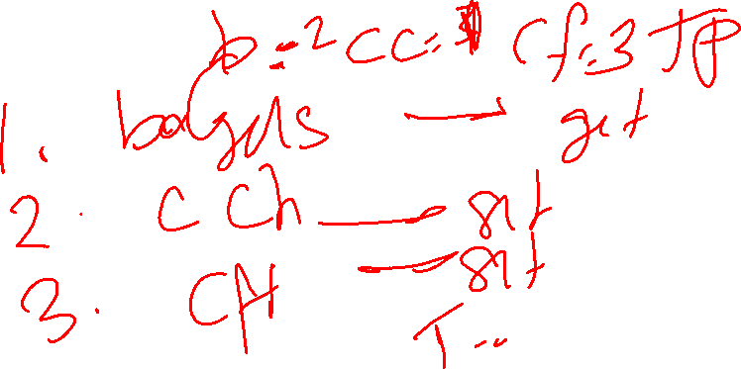
Bagel Shop Checkout Counter
Write a program to calculate the amount a customer should pay in a self checkout counter for his purchases in a bagel shop. The products sold are bagels, cream cheese, and coffee.

Slide 46
Checkout counter Algorithm
Display How many bagels did you buy?
Get the number of bagels purchased and store in memory
Display the number of cream cheese you bought?
Get the number of cream cheese and store it
Display the number of coffee you bought?
Get the number of coffee and store it
Calculate the total amount and display the result

Slide 47
2.1
The Parts of a C++ Program

Slide 48

The Parts of a C++ Program
// sample C++ program
#include <iostream>
using namespace std;
int main()
{
cout << "Hello, there!";
return 0;
}
comment
preprocessor directive
which namespace to use
beginning of function named main
beginning of block for main
output statement
string literal
Send 0 to operating system
end of block for main
Notes:
A namespace is a declarative region that provides a scope to the identifiers (the names of types, functions, variables, etc) inside it. Namespaces are used to organize code into logical groups and to prevent name collisions that can occur especially when your code base includes multiple libraries
A namespace is a group of related elements that each have a unique name or identifier. ... A file path, which uses syntax defined by the operating system, is considered a namespace. For example, C:\Program Files\Internet Explorer is the namespace that describes where Internet Explorer files on a Windows computer.

Slide 49
Special Characters
Character | Name | Meaning
// | Double slash | Beginning of a comment
# | Pound sign | Beginning of preprocessor directive
< > | Open/close brackets | Enclose filename in #include
( ) | Open/close parentheses | Used when naming a function
{ } | Open/close brace | Encloses a group of statements
" " | Open/close quotation marks | Encloses string of characters
; | Semicolon | End of a programming statement

Slide 50
2.2
The cout Object

Slide 51
The cout Object
Displays output on the computer screen
You use the stream insertion operator << to send output to cout:
  cout << "Programming is fun!";

Slide 52
The cout Object
Can be used to send more than one item to cout:
  cout << "Hello " << "there!";
  Or:
  cout << "Hello ";
  cout << "there!";

Slide 53
The cout Object
This produces one line of output:
cout << "Programming is ";
cout << "fun!";

Slide 54
The endl Manipulator
You can use the endl manipulator to start a new line of output. This will produce two lines of output:
cout << "Programming is" << endl;
cout << "fun!";

Slide 55

The endl Manipulator
cout << "Programming is" << endl;
cout << "fun!";
Programming is
fun!

Slide 56
The endl Manipulator
You do NOT put quotation marks around endl
The last character in endl is a lowercase L, not the number 1.
endl
This is a lowercase L

Slide 57
The \n Escape Sequence
You can also use the \n escape sequence to start a new line of output. This will produce two lines of output:
cout << "Programming is\n";
cout << "fun!";
Notice that the \n is INSIDE
the string.

Slide 58
The \n Escape Sequence
cout << "Programming is\n";
cout << "fun!";
Programming is
fun!

Slide 59
2.3
The #include Directive

Slide 60
The #include Directive
Inserts the contents of another file into the program
This is a preprocessor directive, not part of C++ language
#include lines not seen by compiler
Do not place a semicolon at end of #include line

