Slide 1
2.1
The Parts of a C++ Program

Slide 2


The Parts of a C++ Program
// sample C++ program
#include <iostream>
using namespace std;
int main()
{
cout << "Hello, there!";
return 0;
}
comment
preprocessor directive
which namespace to use
beginning of function named main
beginning of block for main
output statement
string literal
Send 0 to operating system
end of block for main

Slide 3
Special Characters
Character | Name | Meaning
// | Double slash | Beginning of a comment
# | Pound sign | Beginning of preprocessor directive
< > | Open/close brackets | Enclose filename in #include
( ) | Open/close parentheses | Used when naming a function
{ } | Open/close brace | Encloses a group of statements
" " | Open/close quotation marks | Encloses string of characters
; | Semicolon | End of a programming statement

Slide 4
2.2
The cout Object

Slide 5
The cout Object
Displays output on the computer screen
You use the stream insertion operator << to send output to cout:
cout << "Programming is fun!";

Slide 6
The cout Object
Can be used to send more than one item to cout:
cout << "Hello " << "there!";
Or:
cout << "Hello ";
cout << "there!";

Slide 7
The cout Object
This produces one line of output: cout << "Programming is "; cout << "fun!";

Slide 8
The endl Manipulator
You can use the endl manipulator to start a new line of output. This will produce two lines of output: cout << "Programming is" << endl; cout << "fun!";

Slide 9
The endl Manipulator
cout << "Programming is" << endl; cout << "fun!";
Programming is
fun!

Slide 10
The endl Manipulator
You do NOT put quotation marks around endl
The last character in endl is a lowercase L, not the number 1.
endl
This is a lowercase L

Slide 11
The \n Escape Sequence
You can also use the \n escape sequence to start a new line of output. This will produce two lines of output: cout << "Programming is\n"; cout << "fun!";
Notice that the \n is INSIDE
the string.

Slide 12
The \n Escape Sequence
cout << "Programming is\n"; cout << "fun!";
Programming is
fun!

Slide 13
2.3
The #include Directive

Slide 14
The #include Directive
Inserts the contents of another file into the program
This is a preprocessor directive, not part of C++ language
#include lines not seen by compiler
Do not place a semicolon at end of #include line

Slide 15
2.4
Variables and Literals

Slide 16
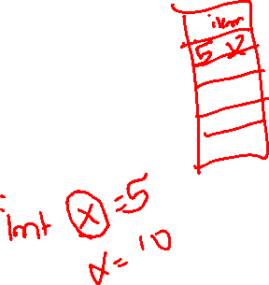
Variables and Literals
Variable: a storage location in memory
Has a name and a type of data it can hold
Must be defined before it can be used:
int item;

Slide 17
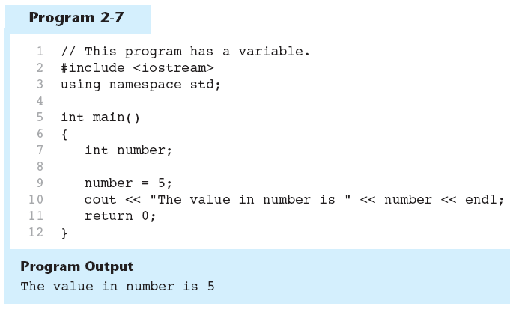
Variable Definition in Program 2-7
Variable Definition

Slide 18
Literals
Literal: a value that is written into a program’s code.
"hello, there" (string literal)
12 (integer literal)

Slide 19
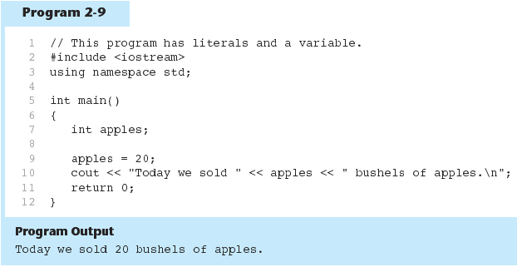
Integer Literal in Program 2-9
20 is an integer literal

Slide 20
String Literals in Program 2-9
These are string literals

Slide 21
2.5
Identifiers

Slide 22
Identifiers
An identifier is a programmer-defined name for some part of a program: variables, functions, etc.

Slide 23
C++ Key Words
Table 2-4 The C++ Key Words
alignas | const | for | private | throw
alignof | constexpr | friend | protected | true
and | const_cast | goto | public | try
and_eq | continue | if | register | typedef
asm | decltype | inline | reinterpret_cast | typeid
auto | default | int | return | typename
bitand | delete | long | short | union
bitor | do | mutable | signed | unsigned
bool | double | namespace | sizeof | using
break | dynamic_cast | new | static | virtual
case | else | noexcept | static_assert | void
catch | enum | not | static_cast | volatile
char | explicit | not_eq | struct | wchar_t
char16_t | export | nullptr | switch | while
char32_t | extern | operator | template | xor
class | false | or | this | xor_eq
compl | float | or_eq | thread_local
You cannot use any of the C++ key words as an identifier. These words have reserved meaning.

Slide 24
Variable Names
A variable name should represent the purpose of the variable. For example: itemsOrdered The purpose of this variable is to hold the number of items ordered.

Slide 25
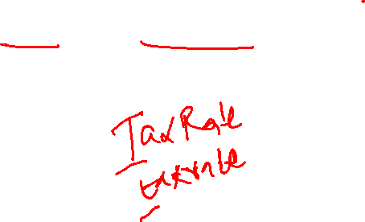
Identifier Rules
The first character of an identifier must be an alphabetic character or and underscore ( _ ),
After the first character you may use alphabetic characters, numbers, or underscore characters.
Upper- and lowercase characters are distinct

Slide 26
Valid and Invalid Identifiers
IDENTIFIER | VALID? | REASON IF INVALID
totalSales | Yes
total_Sales | Yes
total.Sales | No | Cannot contain .
4thQtrSales | No | Cannot begin with digit
totalSale$ | No | Cannot contain $

Slide 27
Valid and Invalid Identifiers
_boxVolume
4thShipment
$TaxRate
Square!Area
Square_Area
Square-Area
Square4Area
yes
No
No
No
Yes
No
Yes

Slide 28
2.6
Integer Data Types

Slide 29


Integer Data Types
Integer variables can hold whole numbers such as 12, 7, and -99.
Table 2-6 Integer Data Types
Data Type | Typical Size | Typical Range
short int | 2 bytes |  −232,768 to 132,767
unsigned short int | 2 bytes | 0 to +65,535
int | 4 bytes | −22,147,483,648 to 12,147,483,647
unsigned int | 4 bytes | 0 to 4,294,967,295
long int | 4 bytes | −22,147,483,648 to 12,147,483,647
unsigned long int | 4 bytes | 0 to 4,294,967,295
long long int | 8 bytes | −29,223,372,036,854,775,808 to 9,223,372,036,854,775,807
unsigned long long int | 8 bytes | 0 to 18,446,744,073,709,551,615

Slide 30
Defining Variables
Variables of the same type can be defined
On separate lines:
int length;
int width;
unsigned int area;
On the same line:
int length, width;
unsigned int area;
Variables of different types must be in different definitions

Slide 31
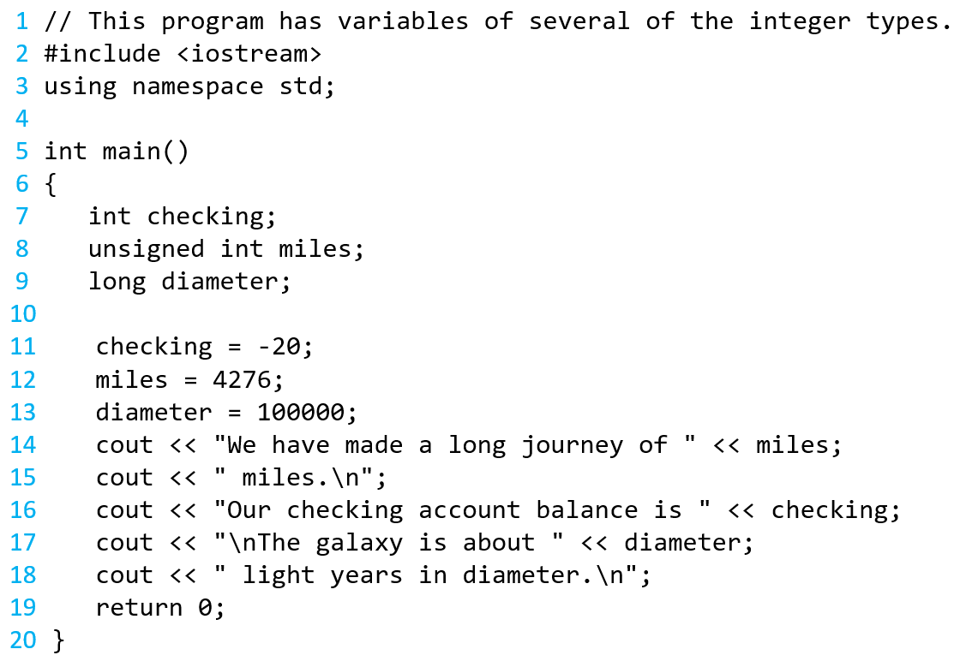

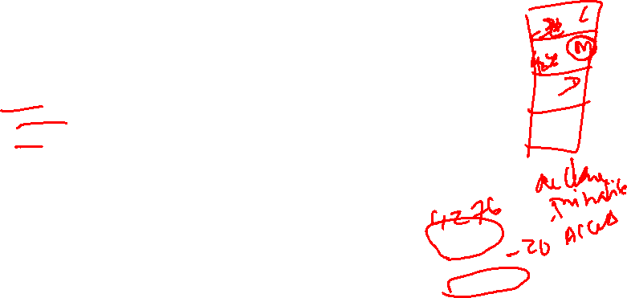
Integer Types in Program 2-10
This program has three variables:
checking, miles, and diameter

Slide 32
Integer Literals
An integer literal is an integer value that is typed into a program’s code. For example: itemsOrdered = 15; In this code, 15 is an integer literal.

Slide 33
Integer Literals in Program 2-10
Integer Literals

Slide 34
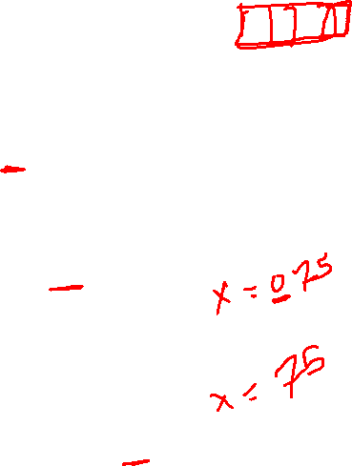
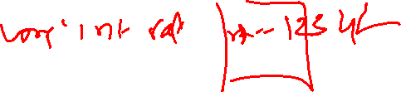
Integer Literals
Integer literals are stored in memory as ints by default
To store an integer constant in a long memory location, put ‘L’ at the end of the number: 1234L
To store an integer constant in a long long memory location, put ‘LL’ at the end of the number: 324LL
Constants that begin with ‘0’ (zero) are base 8: 075
Constants that begin with ‘0x’ are base 16: 0x75A

Slide 35
2.7
The char Data Type

Slide 36
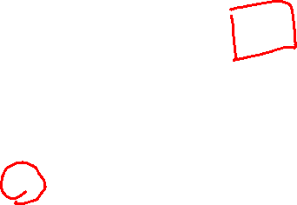
The char Data Type
Used to hold characters or very small integer values
Usually 1 byte of memory
Numeric value of character from the character set is stored in memory:
CODE:
char letter;
letter = 'C';
MEMORY:
letter
67

Slide 37
Character Literals
Character literals must be enclosed in single quote marks. Example: 'A'

Slide 38
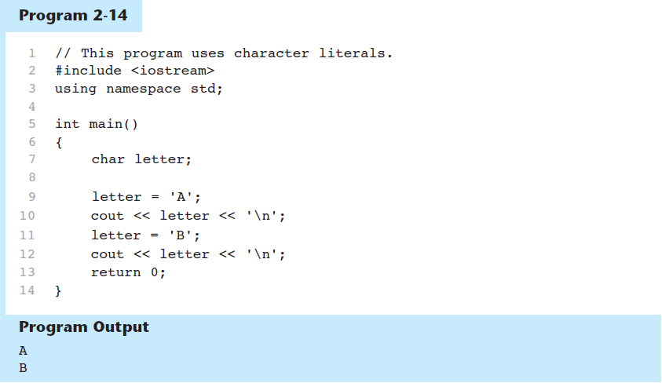




Character Literals in Program 2-14

Slide 39

Character Strings
A series of characters in consecutive memory locations:
"Hello"
Stored with the null terminator, \0, at the end:
Comprised of the characters between the " "
H | e | l | l | o | \0

Slide 40
2.8
The C++ string Class

Slide 41
The C++ string Class
Special data type supports working with strings
#include <string>
Can define string variables in programs:
string firstName, lastName;
Can receive values with assignment operator:
firstName = "George";
lastName = "Washington";
Can be displayed via cout
cout << firstName << " " << lastName;
stringTest.cpp

Slide 42
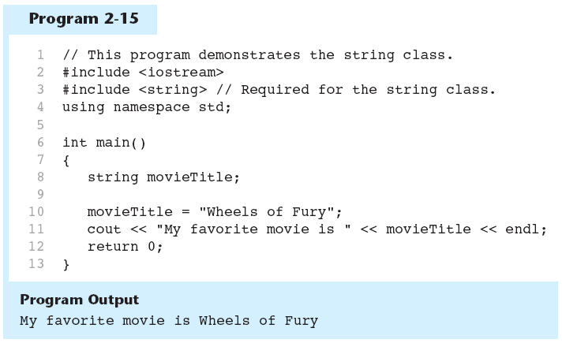
The string class in Program 2-15

Slide 43
2.9
Floating-Point Data Types

Slide 44
Floating-Point Data Types
The floating-point data types are: float double long double
They can hold real numbers such as:
12.45 -3.8
Stored in a form similar to scientific notation
All floating-point numbers are signed

Slide 45
Floating-Point Data Types
Table 2-8 Floating-Point Data Types on PCs
Data Type | Key Word | Description
Single precision | float | 4 bytes. Numbers between ±3.4E–38 and ±3.4E38
Double precision | double | 8 bytes. Numbers between ±1.7E–308 and ±1.7E308
Long double precision | long double | 8 bytes*. Numbers between ±1.7E–308 and ±1.7E308
*Some compilers use 10 bytes for long doubles. This allows a range of ±3.4E–4932 to ±1.1E4832.

Slide 46
Floating-Point Literals
Can be represented in
Fixed point (decimal) notation:
31.4159 0.0000625
E notation:
3.14159E1 6.25e-5
Are double by default
Can be forced to be float (3.14159f) or long double (0.0000625L)

Slide 47
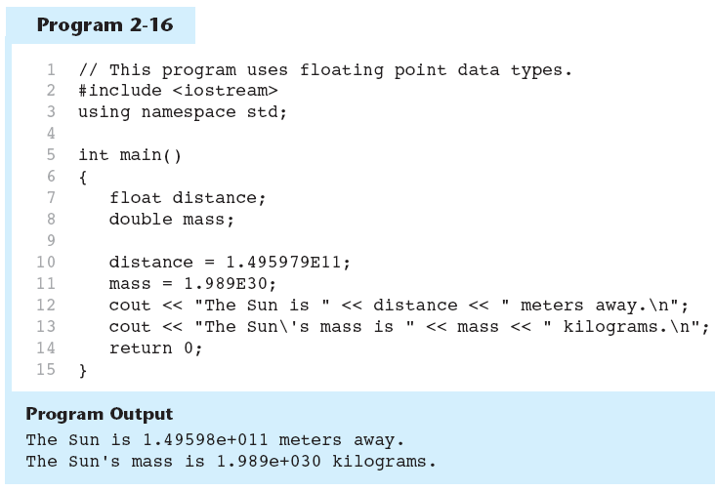
Floating-Point Data Types in Program 2-16

Slide 48
2.10
The bool Data Type

Slide 49

The bool Data Type
Represents values that are true or false
bool variables are stored as small integers
false is represented by 0, true by 1:
bool allDone = true;
bool finished = false;
allDone
finished
1
0

Slide 50
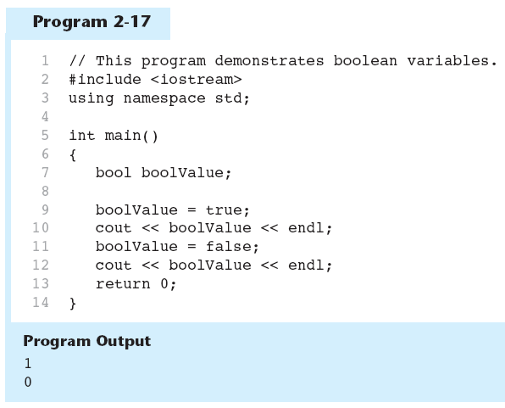


Boolean Variables in Program 2-17

Slide 51
2.11
Determining the Size of a Data Type

Slide 52
Determining the Size of a Data Type
The sizeof operator gives the size of any data type or variable:
double amount;
cout << "A double is stored in "
<< sizeof(double) << "bytes\n";
cout << "Variable amount is stored in "
<< sizeof(amount)
<< "bytes\n";
2.18

Slide 53
2.12
Variable Assignments and Initialization

Slide 54
Variables
In order to store the values, the program needs to declare a symbol called a variable, to be used later in a program.
They are called variables because their values can be changed.
We need to tell the compiler the name of the variable.
Choose descriptive names for variables.
radius for radius
area for area

Slide 55

Variable Names
Descriptive names allow the code to be more readable
Which of the following is more descriptive?
double tr = 0.0725;
double salesTaxRate = 0.0725;

Slide 56

Variables
int main()
allocate memory for radius
{
double radius;
// Step 1: Read in radius
// Step 2: Compute area
// Step 3: Display the area
}
radius
no value

Slide 57
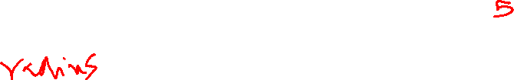
Variables
int main()
{
double radius;
double area;
// Step 1: Read in radius
// Step 2: Compute area
// Step 3: Display the area
}
radius
no value
area
no value
allocate memory for area

Slide 58
Declaring Variables
We need to tell the compiler what type of data a variable can store.
Specify the type of data stored in a variable (integers, real numbers (i.e., numbers with a decimal point), characters, and Boolean types).
The syntax for declaring a variable is
datatype variableName;

Slide 59

Declaring Variables
int count; // Declare count to be an integer variable;
double radius; // Declare radius to be a double variable
char alpha; // Declare a to be a character variable;

Slide 60
Declaring Variables
If variables are of the same type, they can be declared together, as follows:
For example,
datatype variable1, variable2, …, variablen;
int i, j, k;

Slide 61
Assignment Statements
After a variable is declared, we can assign a value to it by using an assignment statement.
In C++, the equal sign (=) is used as the assignment operator.
The syntax for assignment statements is as follows:
An expression represents a computation involving values, variables, and operators that taking them together, evaluates to a value.
Variable = expression;

Slide 62

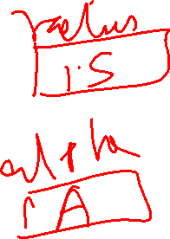
Assignment Statements
int count;
count= 30; // Assign 30 to count;
double radius;
radius = 1.5; // Assign 1.5 to radius;
char alpha;
alpha = 'A'; // Assign 'A' to alpha;

Slide 63

Assignment Statements
int beta;
beta = count + 2; // Assign addition of count and 2 to beta;
int count;
count = count + 1; // Assign addition of count and 1 to count;

Slide 64
Assignment Statements
To assign a value to a variable, you must place the variable name to the left of the assignment operator.
1 = x;
Not Correct

Slide 65
Declaring and Initializing in One Step
int count = 1;
double radius = 1.4;

Slide 66
Note
A variable must be declared before it can be assigned a value.
A variable declared in a method must be assigned a value before it can be used.
Declare the variable
Assign a value to the variable
Use the variable

Slide 67
Variables
int main()
allocate memory for radius and value is assigned
{
double radius = 10.33;
// Step 1: Read in radius
// Step 2: Compute area
// Step 3: Display the area
}
radius
10.33

Slide 68
Variable Initialization
To initialize a variable means to assign it a value when it is defined:
int length = 12;
Can initialize some or all variables:
int length = 12, width = 5, area;

Slide 69
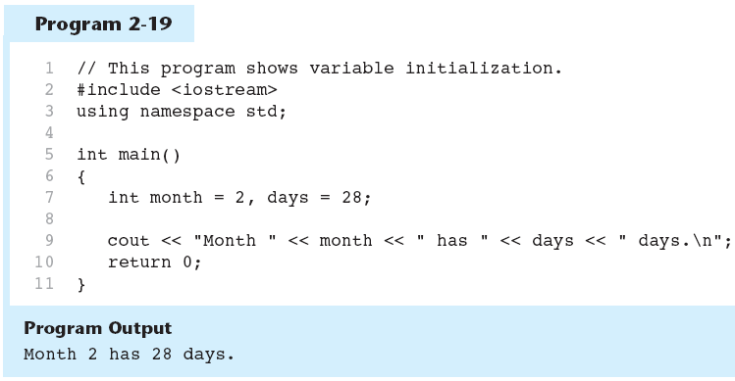
Variable Initialization in Program 2-19

Slide 70

Declaring Variables With the auto Key Word
C++ 11 introduces an alternative way to define variables, using the auto key word and an initialization value. Here is an example:
auto amount = 100;
The auto key word tells the compiler to determine the variable’s data type from the initialization value.
auto interestRate= 12.0;
auto stockCode = 'D';
auto customerNum = 459L;
int
double
char
long

Slide 71
2.13
Scope

Slide 72
Scope
The scope of a variable: the part of the program in which the variable can be accessed
A variable cannot be used before it is defined

Slide 73
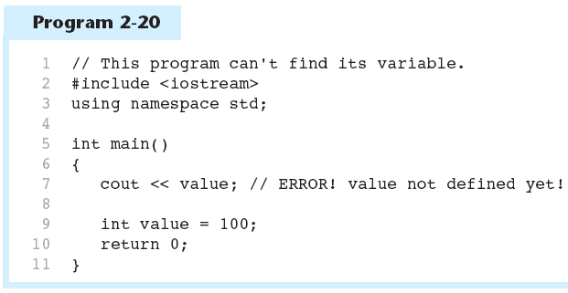
Variable Out of Scope in Program 2-20

Slide 74
2.14
Arithmetic Operators

Slide 75
Arithmetic Operators
Used for performing numeric calculations
C++ has unary, binary, and ternary operators:
unary (1 operand) -5
binary (2 operands) 13 - 7
ternary (3 operands) exp1 ? exp2 : exp3

Slide 76
Binary Arithmetic Operators
SYMBOL | OPERATION | EXAMPLE | VALUE OF ans
+ | addition | ans = 7 + 3; | 10
- | subtraction | ans = 7 - 3; | 4
* | multiplication | ans = 7 * 3; | 21
/ | division | ans = 7 / 3; | 2
% | modulus | ans = 7 % 3; | 1

Slide 77
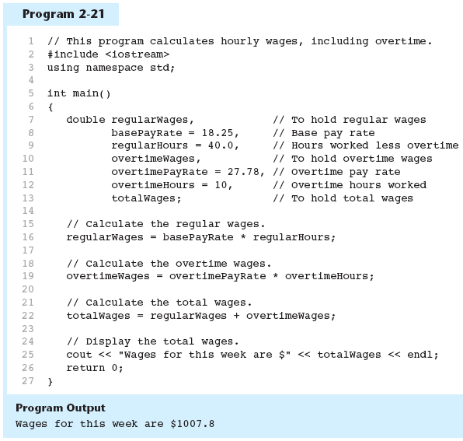
Arithmetic Operators in Program 2-21

Slide 78
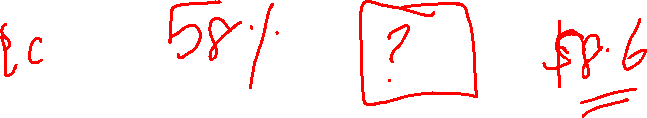
Sales Prediction
A East coast division of a company generates 58% of total sales. Write a program that will predict how much the east coast division will make if the company generates $8.6 million in sales

Slide 79
Writing a Program
Step 1: Designing An Algorithm
The algorithm for calculating the sales of East coast division:
Read in percentage of sales generated by the East Coast.
Read in the predicted amount of sales
Calculate and store the sales prediction for the East Coast sales division by using formula eastCoastSales=YearlySalesPredicition * eastCoastPercentage
Display the result.

Slide 80

Sales Tax – Inclass1
Write a program that will compute the total sales tax on a $95 purchase. The state sales tax is 4% and county sales tax is 2%

Slide 81
Writing a Program
Step 1: Designing An Algorithm
The algorithm to write a program that will compute the total sales tax on a $95 purchase :
Read in state sales tax and county sales tax into constants.
Store the purchase amount.
Calculate and store the amount of state sales tax by stateSalesTax = purchase * STATE_SALES_TAX;
Calculate and store the amount of county sales tax by countySalesTax = purchase * COUNTY_SALES_TAX;
Calculate and store the total amount of sales tax by totalSalesTax = stateSalesTax + countySalesTax;.

Slide 82
Retirement Plan
Write a program that calculates the amount of pay that will be contributed to a retirement plan if 5%, 7%, or 10% of monthly pay of $6000 is withheld.
2.22

Slide 83
Sale Price
Write a program that calculates the sale price of an item that is regularly priced at $59.95, with a 20 percent discount subtracted.
2.23

Slide 84
Integer Division
Division can be tricky.
In a C++ program, what is the value of 1/2?
You might think the answer is 0.5…But, that’s wrong.
The answer is simply 0.
Integer division will truncate any decimal remainder.

Slide 85

Integer Division
5 / 2 yields an integer 2.
5.0 / 2 yields a double value 2.5.
5 / 2.0 yields a double value 2.5
5 % 2 yields 1 (the remainder of the division)
Liang, Introduction to Java Programming, 11th Edition, (c) 2018 Pearson Education, Inc. All rights reserved.

Slide 86
A Closer Look at the / Operator
/ (division) operator performs integer division if both operands are integers
cout << 13 / 5; // displays 2
cout << 91 / 7; // displays 13
If either operand is floating point, the result is floating point
cout << 13 / 5.0; // displays 2.6
cout << 91.0 / 7; // displays 13

Slide 87
A Closer Look at the % Operator
% (modulus) operator computes the remainder resulting from integer division
cout << 13 % 5; // displays 3
% requires integers for both operands
cout << 13 % 5.0; // error
divisionExamples

Slide 88
THE PARTS OF A C++ PROGRAM - Modulus Operator
Normally, the division 17 / 3 would produce a result of 5.67. This corresponds to a result (quotient) of 5 and a remainder of 2.
Reminder: In integer division, the remainder is discarded.
The modulus operator (%) is a binary operator that returns the remainder after an integer division.
Examples:
x = 17 % 3; // x contains 2
x = 23 % 4; // x contains 3
How could you use this operator to determine if a number is even or odd?

Slide 89
A Closer Look at the % Operator
What if we are taking a smaller number modulo a larger number? For example, let’s say we want to calculate 5 % 13.
Quotient is 0: 5 / 13 = 0, since 5 is smaller than 13
Modulus is always the smaller number: 5 % 13 = 5, since that is the remainder after integer division.
If we are taking a smaller number modulo a larger number, the quotient will be 0, but the modulus is always the smaller number.

Slide 90
Remainder or Modulus Operator
Remainder is very useful in programming.
For example, an even number % 2 is always 0 and an odd number % 2 is always 1.
So you can use this property to determine whether a number is even or odd.

Slide 91

Remainder Operator
Suppose today is Saturday and it is 6th day in the week and you, and your friends are going to meet in 10 days. What day is in 10 days?
You can find that day is Tuesday using the following expression:

Slide 92
Swapping the Digits in an Integer
Write a program that reads a two digit integer and swap its digits to create a new integer. For example, if an integer is 65, after swapping it becomes 56.
Hint: 65 % 10 = 5 and 65 / 10 = 6
5*10 + 6 = 56
Liang, Introduction to Java Programming, 11th Edition, (c) 2018 Pearson Education, Inc. All rights reserved.

Slide 93
Writing a Program
Step 1: Designing An Algorithm
The algorithm to swap the digits in a two digit number:
Read in number.
Compute the units and tens digits by using divison and modulo operators d1 = num/10, d2 = num %10
Now compute swapped number as d2*10 + d1
Display the result.

Slide 94
Last digit
Write a program to extract the rightmost digit of a number.
2.24

Slide 95
2.15
Comments

Slide 96
Comments
Used to document parts of the program
Intended for persons reading the source code of the program:
Indicate the purpose of the program
Describe the use of variables
Explain complex sections of code
Are ignored by the compiler

Slide 97
Single-Line Comments
Begin with // through to the end of line:
int length = 12; // length in inches
int width = 15; // width in inches
int area; // calculated area
// calculate rectangle area
area = length * width;

Slide 98
Multi-Line Comments
Begin with /*, end with */
Can span multiple lines:
/* this is a multi-line
comment
*/
Can begin and end on the same line:
int area; /* calculated area */

Slide 99
2.16
Named Constants

Slide 100
Named Constants
A named constant is an identifier that represents a permanent value.
The value of a variable may change during the execution of a program, but a named constant, or simply constant, represents permanent data that never changes.
A constant is also known as a const variable in C++.

Slide 101
Named Constants
The syntax for declaring a constant is as below:
For example,
const datatype CONSANTNAME = value;
const double PI = 3.14159;
Liang, Introduction to Java Programming, 11th Edition, (c) 2018 Pearson Education, Inc. All rights reserved.

Slide 102
Named Constants
Used for representing constant values with descriptive names:
const double TAX_RATE = 0.0675;
const int NUM_STATES = 50;
Often named in uppercase letters

Slide 103
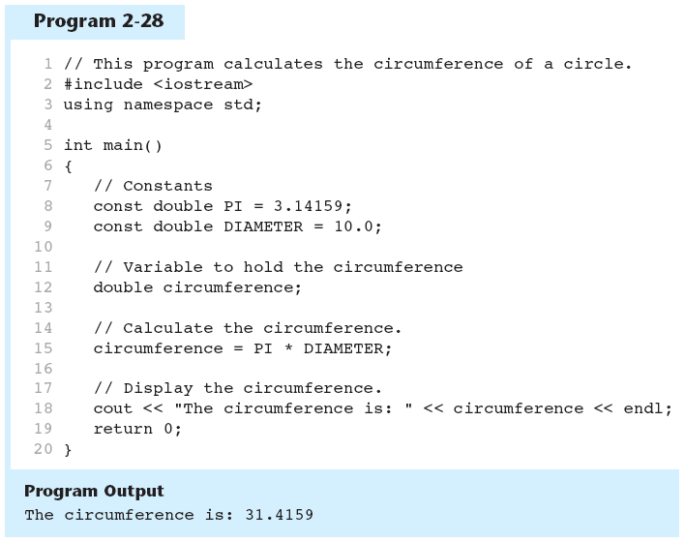
Named Constants in Program 2-28

Slide 104
2.17
Programming Style

Slide 105
Programming Style
The visual organization of the source code
Includes the use of spaces, tabs, and blank lines
Does not affect the syntax of the program
Affects the readability of the source code

