Slide 1
3.1
The cin Object

Slide 2
The cin Object
Standard input object
Like cout, requires iostream file
Used to read input from keyboard
Information retrieved from cin with >>
Input is stored in one or more variables

Slide 3
Introducing Programming with an example
Computing the Area of a Circle
This program computes the area of the circle.

Slide 4

Writing a Program
Step 1: Designing An Algorithm
The algorithm for calculating the area of a circle:
Read in the circle’s radius using keyboard input.
Compute the area using the following formula:
Display the result.
π = 3.14159

Slide 5
Trace a Program Execution
animation
#include <iostream>
using namespace std;
int main() {
double radius;
double area;
// Step 1: Read in radius
radius = 20;
// Step 2: Compute area
area = radius * radius * 3.14159;
// Step 3: Display the area
cout << "The area is ";
cout << area << endl;
}
allocate memory for radius
radius
no value

Slide 6
Trace a Program Execution
animation
memory
#include <iostream>
using namespace std;
int main() {
double radius;
double area;
// Step 1: Read in radius
cout << “Enter in a radius” ;
cin >> radius ;
// Step 2: Compute area
area = radius * radius * 3.14159;
// Step 3: Display the area
cout << "The area is ";
cout << area << std::endl;
}
radius
no value
area
no value
allocate memory for area

Slide 7
Trace a Program Execution
animation
assign 20 to radius
#include <iostream>
using namespace std;
int main() {
double radius;
double area;
// Step 1: Read in radius
cout << “Enter in a radius” ;
cin >> radius ;
//radius = 20;
// Step 2: Compute area
area = radius * radius * 3.14159;
// Step 3: Display the area
cout << "The area is ";
cout << area << std::endl;
}
radius
20
area
no value

Slide 8
Trace a Program Execution
animation
memory
#include <iostream>
using namespace std;
int main() {
double radius;
double area;
// Step 1: Read in radius
cout << “Enter in a radius” ;
cin >> radius ;
// Step 2: Compute area
area = radius * radius * 3.14159;
// Step 3: Display the area
cout << "The area is ";
cout << area << std::endl;
}
radius
20
area
1256.636
compute area and assign it to variable area

Slide 9
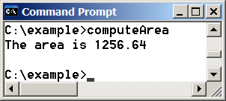
Trace a Program Execution
animation
memory
#include <iostream>
using namespace std;
int main() {
double radius;
double area;
// Step 1: Read in radius
cout << “Enter in a radius” ;
cin >> radius ;
// Step 2: Compute area
area = radius * radius * 3.14159;
// Step 3: Display the area
cout << "The area is ";
cout << area << std::endl;
}
radius
20
area
1256.636
print a message to the console

Slide 10
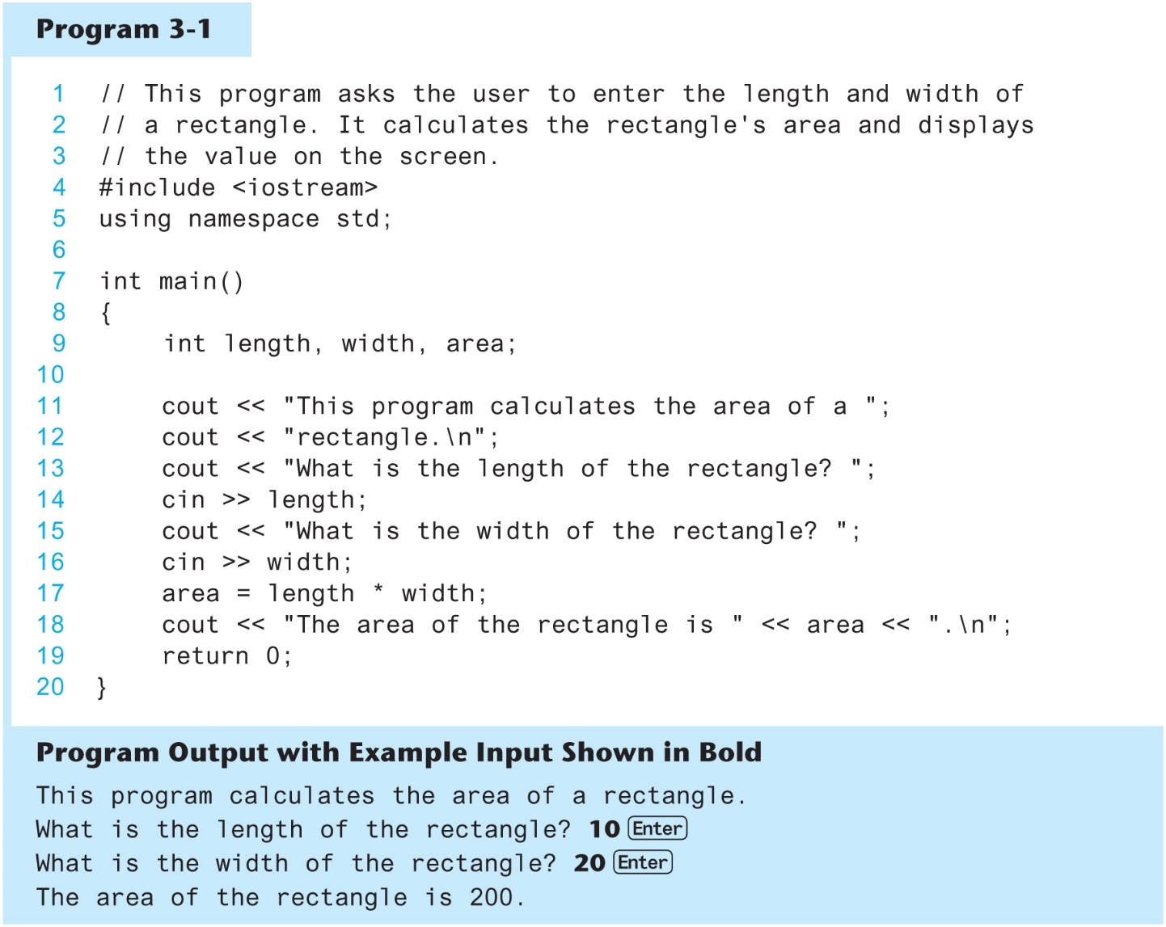
The cin Object in Program 3-1

Slide 11
The cin Object
cin converts data to the type that matches the variable:
int height;
cout << "How tall is the room? ";
cin >> height;

Slide 12
Displaying a Prompt
A prompt is a message that instructs the user to enter data.
You should always use cout to display a prompt before each cin statement.
cout << "How tall is the room? ";
cin >> height;

Slide 13
The cin Object
Can be used to input more than one value:
cin >> height >> width;
Multiple values from keyboard must be separated by spaces
Order is important: first value entered goes to first variable, etc.

Slide 14
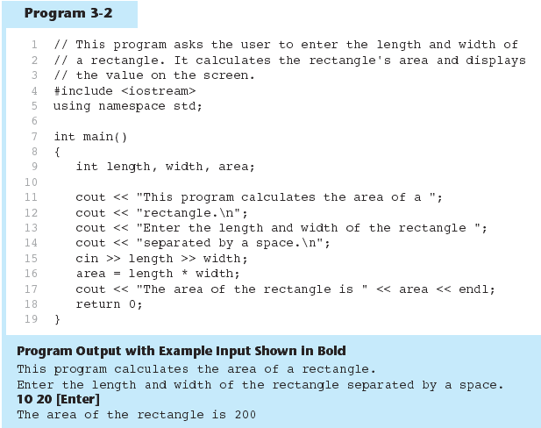
The cin Object Gathers Multiple Values in Program 3-2

Slide 15
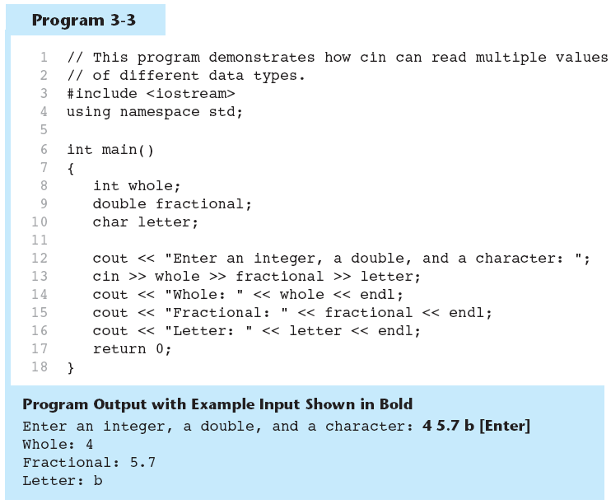
The cin Object Reads Different Data Types in Program 3-3

Slide 16
Volume of a cuboid
Calculate volume of a cuboid by taking in length, breadth and width from the user.

