Slide 1
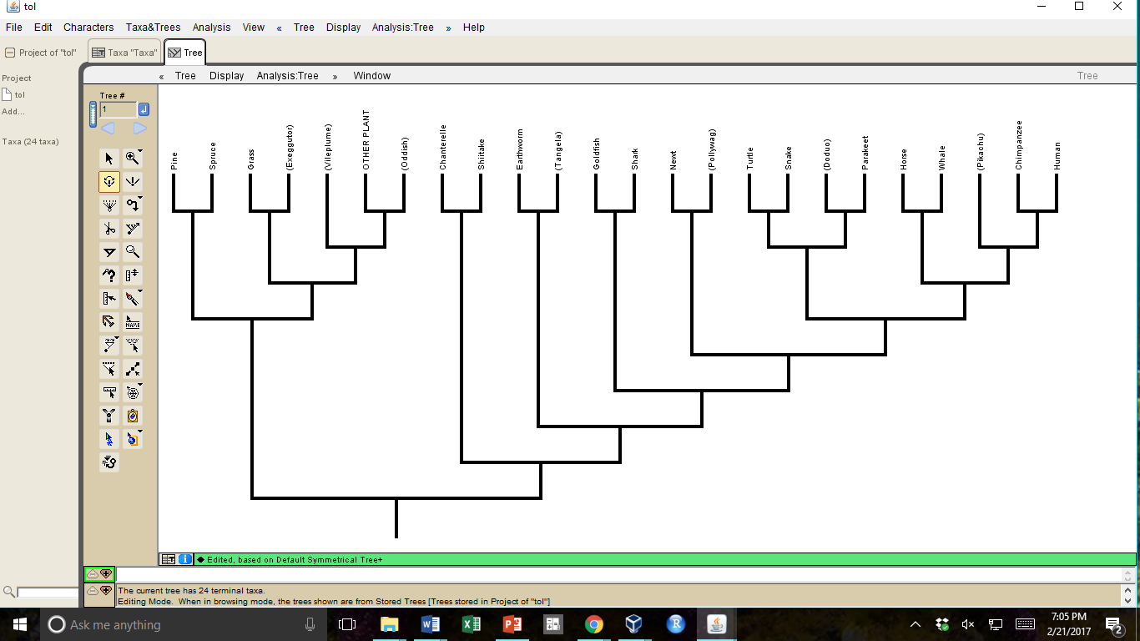
(Exeggutor)
(Vileplume)
Chanterelle
(Poliwag)
Chimpanzee
(Oddish)
(Tangela)
Parakeet
(Pikachu)
Spruce
Grass
Mango
Shiitake
Shrimp
Goldfish
Shark
Newt
Turtle
Snake
(Doduo)
Horse
Whale
Human
Pine

