Slide 1
Bicycle Shop Simulation
Data 604 Final Project
Leticia Salazar

Slide 2
Introduction
The bicycle industry has boomed within the last 2 years of a global pandemic affecting wait times to get a service.
This project simulated a 'typical' day at a bicycle shop, the services they provide and wait times pre-pandemic.
Things to consider:
Normal hours of operation for a bike shop can range from 6 – 8 hours but I am setting a max of 95 minutes for this model to limit results count
Sales and Special orders have been combined for a max time of 75 minutes
Repairs (short and long) have also been combined for a max time of 95 minutes
Model shows 14 operational days with 20 repairs, 16 sales and 10 random inquiries; in a real scenario these services can have a larger queue with this time frame

Slide 3
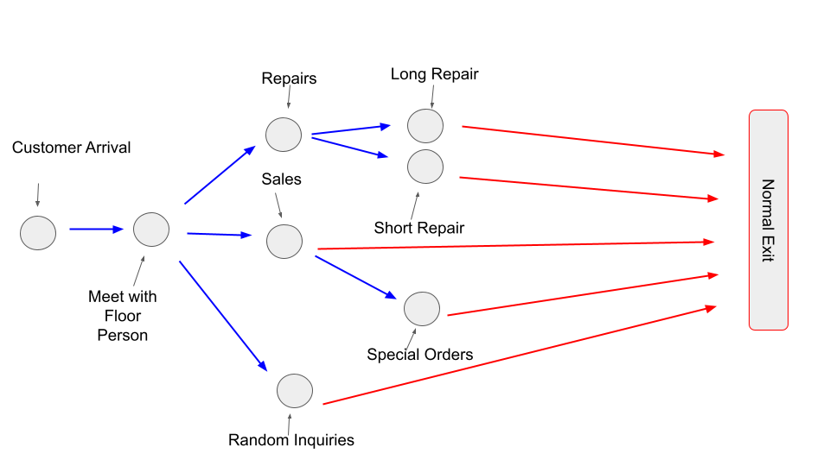
Flowchart for model
The simulation includes:
Customer Arrival
Meet with person working the floor: depending on the type of service needed the customer will be directed to one of three different service areas:
Random inquiries: using air pump, questions not related to the business, browsing, etc
Sales: looking to buy a bicycle, parts or accessories
Special orders: if items are not available some customers may decide to place an order (can take up to 2 days for the order to arrive
Repairs: within this category there's different types of services
Short repair: flat fixes, minor adjustments (these usually take anywhere between 10 - 45 minutes)
Long repairs: tune-ups, bike assemblies, part replacements, major adjustments (these usually take between 1 hour - 1 business days)
Normal Exit

Slide 4
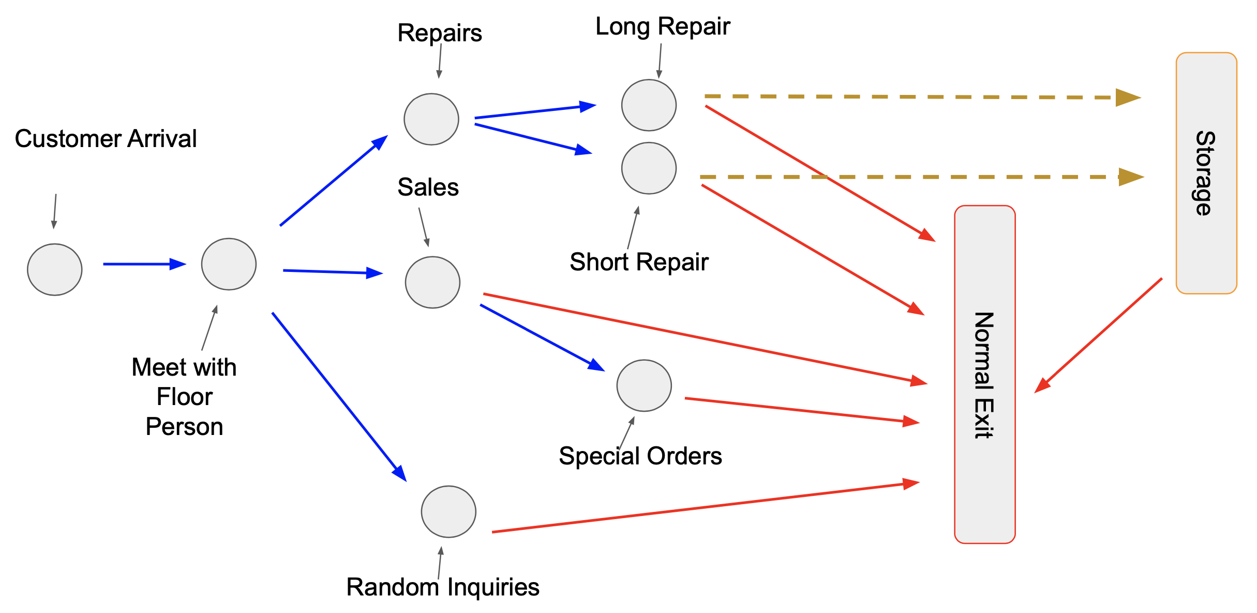
Original Flowchart (intended to use)

Slide 5
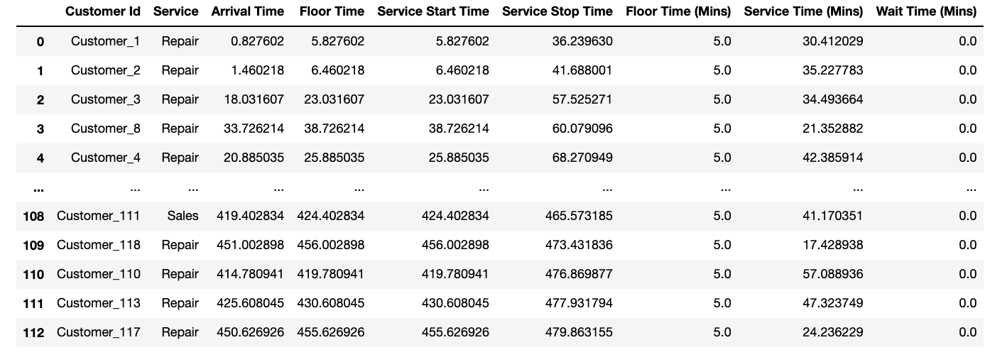
Validity and verification
To confirm the validity of this simulation is hard since I have not seen other models for bike shops. By trial and error, I was able to verify the wait times for each service provided based solely on personal experience.
The data frame shows how the simulation performed randomizing the services and times for each customer.

Slide 6
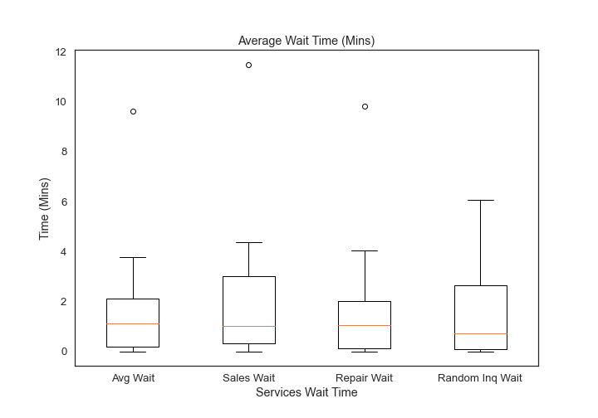
Graphs:
Figure 1 shows the averages for all wait times fall between 1 - 1.5 minutes with a couple of outliers in avg wait, sales and repairs ranging between 9 - 12 mins.

Slide 7
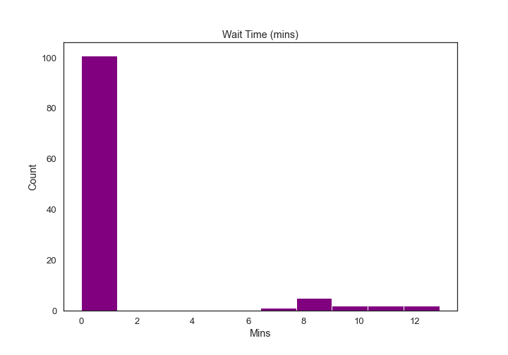
Graphs Cont.
Figure 2 is a histogram showing the data's frequency distribution for wait time in minutes. About 100 customer have a wait time of 0 - 1.5 minutes and less than 10 customers wait around 2 - 13 minutes for a service.

Slide 8
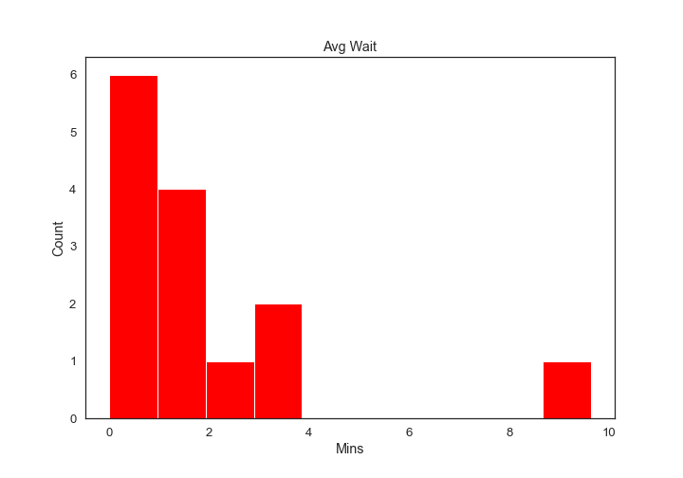
Graphs Cont.
Figure 3, also a histogram, shows the calculated average wait of the model with the majority of customers wait time being between 0 - 4 minutes and a few waiting between 8 - 10 minutes.

Slide 9
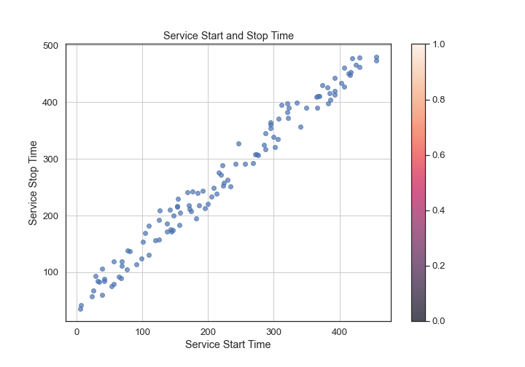
Graphs Cont.
Figure 4 is scatter plot showing a positive correlation for service start and stop time.

Slide 10
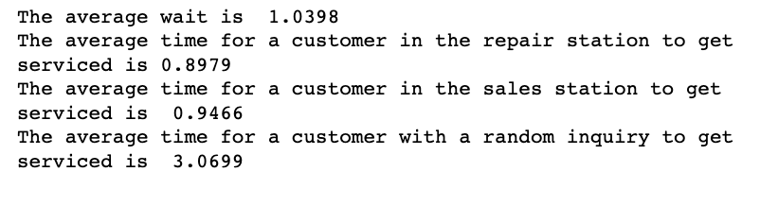
Conclusion
The average wait time to get a service is less than 1 minute.
Majority of the customers that come into the shop wait no more than 6 minutes to get serviced.
Initially my model showed some missing values for wait times for random inquiries.
I kept getting other errors that could have been due to not placing the random inquiries properly in the for loop, but I couldn't be certain.
Overall, the model does show a good representation of what a wait time in a bike shop would be like.
Plenty of factors can increase these wait times such as a global pandemic by 3 - 4 times the average.
I would consider going back to this model and improve it over time

Slide 11
References and links
GitHub: here you can explore my attempts to run this simulation.
Code Credit: after doing some code research, I came across another person’s code in rpubs. With some modifications I was able to run this simulation properly when my code kept failing.

