Slide 1
Bicycle Shop Simulation
Data 604 Final Project
Leticia Salazar

Slide 2
Introduction

Slide 3
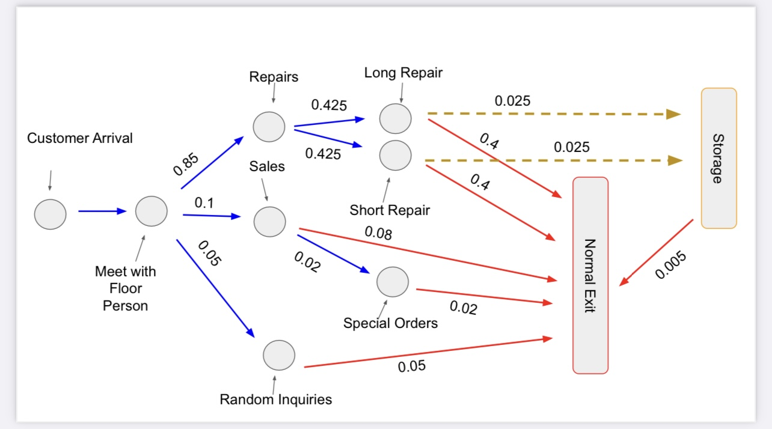
Flowchart

