Slide 1
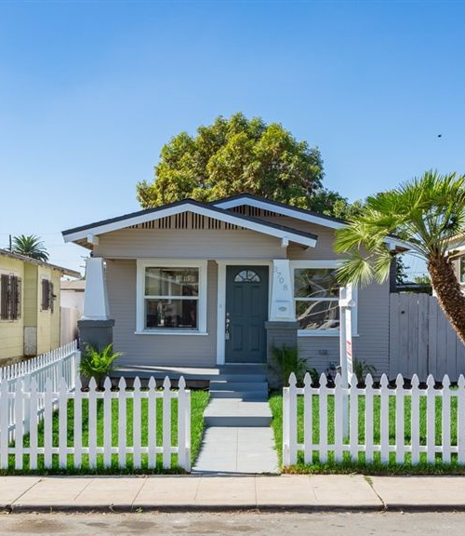
House Price Prediction
Group 2: William Aiken, Donald Butler, Michael Ippolito, Bharani Nittala, and Leticia Salazar

Slide 2
Agenda
1. Introduction
1.1 Plots
2. Methodology
2.1 Results and Discussion
3. Conclusion and Future work
Presentation Title

Slide 3

Introduction
With the housing market affected by factors such as mortgage rates, inflation, or economic recession, housing prices have risen dramatically over the years.
We used a multivariate linear model to predict housing prices using factors as house area, number of bedrooms, whether it is furnished, nearness to a main road, and the presence of amenities like basements and guest houses.

Slide 4




A little more about our data
Contains
Missing in action
545 observations and 13 variables
Data didn’t specify what the variable ‘prefarea’ represented
Gathered from
Prep Work
Kaggle.com
No missing variables

Slide 5
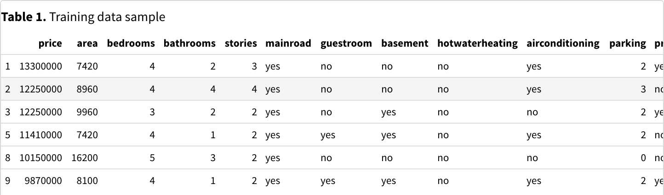
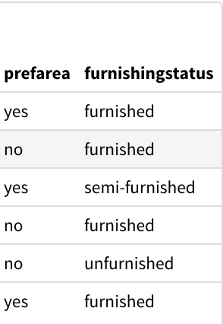
Our training data:

Slide 6
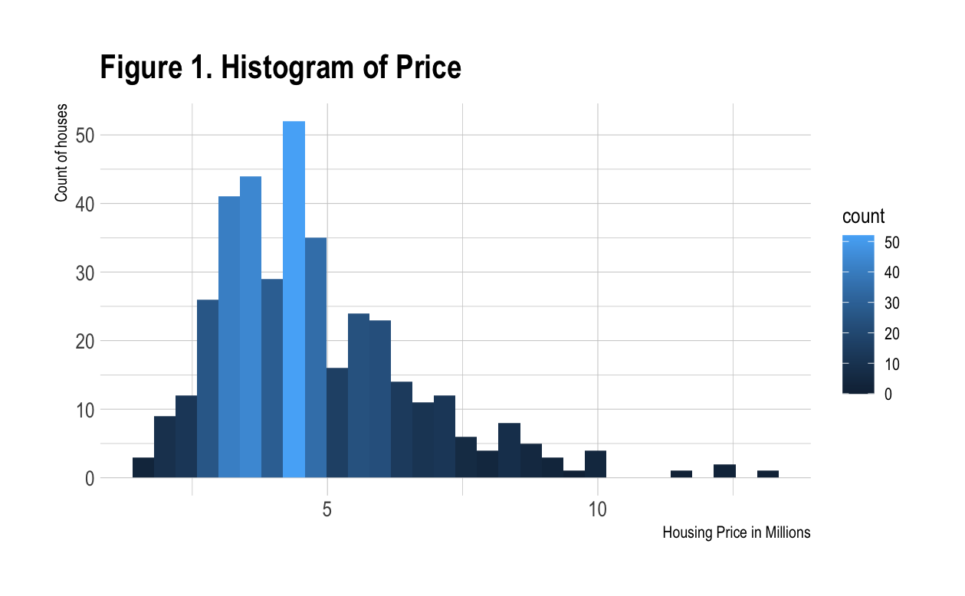
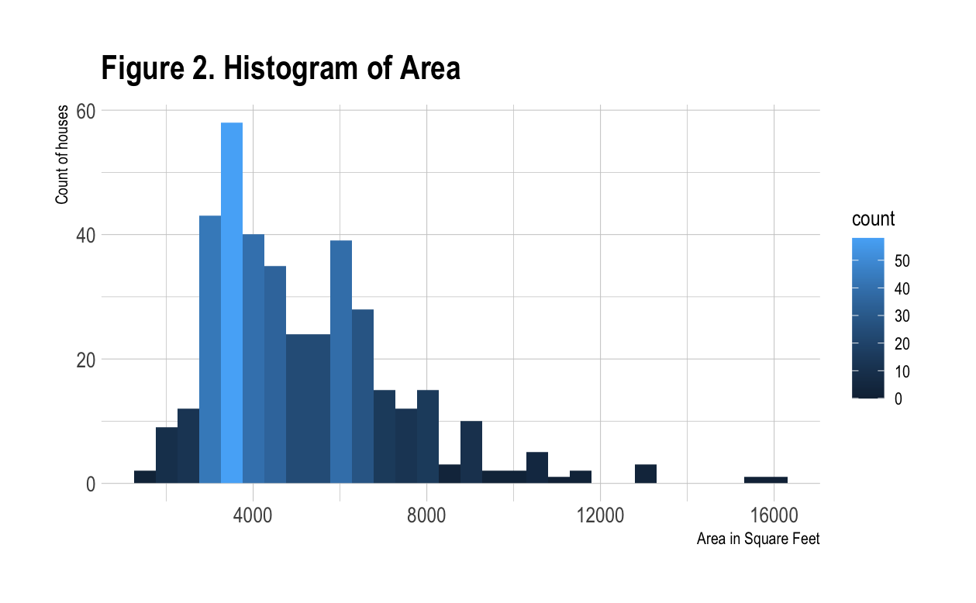
Data contains houses priced above 1 million
We expect that increases in area would lead to increases in price

Slide 7
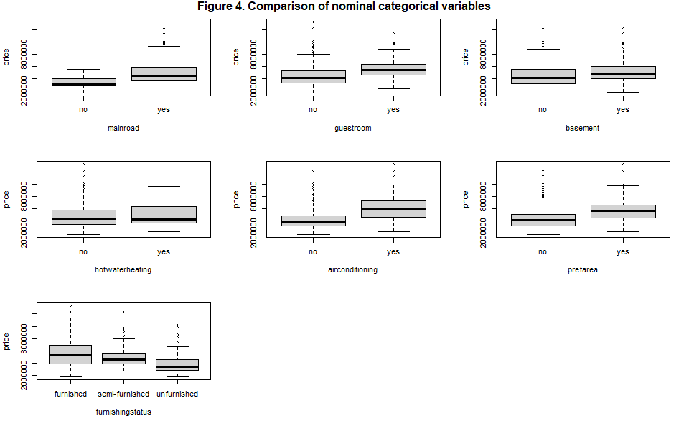
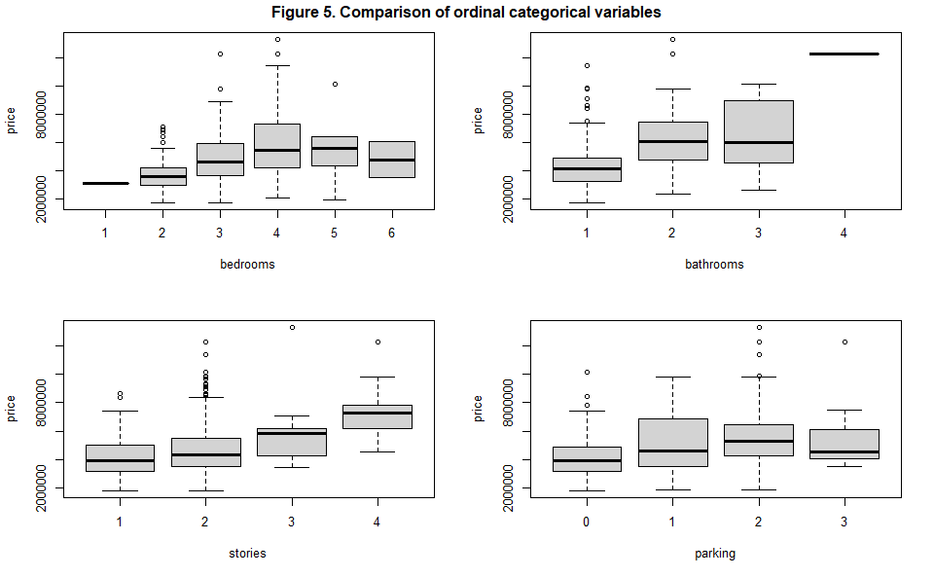
Box plots of nominal and ordinal categorical variables

Slide 8
Methodology
Evaluation
Examined
Normal of residuals
Homoscedasticity of residuals
Independence of predictors
Linearity of fit
Predictors to evaluated how they might affect the response variable (price)
Assessed
Model Building
545 records and determined multiple linear regression model was appropriate
Preparation
Linear model against the full data
Stepwise to reduce the predictor
Split our data into a training and evaluation set
Created dummy variables

Slide 9
Methodology
Evaluate Homoscedasticity
Results…
Used Breusch-Pagan test
Evaluate Normality
Used Shapiro test
Evaluate Colinearity
Evaluate Outliers
Looked into variance inflation factors (VIFs)
Looked at hat values and compare them to a cutoff point

Slide 10
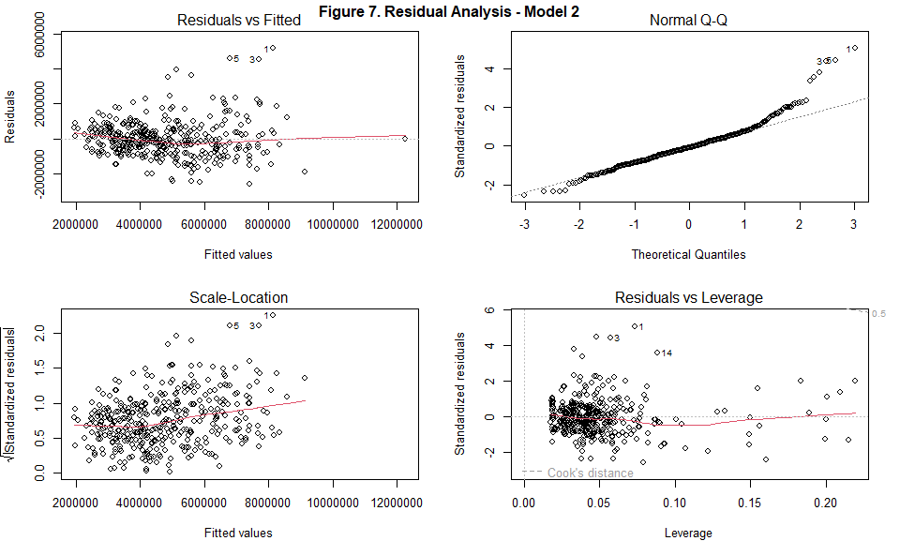
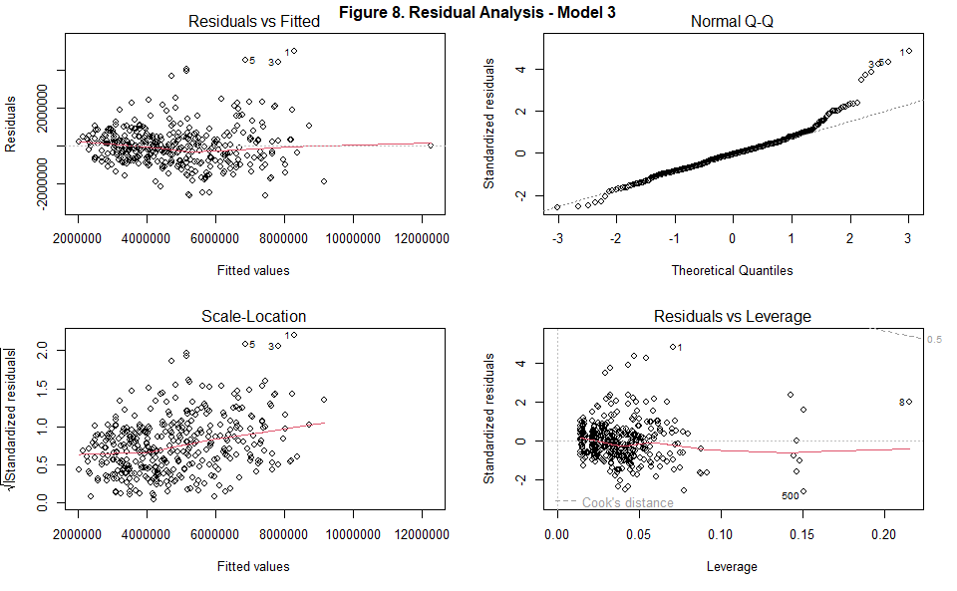
Results of Model
Our model showed:
Residuals were heteroscedastic
Not normally distributed
There were no problems with linearity of fit or colinearity among the predictors in our initial modeling attempts

Slide 11
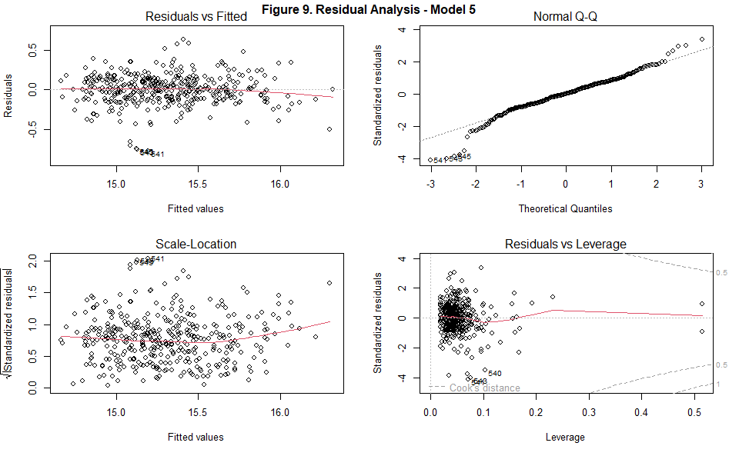
Results of Model
To fix our issues shown in Figures 7 and 8
we chose to run a Box-Cox transformation to give us an idea of whether a transformation of the response variable would be appropriate
We also implemented the the Shapiro and Breusch-Pagan tests to obtain the results shown in Figure 9
Residuals were now homoscedastic with the highest VIF of 2.04
Demonstrated slight colinearity among some variables

Slide 12
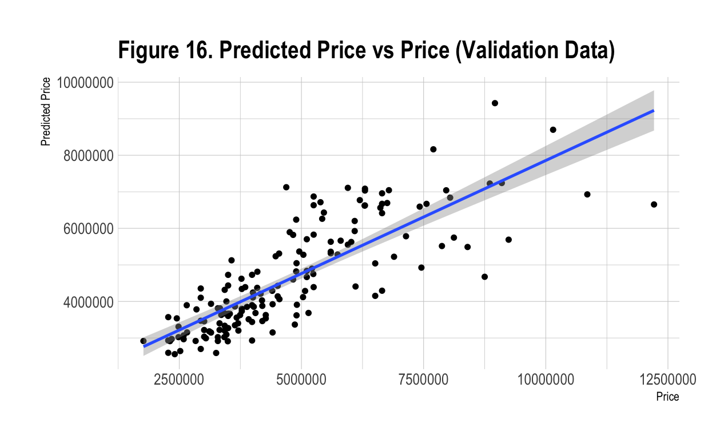
Results of Model
We then:
Applied a log transformation to the response variable (price)
Yielded homoscedastic residuals but still non-normally distributed
Attempted a Huber-weighted robust model
Didn’t fully correct the issue but noted that in larger data sets, non-normality of residuals doesn’t affect model results significantly.
In addition:
Examined outliers to evaluate any evident trends
Perceived none
Removed the most significant outliers to attempt a better fit
Final product

Slide 13
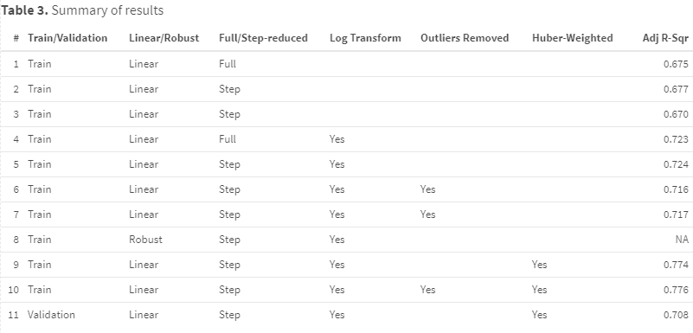
Conclusion
We found we were somewhat limited by the data set, in that there appeared to be one or more confounding variables that influenced price and that were not present in the data set.

Slide 14


Future work
Future research could be done to obtain a richer set of data with additional explanatory variables.
That could also mitigate the other limitation we encountered: that of non-normally distributed residuals.
Based on our literature review, that limitation may be less important, as our data set was fairly large compared to the number of explanatory variables.

Slide 15



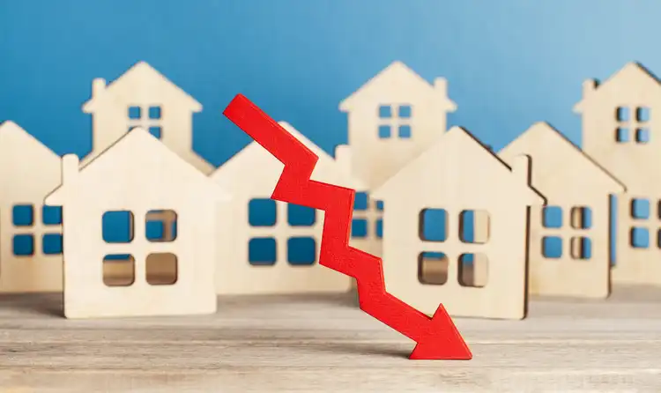
Thank you!
-- Group 2

