Slide 1

Title of Project
Group 2: William Aiken, Donald Butler, Michael Ippolito, Bharani Nittala, and Leticia Salazar

Slide 2
Agenda
1. Introduction
2. Methodology
2.1 Result
2.2 Discussion
3. Conclusion
Presentation Title

Slide 3

Introduction
At Contoso, we empower organizations to foster collaborative thinking to further drive workplace innovation. By closing the loop and leveraging agile frameworks, we help business grow organically and foster a consumer-first mindset.

Slide 4
Methodology
Nov 20XX
May 20XX
Disseminate standardized metrics
Deploy strategy networks with compelling e-business needs
Sep 20XX
Synergize scalable
e-commerce
Jan 20XX
Mar 20XX
Coordinate e-business applications
Foster holistically superior methodologies

Slide 5



How we get there
ROI
Envision multimedia-based expertise and cross-media growth strategies
Visualize quality intellectual capital
Engage worldwide methodologies with web-enabled technologies
Niche markets
Pursue scalable customer service through sustainable strategies
Engage top-line web services with cutting-edge deliverables
Supply chains
Cultivate one-to-one customer service with robust ideas
Maximize timely deliverables for real-time schemas

Slide 6


Conclusion
At Contoso, we believe in giving 110%. By using our next-generation data architecture, we help organizations virtually manage agile workflows. We thrive because of our market knowledge and great team behind our product. As our CEO says, “Efficiencies will come from proactively transforming how we do business.”

Slide 7



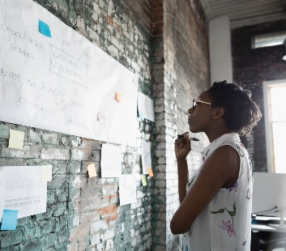
Thank you
Mirjam Nilsson
mirjam@contoso.com
www.contoso.com

