Slide 1
Old & New Testament
Data mining
Cernazanu-Glavan Diana
Bulica Letitia-Anda

Slide 2
The Dataset
455,347
163,085
14,076
Old Testament
total words
words excluding stop words
unique words
186,310
64,106
9804
New Testament
words excluding stop words
unique words
total words

Slide 3
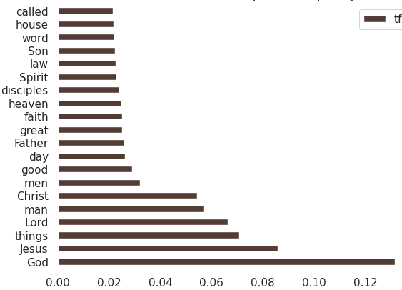
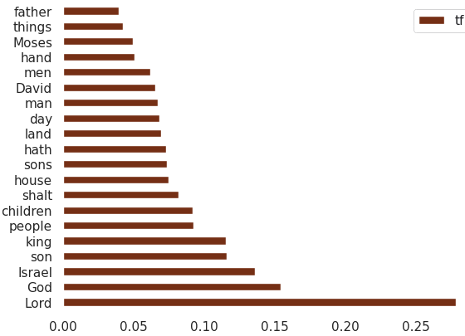
TF-IDF
Old Testament
New Testament

Slide 4
Relationships between the words
Bigrams and N-grams

Slide 5
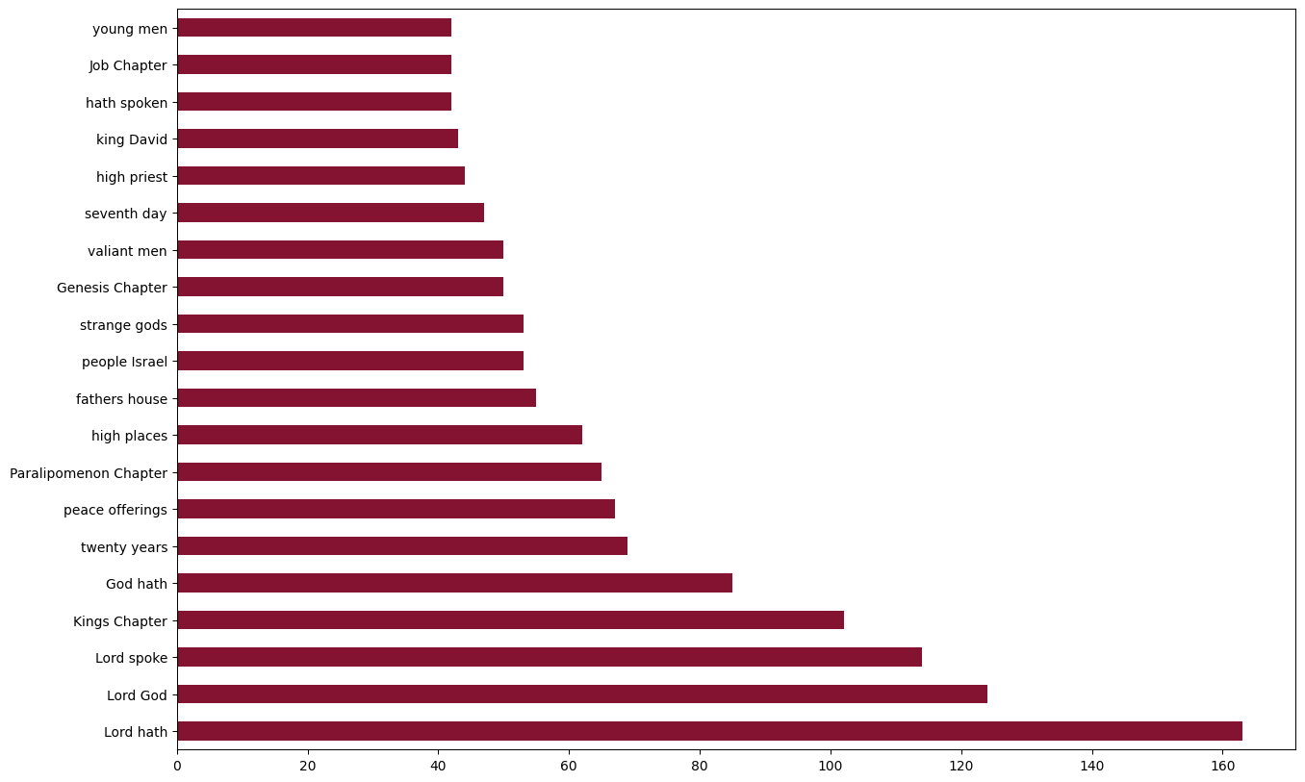
Bigrams
Old Testament

Slide 6
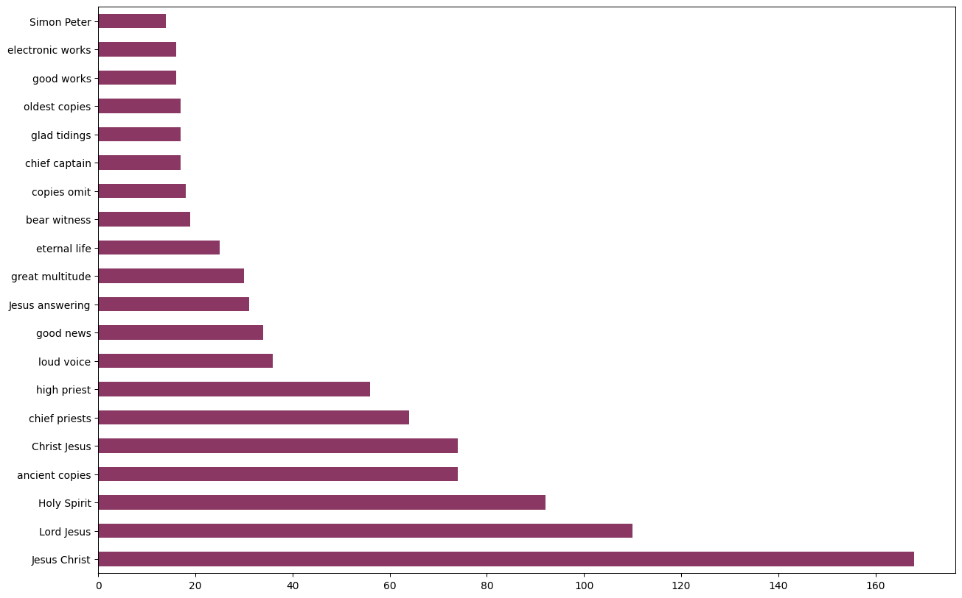
Bigrams
New Testament

Slide 7
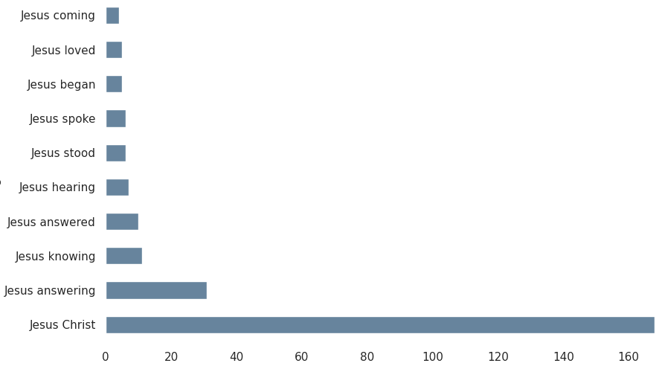
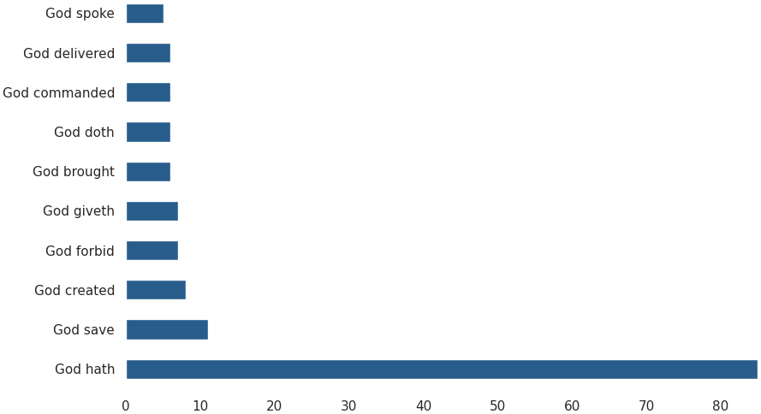

Slide 8
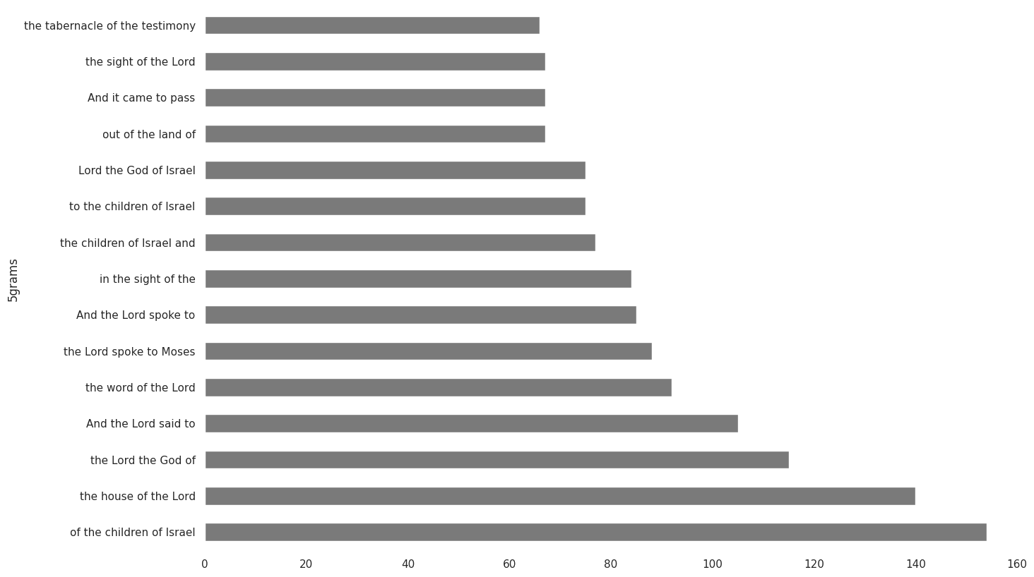
5-Grams
Old Testament

Slide 9
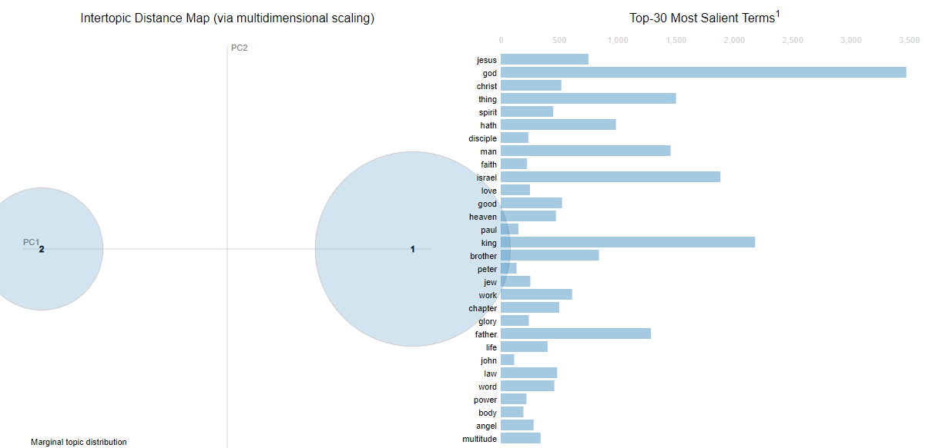
Topic Modelling

Slide 10
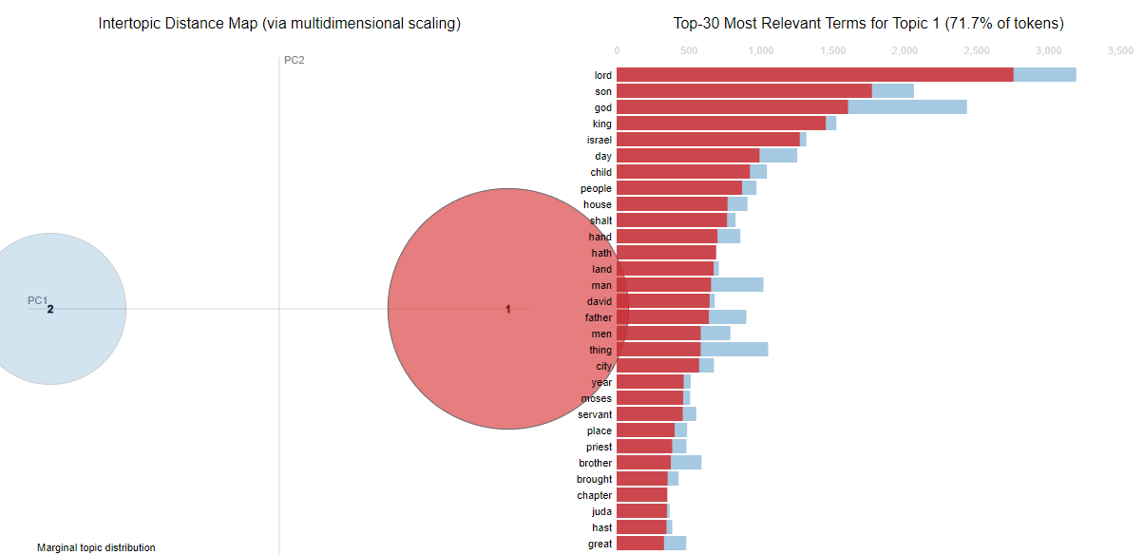
Topic Modelling

Slide 11
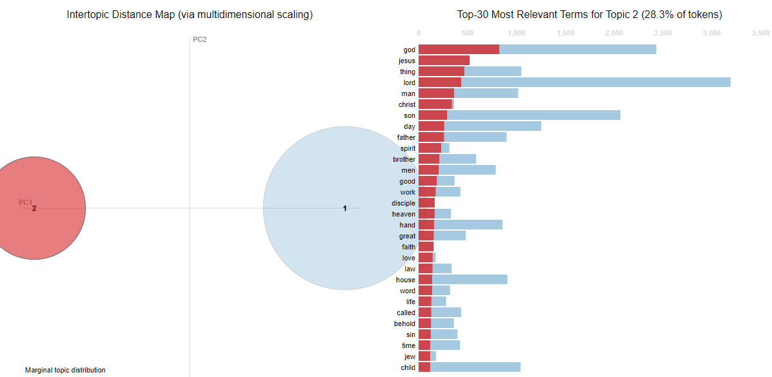
Topic Modelling

Slide 12
The main characters
Jesus | 260
Paul | 100
Peter | 100
John | 86
Moses | 71
Abraham | 49
David | 37
Mary | 34
David | 749
Moses | 624
Saul | 308
Juda | 292
Aaron | 290
Solomon | 208
Pharao | 161
Samuel | 127
The New Testament
The Old Testament

Slide 13
Most common nouns
Lord | 3917
God | 2151
Israel | 1912
son | 1619
king | 1336
people | 1297
children | 1289
God | 1284
Jesus | 837
things | 693
Lord | 651
man | 71
Christ | 49
The New Testament
The Old Testament

Slide 14
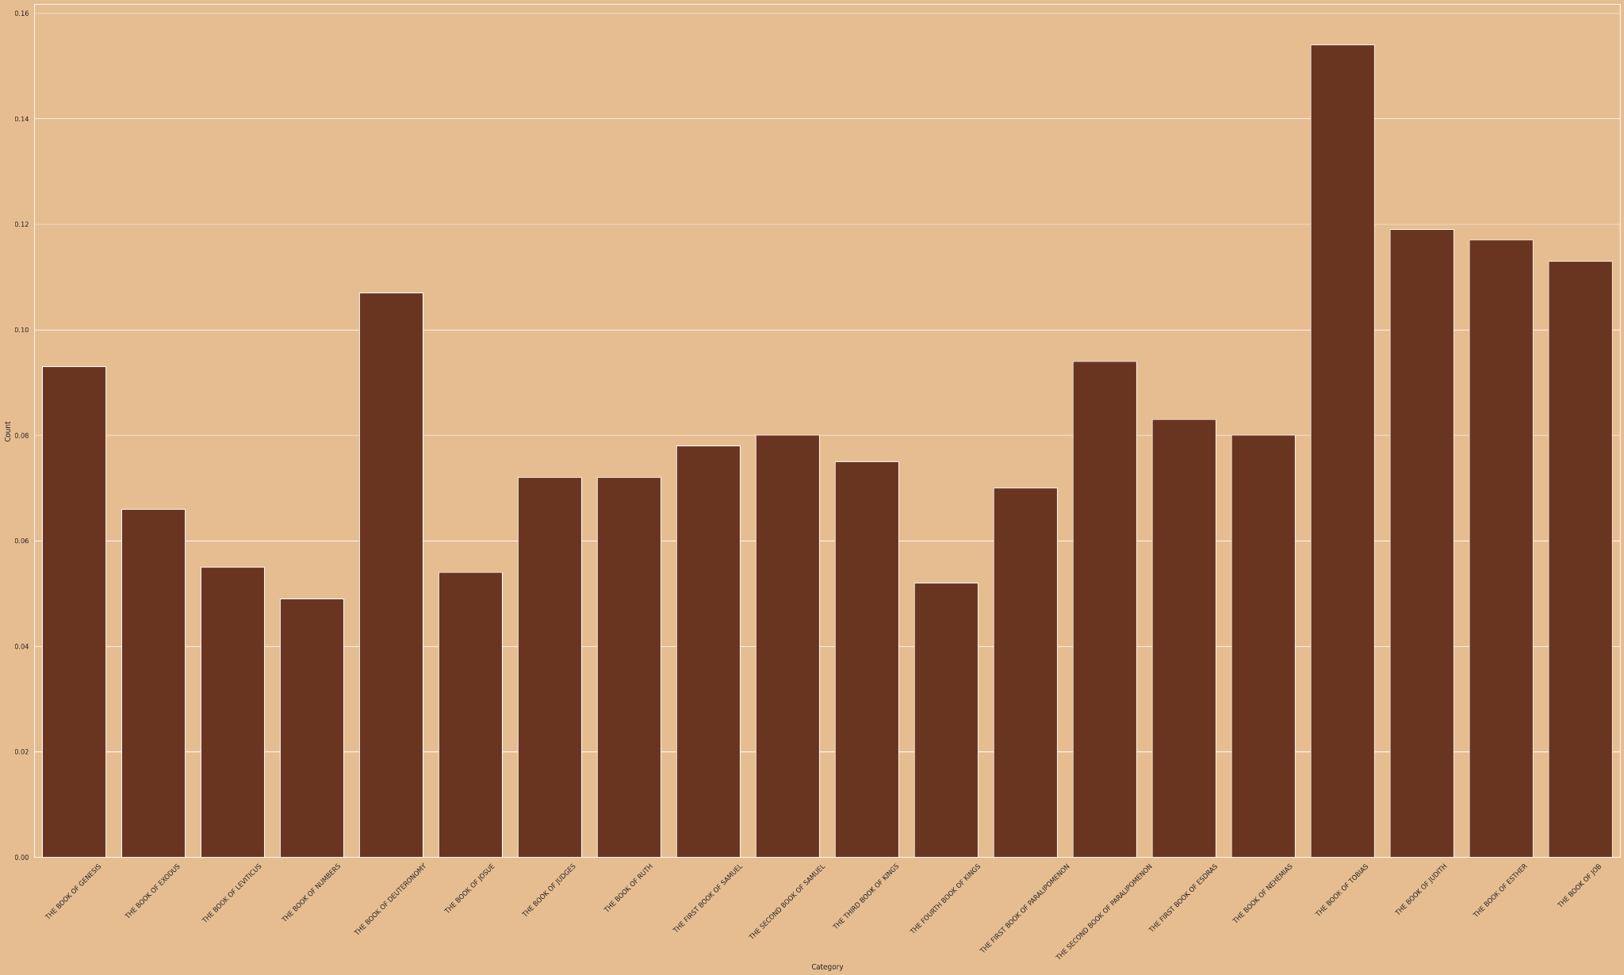
Sentiment analysis of the old testament

Slide 15
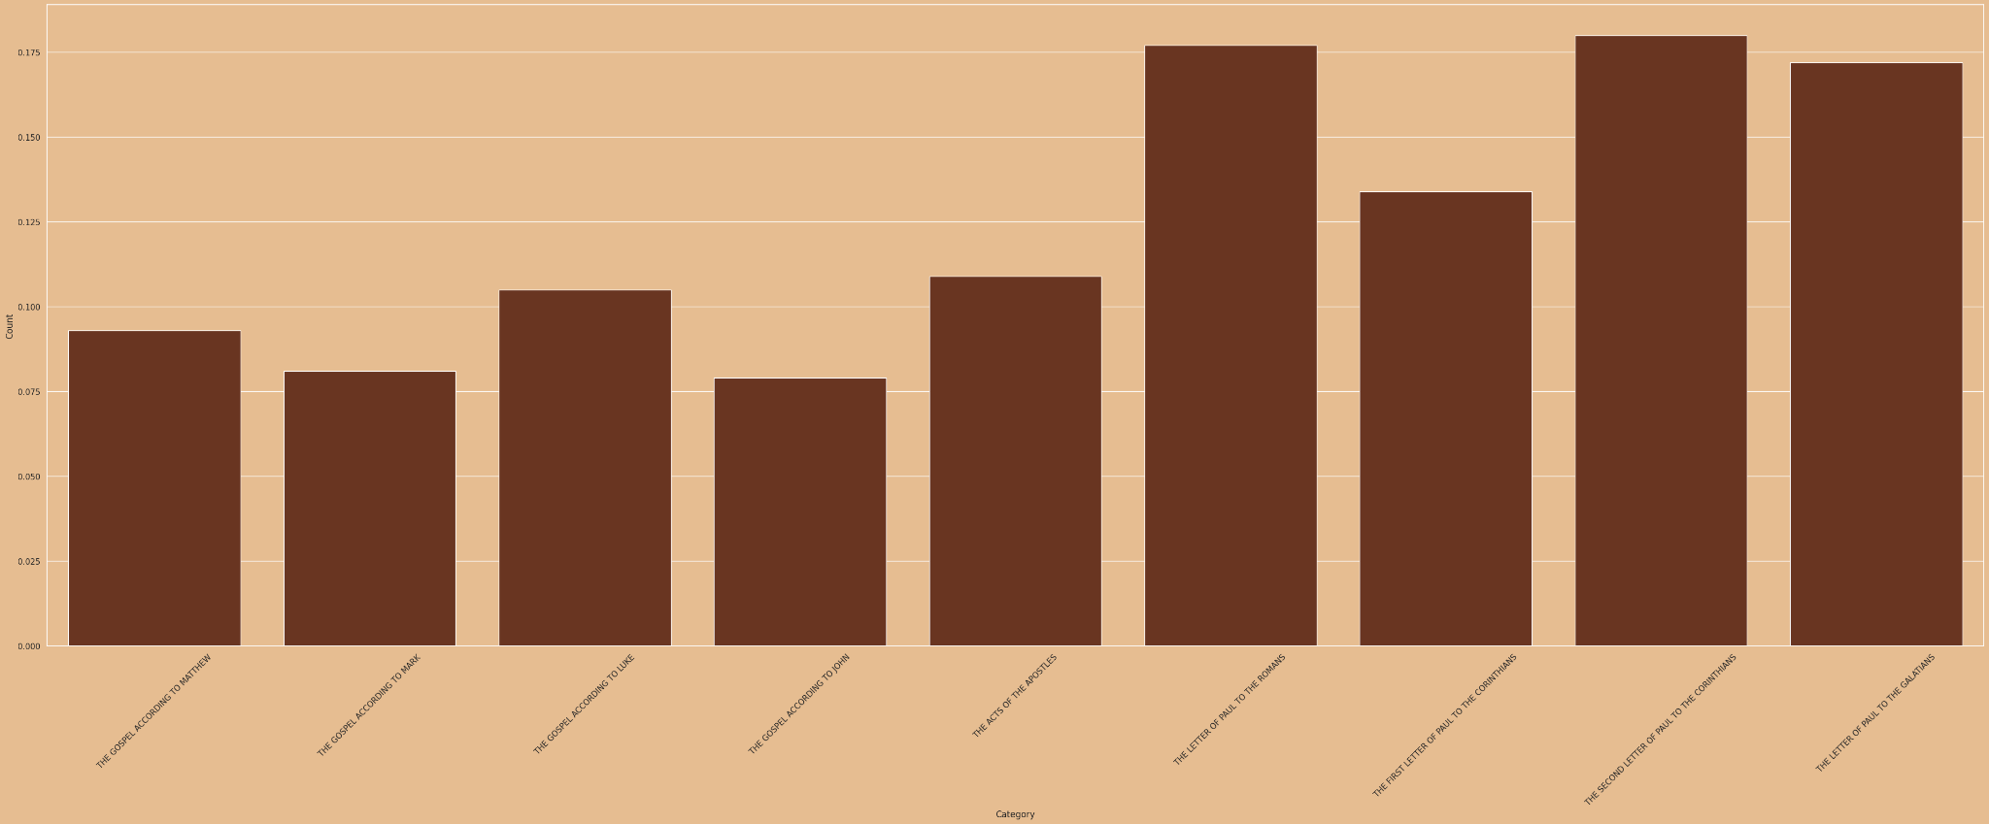
Sentiment analysis of the new testament

Slide 16
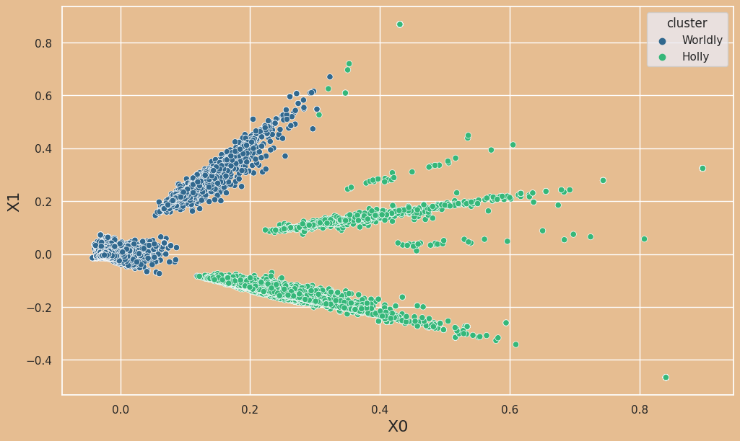
Clustering performed on both books

Slide 17
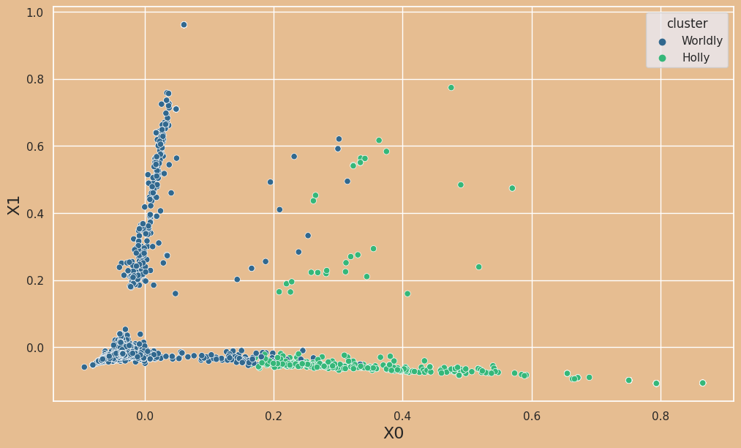
Clustering performed on two chapters

Slide 18
Thank you!

