Slide 1

SMS Spam Classification
Fundamentals of Data Science 2021/2022
Final Project
2nd presentation – 16 Dec 2021
Prof. Fabio Galasso
Group members:
Simone Boesso
Davide Cacciatore
Giulio Corsetti
Francesca Possenti
Letizia Russo

Slide 2
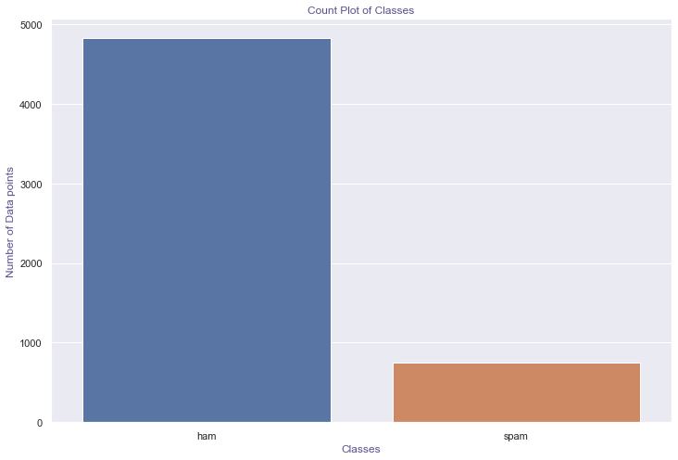
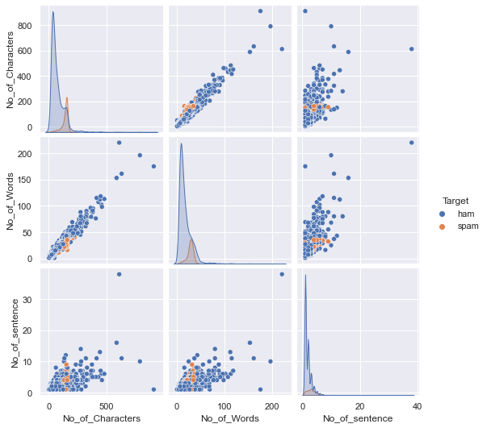
EXPLORATORY DATA ANALYSIS
Ham: 4825
Spam: 747
Fundamentals of Data Science 2021/2022 – Final Project
2nd presentation – 16 Dec 2021

Slide 3
EXPLORATORY DATA ANALYSIS
Examples of ham and spam messages in the dataset.
Pre-processing
HAM | I'm gonna be home soon and i don't want to talk about this stuff anymore tonight, k? I've cried enough today.
SPAM | WINNER!! As a valued network customer you have been selected to receivea å£900 prize reward! To claim call 09061701461. Claim code KL341. Valid 12 hours only.
Removing punctuation
Lemmatize
Lowercase texts
Split words
Removing stopwords
Vectorize SMS
Fundamentals of Data Science 2021/2022 – Final Project
2nd presentation – 16 Dec 2021

Slide 4
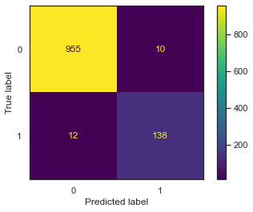
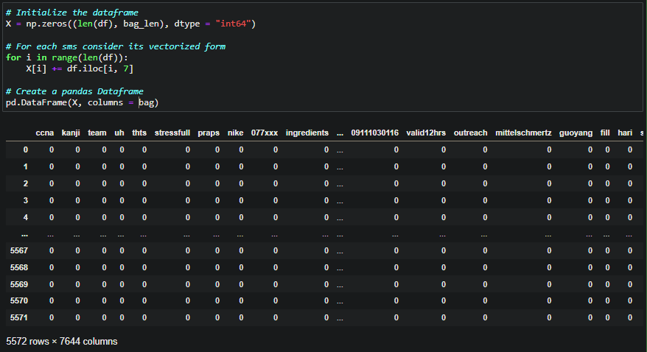
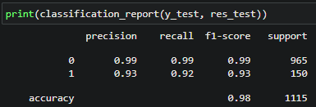
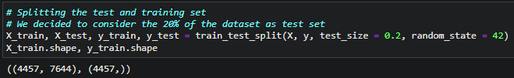
NAÏVE BAYES MODEL
- FROM ASSIGNMENT 2 -
Create the dataframe: on the rows the SMS,
on the columns all the words in the corpus
Confusion matrix for the implemented model
Splitting the dataset in train and test set.
Fundamentals of Data Science 2021/2022 – Final Project
2nd presentation – 16 Dec 2021

Slide 5
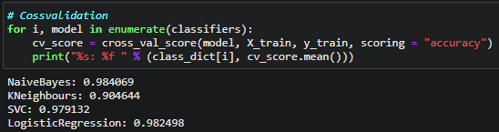
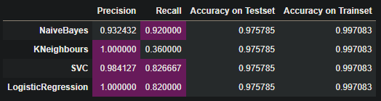
COMPARING WITH OTHER CLASSIFIER
MultinomialNB – KNeighbours – SVC – Logistic Regression
Accuracy with 5-Fold Cross-validation.
Metrics
Credits to:
Spam or Ham: SMS Classifier – Karnika Kapoor
How to create a spam filter using Bayes’ theorem? – Roman Studer
Fundamentals of Data Science 2021/2022 – Final Project
2nd presentation – 16 Dec 2021

Slide 6
NEXT STEPS AND FUTURE DEVELOPMENTS
Fundamentals of Data Science 2021/2022 – Final Project
2nd presentation – 16 Dec 2021

Slide 7
Thank you
for the attention!
Fundamentals of Data Science 2021/2022 – Final Project
2nd presentation – 16 Dec 2021

