Slide 1
Nomad Algorithm
Group Assignment
M11001002 王思豪
M11001107 石旻晉
M11001201 葉宥蓁
M11001K04 鍾瑜安

Slide 2
CONTENTS
01
Introduce
02
Algorithm concept
03
Process
04
Results and Comparison

Slide 3
PART 01
Introduce
Nomads as the idea for an algorithmic construction ....

Slide 4
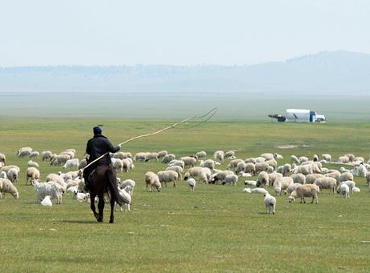

Introduce
Nomads as the idea for an algorithmic construction ....
Nomads are people who move frequently from one place to another, gaining access to living resources through mobility, and often need to avoid reaching their natural carrying limits.
Nomadic
This time, the algorithm is built with the concept of nomad, and the best solution is sought through the idea of nomadic movement.
Notes:
游居者是指頻繁從一處移居到另一處，通過移動的方式獲得生活資源，且往往需要避免資源達到其自然承載極限。(上)
本次以游牧者為概念進行演算法建置，透過游牧者移動的想法尋求最佳解。(下)
<number>

Slide 5
PART 02
Algorithm concept
The main concept of algorithm and the important technical ...

Slide 6






Algorithm concept
How to find food?
Number of people increase or decrease
n people
Position if this time
Randomly generate a group of people (n), each time you assign n/a people out to search, all of them move to the place with more food.
Compare
This time, compared with the last time, how many times the resources increase or decrease, and put this multiplier into tanh (hyperbolic function).
$\frac{n}{a}people$
Position if last time
How to recover after resource depletion?
How to judge the best position?
Shortage of food
after b iterations.
Migration
The food can support b iterations, and after b iterations, the food is consumed, and it needs to pass through c iterations before new food grows here.
People move to the next place, each time record d the position of the most abundant food (best fitness), and compare with the last position to do and record.
Enough of food
after c iterations
Best position record

Slide 7
PART 03
Process
Algorithm process and detailed introduction...

Slide 8
Process
Initialize
Choose the center point and decide the position of the nomad.
The best position to record from the nomads.
Assign n/a nomads to search for resources
Nomads move to places where food is available.
Resource recovery.
The iterations are reached
No
Yes
End

Slide 9
Process
Initialize
Name of parameters | Meaning of the parameters | Parameter setting
ite(Iteration) | Number of iterations. | 100
dim(Dimension) | The unknown number of the current solution. | 2
LB&UB | Lower and upper bound. | -5~5
ori_num_people | How many nomads? | 200
ratio_scout(a) | Percentage of nomads going out in search of resources. | 1/3
res_sup(b) | Resources can support several iterations. | 1
res_back(c) | The consumed resources need several iteraions to recover. | 6
res_rec | Record a few of the best resource points and how many more iterations of these points are needed to recover the resource. | 3
act_rng | The percentage of nomads moving around. | 0.05

Slide 10

Process
Choose the center point and decide the position of the nomad.
UB
In the pre-defined upper bound and lower bound, select the center point.
Nomads are active in the area around the center point.
Nomad activity range setting:
center + act_rng * (UB-LB) * random.uniform(-0.5,0.5)
act_rng : A movement ratio given by the nomad to avoid too large a range of movement.
center
LB
UB
LB
Notes:
1.在設定的Upper bound and Lower bound內，選擇中心點
2.游牧者在中心點附近的範圍活動
範圍設定:self.cen_loc + self.act_rng * np.subtract(self.UB, self.LB) * np.random.uniform(-0.5, 0.5, size=(self.num_peoples, self.dim))
中心點center + act_rng * (UB-LB) * random.uniform(-0.5,0.5)
act_rng避免游牧者移動範圍過大所給予的一個移動比例
<number>

Slide 11

Process
The best position to record from the nomads.
UB
Calculate fitness according to the nomad's position and record the best fitness position.
Calculate whether the best position has run out of food (whether it has stayed in this position for b iteration).
Avoid falling into the local optimality.
The optimal location of the record will be restored after a few iterations.
determined by the hyperparameter c.
Best fitness
center
LB
UB
LB
Notes:
1.根據游牧者的位置計算fitness，並記錄最佳fitness的位置
2.計算最佳位置是否已經糧食耗盡(以經過b個iteration)，若以耗盡，遊牧民族則無法在此點附近活動。
, if it has run out, the nomads will not be able to activity near this position.(太多字了沒打上去)
(可避免游牧民族一直在同一點附近，導致落入區域最佳解。)
Avoid nomads staying near the same point all the time, resulting in falling into the local optimality..(太多字了沒打上去)
3.紀錄最佳位置在幾個iteration後(由超參數C決定)，將恢復資源。
The optimal location of the record will be restored after a few iterations (determined by the hyperparameter C).
<number>

Slide 12
Process
Nomads move to places where food is available
UB
Nomads move to the places with the best food performance.
Includes places where resources have been restored.
According to this iteration getting food affects the increase and decrease of nomads.
Increase and decrease of nomads :
(Previous Feeding / Current Feeding -1) * tanh
Nomads increase -1 to 1 times.
Best fitness
center
LB
UB
LB
Notes:
游牧者往糧食表現最好的地方進行移動(包含先前紀錄中資源已回復的地方)
Nomads move to the places with the best food performance.(Includes places where resources have been restored)
游牧者往有糧食的地方移動(標題)，根據本次iterarion獲得糧食影響人員的增加與減少
上一次的糧食/此次糧食 -1
(Previous Feeding / Current Feeding -1) * tanh
增加-1至1倍人民
Nomads increase -1 to 1 times.
<number>

Slide 13

Process
Resource recovery.
UB
Best fitness
center
Used resources still need to recover time (reduce an iteration)
If the resource is restored, the nomad can move to this place in the next iteration.
LB
UB
The best location in the past,and the resource is restored.
LB
Notes:
使用過的資源還需恢復時間(減少一個iteration)
Used resources still need to recover time (reduce an iteration)
若資源已恢復，游牧者可在下一輪往此地方移動。
If the resource is restored, the nomad can move to this place in the next turn.
<number>

Slide 14
Process
Has iterations reached the set value?
UB
If it is reached, the algorithm is terminated.
If not reached, assign n/a nomads for the next iteration of food search.
Resource Search Range:
Search for resources at a distance of R from the last center point.
These position must not be in areas where they have been previously stationed.
Compare to previous record.
R
LB
UB
LB
Notes:
如果到達了，則結束演算法。
If it is reached, the algorithm is terminated.
如果未到達，則派出n/a個游牧者進行下一輪糧食搜索。
If not reached, assign n/a nomads for the next iteration of food search.
資源搜索範圍:Resource Search Range:
距離上次生活中心點為r以上的地方進行搜索資源。
Search for resources at a distance of R from the last center point.
這些點位不可在先前曾經駐紮過的範圍內。
These position must not be in areas where they have been previously stationed.
和先前紀錄的矩陣進行比較，若表現沒有比較佳，且原先該地資源已回復，則返回至此資源較佳處。
Compare to previous record
If the performance is not better and the original resource at that location has recovered, then return to this better resource.(太多了沒有放)
<number>

Slide 15
PART 04
Results and
Comparison
Results of the algorithm execution and comparison with other algorithms...

Slide 16
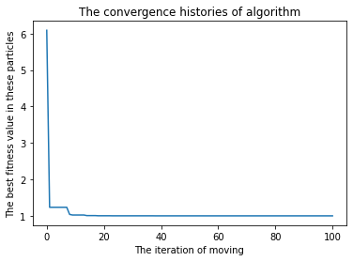
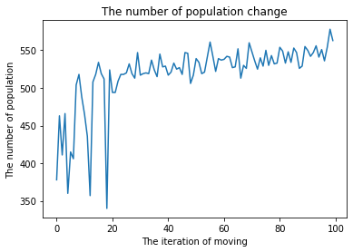
Results and Comparison
Results
Convergence of the Nomad Algorithm in 2 dimensions | The number of population changes of the Nomad Algorithm in 2 dimensions
Notes:
<number>

Slide 17
Results and Comparison
Nomad Algorithm v.s PSO Algorithm
PSO (Rastrigin function)
Variable | 2 | 4 | 10
Fitness value | 0 | 2.98 | 13.93
Consuming time(sec) | 0.02 | 0.03 | 0.07
Nomad Algorithm (Rastrigin function)
Variable | 2 | 4 | 10
Fitness value | 0.99547 | 2.037 | 17.716
Consuming time(sec) | 0.65 | 0.65 | 2.81
Notes:
Our algorithm performs worse than the PSO algorithm, but the fitness obtained from the Nomad Algorithm is not far from the PSO algorithm, so we think the Nomad Algorithm that we invented is good enough to do optimization.
這是旻晉打的
<number>

