Slide 1
Chapter 2-2
How to Simulate Verilog HDL codes ?
Examples

Slide 2
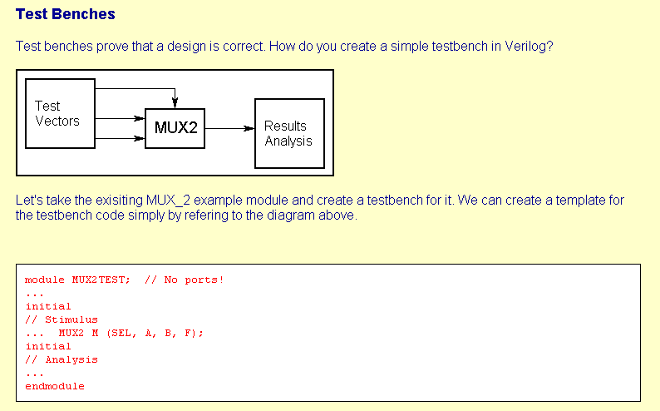
< Example 1 >
<Ref> http://www.doulos.com , Duolos Company, 2002

Slide 3
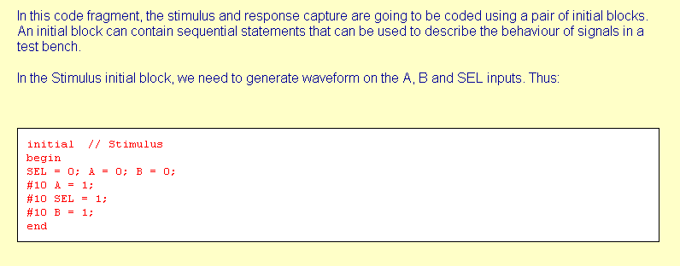

Slide 4
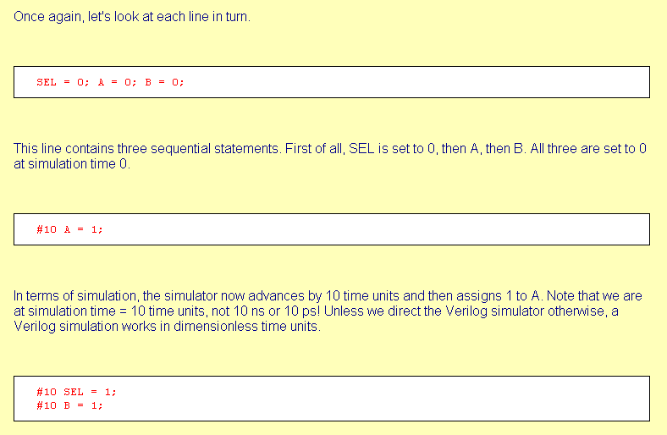

Slide 5
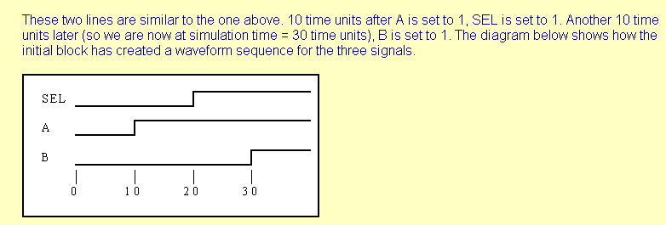

Slide 6
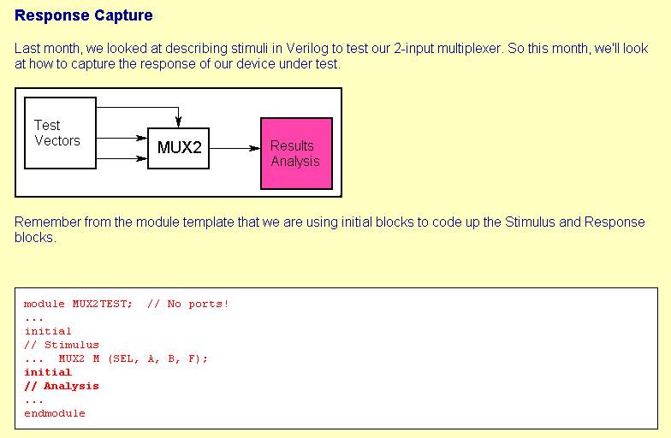

Slide 7
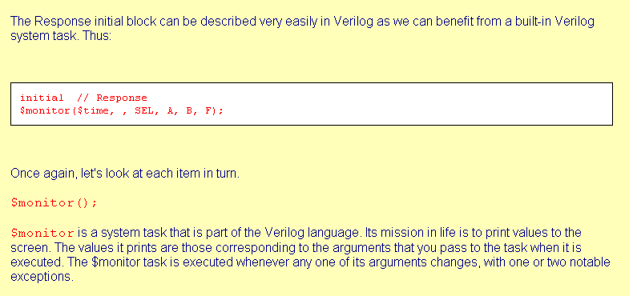

Slide 8
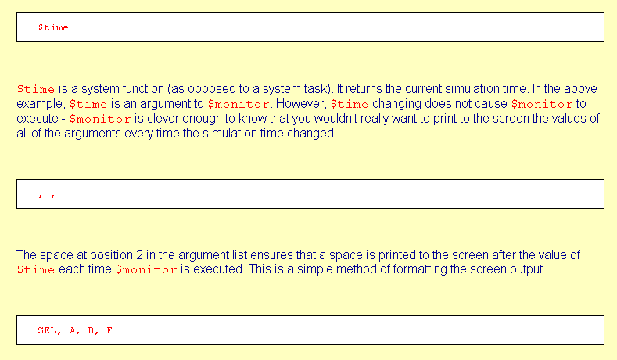

Slide 9
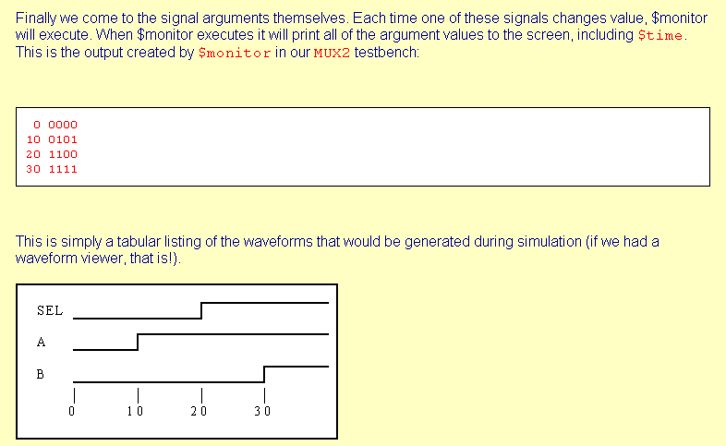

Slide 10
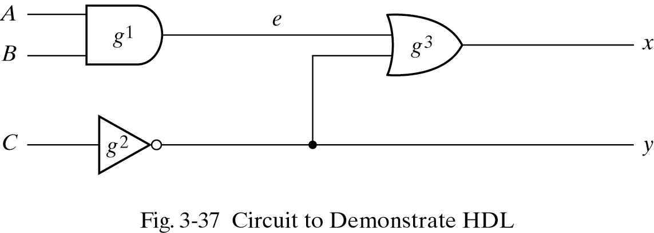
< Example 2 >
<Ref> M. Morris Mano, Digital Design, 3rd ed., Prentice Hall 2002

Slide 11
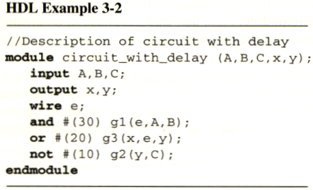
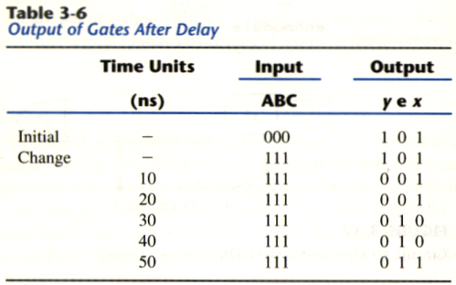

Slide 12
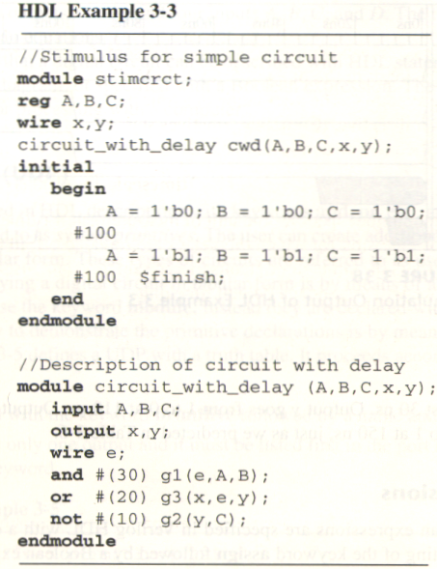
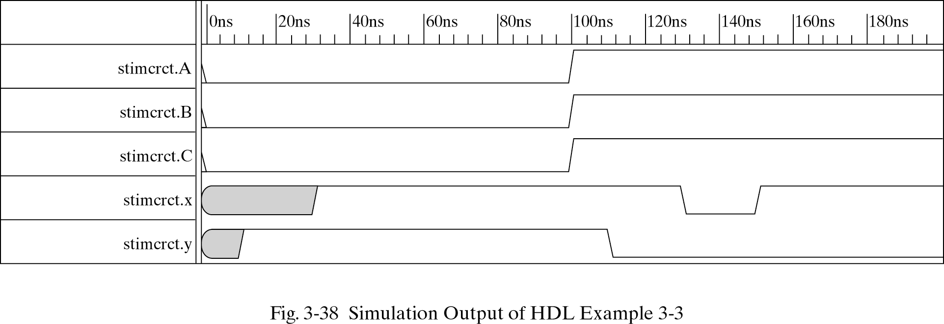

Slide 13
< Example 3 >
module stimulus;
reg[7:0] A,B;
// reg TC;
wire[15:0] PRODUCT;
//-------------------
reg CLK;
reg Reset;
reg [15:0] D_PRODUCT;
reg [7:0] IN_A [3:0];
reg [7:0] IN_B [3:0];
reg [1:0] index;
// --------------------------------
mult8x8 mult2(A,B,PRODUCT);
// -------------------------------
always #10 CLK=~CLK;
initial
begin
Reset=1'b0;
CLK=1'b0;
#25 Reset=1'b1;
end
always @(posedge Reset) begin
$readmemb("MultiIN_A.dat", IN_A);
$readmemb("MultiIN_B.dat", IN_B);
end
always @(posedge CLK) begin
if(~Reset)
begin
A<=0;
B<=0;
end
else
begin
A<=IN_A[index];
B<=IN_B[index];
end
end
always @(posedge CLK) begin
if(~Reset)
begin
index<=2'b00;
end
else
begin
index<=index+1;
end
end
always @(posedge CLK) begin
if(~Reset)
begin
D_PRODUCT<=16'b0;
end
else
begin
D_PRODUCT<=PRODUCT;
end
end
endmodule
Read input test vectors
from text files

Slide 14
MultiIN_A.dat
MultiIN_B.dat
00000010
01001110
01000000
10000001
00000001
00001111
11110000
10000100

