Slide 1
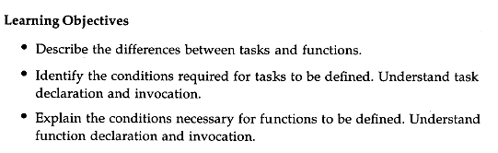
Chapter 8 Tasks & Functions

Slide 2
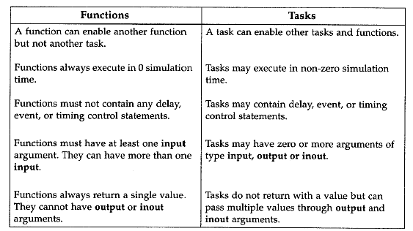

Slide 3
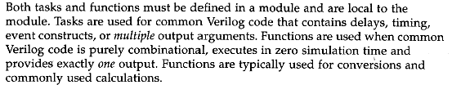

Slide 4
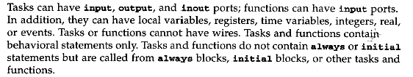

Slide 5
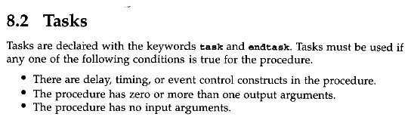


Slide 6
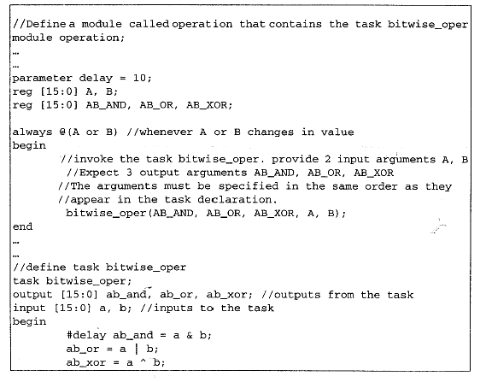

Slide 7
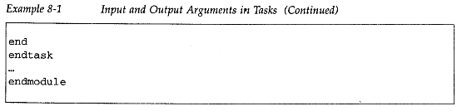

Slide 8
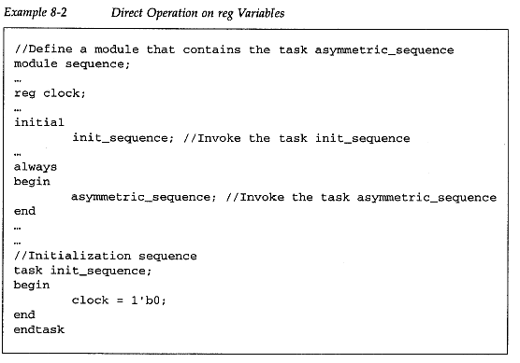

Slide 9
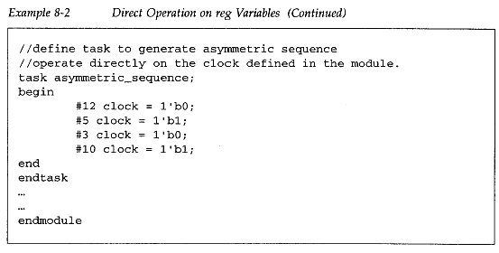

Slide 10
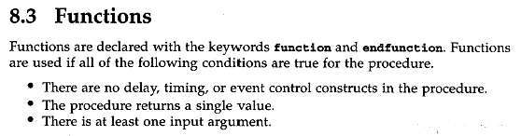

Slide 11
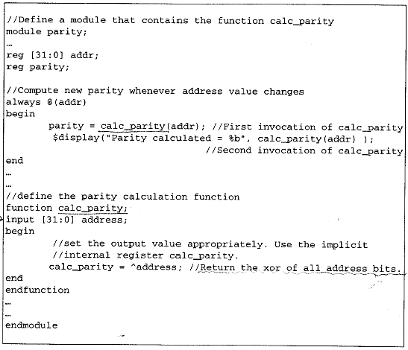

Slide 12
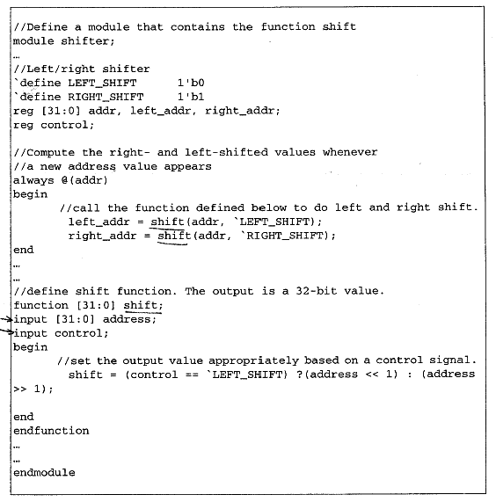

Slide 13
4-bit Adder Using Functions
module add_4_r (A, B, C_in, SUM, C_out);
input [3:0] A, B;
input C_in;
output [3:0] SUM;
output C_out;
function fulladd;
input a, b, c_in;
{c_out, sum}=a+b+c_in;
endfunction
always @(A or B or C_in)
begin
{C0, SUM[0]}=fulladd(A[0], B[0], C_in);
{C1, SUM[1]}=fulladd(A[1], B[1], C0);
{C2, SUM[2]}=fulladd(A[2], B[2], C1);
{C_out, SUM[3]}=fulladd(A[3], B[3], C2);
end
endmodule

Slide 14
4-bit Adder Using a Task
module add_4_r (A, B, C_in, SUM, C_out);
input [3:0] A, B;
input C_in;
output [3:0] SUM;
output C_out;
task fulladd;
input a, b, c_in;
output sum, c_out;
{c_out, sum}=a+b+c_in;
endtask
always @(A or B or C_in)
begin
fulladd(A[0], B[0], C_in, SUM[0], C0);
fulladd(A[1], B[1], C0 , SUM[1], C1);
fulladd(A[2], B[2], C1, SUM[2], C2);
fulladd(A[3], B[3], C2, SUM[3], C_out );
end
endmodule

