Slide 1

ANGULAR COURSE
Angular Fundamentals
VTI ACADEMY
Author: Tống Minh Giang
May 2020

Slide 2
Nội dung
Tạo mới Angular project (Angular CLI).
Kiến trúc ứng dụng với Angular: Components, Directives, NgModules, Services, etc.
Bootstrap ứng dụng Angular.
Tạo mới NgModule.
Tạo mới Angular Component.
Data-binding: Interpolation, property binding, event binding.
Component communications.

Slide 3
Yêu cầu chung
Có hiểu biết về HTML, CSS, JavaScript/TypeScript.
Phần mềm:
Nodejs
TypeScript
Angular CLI
Editor: VS Code, Atom, Sublime Text, WebStorm, Vim, etc

Slide 4
Angular CLI
npm install -g @angular/cli or npm i -g @angular/cli
ng new <app-name>
ng new my-app
ng new my-app --style=scss

Slide 5
Angular Architecture
Notes:
https://angular.io/guide/architecture

Slide 6
NgModule
NgModule
declarations
exports
imports
providers
bootstrap

Slide 7
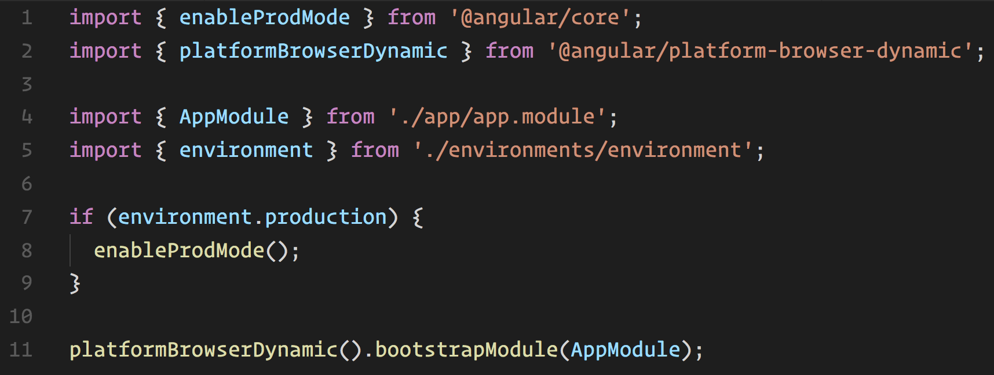
Bootstrap ứng dụng

Slide 8
Tạo mới NgModule
Manual.
CLI:
ng g module my-module
ng g m my-module

Slide 9
Tạo mới Component
Manual.
CLI:
ng g component my-new-component
ng g c my-new-component

Slide 10
Component
Component
selector
template
templateUrl
providers
styles

Slide 11
Angular Databinding
Template
Component Class
Interpolation
Property Binding
Event Binding
Two-way Binding

Slide 12
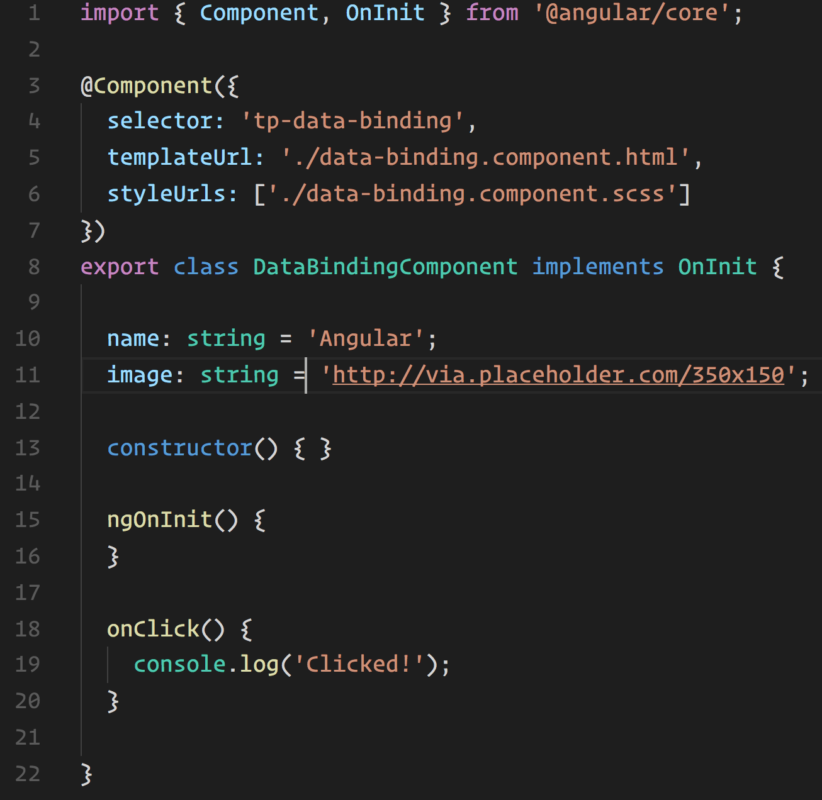
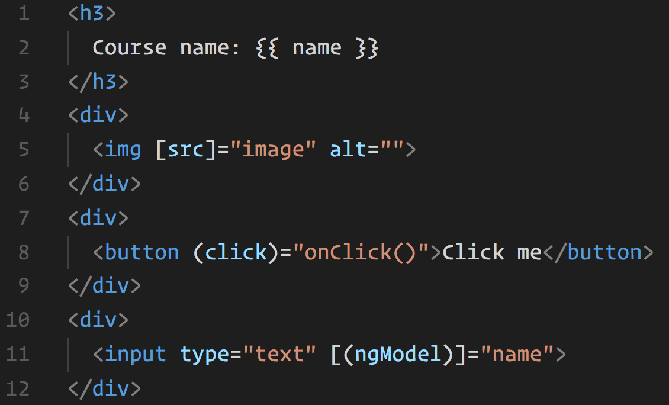
Thực hành Databinding

Slide 13
Component
Root Component
Comp A
Child A
Child A
Comp B
Child B
Component
Component or Directive

Slide 14
Component communications
Root Component
Comp A
Child A
Child A
Comp B
Child B
Component
Component or Directive
Data binding
Event

Slide 15
Component communications
Working with input, output.
Tạo alias cho input, output.
Intercept input property changes with a setter
@ViewChild()
Service, ngrx

