Slide 1
Movenet
LSTM
Not fall or Fall or Lie
Movenet
LSTM
Not fall or Fall or Lie
Khung hình
(Camera)
YOLOv8 nano
Deep SORT
Movenet
LSTM
Not fall or Fall or Lie

Slide 2
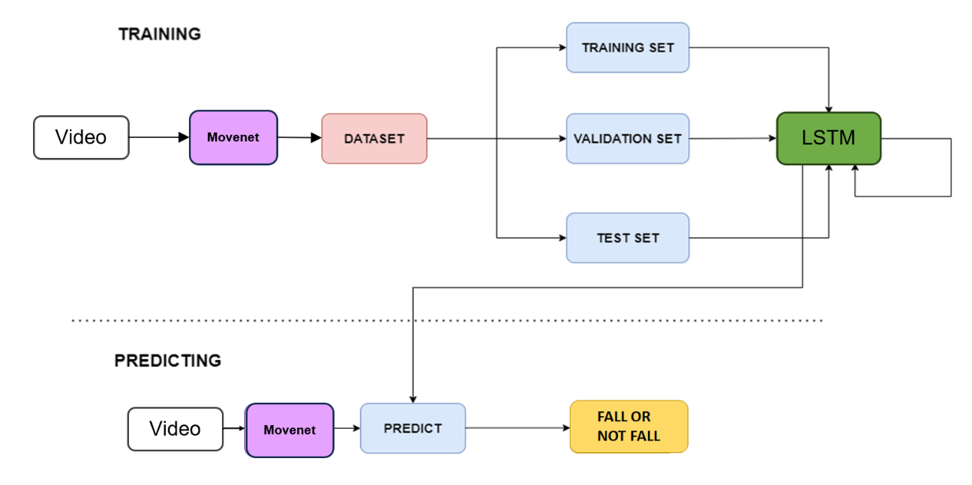
MOVENET
LSTM
MOVENET

Slide 3
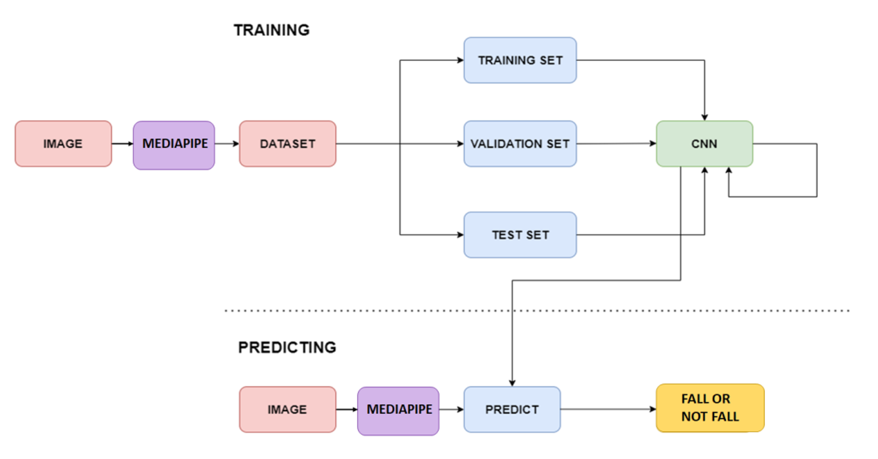
MOVENET
MOVENET

Slide 4
North-west
North
North-east
West
East
South-west
South
South-east

