Slide 1

02
Software requirements
Use-case model and Functional – NonFunctional Requirements
Introduction to Software Engineering - 20CLC07
Foodaholic – Group 01

Slide 2
Use-case model
Use-case model of Foodaholic website
Introduction to Software Engineering - 20CLC07
Foodaholic – Group 01

Slide 3
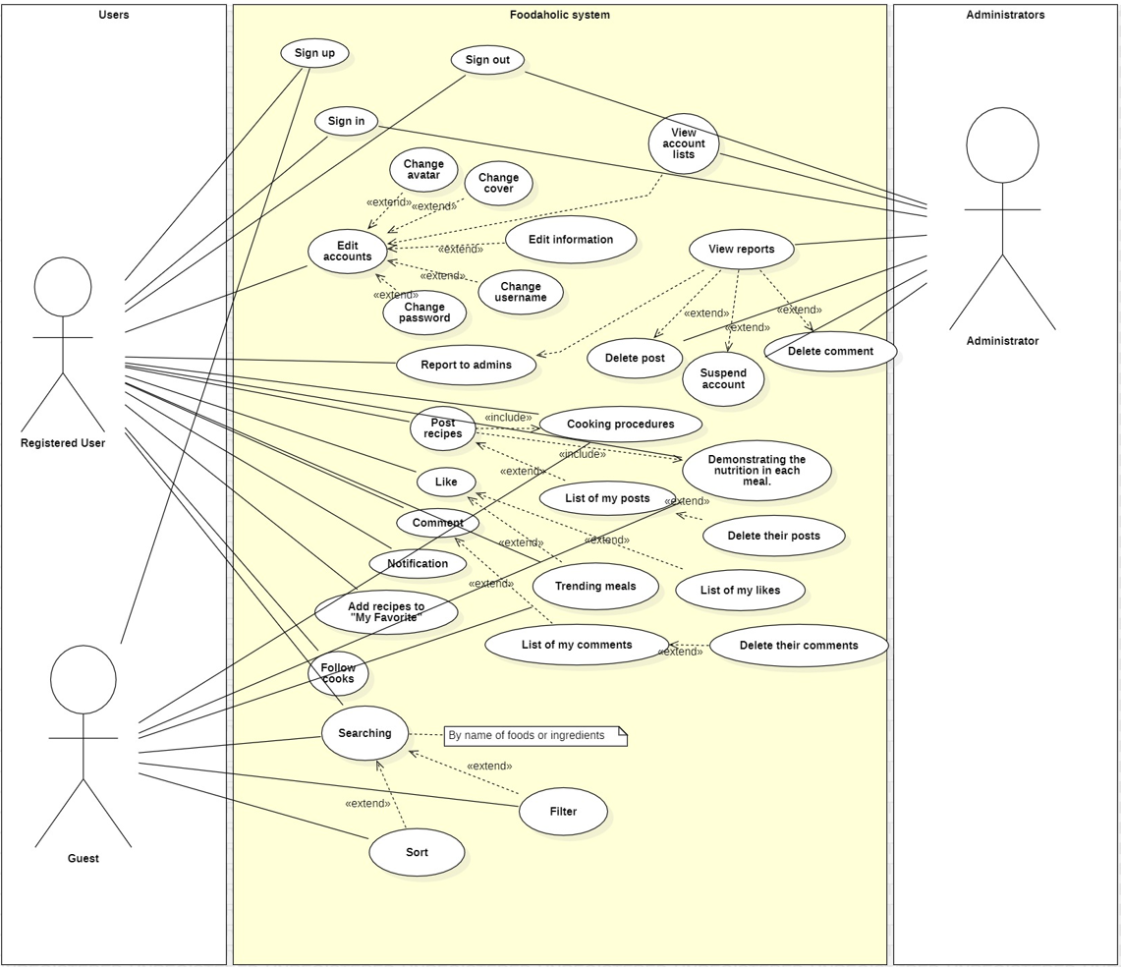
Use-case model
Model elements:
Three actors:
Guest (Un-registered user)
Registered user (Main user of the website)
Admin (User management)
Many use-cases, include:
The features will be developed in the future
The features have been completed
(will be mentioned in the functional requirements)
Introduction to Software Engineering - 20CLC07
Foodaholic – Group 01

Slide 4
Functional Requirements
List of the functionalities that my team have already achieved
Introduction to Software Engineering - 20CLC07
Foodaholic – Group 01

Slide 5
User side:
Functional Requirements
1. Log in
2. Sign up
3. Log in as Guest
4. Post recipes
5. Search recipes
6. Sort search result
7. View derail post
8. List user’s recipes
9. Change information
10. Delete post
11. Report post
12. Report account
13. Comment
14. User's favorite recipes list
15. Give emoji below post
Admin side:
1. View reported posts list
2. View reported accounts list
3. Delete post
4. Suspend account
Introduction to Software Engineering - 20CLC07
Foodaholic – Group 01

Slide 6
Non-Functional Requirements
Specifies criteria that can be used to judge the operation of Foodaholic’s system
Introduction to Software Engineering - 20CLC07
Foodaholic – Group 01

Slide 7
Non-Functional Requirements
1. Compatibility:
The system must be compatible with many different versions of operating systems and browsers
2. Usability:
The web shall be easy-to-use and shall be appropriate for all people.
3. Availability:
System must allows customers to access services 24 hours a day with minimum downtime period for backup and maintenance.
4. Capacity:
The Web must have a large capacity to hold user data, web data, image, …
5. Security:
Encrypt password, user data to protect user account
Introduction to Software Engineering - 20CLC07
Foodaholic – Group 01

