Slide 1
Problem statement
Problem | People don’t know how to cook Lack of quality cooking-sharing websites
Affects | Quality of meal People’s health
Impact | No control over about energy/calories
Solution | Providing a place: Share delectable meals Know the total calories of each meal

Slide 2
Product position statement
For | Everyone in Vietnam
Who | want to: - Learning cooking - Sharing recipes
Product name | Foodaholic
Users can | Shares recipes and foods, see each nutrient in the diet, total calories
Special | A list of nutrients and energy consumption
Our product | Website product in PC

Slide 3
User Summary
Administrators | Manage users and posts
Registered Users | See the recipes Post a recipe Interact in a recipe
Guests | See the recipes

Slide 4
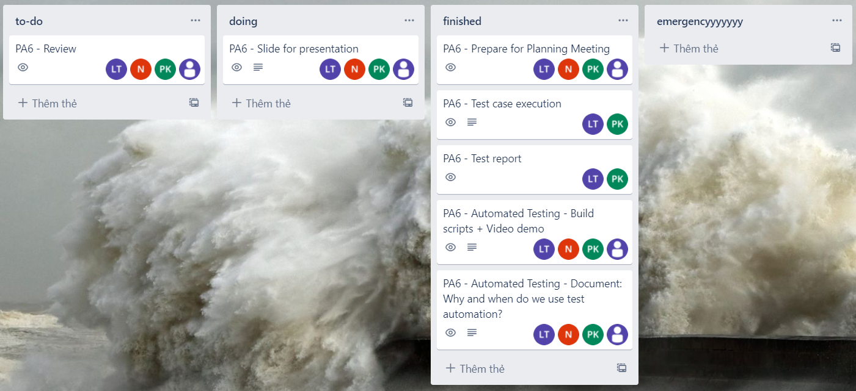
Trello (Doing)

Slide 5
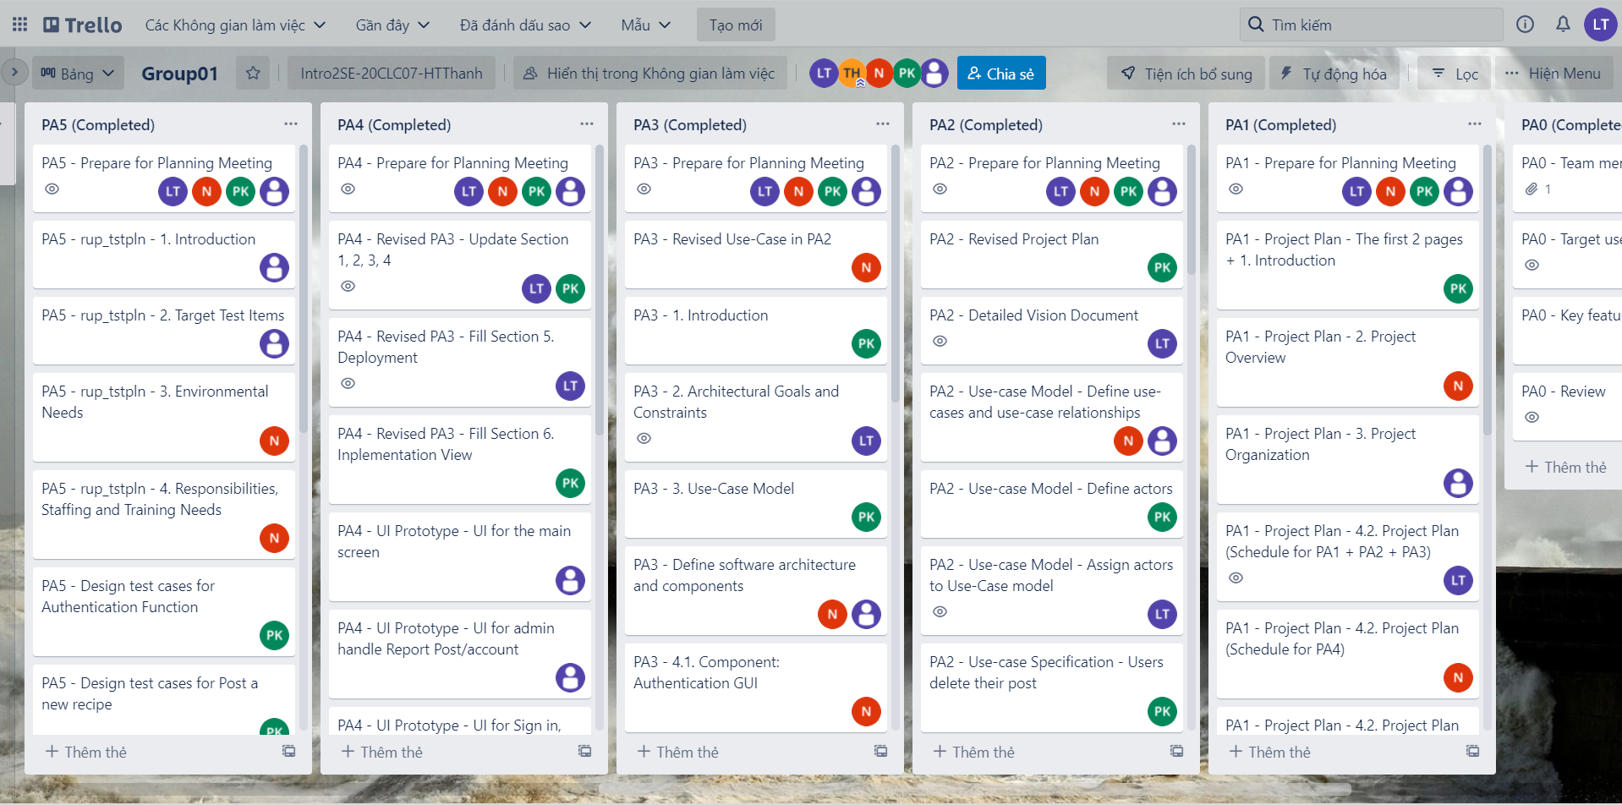
Trello (Done)

Slide 6
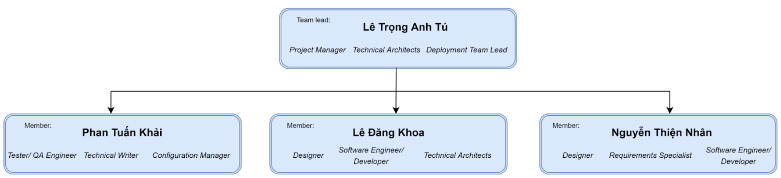
Team structure

Slide 7
Responsibilities
Name | Responsibilities
Lê Trọng Anh Tú | Set deadline for each tasks Manage the overall project discipline
Nguyễn Thiện Nhân | Implement software program Capture the specification in Use-case
Phan Tuấn Khải | Manage testing operation Write and review all documents
Lê Đăng Khoa | Design UI for our software Implement software program

