Slide 1
Sequence to Action dataset

Slide 2
1. Introduction
Ideal dataset = Natural Instructions executed by people using the UI
E.g: Natural Instruction = “Let’s turn off the WiFi”
=> Multiple annotation UIs to show how to do this instruction
But ideal dataset requires significant investment
Create new 3 datasets
PIXELHELP: full task evaluation
ANDROIDHOWTO: training model + action phrase extraction
RICOSCA: training model + grounding

Slide 3
PIXELHELP dataset
Link: https://support.google.com/pixelphone
187 multi-step instructions for 4 task categories, annotated by human
+ 88 general task
+ 38 Gmail task
+ 31 Chrome task
+ 30 Photo related task
User input & Physical button are discarded

Slide 4
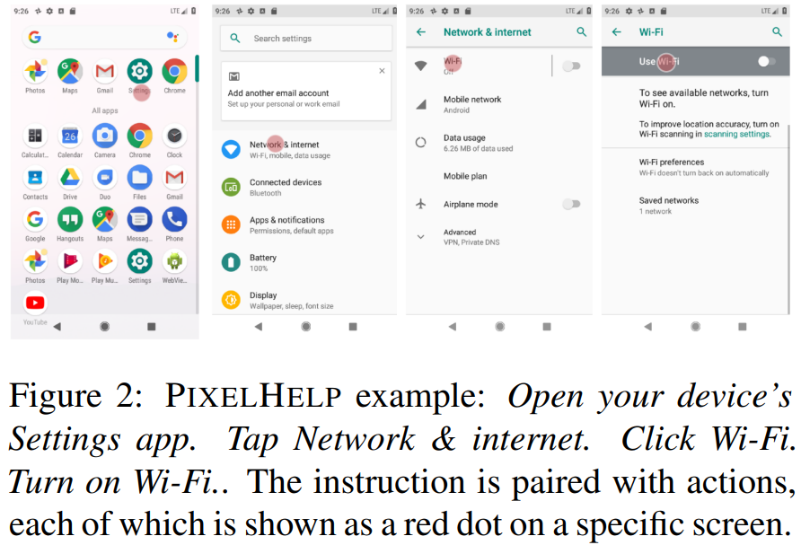

Slide 5
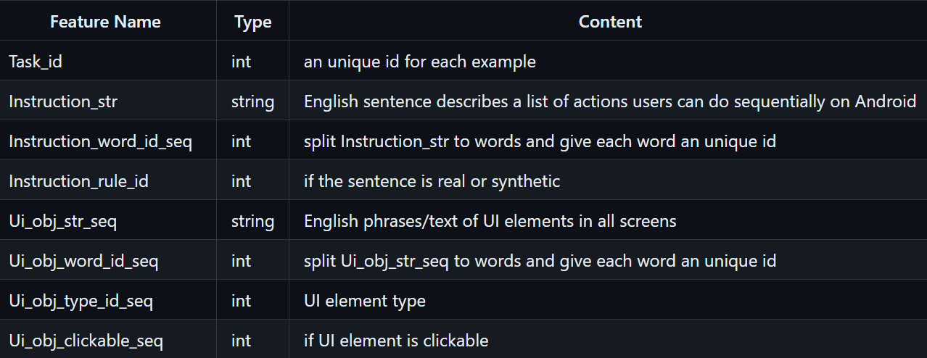





Slide 6
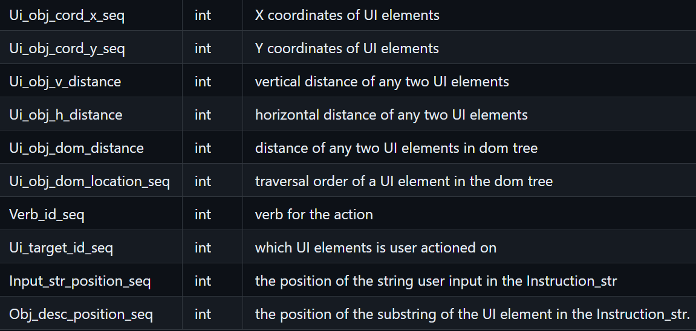









Slide 7
ANDROIDHOWTO dataset
Use English in Android devices
Given a “how-to question” => Access multiple webpages => Find candidate instructions for this question
Extract instruction text data

Slide 8
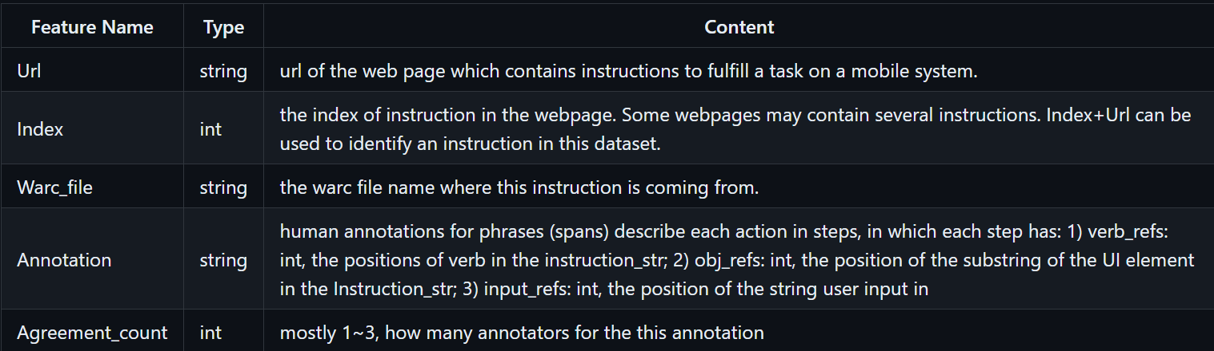
- Each line contains annotation of one task

Slide 9
RICOSCA dataset
Pair “action tuples along screens” with “action description” dataset
=> Difficult to collect this dataset
=> RICOSCA dataset

Slide 10
72K Android UI screens from 9.7K Android apps
Each screen = screenshot image + collection of UI objects
Each object = name (English phrase such as “Send”) + type (Button, Image, Checkbox) + bounding box position
For each screen, random UI element as target object, synthesize commands for operating them
Generate multiple commands to capture different expressions (Tap = tap, click, press)
- 295,476 single-step command -> operating 177,962 target objects -> 25,677 Android screen
ivelin/ui_refexp_saved · Datasets at Hugging Face

