Slide 1
Enabling conversational interaction on mobile with LLMs Bryan Wang, Student Researcher, and Yang Li, Research Scientist, Google Research
Enabling conversational interaction on mobile with LLMs – Google Research Blog (googleblog.com)

Slide 2
Interacting with mobile devices by natural language input
The model need to understand GUI to answer questions related to specific information displayed on the screen
Prior research => enable Conversational Interaction => require considerable effort in curating large-scale datasets and training models
With Large Language Model (LLM) => present a set of prompting techniques => save time and resources before investing in dedicated datasets and models
In this paper
Contributing algorithm that generates the text representation (HTML) of mobile UIs
Achieving high performance using only 2 data examples per task

Slide 3
Prompting LLMs with UIs
LLMs support in-context few-shot learning via prompting
Prompt with a few (input, output) data exemplars
LLM can only take text input
Paper contributes an algorithm that generates the text representation of mobile UIs using DFS traversal (Android UI => HTML syntax)
Chain of thought prompting: generate intermediate results and chain them together to arrive at the final output

Slide 4
Experiments
Conduct comprehensive experiments with four pivotal modeling tasks
(1). Screen question-generation
(2). Screen summarization
(3). Screen question-answering
(4). Mapping instruction to UI action

Slide 5
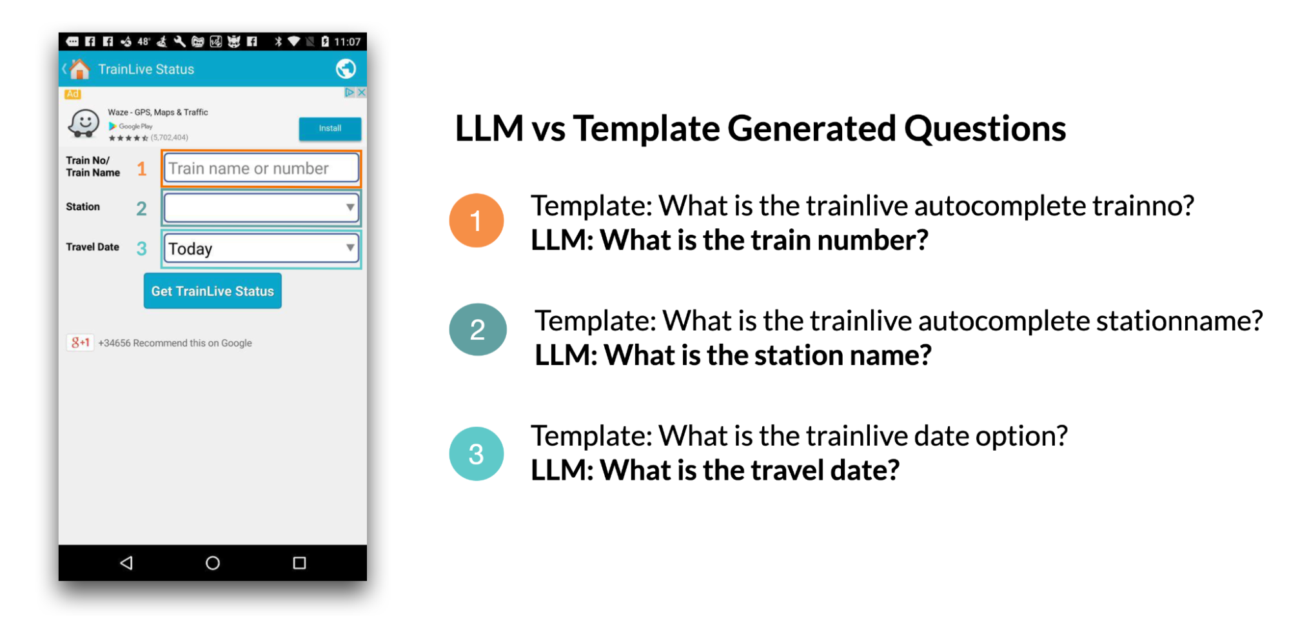
Task 1: Screen question generation
Given a mobile UI screen => synthesize coherent, grammatically correct natural language questions relevant to the UI elements requiring user input

Slide 6
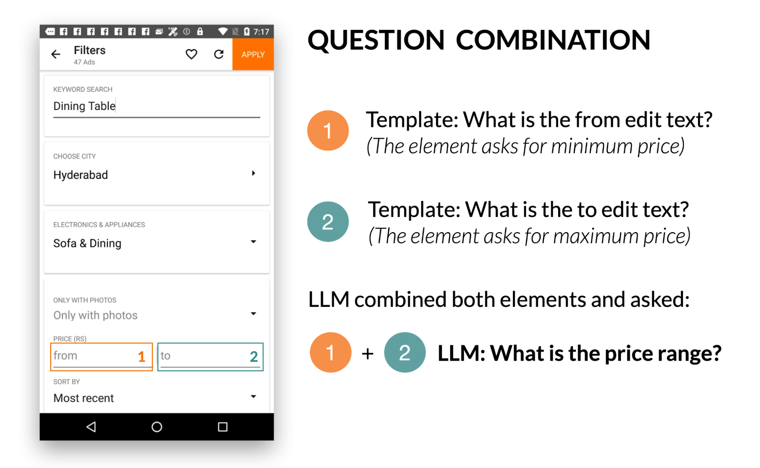
LLM could use its prior knowledge to combine multiple related input fields to ask a single question

Slide 7
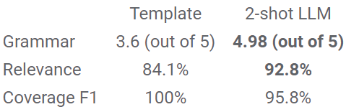
Evaluate “Screen question generation” task based on human rating

Slide 8
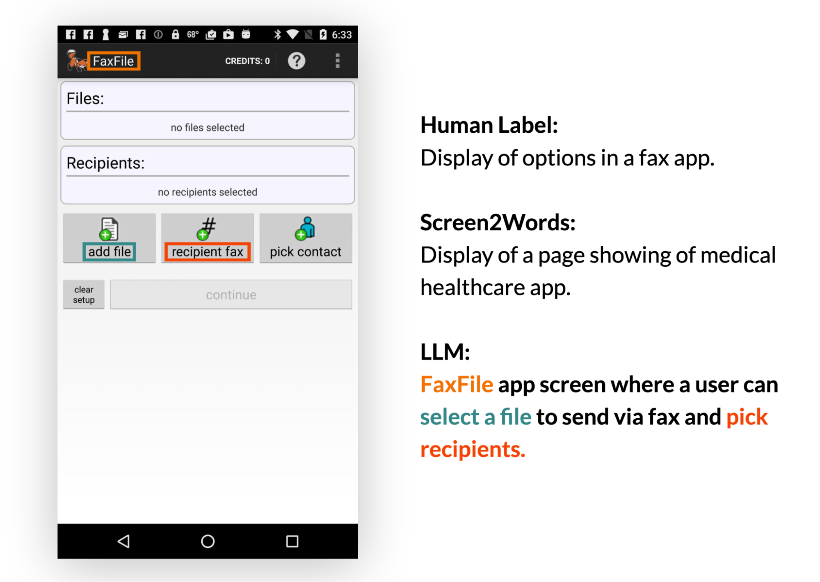
Task 2: Screen summarization
- This is the automatic generation of descriptive language overviews
- Help users quickly understand the purpose of a mobile UI
Example summary generated by 2-shot LLM. LLM is able to use specific text on the screen to compose more accurate summaries

Slide 9
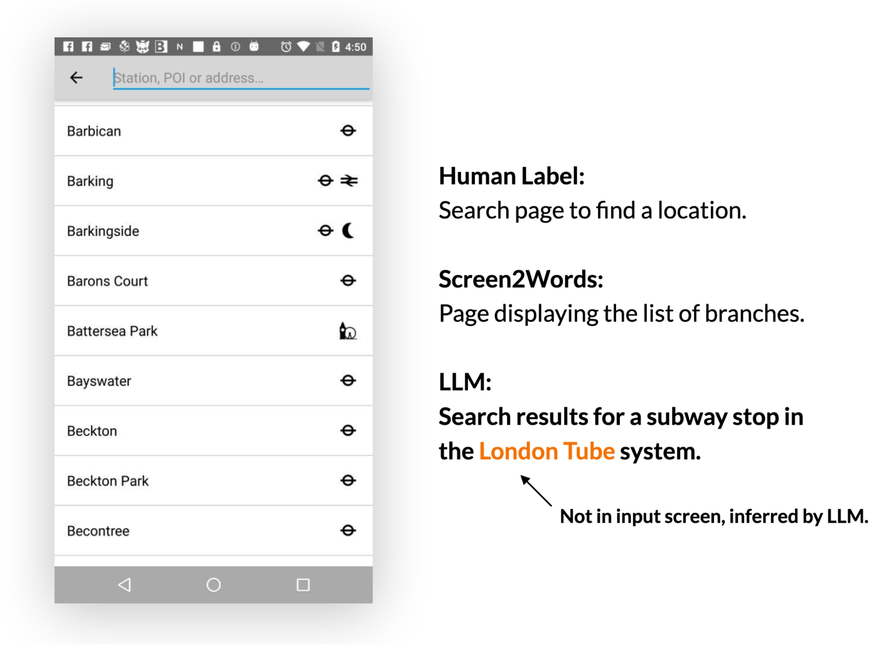
LLMs can use their prior knowledge to deduce information not presented in the UI when creating summaries

Slide 10
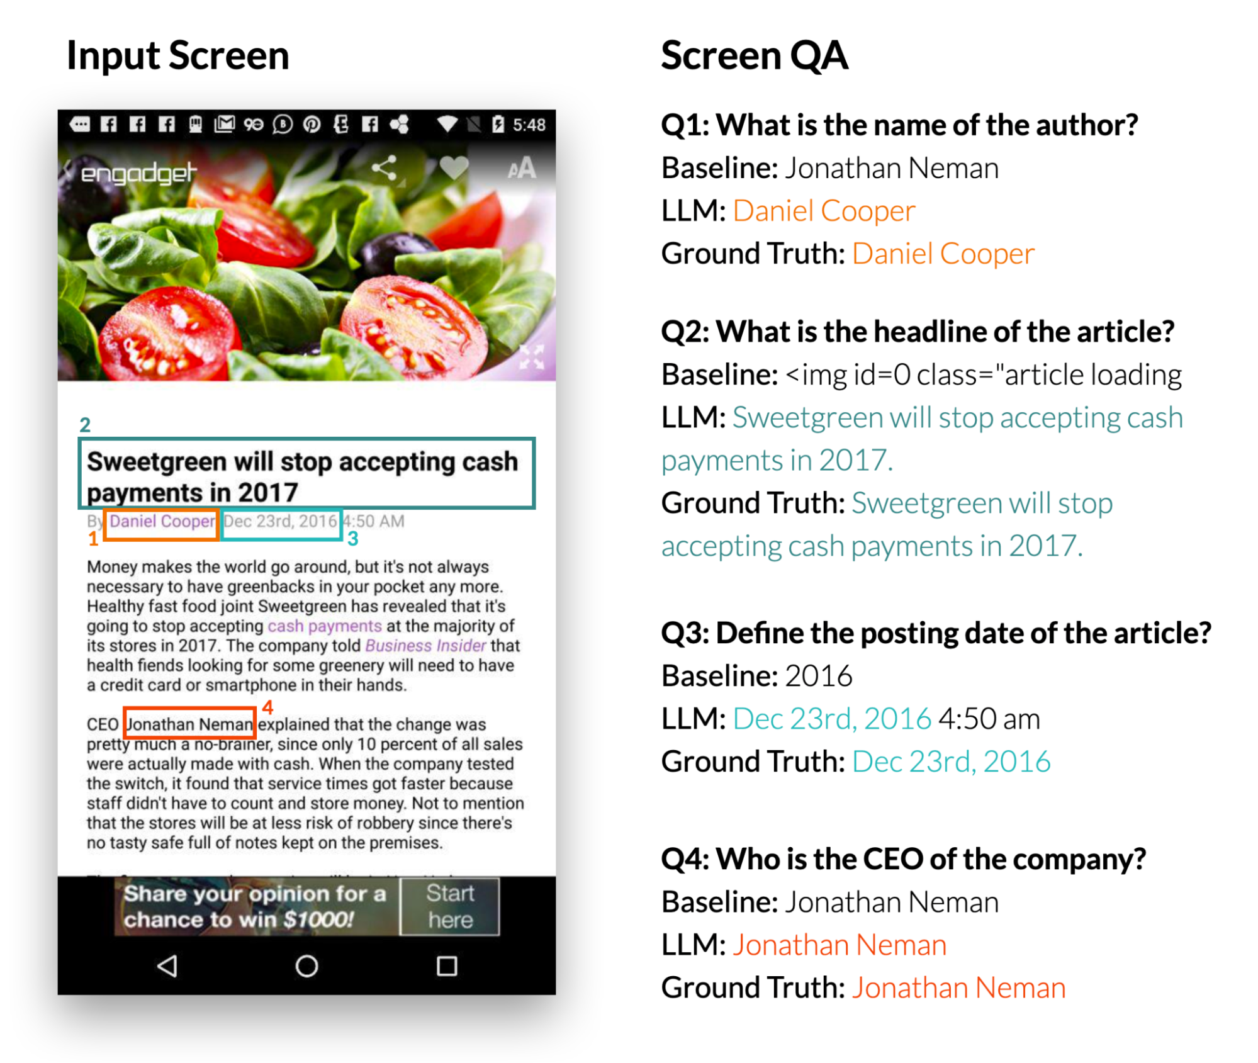
Task 3: Screen question-answering
- Given a mobile UI and an open-ended question asking for information regarding the UI, the model should provide the correct answer
- Focusing on factual questions

Slide 11
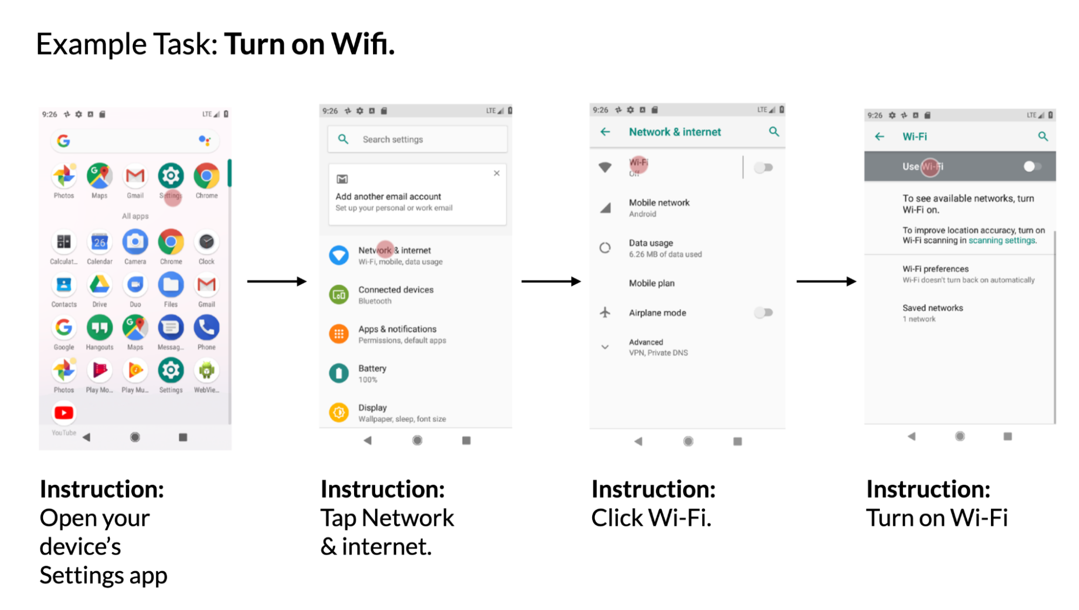
Task 4: Mapping Instruction to UI Action
Given a mobile UI screen and natural language instruction to control the UI => predict the ID of the object to perform the instructed action

