Slide 1
Introduction to Android Studio
The official IDE for Google's Android operating system
Designed specifically for Android development
Link: Download Android Studio & App Tools - Android Developers

Slide 2

Create new project in Android Studio
Open Android Studio
File New New Project
Choose `Empty Activity`
We only focus on `activity_main.xml`

Slide 3
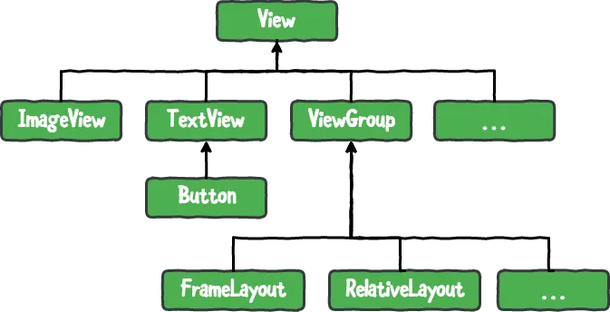
UI in Android app
Provide XML syntax for UI screen

Slide 4
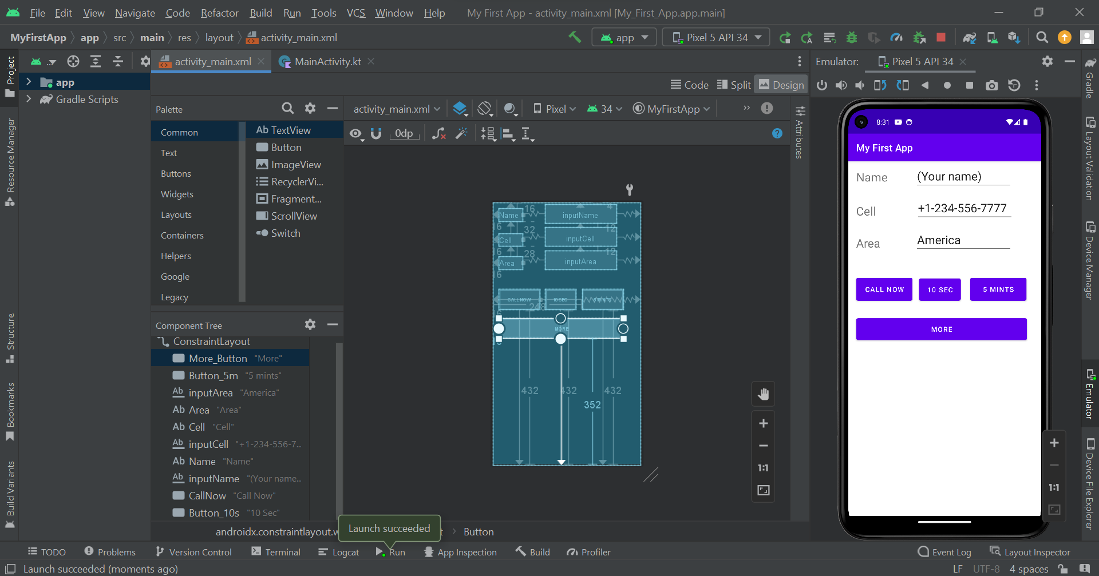
Notes:
Show code for more detailed about Component Tree

