Slide 1
KAIST SoC Summer Internship
Final Presentation
FunnyGPT - Mobile UI Screen Summarization
Cyber-Physical System Lab
Student: Le Trong Anh Tu
Mentor: Prof. Insik Shin & Sunjae Lee

Slide 2
About my work
Working individually
Dividing into 2 main phases
+ Phase 1: Explore FluidGPT, about dataset for testing, and how they interact with mobile using LLMs
+ Phase 2: Create FunnyGPT for summarizing Mobile UI Screen
+ Presentation phase: Review what I have done in this internship

Slide 3
Schedule
Beginning of the internship: Build FluidGPT as mobile application (example, in the web version, https://www.adept.ai/blog/act-1)
Up to the end of Phase 1
=> New goal: Build FunnyGPT for mobile UI screen summarization task

Slide 4
Phase 1: FluidGPT
Tutorial for using OpenAI API + Prompt engineering with GPT
+ Using Python as programming language
+ Understand how to use OpenAI API and how to prompt efficiently
+ The general way to use OpenAI API (https://github.com/openai/openai-cookbook/blob/main/examples/How_to_format_inputs_to_ChatGPT_models.ipynb)
Notes:
Week 1: 1. https://platform.openai.com/docs/quickstart/start-with-an-instruction 2. https://learn.deeplearning.ai/chatgpt-prompt-eng/lesson/1/introduction

Slide 5
Phase 1: FluidGPT (cont.)
Read paper https://ai.googleblog.com/2023/05/enabling-conversational-interaction-on.html
+ Understand GUI using LLMs
+ Android UI => XML/HTML syntax (LLMs only accepts text)
+ Achieve high performance using only 2 data examples per task
+ 4 main tasks: Screen question-generation, Screen summarization, Screen question-answering, Mapping instruction to UI Action

Slide 6
Phase 1: FluidGPT (cont.)
Learn about sequence to action (seq2act) dataset for testing our model
+ Include 3 datasets for training and testing
+ Evaluation => PIXELHELP dataset
* Contains data using only string (the name of UI elements) and integer (detect UI element in 1 screen) => Need to transform into XML syntax
Notes:
1. https://github.com/google-research-datasets/seq2act

Slide 7
Phase 1 => Phase 2
Create a schedule for FunnyGPT - Mobile UI Screen Summarization
+ One task from the paper I have read
+ Send this schedule to mentor through Slack

Slide 8
Phase 2: FunnyGPT
Explore what XML is and create some simple screen through Android Studio
+ Android Studio is the IDE for Android development
+ Know how to create a project in Android Studio
+ Represent a mobile UI screen by XML syntax

Slide 9
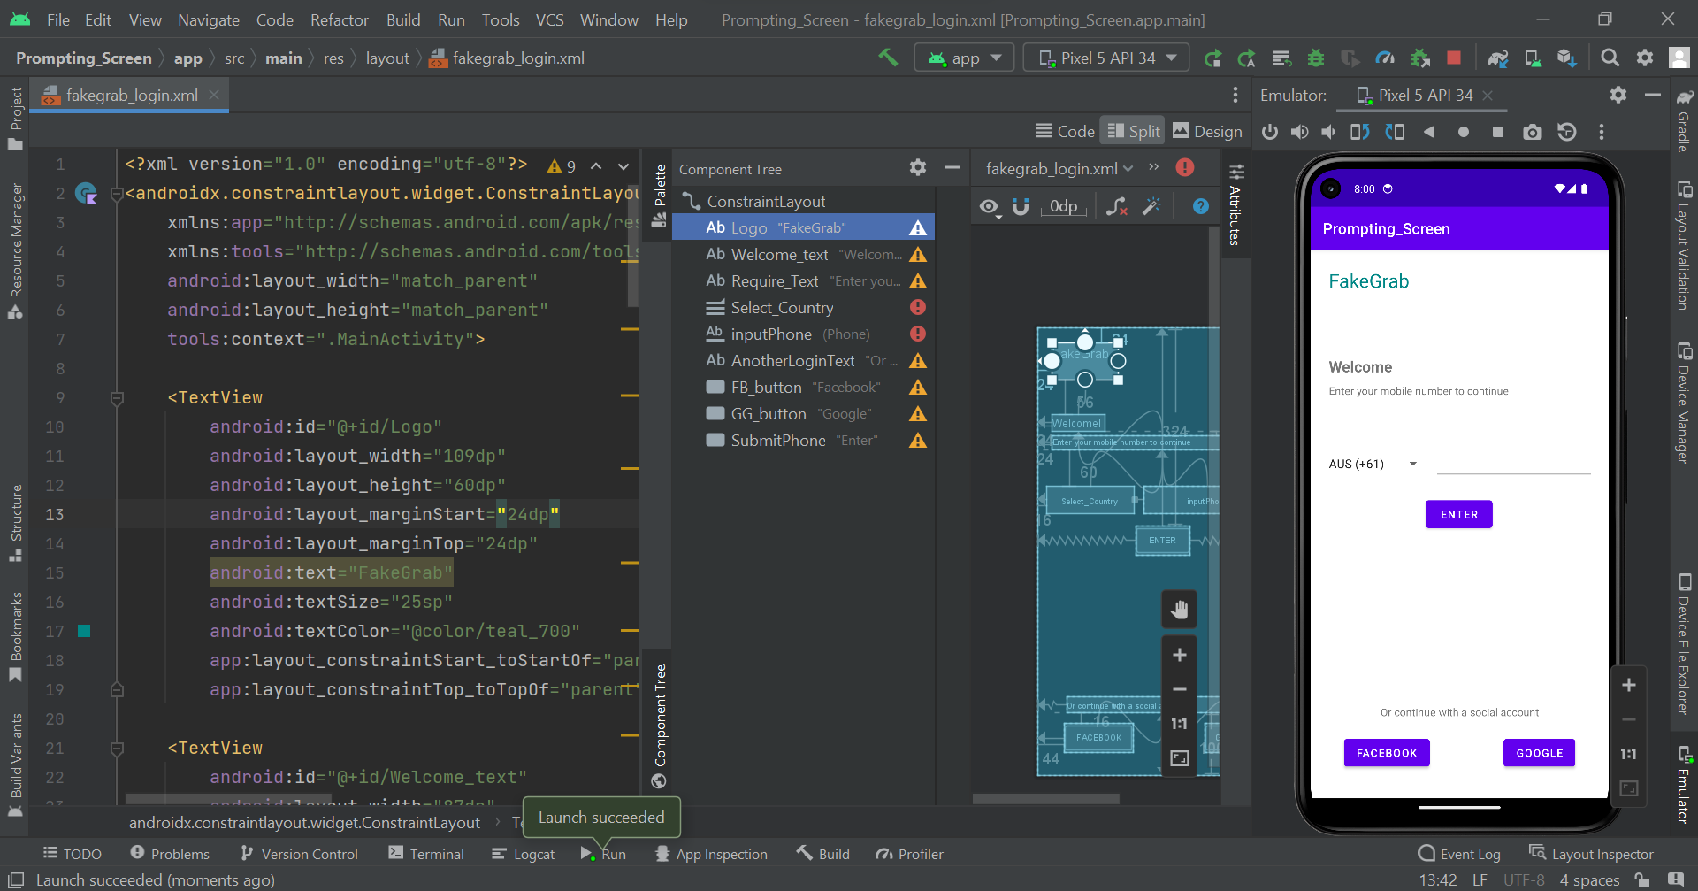

Slide 10
Phase 2: FunnyGPT (cont.)
Create an application like ChatGPT on mobile
+ Receive a question from user through EditText box
+ Display this question on screen and clear it in EditText box
+ Set up OpenAI API key, OpenAI API URL, and HTTP Connection for requesting to and responding from API
+ Send a question to API
+ Receive an answer from API and display it on screen

Slide 11
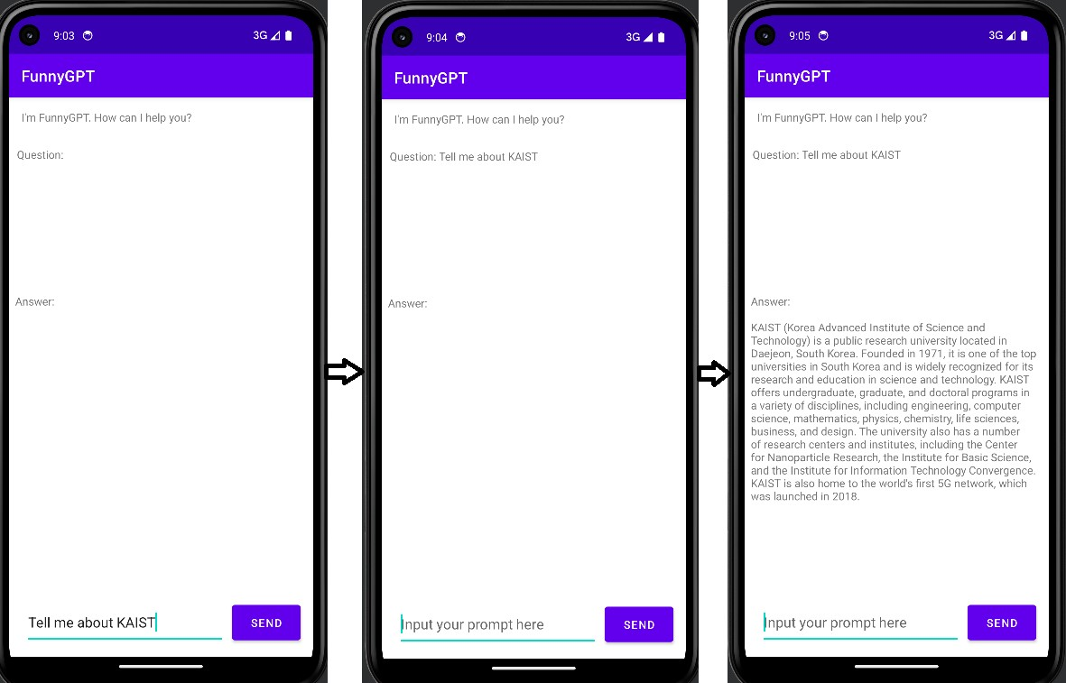

Slide 12
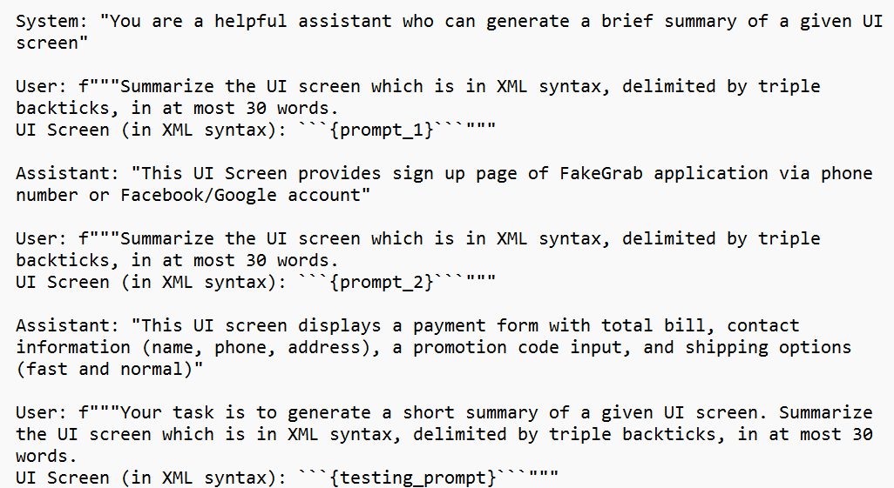
Phase 2: FunnyGPT (cont.)
- Create 2 UI screens in XML syntax and their output for prompting FunnyGPT

Slide 13
Phase 2: FunnyGPT (cont.)
- Build completely FunnyGPT for mobile UI screen summarization
+ Only accept text input => XML syntax
+ One link of XML screen for testing: https://github.com/dytlabs/Taxi-App-Android-XML/tree/master/app/src/main/res/layout

Slide 14
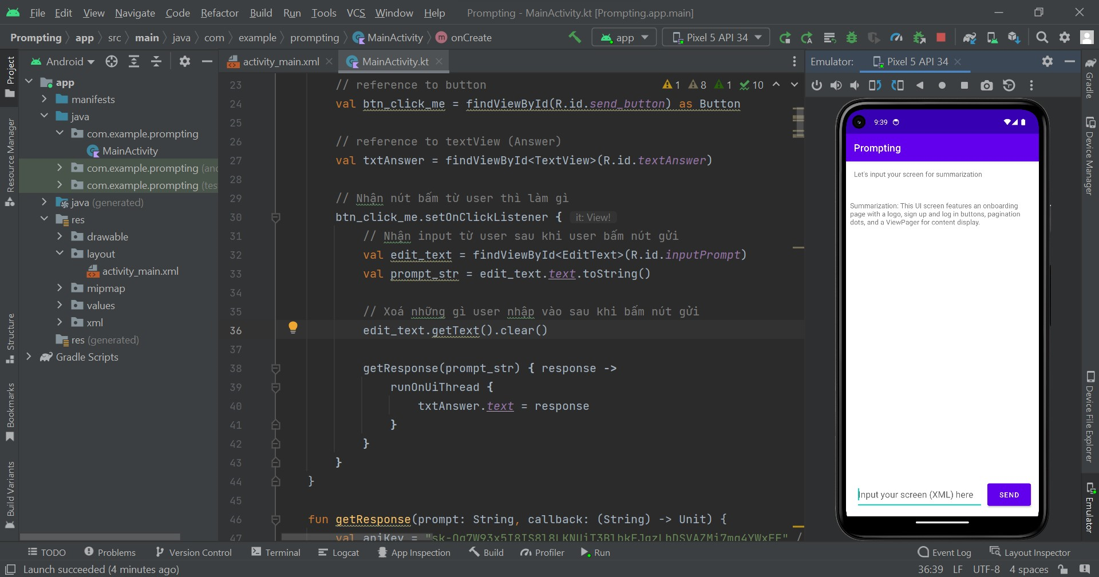

Slide 15
Future Work
- Protect API key
Users don’t know XML => UI screen as input => How to transform into XML/HTML syntax => Computer Vision
+ Or, write code, UI screen dataset in Github => XML syntax

