Slide 1
Thong LT autosar
Autosar

Slide 2
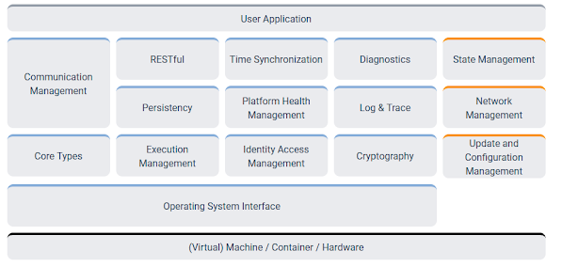
Thong LT autosar
Adaptive Platform
https://www.autosar.org/standards/adaptive-platform/

Slide 3
Thong LT autosar
Basic software

Slide 4
Thong LT autosar
Diagnostic over Internet Protocol (DoIP)

