Slide 1
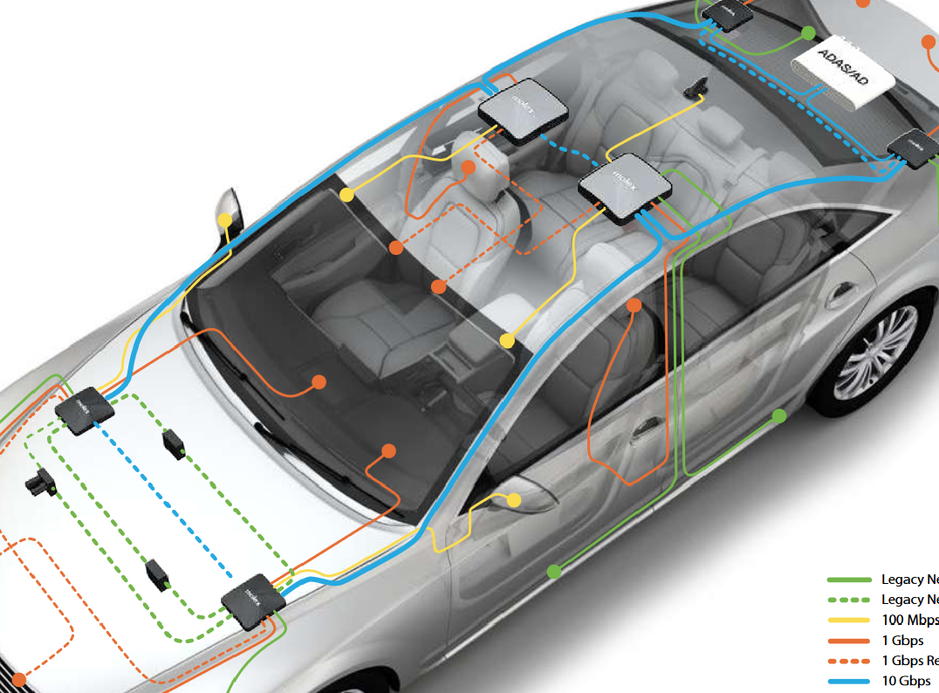
Thong LT autosar
Autosar

Slide 2
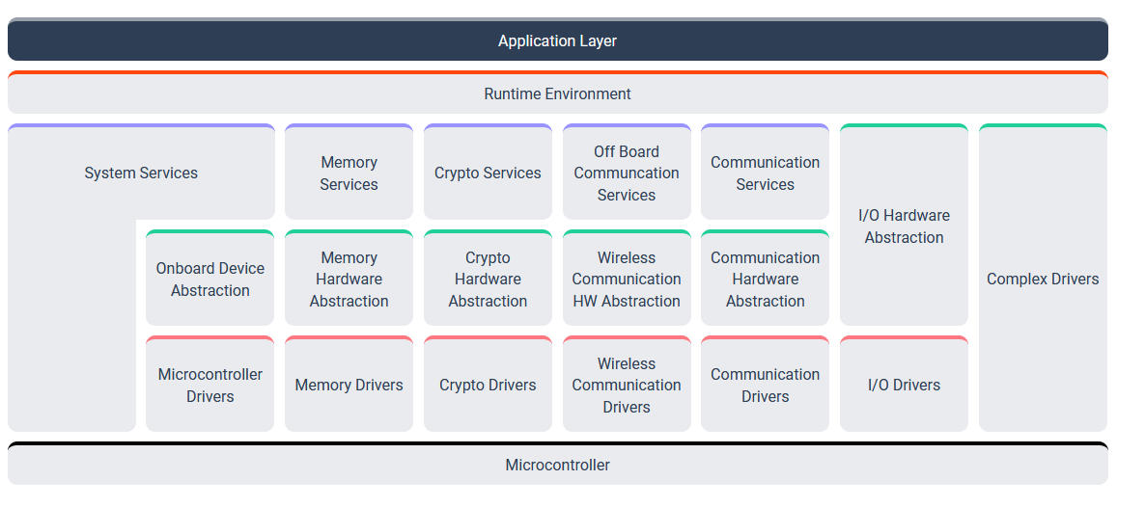
Thong LT autosar
1. Classic Platform
https://www.autosar.org/standards/classic-platform/

Slide 3
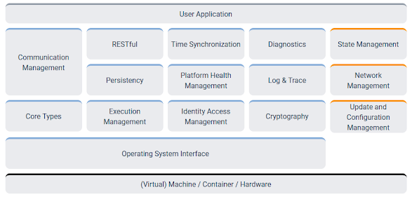
Thong LT autosar
2. Adaptive Platform
https://www.autosar.org/standards/adaptive-platform/

Slide 4
Thong LT autosar
3. Basic software

Slide 5
Thong LT autosar
5. Diagnostic over Internet Protocol (DoIP)
https://www.autosar.org/fileadmin/user_upload/standards/classic/4-3/AUTOSAR_SWS_DiagnosticOverIP.pdf

Slide 6
Thong LT autosar
6. Advanced driver-assistance system (ADAS)

Slide 7
Thong LT autosar
7. CAN protocol

