Slide 1
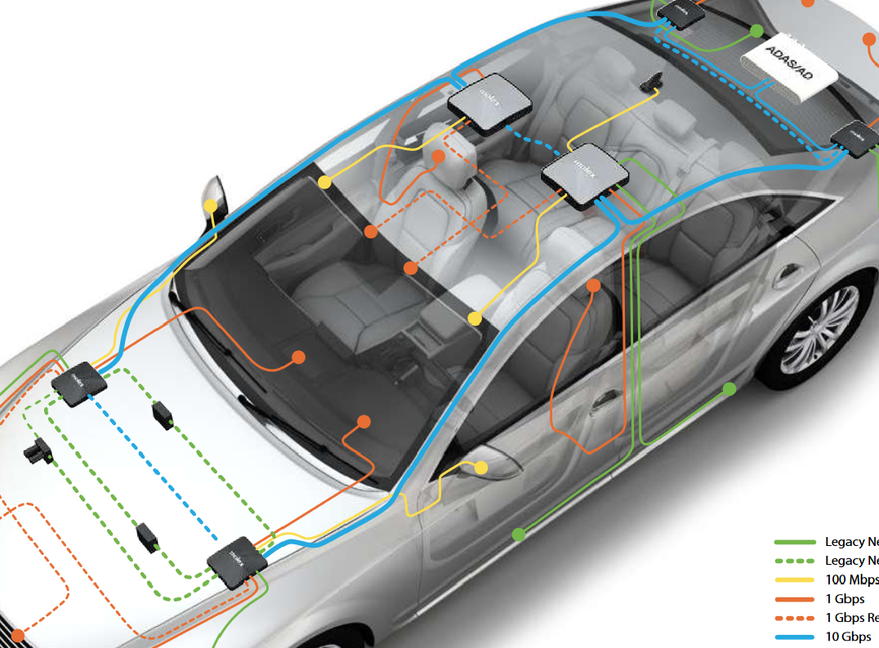
Thong LT autosar
Overview

Slide 2
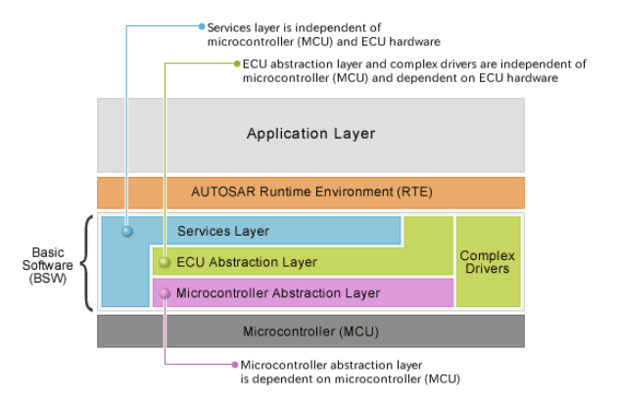
Thong LT autosar
Overview
https://www.renesas.com/us/en/application/automotive/common-automotive-technologies/autosar/autosar-layered-architecture

Slide 3
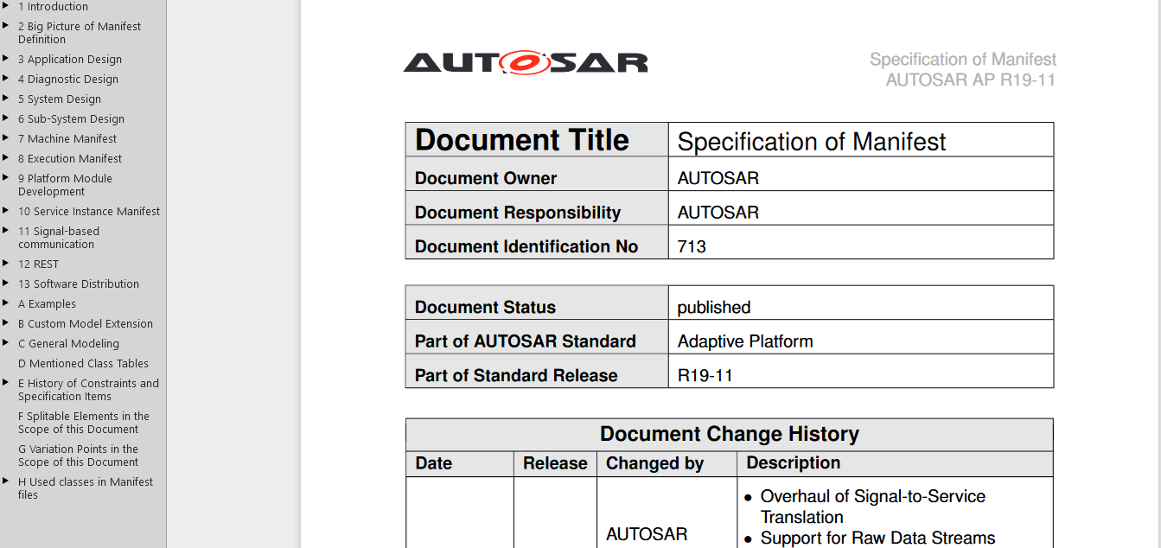
Thong LT autosar
Overview
AUTOSAR_TPS_ManifestSpecification https://www.autosar.org/fileadmin/user_upload/standards/adaptive/19-11/AUTOSAR_TPS_ManifestSpecification.pdf

Slide 4
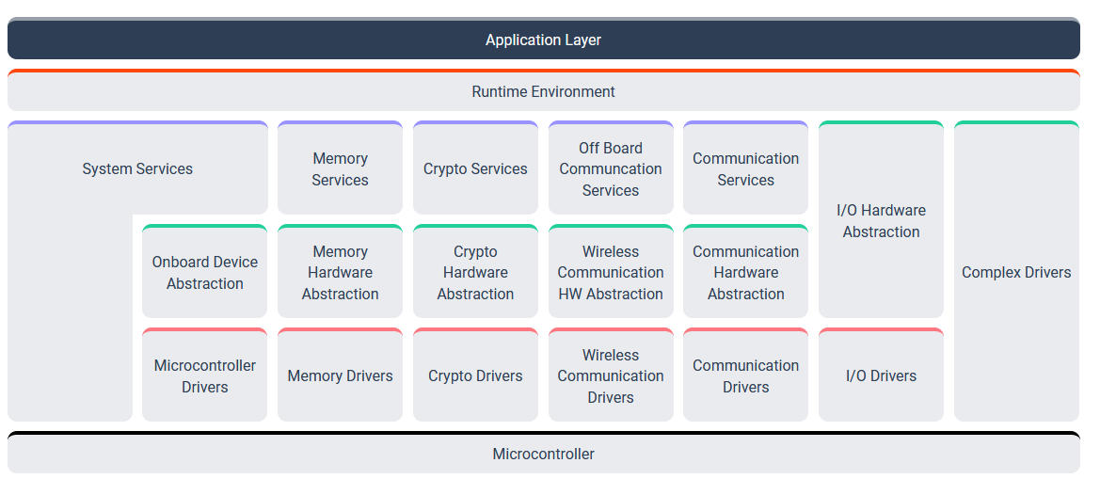
Thong LT autosar
1. Classic Platform
https://www.autosar.org/standards/classic-platform/

Slide 5
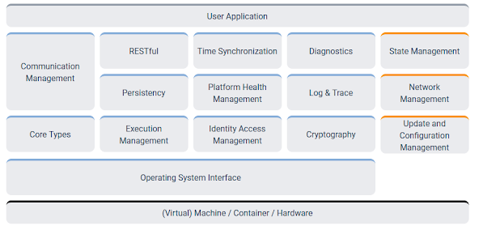
Thong LT autosar
2. Adaptive Platform
https://www.autosar.org/standards/adaptive-platform/

Slide 6
Thong LT autosar
3. Basic software

Slide 7
Thong LT autosar
3. Basic software
AUTOSAR XML files
https://www.ibm.com/docs/en/rhapsody/9.0.1?topic=modeling-importing-exporting-autosar-xml-files

Slide 8
Thong LT autosar
5. Diagnostic over Internet Protocol (DoIP)
https://www.autosar.org/fileadmin/user_upload/standards/classic/4-3/AUTOSAR_SWS_DiagnosticEventManager.pdf https://distek.com/2019/06/28/autosar-2/ https://www.embeddedtutor.com/2019/09/autosar-dem-module.html
https://www.embeddedtutor.com/2019/09/autosar-dem-module.html
https://www.autosar.org/fileadmin/user_upload/standards/classic/4-3/AUTOSAR_SWS_DiagnosticOverIP.pdf

Slide 9
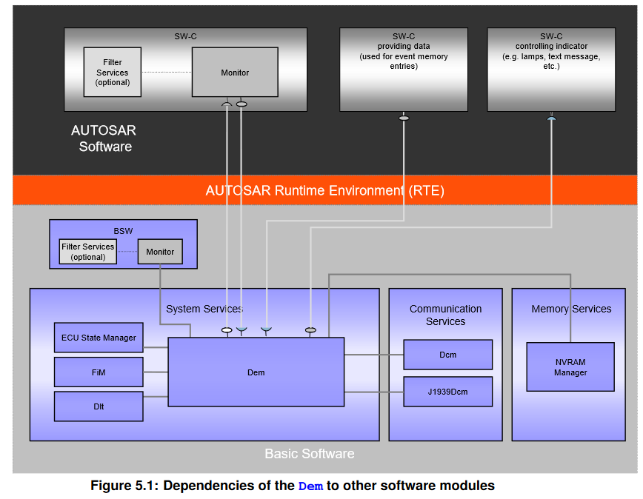
Thong LT autosar
5. Diagnostic over Internet Protocol (DoIP)
-The AUTOSAR basic software (BSW)
- Diagnostic event manager (DEM)
- Diagnostic communication manager (DCM)
- Function inhibition manager (FIM)
- Software components (SWCs)
- Diagnostic trouble codes(DTC)

Slide 10
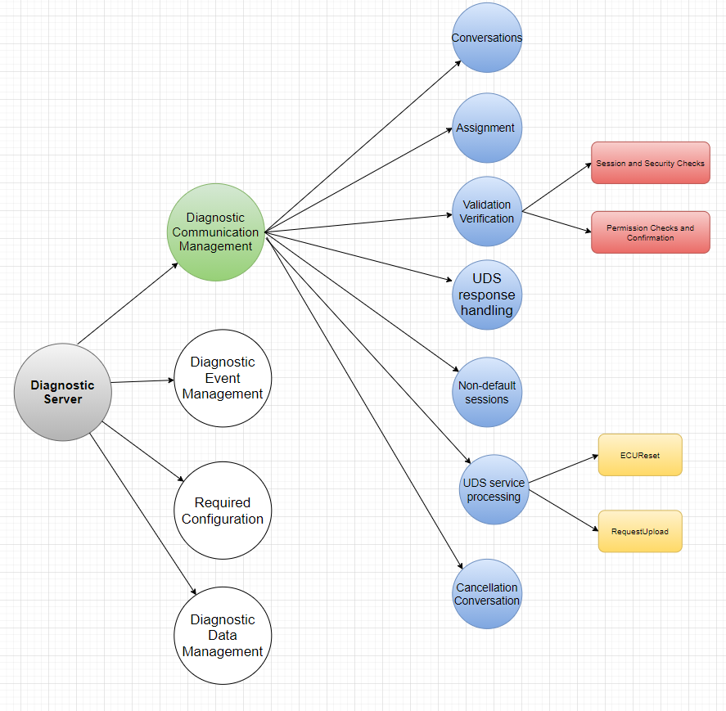
Thong LT autosar
5. Diagnostic over Internet Protocol (DoIP)

Slide 11
Thong LT autosar
5. Diagnostic over Internet Protocol (DoIP)
Diagnostic Event Manager
https://www.autosar.org/fileadmin/user_upload/standards/classic/4-3/AUTOSAR_SWS_DiagnosticEventManager.pdf

Slide 12
Thong LT autosar
5. Diagnostic over Internet Protocol (DoIP)
- Function inhibition manager (FIM)
https://www.autosar.org/fileadmin/user_upload/standards/classic/4-3/AUTOSAR_SWS_FunctionInhibitionManager.pdf

Slide 13

Thong LT autosar
5. Diagnostic over Internet Protocol (DoIP)
https://www.autosar.org/fileadmin/user_upload/standards/classic/4-3/AUTOSAR_TPS_DiagnosticExtractTemplate.pdf

Slide 14
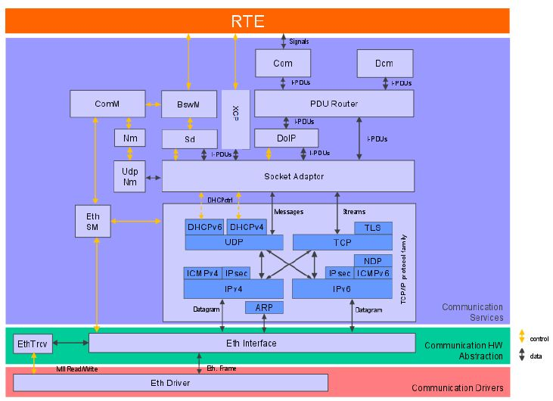
Thong LT autosar
5. Diagnostic over Internet Protocol (DoIP)

Slide 15
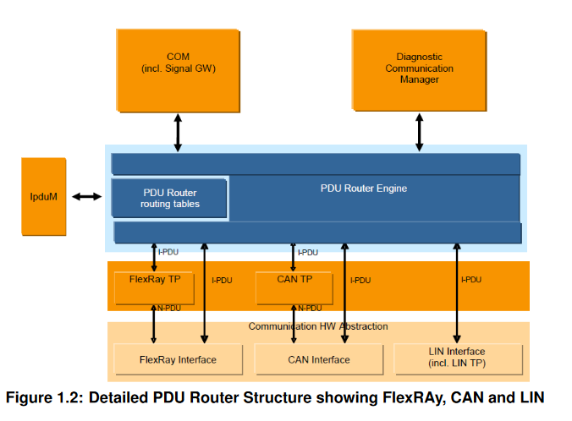
Thong LT autosar
5. DoIP- PDU Router
https://www.autosar.org/fileadmin/user_upload/standards/classic/20-11/AUTOSAR_SWS_PDURouter.pdf

Slide 16
Thong LT autosar
6. Advanced driver-assistance system (ADAS)

Slide 17
Thong LT autosar
7. CAN protocol

