Slide 1
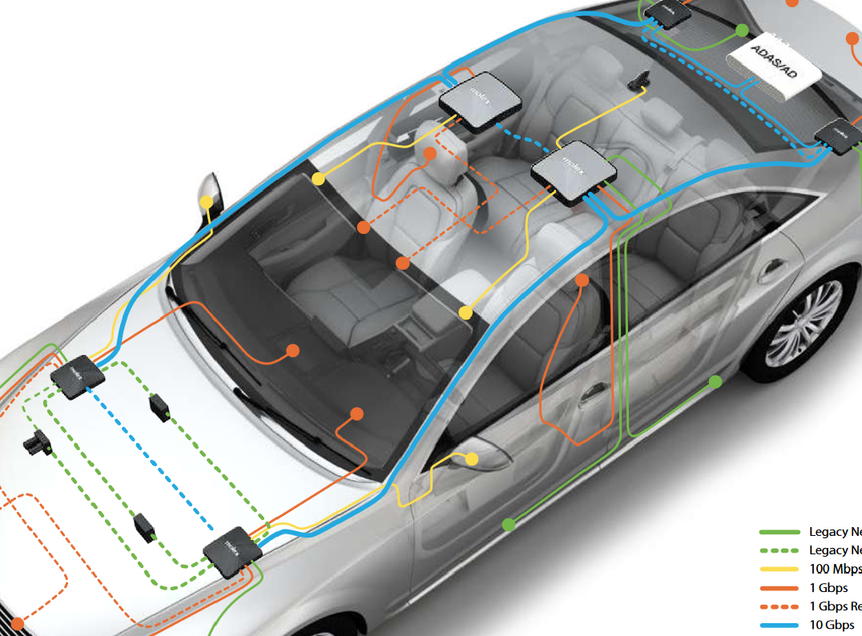
Thong LT autosar
Overview

Slide 2
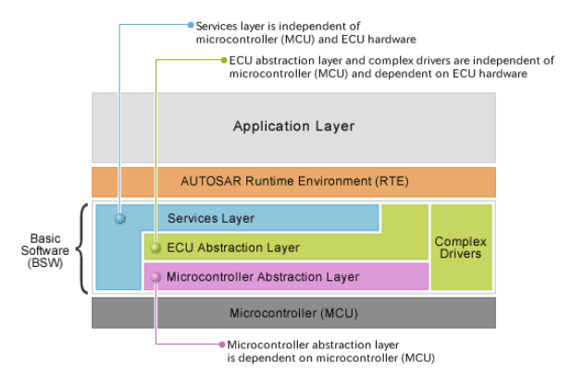
Thong LT autosar
Overview
https://www.renesas.com/us/en/application/automotive/common-automotive-technologies/autosar/autosar-layered-architecture

Slide 3
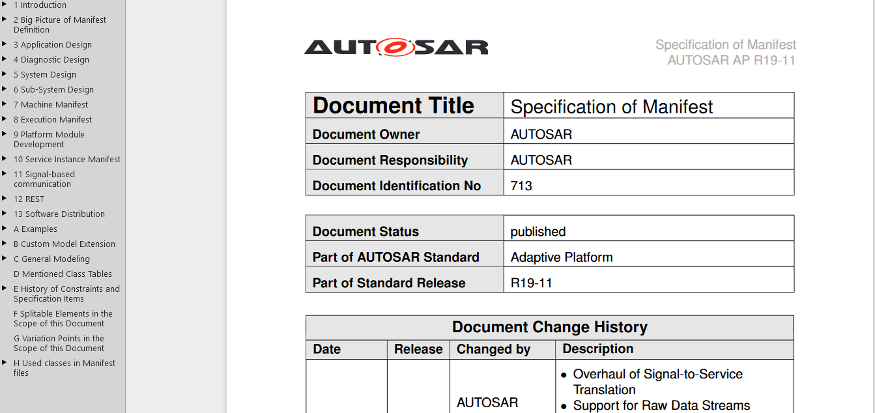
Thong LT autosar
Overview
AUTOSAR_TPS_ManifestSpecification https://www.autosar.org/fileadmin/user_upload/standards/adaptive/19-11/AUTOSAR_TPS_ManifestSpecification.pdf

Slide 4
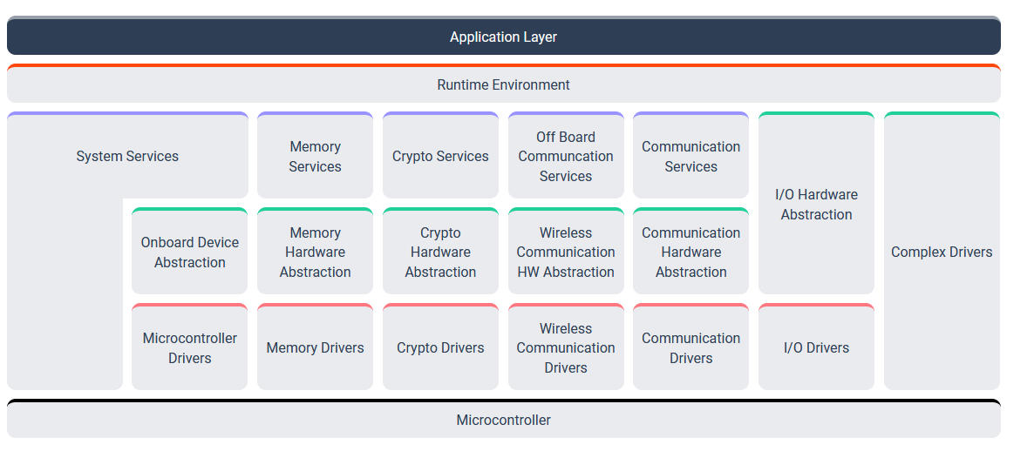
Thong LT autosar
1. Classic Platform
https://www.autosar.org/standards/classic-platform/

Slide 5
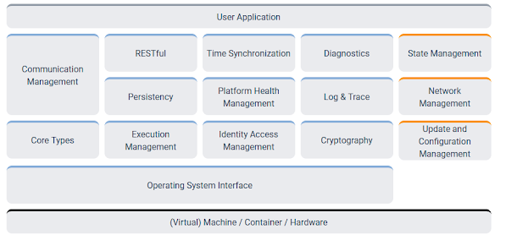
Thong LT autosar
2. Adaptive Platform
https://www.autosar.org/standards/adaptive-platform/

Slide 6
Thong LT autosar
3. Basic software

Slide 7
Thong LT autosar
3. Basic software
AUTOSAR XML files
https://www.ibm.com/docs/en/rhapsody/9.0.1?topic=modeling-importing-exporting-autosar-xml-files

Slide 8
Thong LT autosar
5. Diagnostic over Internet Protocol (DoIP)
https://www.autosar.org/fileadmin/user_upload/standards/classic/4-3/AUTOSAR_SWS_DiagnosticEventManager.pdf https://distek.com/2019/06/28/autosar-2/ https://www.embeddedtutor.com/2019/09/autosar-dem-module.html
https://www.embeddedtutor.com/2019/09/autosar-dem-module.html
https://www.autosar.org/fileadmin/user_upload/standards/classic/4-3/AUTOSAR_SWS_DiagnosticOverIP.pdf

Slide 9
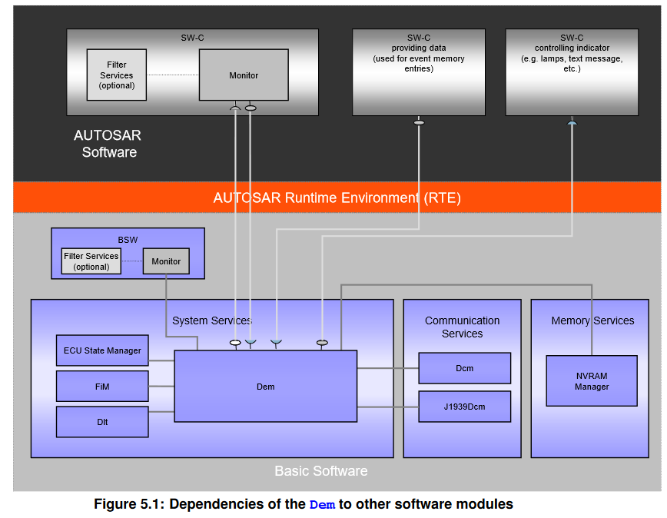
Thong LT autosar
5. Diagnostic over Internet Protocol (DoIP)
-The AUTOSAR basic software (BSW)
- Diagnostic event manager (DEM)
- Diagnostic communication manager (DCM)
- Function inhibition manager (FIM)
- Software components (SWCs)
- Diagnostic trouble codes(DTC)

Slide 10
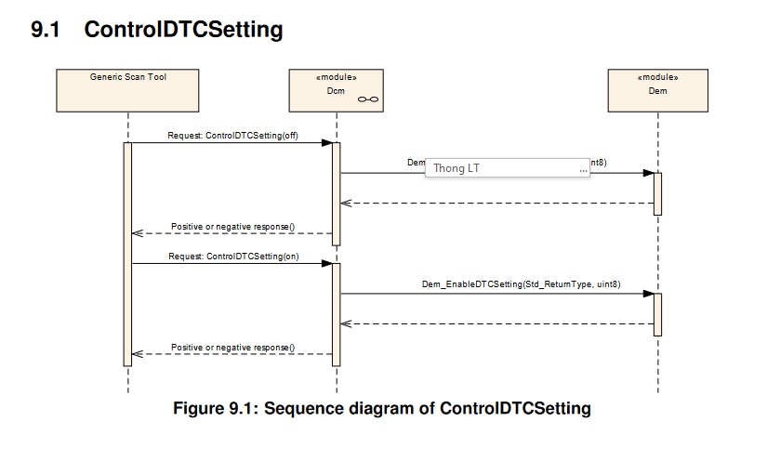
Thong LT autosar
5. Diagnostic over Internet Protocol (DoIP)

Slide 11
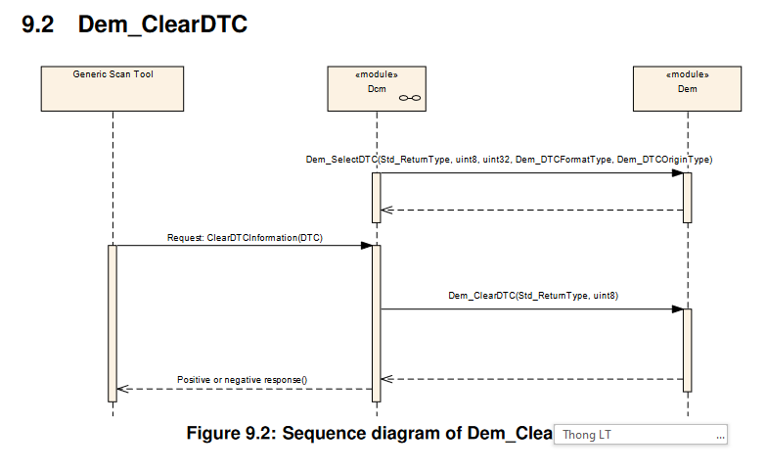
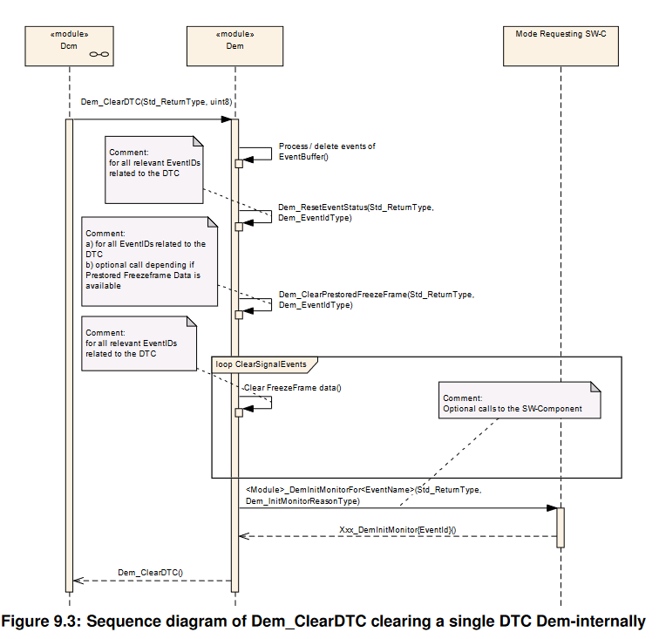
Thong LT autosar
5. Diagnostic over Internet Protocol (DoIP)

Slide 12
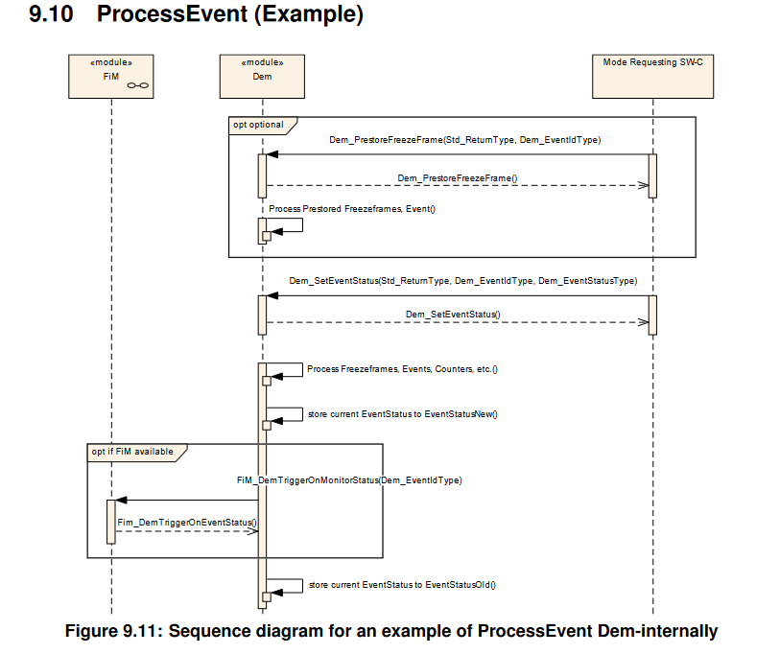
Thong LT autosar
5. Diagnostic over Internet Protocol (DoIP)

Slide 13
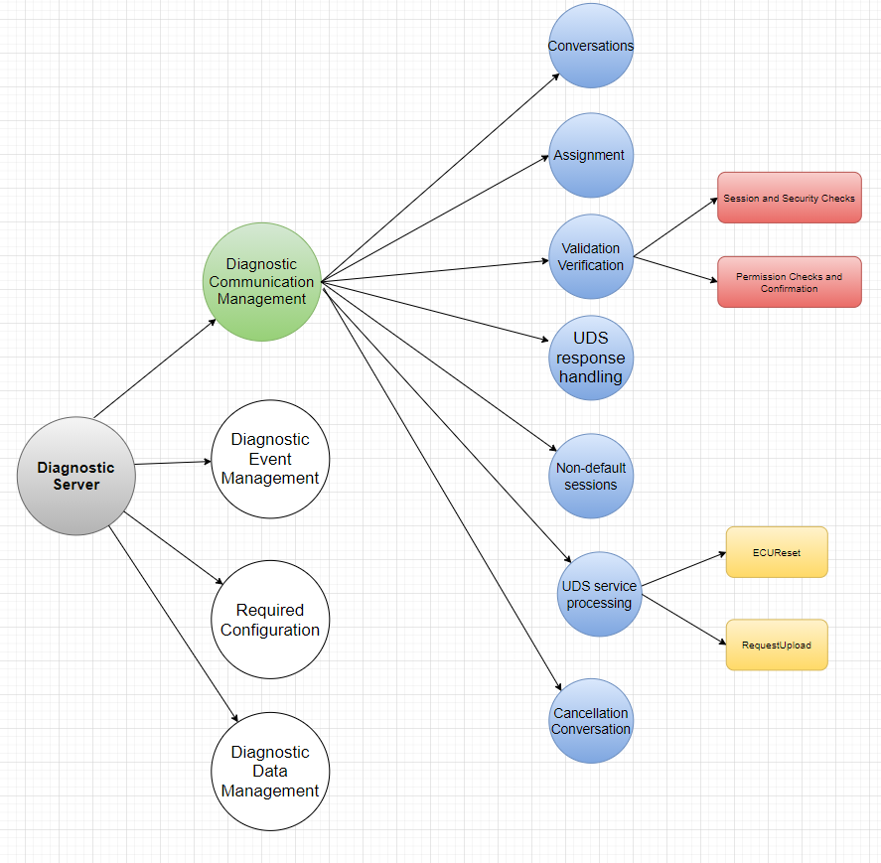
Thong LT autosar
5. Diagnostic over Internet Protocol (DoIP)

Slide 14
Thong LT autosar
5. Diagnostic over Internet Protocol (DoIP)
Diagnostic Event Manager
https://www.autosar.org/fileadmin/user_upload/standards/classic/4-3/AUTOSAR_SWS_DiagnosticEventManager.pdf

Slide 15
Thong LT autosar
5. Diagnostic over Internet Protocol (DoIP)
- Function inhibition manager (FIM)
https://www.autosar.org/fileadmin/user_upload/standards/classic/4-3/AUTOSAR_SWS_FunctionInhibitionManager.pdf

Slide 16

Thong LT autosar
5. Diagnostic over Internet Protocol (DoIP)
https://www.autosar.org/fileadmin/user_upload/standards/classic/4-3/AUTOSAR_TPS_DiagnosticExtractTemplate.pdf

Slide 17
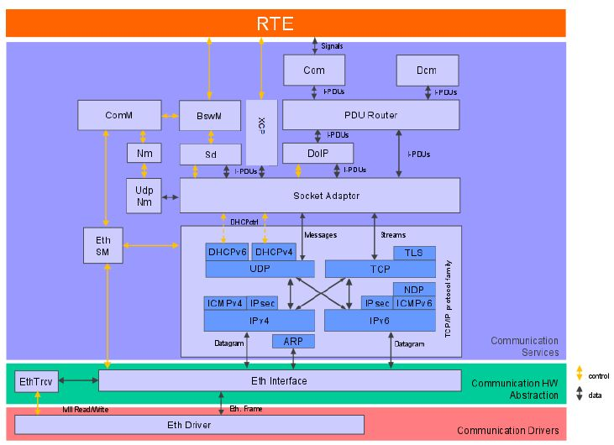
Thong LT autosar
5. Diagnostic over Internet Protocol (DoIP)

Slide 18
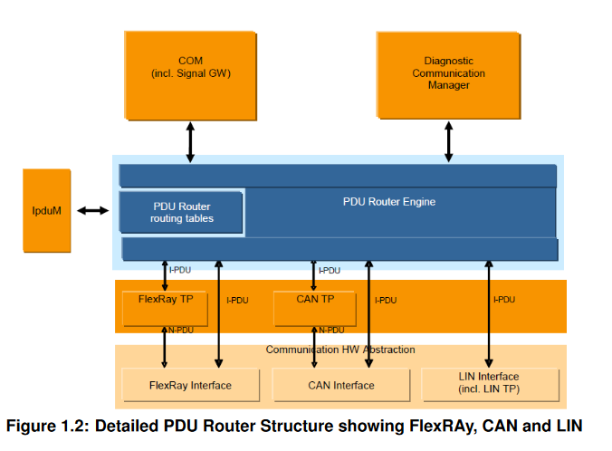
Thong LT autosar
5. DoIP- PDU Router
https://www.autosar.org/fileadmin/user_upload/standards/classic/20-11/AUTOSAR_SWS_PDURouter.pdf

Slide 19
Thong LT autosar
6. Advanced driver-assistance system (ADAS)

Slide 20
Thong LT autosar
7. CAN protocol

