Slide 1
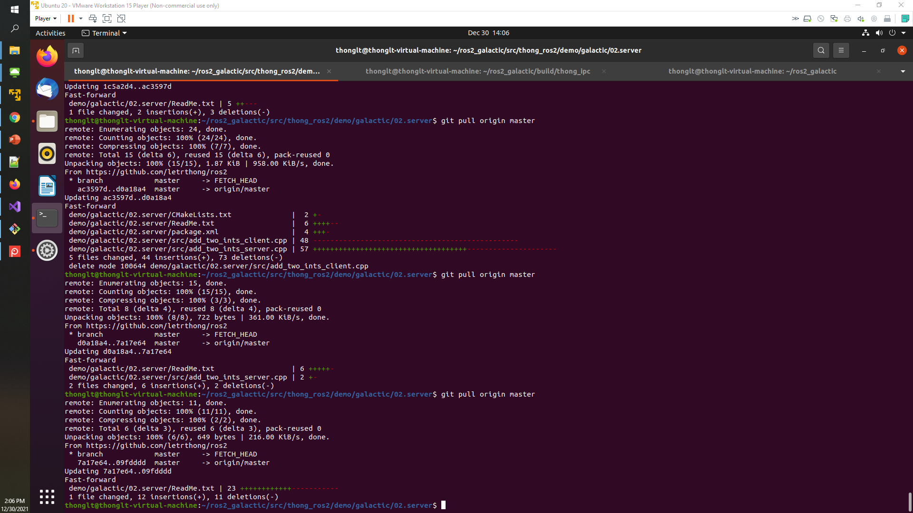
ROS 2
Setup RO2 on Virtual Ubuntu OS
https://docs.ros.org/en/galactic/Installation.html
Thong LT

Slide 2
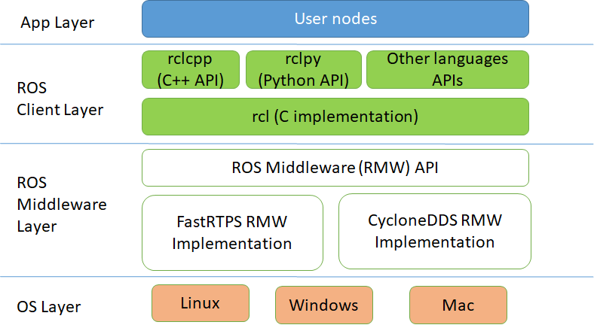
https://aws.amazon.com/blogs/robotics/ros2-foxy-fitzroy-robot-development/

Slide 3
IPC
Client
Blocking
Non-blocking
Notification
Callback
Callback
Server
Services
Actions
Topics
synchronous
asynchronous

Slide 4
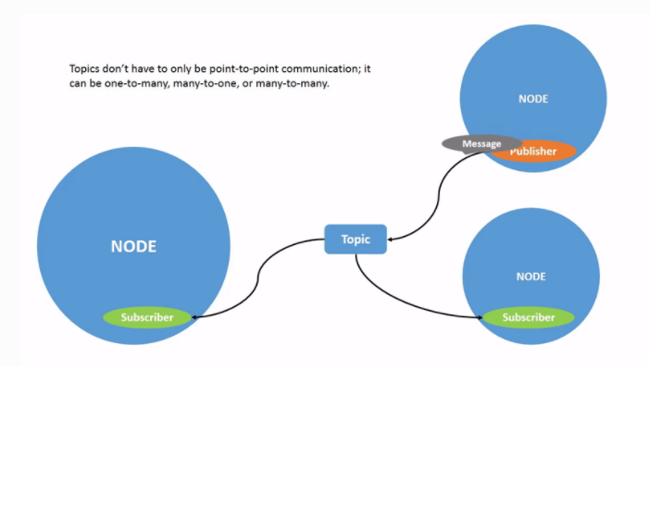
https://docs.ros.org/en/galactic/Tutorials/Topics/Understanding-ROS2-Topics.html

Slide 5
Nodes https://github.com/ros2/examples/tree/master/rclcpp/
Topics
Services
Parameter server
https://docs.ros.org/en/foxy/Tutorials/Understanding-ROS2-Actions.html

Slide 6
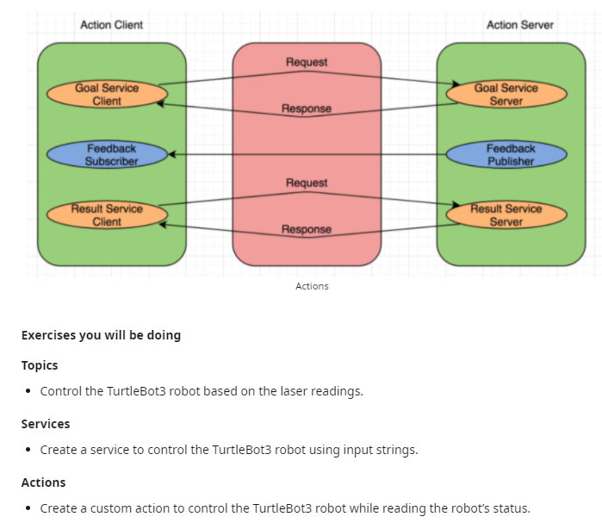
Nodes
Topics
Services
Parameter server
https://www.reddit.com/r/ROS/comments/nrzk9d/ros2_basics_for_python/

Slide 7
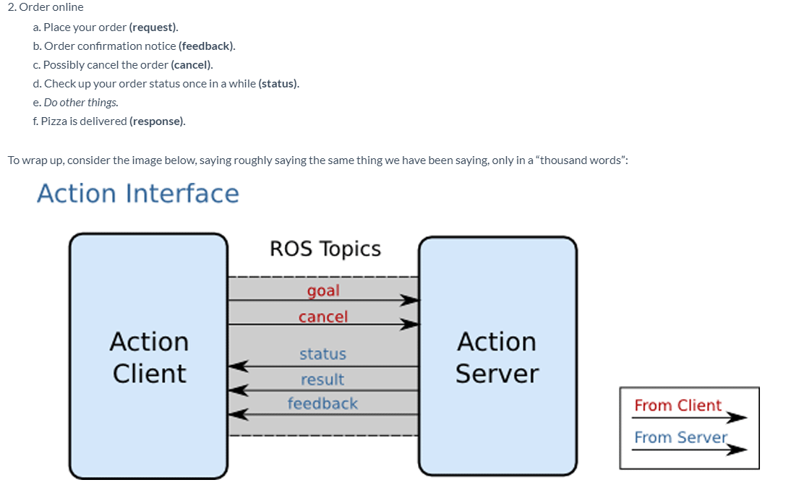
https://www.theconstructsim.com/ros-5-mins-034-ros-action/

Slide 8
Install packets
Install ros2
- Ubuntu Linux - Focal Fossa (20.04) 64-bit
Step1.
https://docs.ros.org/en/galactic/Installation/Ubuntu-Development-Setup.html
Step2.
https://docs.ros.org/en/galactic/Installation/Ubuntu-Install-Debians.html
2. Install packets in C++ (rclcpp)
3. Install packets for testing
source /opt/ros/galactic/setup.bash
ros2 run demo_nodes_cpp talker
source /opt/ros/galactic/setup.bash
ros2 run demo_nodes_py listener
sudo apt install ros-galactic-desktop source /opt/ros/galactic/setup.bash

Slide 9
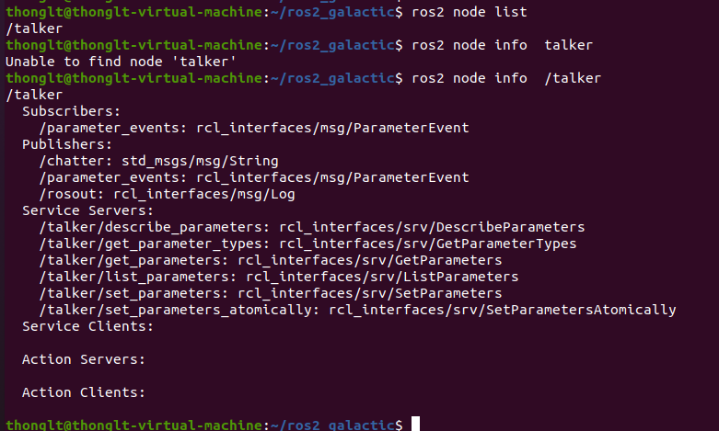
Cli on ros 2
ros2 node list
ros2 node info <node_name>

Slide 10
rclcpp
ros2 node list
ros2 node info <node_name>

Slide 11
How to create an example https://docs.ros.org/en/galactic/Tutorials/Writing-A-Simple-Cpp-Service-And-Client.html installing system dependencies. http://wiki.ros.org/rosdep http://wiki.ros.org/rosdep/Tutorials/How%20to%20add%20a%20system%20dependency https://colcon.readthedocs.io/en/released/ ROS 2 package and packets in workspaces https://docs.ros.org/en/foxy/Tutorials/Creating-Your-First-ROS2-Package.html Example at https://docs.ros.org/en/galactic/Features.html https://github.com/ros2/examples/tree/master/rclcpp https://roboticsbackend.com/create-a-ros2-cpp-package/
rclcpp

Slide 12
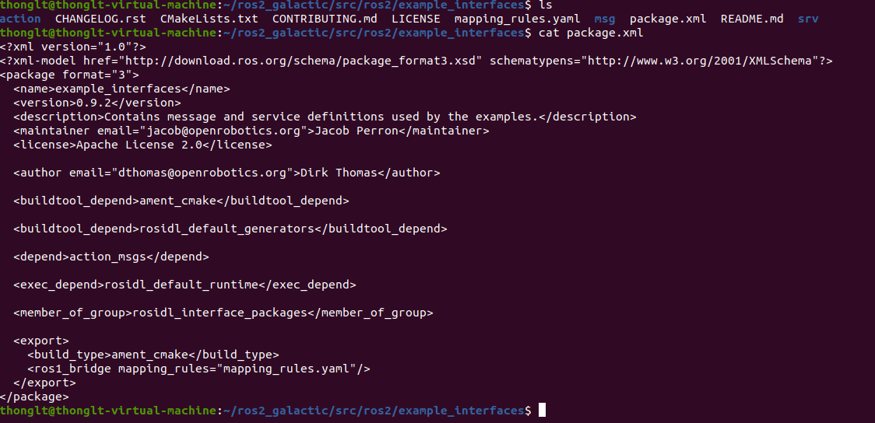
interface https://github.com/ros2/example_interfaces/tree/master/msg https://docs.ros.org/en/foxy/Tutorials/Custom-ROS2-Interfaces.html
rclcpp
Notes:
ros2 interface show tutorial_interfaces/msg/Num

Slide 13
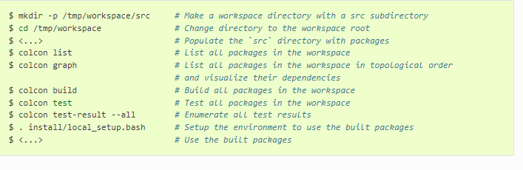
colcon
https://colcon.readthedocs.io/en/released/user/quick-start.html

Slide 14
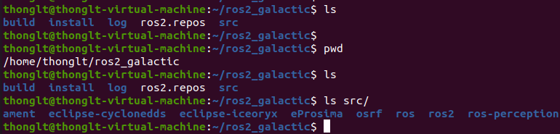
Build an example
https://github.com/ros2/examples

Slide 15
Build an example from ros2
Step1: cd src
Step2: git clone git clone https://github.com/letrthong/ros2 thong_ros2
Step3: cd ..
Step4: colcon list | grep “thong”
Step5: colcon build --packages-select --allow-overriding thong_ipc
Step6: . ~/ros2_galactic/install/local_setup.bash
Step7: ros2 run ipc demo.out

Slide 16
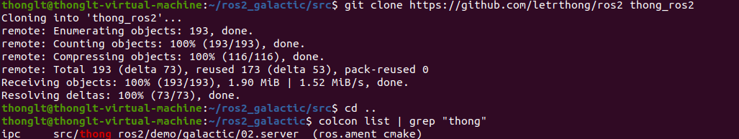
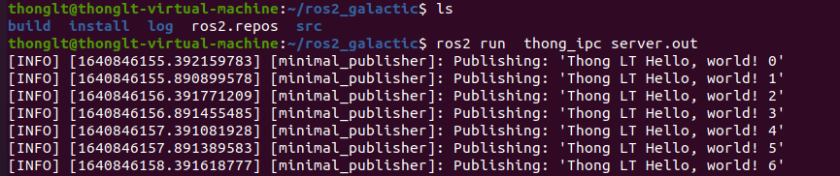
Build source from ros2
https://github.com/letrthong/ros2/tree/master/demo/galactic/02.server#readme
https://github.com/letrthong/ros2/tree/master/demo/galactic/02.server

Slide 17
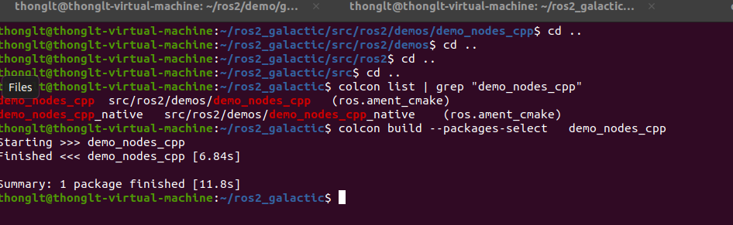
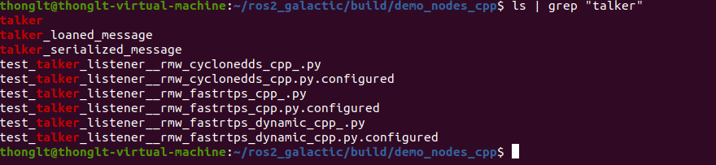
Build an example from os2_galactic
colcon build --packages-select demo_nodes_cpp
. ~/ros2_galactic/install/local_setup.bash
ros2 run demo_nodes_cpp talker

Slide 18
Navigation
https://navigation.ros.org/

