Slide 1

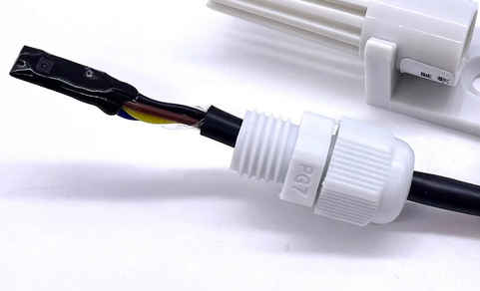
Taidacent Digital Humidity Sensor Probe Protection Housing Planting Soil Cover Sht11 Waterproof Cover for Temperature Sensor

Slide 2
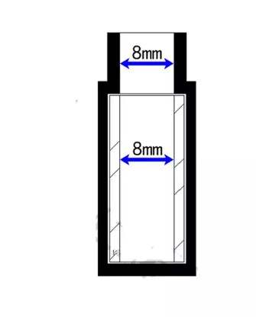
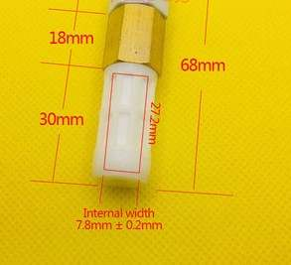
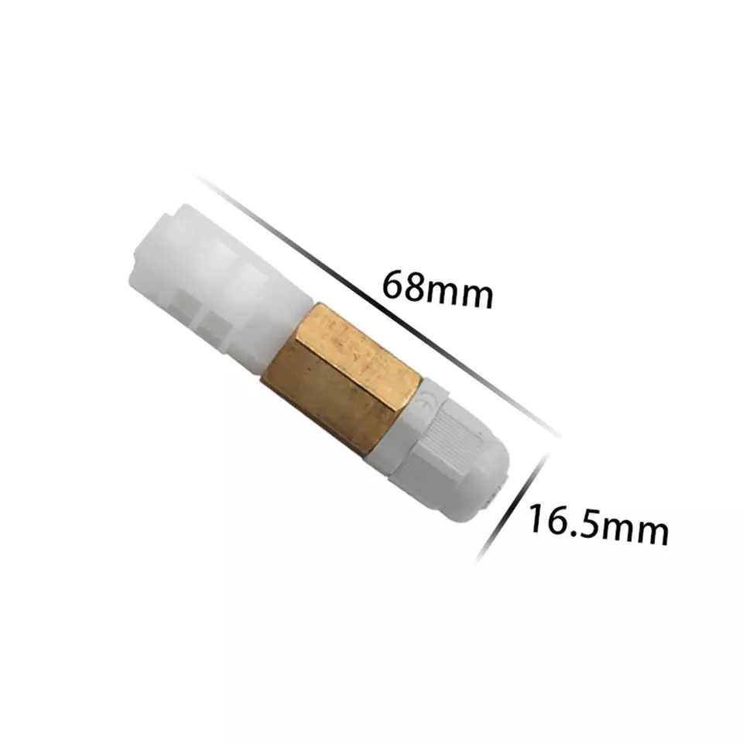

Slide 3
