Slide 1

ESP32-WROOM-32
Telua IoT platform

Slide 2
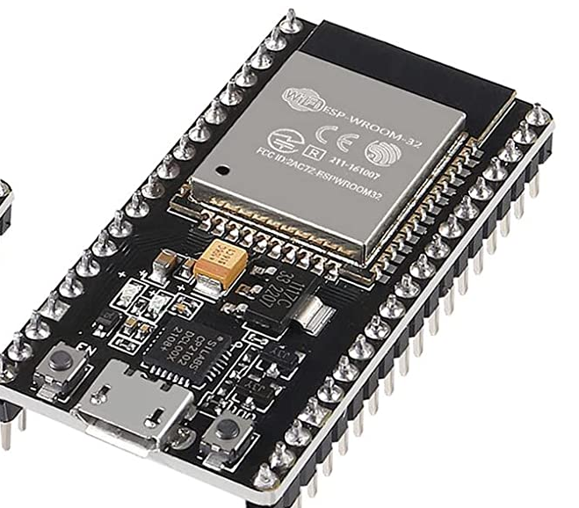
ACEIRMC - ESP32S ESP32 CP2102 38 pins Development Board 2.4 GHz Dual Core WLAN WiFi + Bluetooth 2-in-1 Microcontroller ESP-WROOM-32 Chip for ESP32 Compatible with Arduino IDE
https://www.amazon.com/Organizer-Development-Dual-Mode-Microcontroller-Integrated/dp/B08FR5Y85W
https://shopee.vn/B%E1%BA%A3ng-M%E1%BA%A1ch-Ph%C3%A1t-Tri%E1%BB%83n-ESP32-TYPE-C-USB-CH340C-WiFi-Bluetooth-Ultra-Low-L%C3%B5i-K%C3%A9p-ESP32-DevKitC-32-ESP-WROOM-32-i.770245757.23825959681

Slide 3
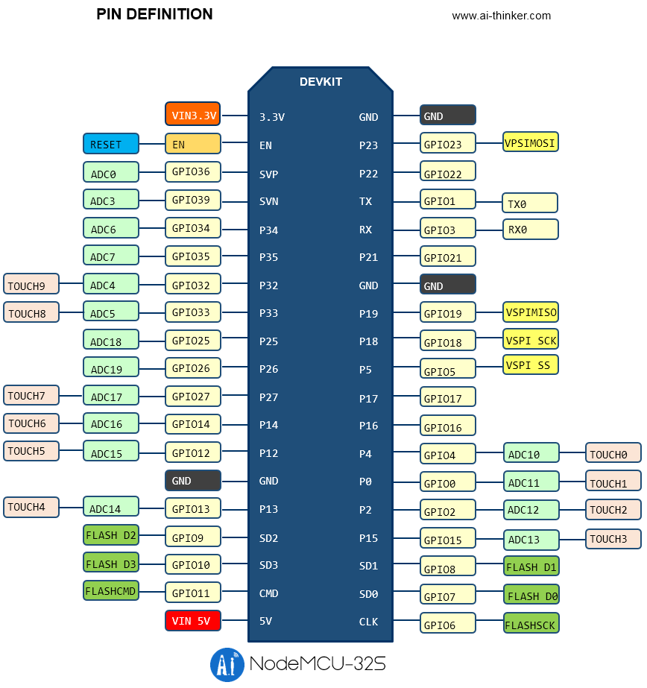
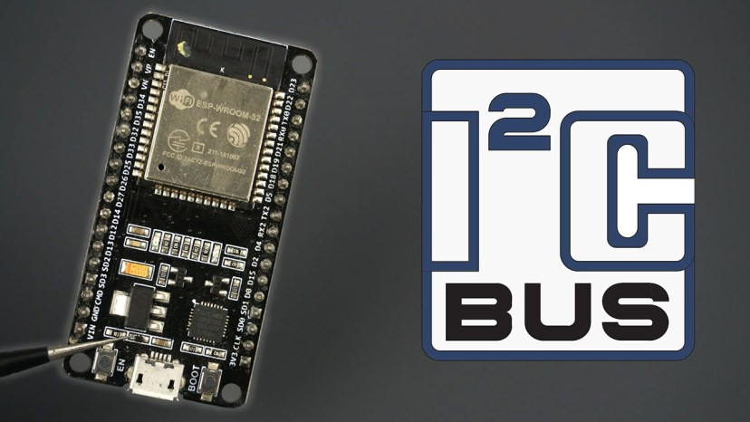
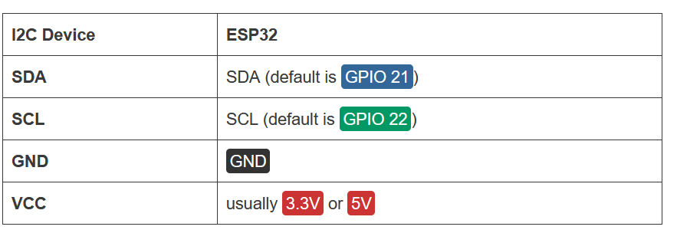

Slide 4
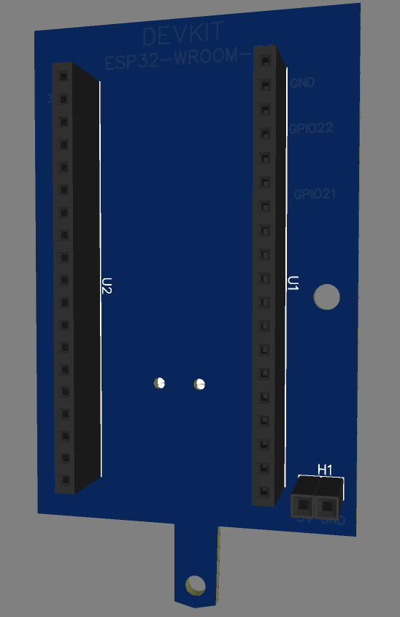
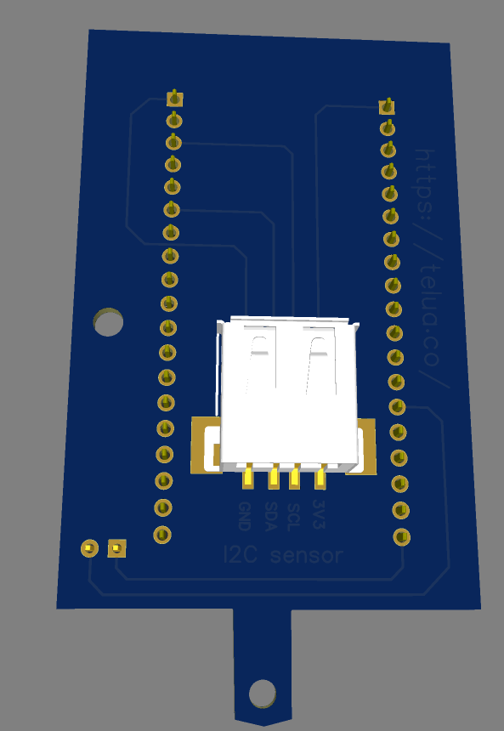

Slide 5
https://detail.1688.com/offer/659172560112.html?spm=a26352.13672862.offerlist.52.db7c3a36BqbM9z
LILYGO® TTGO T-SIM7000E ESP32-WROVER-B
LILYGO T-A7068E-H/T-A7608SA-H board specifications:
https://makeradvisor.com/tools/t-sim7000g-esp32/
https://randomnerdtutorials.com/esp32-sim800l-send-text-messages-sms/

