Slide 1
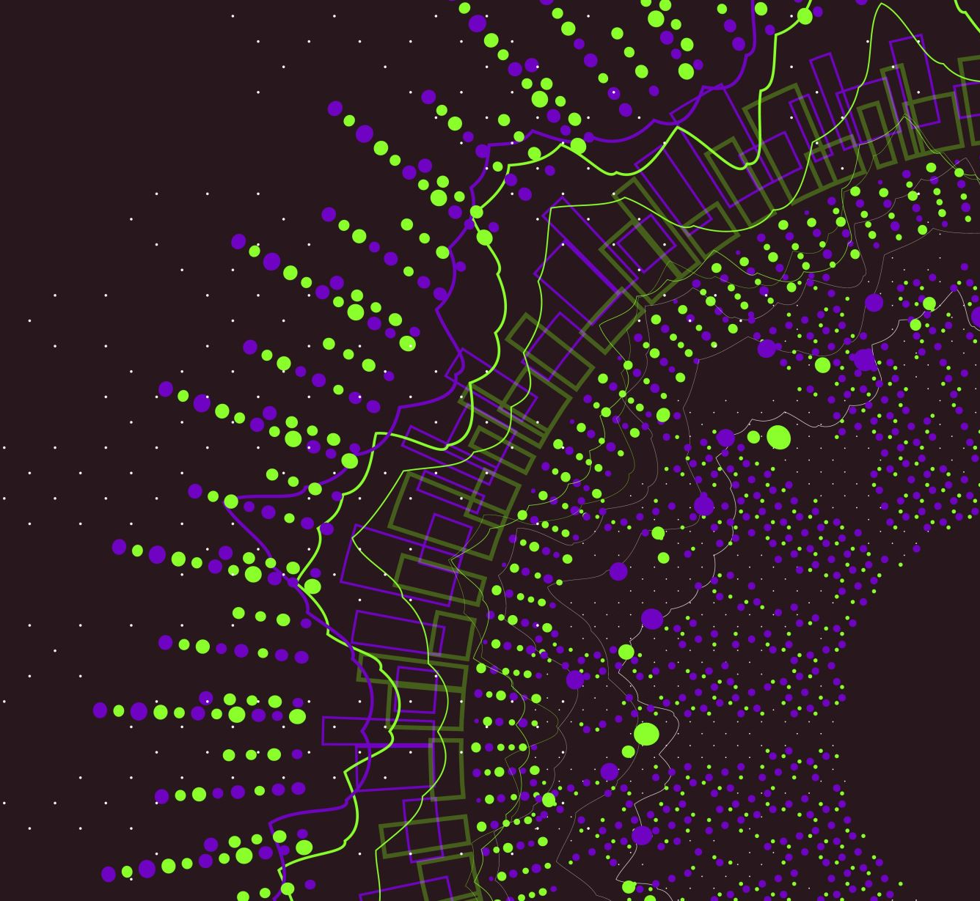
ESP32
Telua IoT platform

