Slide 1
Telua IoT Platform
https://telua.co - Telua IoT platform

Slide 2
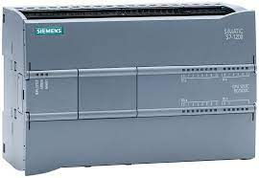
Some PLC based Automation Projects ( PLC - Programmable logic controller )
PLC Based on Garden Irrigation System
PLC Based on Automatic Motor Speed Monitoring System
PLC Based on Multi-Channel Temperature Monitoring and Controlling System
PLC Based on Humidity and CO2 Monitoring and Controlling System
PLC Based on Agriculture Irrigation System
PLC Based Door Open and Closing System
PLC Based Temperature Controller
PLC Based Automatic Coffee Vending Machine
PLC Based Automatic Traffic and Street Light Controller
Automatic Water Level Control System Using PLC Project
Automatic Feeder Machine
https://telua.co - Telua IoT platform

Slide 3
Problem of PLC
- The license of software is expensive
- No easy to configure with normal users
Solution
- Develop the visual programing language instead of PLC to control devices via the internet and support the automation industry
https://telua.co - Telua IoT platform

Slide 4
Why better ?
- Price is cheaper
- Open APIs for community
- Open-source hardware of sensors
- Integrate machine to machine and machine learning for smart agriculture
- Support multi-language
- Support to integrate the Telua IoT platform with producers for smart lighting, smart fan, smart cooker, etc.
https://telua.co - Telua IoT platform

Slide 5
Technical Advantages
- Support data model to add new product
- Using Progressive web apps (PWAs), PWA can run on multiple platforms and devices from a single codebase
- Remote control
- Real-time connection between machine and machine
https://telua.co - Telua IoT platform

Slide 6
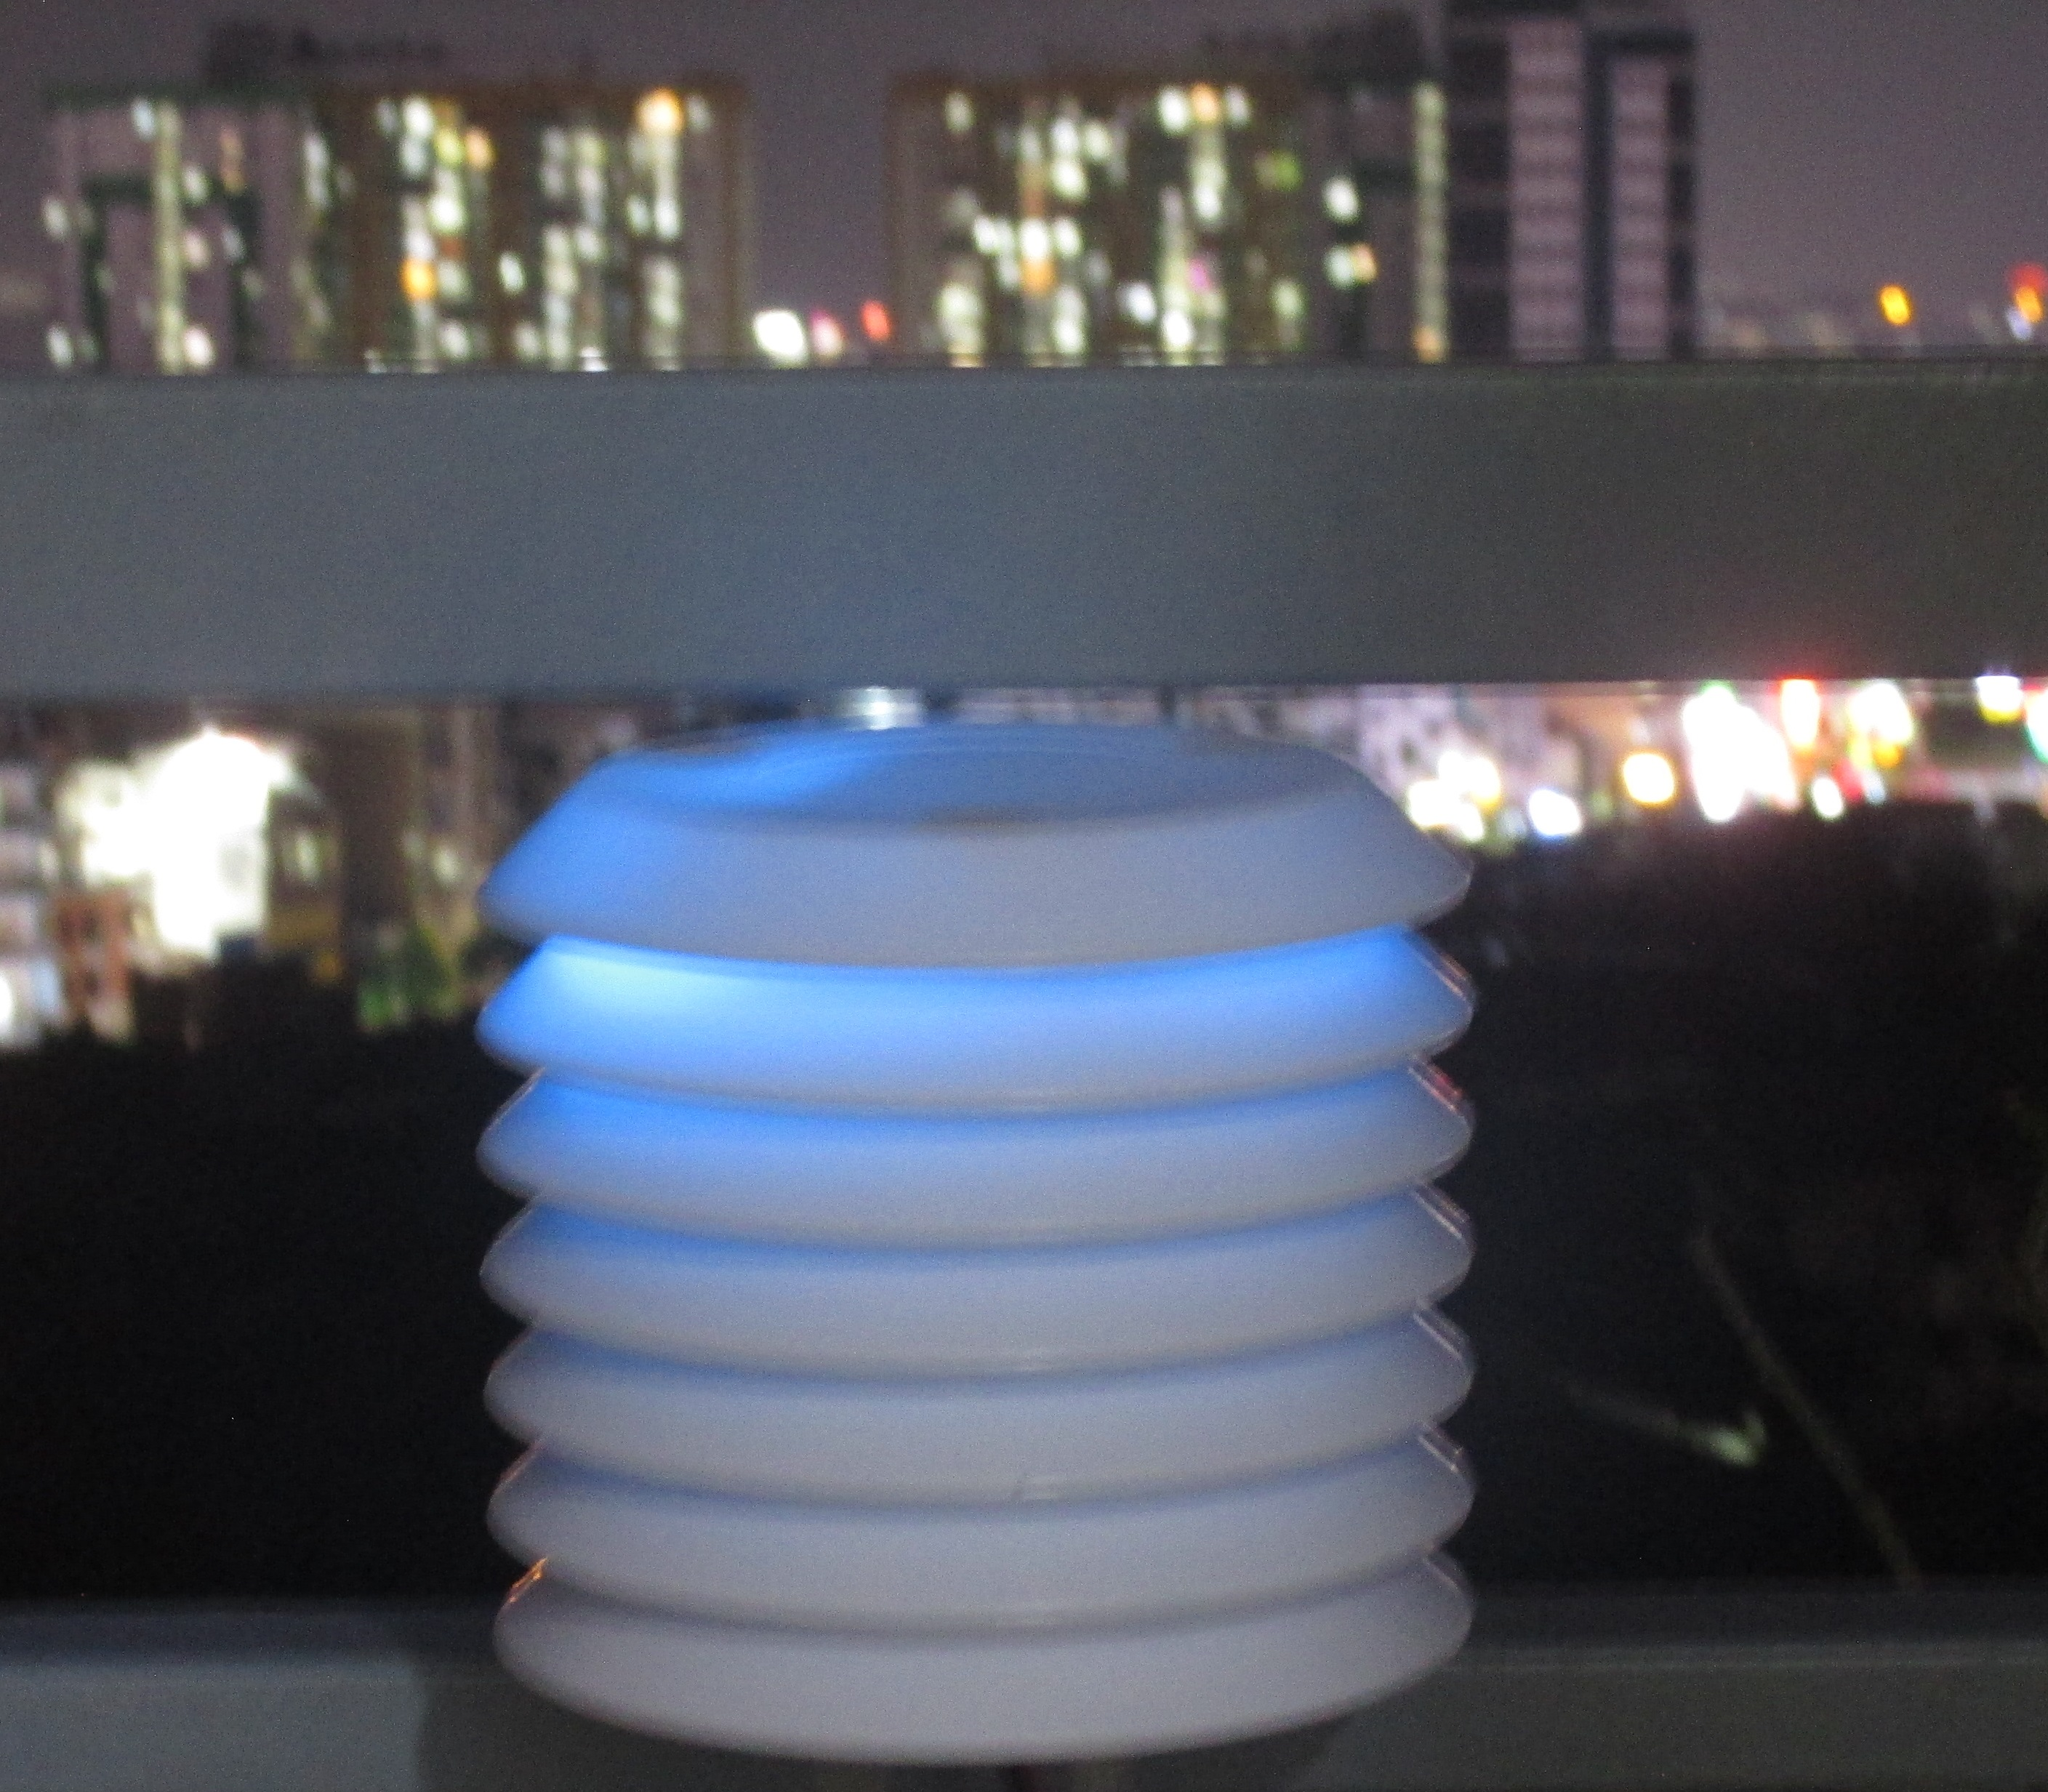
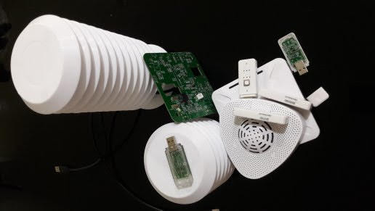
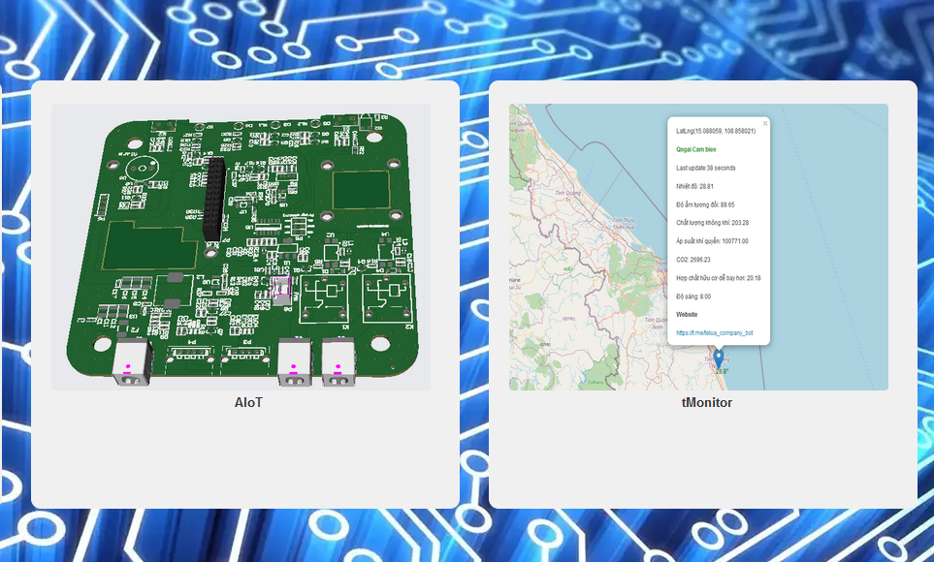
Products
Hardware
CO2, VOC, pH, Lux, Temperature, Humidity Sensor
GPIO controller
GPIO Expander
Software
https://telua.co/aiot
https://telua.co/tmonitor
https://telua.co - Telua IoT platform

Slide 7
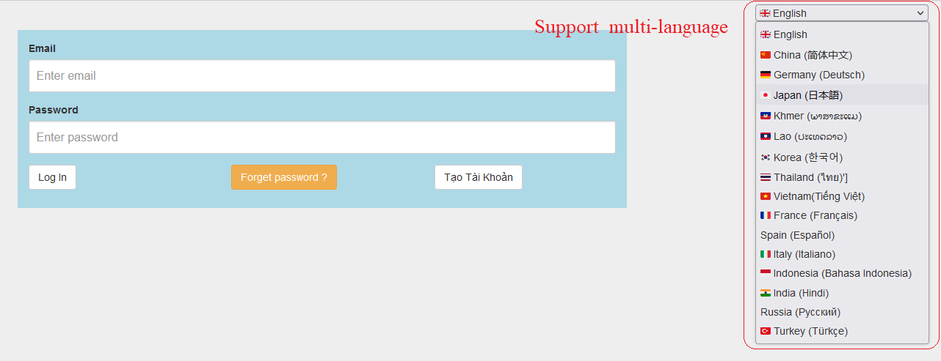
Demo
Control devices
https://telua.co/aiot
User: letrthong@gmail.com
Password: 12345678
Detailed guideline (Vietnamese)
https://github.com/letrthong/telua_esp32_sensor/blob/master/esp32_hardware/telua_eps32.pdf
Weather station (Vietnamese)
https://telua.co/tmonitor#api
The visual programming language
https://github.com/letrthong/uhes_visual_programing_iot
https://telua.co - Telua IoT platform

Slide 8
Business Model
Sale Sensors, devices
A device must pay fee 1$ or 2$ per month if the user has greater than 3 devices
1000 Users
$5
$5000
https://telua.co - Telua IoT platform

Slide 9





Some IoT Platforms
https://www.tuya.com/
Blynk IoT
IBM Watson IoT
https://telua.co - Telua IoT platform

Slide 10
Some startup companies in Vietnam
https://tmonitor.live/
https://weatherplus.vn/
https://www.lotoda.vn/
https://eplusi.net/
https://www.nextfarm.vn
https://farmext.com/
https://dqsmart.vn/san-pham/thiet-bi-cam-bien-nhiet-do-do-am/ ( Điện Quang)
https://www.aquaeasy.life/ ( Bosch )
https://telua.co - Telua IoT platform

