Slide 1

Course Assignment Presentation
Create the app for sport club
(like brumbies-mobileapp.meteor.com)
Lê Trung Đạt
Notes:
Hello every one, I’m Lê Trung Đạt, I have studied at FPT university. Now I will introduce about my product.I had choosen topic create app for sport club

Slide 2
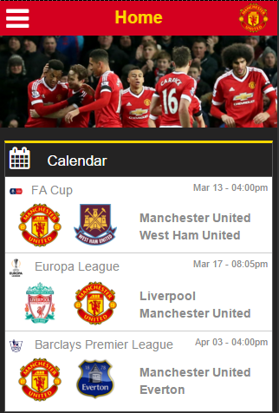
About Web
Website for Manchester united
Single page application
Required on Mobile only
Include 4 main page
Firebase Data cloud service
Notes:
My product is a single page application for mobile only and temporary it have 4 main page include new page, calendar page, team page and ladder page. I used Firebase to make my backend cloud service.

Slide 3








Technical
Notes:
About technology I code depends core is html 5 , css3 and javascript. Beside that, I using AngularJS to code javascript, sass to manage my css code, bootstrap to responsive and get some web component style. I have used some support tool like gulp, github, and bower

Slide 4
DEMO
Run my product…

Slide 5

Achievement
During this assignment:
Use gulp to automate my task
Manage my library and framework with bower.
Manage my source code with Github
Experience in build website with Angularjs.
Known to use Sass to manage my Css code.
Use bootstrap to responsive web page.

Slide 6

Bugs and Issues
Still not beautiful website
Not comfortable when using
Some bug in safari
not use modern JavaScript languages
(ES6, TypeScript)

Slide 7

Improve
In the future:
Research more about Angularjs.
Improve knowledge about user interface design.
Get knowledge about some modern javascript language
Code structured and coding convention.

Slide 8

Question & answer

Slide 9

The end

