Slide 1

CHULALONGKORN UNIVERSITY FACULTY of ENGINEERING DEPARTMENT OF ELECTRICAL ENGINEERING
direct method for
sparse SYMMETRIC POSITIVE DEFINITE matrix
The multifrontal method
MASTER STUDENT : Mr. LE TRUONG THANH
28th May 2021

Slide 2
Content
I) Objective
II) Theoretical basis
1) Sparse matrix:
2) Cholesky factorization
3) Cholesky factorization with sparse matrix
4) Cholesky factorization with sparse matrix based on Multifrontal method
III) Testing result.

Slide 3
I) Objective
Normal basis direct methods:
- Ordinary Cholesky Factorization
- Gaussian Elimination
=> Inefficency and waste of computational time
Cholesky Factorization based on Multifrontal method

Slide 4
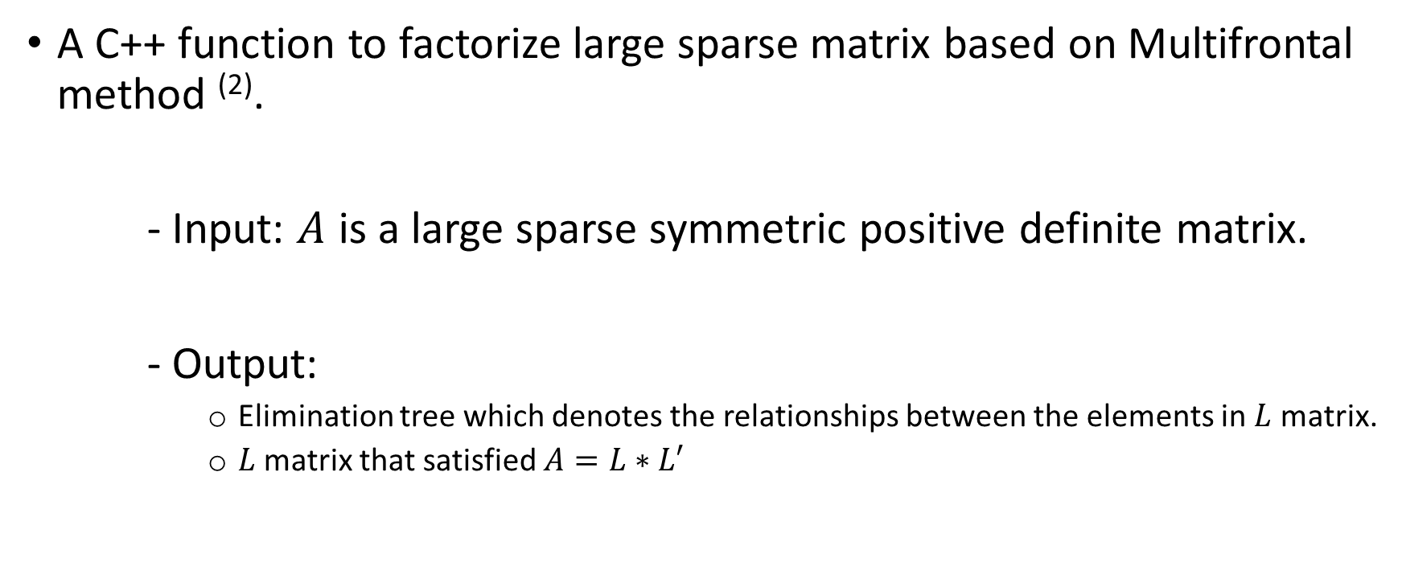
I) Objective
A C++ function to factorize large sparse matrix based on Multifrontal method ⁽²⁾.
- Input: $A$ is a large sparse symmetric positive definite matrix.
- Output:
Elimination tree which denotes the relationships between the elements in $L$ matrix.
$L$ matrix that satisfied $A=L∗L′$

Slide 5
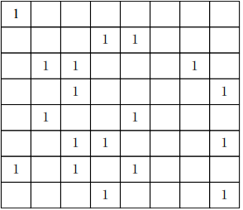
II) Theoretical basis
Sparse matrix:
Almost elements in matrix is zeros
(larger than 95% per row/column)

Slide 6
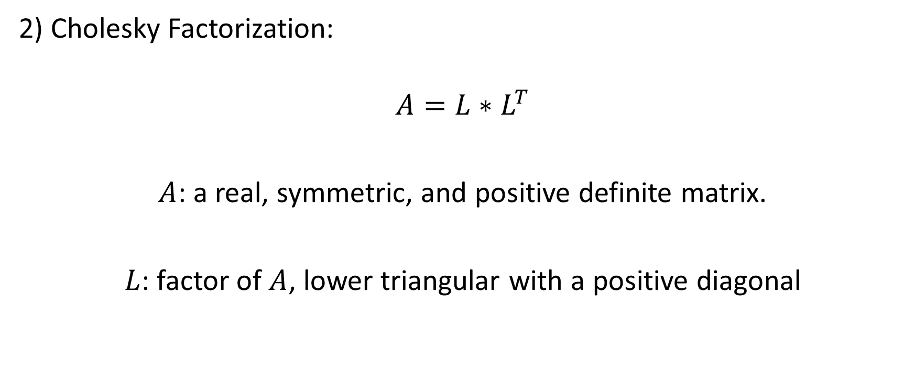
II) Theoretical basis
2) Cholesky Factorization:
$$A=L∗L^{T}$$
$A$: a real, symmetric, and positive definite matrix.
$L$: factor of $A$, lower triangular with a positive diagonal

Slide 7
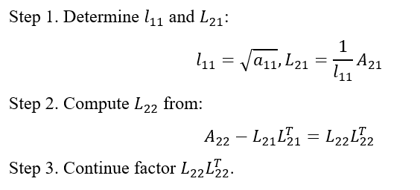

II) Theoretical basis
2) Cholesky Factorization:
$$\left[\begin{matrix}a_{11} & A_{21}^{T} \\ A_{21} & A_{22}\end{matrix}\right]=\left[\begin{matrix}l_{11} & 0 \\ L_{21} & L_{22}\end{matrix}\right]\left[\begin{matrix}l_{11} & L_{21}^{T} \\ 0 & L_{22}^{T}\end{matrix}\right]=\left[\begin{matrix}l_{11}^{2} & l_{11}L_{21}^{T} \\ l_{11}L_{21} & L_{21}L_{21}^{T}+L_{22}L_{22}^{T}\end{matrix}\right]$$

Slide 8
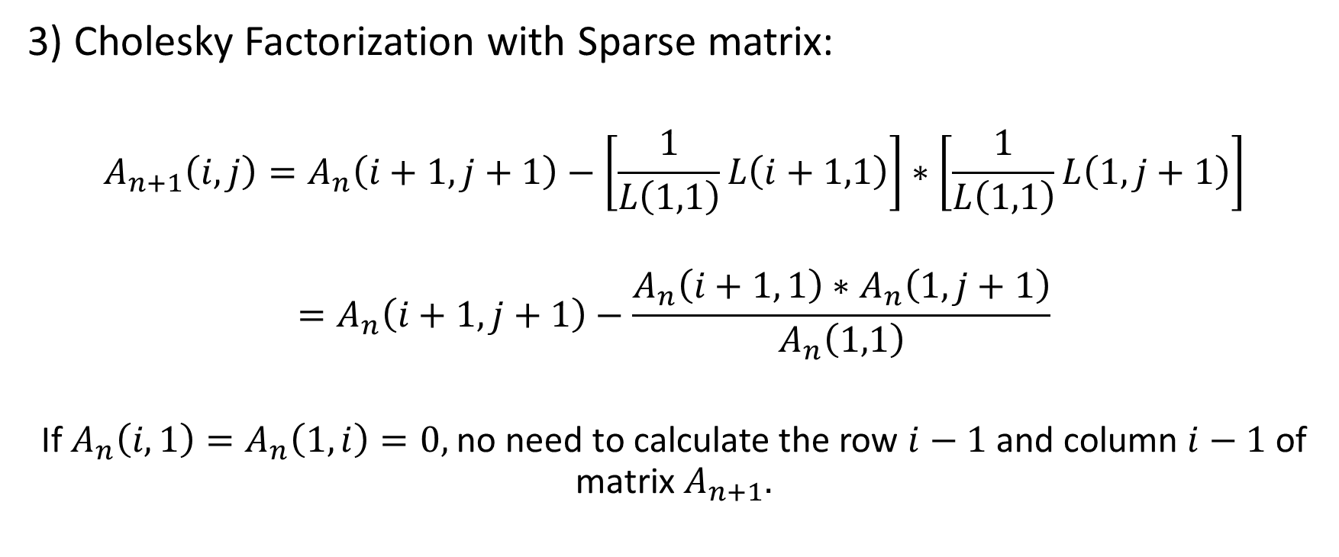
II) Theoretical basis
3) Cholesky Factorization with Sparse matrix:
$$A_{n+1}\left(i,j\right)=A_{n}\left(i+1,j+1\right)−\left[\frac{1}{L\left(1,1\right)}L\left(i+1,1\right)\right]∗\left[\frac{1}{L\left(1,1\right)}L\left(1, j+1\right)\right]$$
$$=A_{n}\left(i+1,j+1\right)−\frac{A_{n}\left(i+1, 1\right)∗A_{n}\left(1, j+1\right)}{A_{n}\left(1,1\right)}$$
If $A_{n}\left(i,1\right)=A_{n}\left(1,i\right)=0,$ no need to calculate the row $i−1$ and column $i−1$ of matrix $A_{n+1}.$

Slide 9
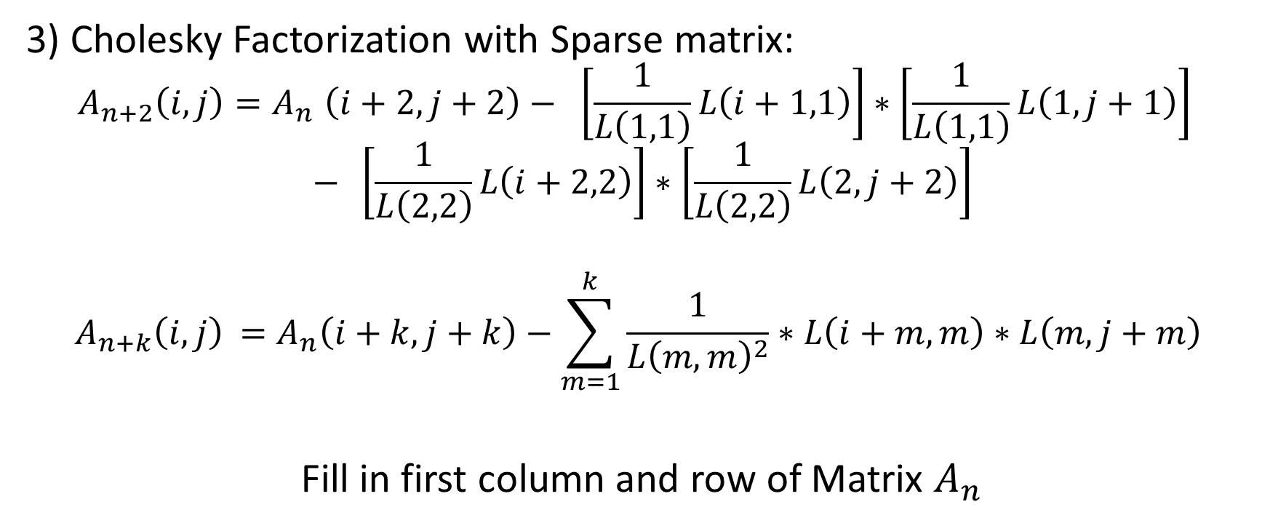
II) Theoretical basis
3) Cholesky Factorization with Sparse matrix:
$$A_{n+2}\left(i,j\right){=A}_{n}\left(i+2,j+2\right)− \left[\frac{1}{L\left(1,1\right)}L\left(i+1,1\right)\right]∗\left[\frac{1}{L\left(1,1\right)}L\left(1, j+1\right)\right]$$
$$− \left[\frac{1}{L\left(2,2\right)}L\left(i+2,2\right)\right]∗\left[\frac{1}{L\left(2,2\right)}L\left(2, j+2\right)\right]$$
$$A_{n+k}\left(i,j\right){ =A}_{n}\left(i+k,j+k\right)−\sum_{m=1}^{k}{\frac{1}{{L\left(m,m\right)}^{2}}∗L\left(i+m,m\right)∗L\left(m, j+m\right)}$$
Fill in first column and row of Matrix $A_{n}$

Slide 10
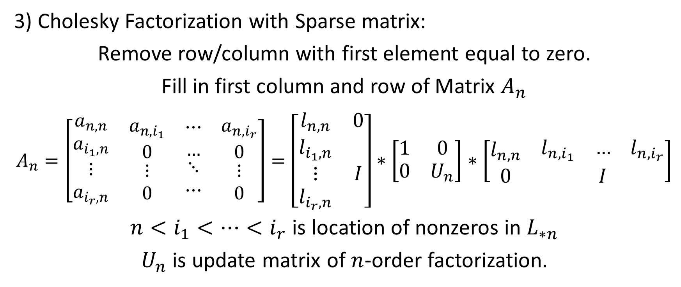
II) Theoretical basis
3) Cholesky Factorization with Sparse matrix:
Remove row/column with first element equal to zero.
Fill in first column and row of Matrix $A_{n}$
$$A_{n}=\left[\begin{matrix}\begin{matrix}\begin{matrix}\begin{matrix}a_{n,n} \\ a_{i_{1},n}\end{matrix} \\ \begin{matrix}⋮ \\ a_{i_{r},n}\end{matrix}\end{matrix} & \begin{matrix}\begin{matrix}a_{n,i_{1}} \\ 0\end{matrix} \\ \begin{matrix}⋮ \\ 0\end{matrix}\end{matrix}\end{matrix} & \begin{matrix}\begin{matrix}\begin{matrix}⋯ \\ …\end{matrix} \\ \begin{matrix}⋱ \\ ⋯\end{matrix}\end{matrix} & \begin{matrix}\begin{matrix}a_{n,i_{r}} \\ 0\end{matrix} \\ \begin{matrix}⋮ \\ 0\end{matrix}\end{matrix}\end{matrix}\end{matrix}\right]=\left[\begin{matrix}l_{n,n} & 0 \\ \begin{matrix}l_{i_{1},n} \\ ⋮ \\ l_{i_{r},n}\end{matrix} & I\end{matrix}\right]∗\left[\begin{matrix}1 & 0 \\ 0 & U_{n}\end{matrix}\right]∗\left[\begin{matrix}l_{n,n} & \begin{matrix}l_{n,i_{1}} & … & l_{n,i_{r}}\end{matrix} \\ 0 & I\end{matrix}\right]$$
$n<i_{1}<…<i_{r}$ is location of nonzeros in $L_{∗n}$
$U_{n}$ is update matrix of $n$-order factorization.

Slide 11
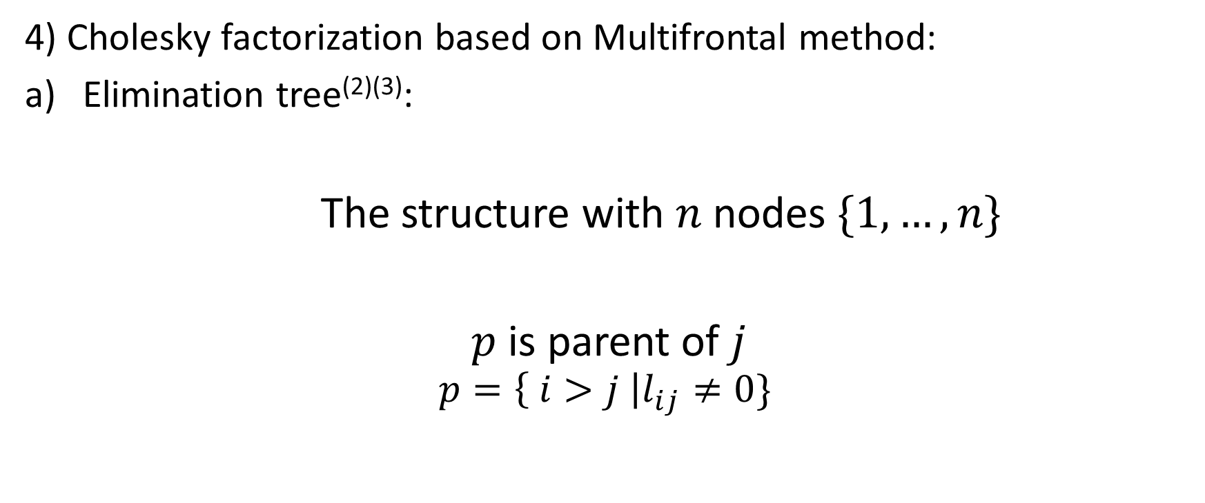
II) Theoretical basis
4) Cholesky factorization based on Multifrontal method:
Elimination tree⁽²⁾⁽³⁾:
The structure with $n$ nodes $\{1,…, n\}$
$p$ is parent of $j$
$$p=\left\{ i>j \right|l_{ij}≠0\}$$

Slide 12
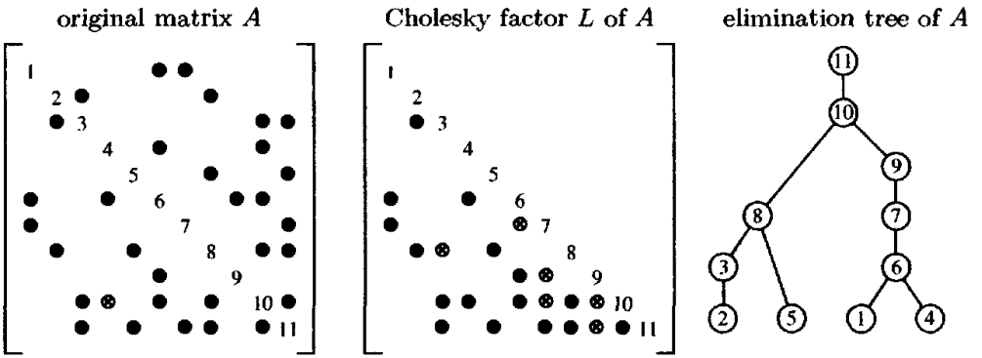
II) Theoretical basis
4) Cholesky factorization based on Multifrontal method:
Elimination tree⁽²⁾⁽³⁾:

Slide 13
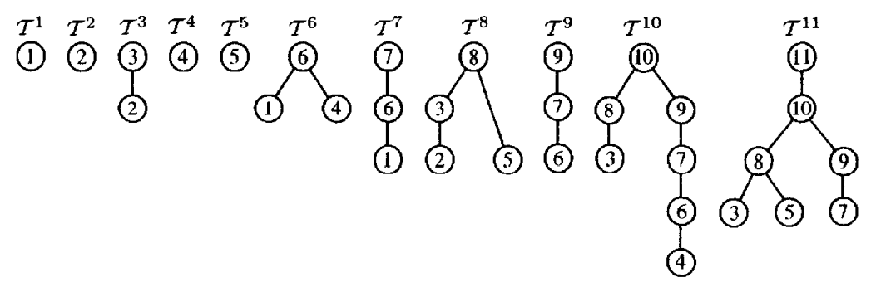

Slide 14
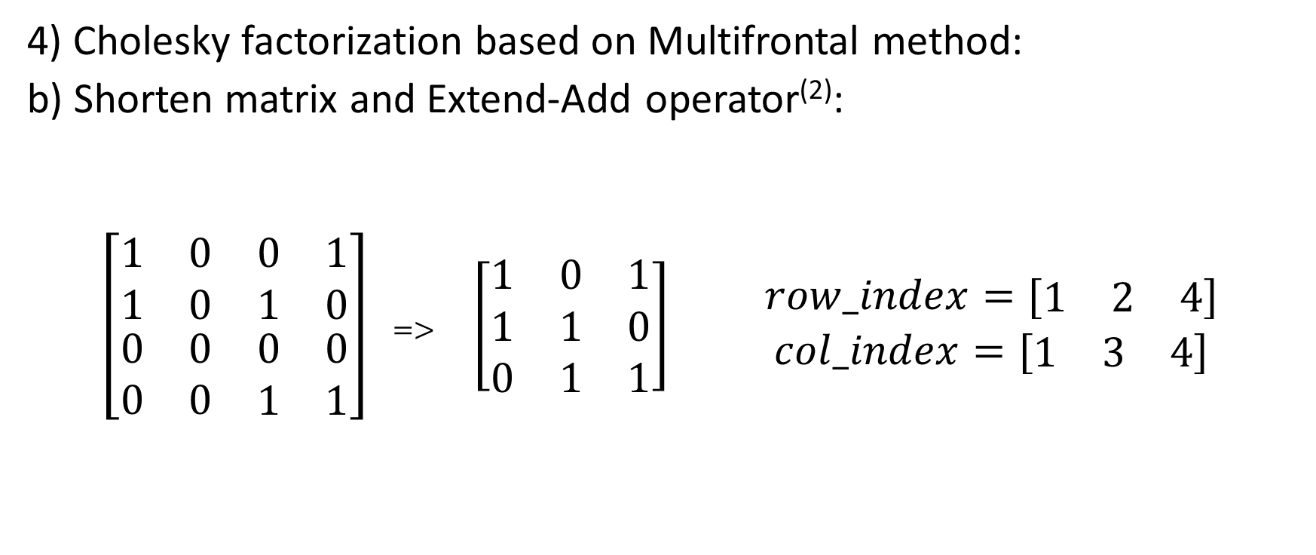
II) Theoretical basis
4) Cholesky factorization based on Multifrontal method:
b) Shorten matrix and Extend-Add operator⁽²⁾:
$\left[\begin{matrix}\begin{matrix}1 & 0 \\ 1 & 0\end{matrix} & \begin{matrix}0 & 1 \\ 1 & 0\end{matrix} \\ \begin{matrix}0 & 0 \\ 0 & 0\end{matrix} & \begin{matrix}0 & 0 \\ 1 & 1\end{matrix}\end{matrix}\right]$ => $\left[\begin{matrix}1 & 0 & 1 \\ 1 & 1 & 0 \\ 0 & 1 & 1\end{matrix}\right]$ $\begin{matrix}row_index=[\begin{matrix}1 & 2 & 4\end{matrix}] \\ col_index=[\begin{matrix}1 & 3 & 4\end{matrix}] \end{matrix}$

Slide 15
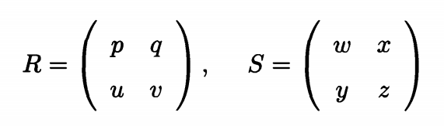
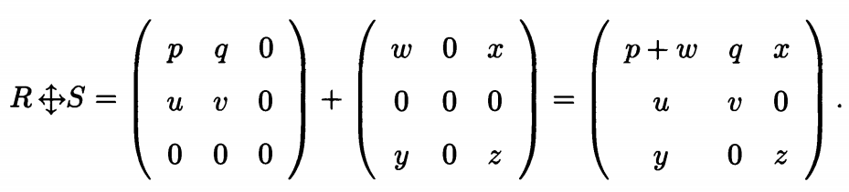

II) Theoretical basis
4) Cholesky factorization based on Multifrontal method:
b) Shorten matrix and Extend-Add operator⁽²⁾:
$index=[1, 2]$ $index=[1, 3]$

Slide 16
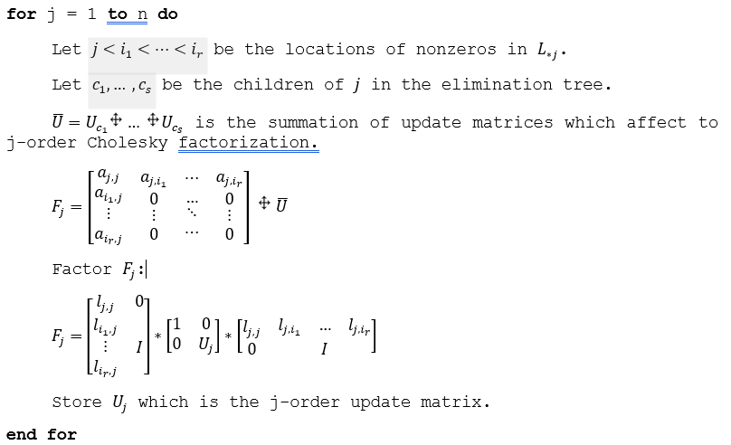
II) Theoretical basis
4) Cholesky factorization based on Multifrontal method:
c) Algorithm:

Slide 17
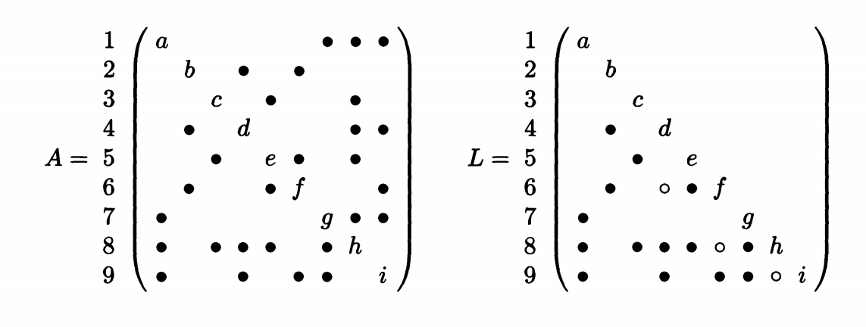
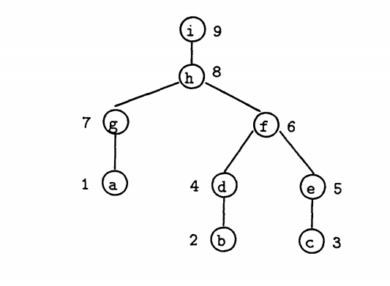
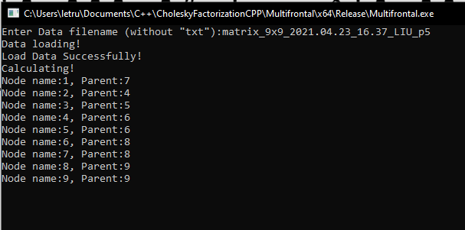
III) Testing result

Slide 18
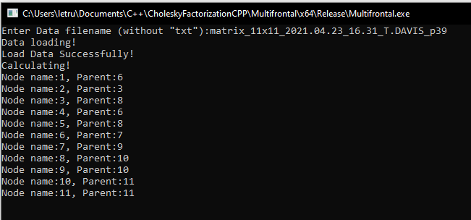
III) Testing result

Slide 19
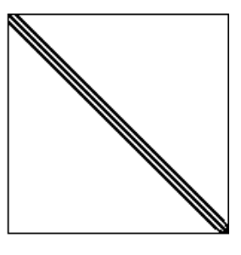
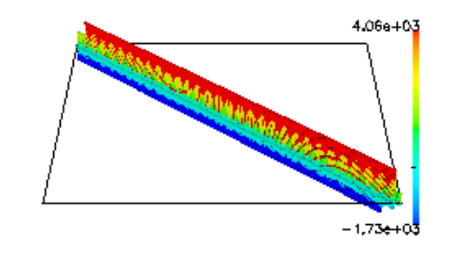
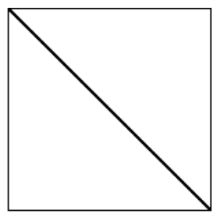
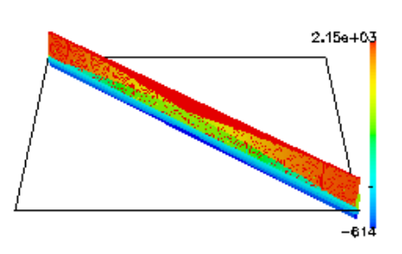
III) Testing result
First Dataset
Second Dataset
Max eigenvalue | 9.6688590706791765E+03
Min eigenvalue | 3.8956266582265278E-07
Condition number | 2.481978E+10.
Size | 5489 x 5489
Type | real symmetric positive definite
Nonzeros elements | 217669
Max eigenvalue | 4.6016534362482462E+03
Min eigenvalue | 2.4268618877322254E-08
Condition number | 1.896133E+11
Size | 90449 x 90449
Type | real symmetric positive definite
Nonzero elements | 4427725

Slide 20
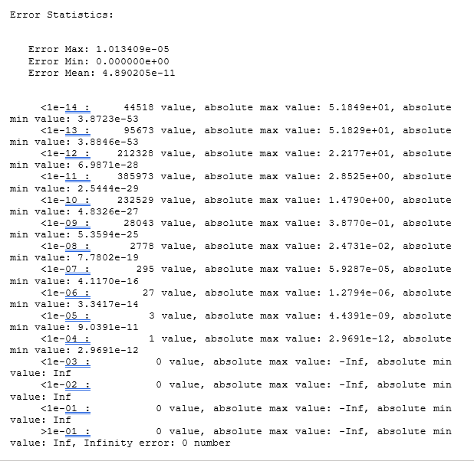
III) Testing result
First dataset
 | Multifrontal | Ordinary Cholesky | Built-in Cholesky
Time(s) | 15.509 | 446.692 | 39.814
Memory(MB) | 92.9 | 487.5 | 487.4

Slide 21
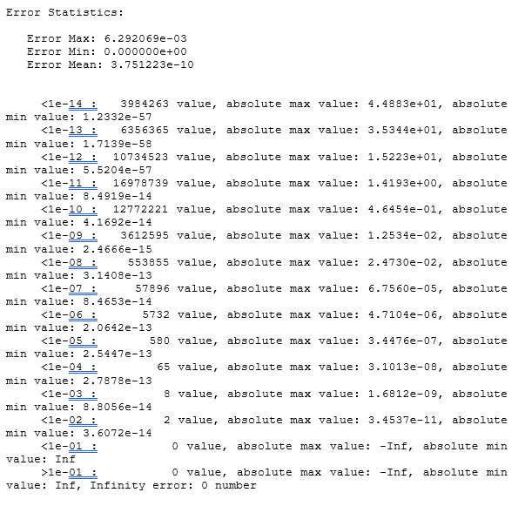
III) Testing result
Second dataset
Computational time: 2810.36s.
Memory usage: 3.7GB (peak 4.0GB).

Slide 22
III) Testing result
Conclusion
The Cholesky factorization based on Multifrontal method is not only very precise but also faster and lighter than ordinary Cholesky factorization.

Slide 23
References:
(1) Yan, D., T. Wu, Y. Liu, and Y. Gao. "An Efficient Sparse-Dense Matrix Multiplication on a Multicore System." Paper presented at the 2017 IEEE 17th International Conference on Communication Technology (ICCT), 27-30 Oct. 2017.
(2) Liu, Joseph W. H. "The Multifrontal Method for Sparse Matrix Solution: Theory and Practice." SIAM Review 34, no. 1 (1992/03/01 1992): 82-109.
(3) Davis, Timothy A. Direct Methods for Sparse Linear Systems. Fundamentals of Algorithms. Society for Industrial and Applied Mathematics, 2006.
(4) Duff, I. S., A. M. Erisman, and J. K. Reid. Direct Methods for Sparse Matrices. Numerical Mathematics and Scientific Computation. 2 ed. Oxford: Oxford University Press, 2017.
(5) Kincaid, David, and Ward Cheney. "Numerical Analysis : Mathematics of Scientific Computing, Third Edition." (2009).

