Slide 1


Slide 2
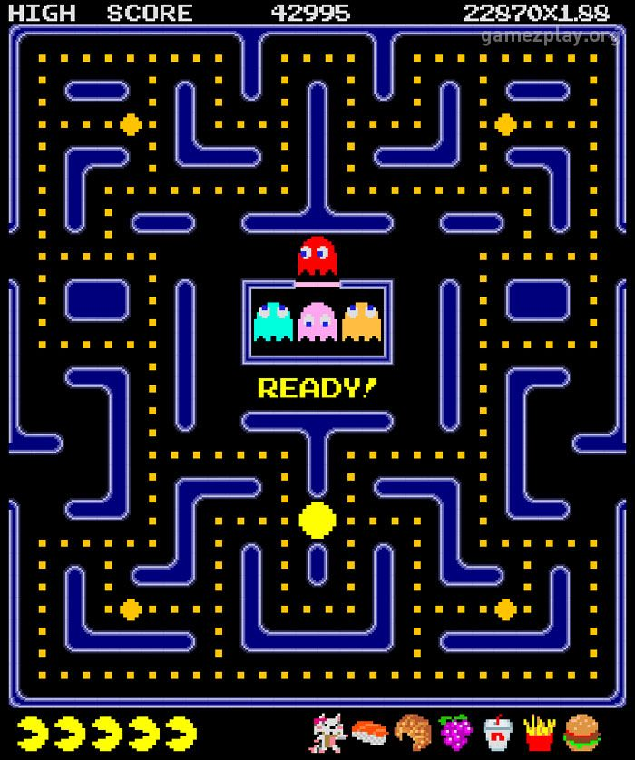

Slide 3
P A C-M A N
60%
LOADING...

Slide 4



P A -M A N
60%
LOADING...

