Slide 1


Inventory Taking in the
SLT Dayton Warehouse
User guide: Stockcount app and Elixir ERP
Notes:
Introduce the session: how users take inventory in the warehouse using the Stockcount app and how the count is brought into Elixir.

Slide 2



The Stockcount app is the golden source
What it shows
What users count in the warehouse
STOCKCOUNT APP
Golden source of inventory data
What it does not show
What is in the system (Elixir)
Notes:
The Stockcount app is the golden source of inventory data. It does not show what is in the system.

Slide 3


The process at a glance
StockCount
Import
Review
Adjust/ Receive
Warehouse users count stock with the Stockcount app
Download the data (CSV or Excel) and import it into Elixir
Review the reports, then decide to adjust or receive
Notes:
Three stages: count in the warehouse with the Stockcount app, download and import into Elixir, then review the reports and decide what to adjust or receive.

Slide 4





Before you start
Product master is up to date
Count, product name and landed cost
Location areas and locations are up to date
Check before counting begins
No master data changes while counting
Cannot create products or locations, or update data, while inventory taking is in progress
Bins (locations) are allocated to users
Each bin is assigned to a counting user
Credentials are created for counting users
For the users who will take inventory
Notes:
Master data must be current before counting: product master (count, product name, landed cost) and location areas and locations. While inventory taking is in progress, products and locations cannot be created and data cannot be updated. Bins are allocated to users, and credentials are created for the users who will take inventory.

Slide 5
Process flow
1
2
3
4
5
Count
Download
Import & Get Stockcount Report
Extract Stockcount report
Extract Stockcount Inventory Adj download
Users count in the warehouse with the Stockcount app
After FINISH, download CSV.
Import the Excel file into Elixir.
Goto WMS-> Import/Export -> Import -> Stockcount Import
This report will provide data that has been imported in Elixir for verification purposes
This report will give data from Elixir and Stockcount to decide adjustment
Notes:
Walk through the five steps: count in the Stockcount app, download after FINISH (a Stockcount_Id is created for each download), import the Excel into Elixir, review with the new reports, then decide what to adjust or receive.

Slide 6
New reports for Adjustment
Stockcount Report
Review what has been loaded in Elixir
Stockcount-Elixir Comparison (Batch)
Product and batch level: stockcount vs Elixir
Stockcount-Elixir Comparison (Location)
Location level: stockcount vs Elixir
Inventory Adj Download
Inventory adjustment download for all products in the stockcount
Notes:
The five new reports: Stockcount Report (by stockcount_id), the two comparison reports (batch and location), the Inventory Adj Download and the Receive Import template.

Slide 7


Decide: adjust or receive
Inventory Adj Download
Inventory adjustment download for all products in the stockcount
Receive Import Template
Receive import template for all products in the stockcount
Users take the adjust and receive decisions
Notes:
Both downloads cover all products in the stockcount. Users have to take decisions on adjusting and receiving.

Slide 8



Points to discuss
One product in multiple stockcounts
Users take the decisions
Product or batch on hold (Committed)
The same product can appear in more than one stockcount location. Agree how to handle it.
Adjusting or receiving is decided by the user.
It cannot be adjusted until it is shipped out or unconfirmed.
Notes:
Open points for discussion: a product appearing in multiple stockcounts; the decisions on adjusting and receiving sit with users; a product or batch on hold (Committed) cannot be adjusted until it is shipped out or unconfirmed.

Slide 9



Make sure the Stockcount data is right
The system runs some validations, but users must make sure of:
Data integrity
Data cleanliness
Data validations
Notes:
Close: the system does some validations, but users are responsible for data integrity, data cleanliness and data validations.

Slide 10
Pre Steps for SLT
Identify users who will take inventory
Create credentials (user/password) for users
Identify locations (bins) for users for inventory
Add new products or locations if missing
Make sure all sales orders are either open or closed (no committed qty)
Make sure all receives are closed (putaway done)
Make sure all scheduled transfers are closed (received in destination warehouse)
Extract inventory dumps at product, batch and location levels
Provide excel files for users, user-credentials, user-locations to Elixir support
Notes:
Close: the system does some validations, but users are responsible for data integrity, data cleanliness and data validations.

Slide 11
Pre Steps for Elixir Support
Update Stockcount application with user info
Give access to users to download the Stockcount application
Notes:
Close: the system does some validations, but users are responsible for data integrity, data cleanliness and data validations.

Slide 12
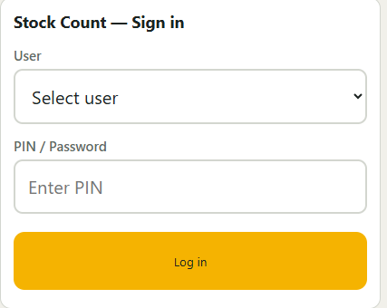
Stockcount – Inventory taking application
Download .zip file that Elixir will provide access
Right click on .zip file and click on ‘Extract All’ and select the folder to copy files
There will be 5 files with index.html
Click on index.html and screen will open
Notes:
Close: the system does some validations, but users are responsible for data integrity, data cleanliness and data validations.

Slide 13
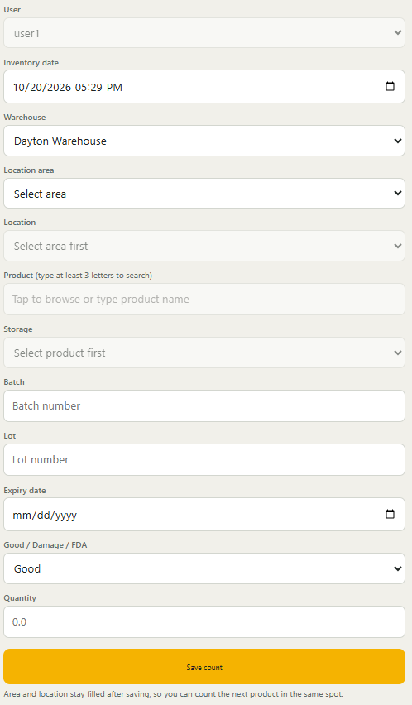
Stockcount – Inventory taking application
User will enter credentials and log in.
User can see inventory taking screen
Location Area and locations are as per user
User will go bin by bin and enter data on UI
Key is Product/Batch/Lot/Expiry Date/Good Damage Ind/Storage
System shows old entry to edit if same key is entered again
After completing, click on Save Count button
Notes:
Close: the system does some validations, but users are responsible for data integrity, data cleanliness and data validations.

Slide 14
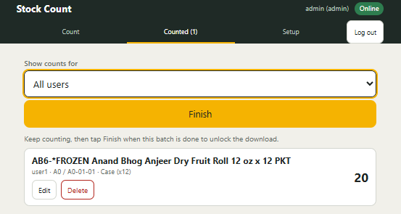
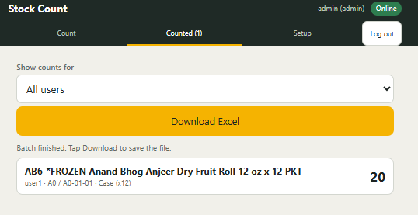
Stockcount – Inventory taking application
Admin can login using their credentials and select the user and can see the data captured.
Admin can go to counted tab and select user & click on Finish once done.
Only Admin has rights to access counter and setup
Admin can download excel data
Notes:
Close: the system does some validations, but users are responsible for data integrity, data cleanliness and data validations.

Slide 15
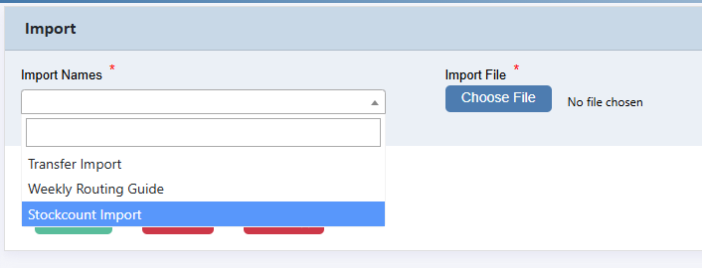
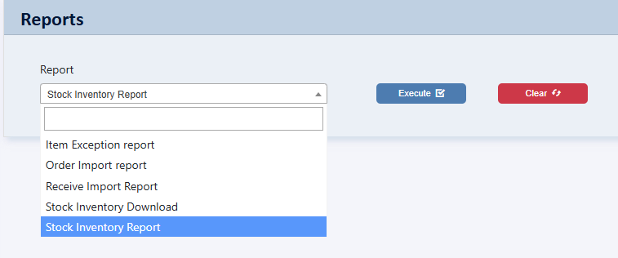
Stockcount – Inventory taking application
Excel data downloaded from Stockcount has to be imported to Elixir
Go to Elixir WMS -> Import/Export -> Imports
Choose the file downloaded from Stockcount and import
If loaded multiple times, system will create multiple versions
Only latest version will be used for Inventory Adjustment
Extract data from Elixir that has been imported Go to WMS ->Import->Export->Reports->Stockcount Inventory Report
Notes:
Close: the system does some validations, but users are responsible for data integrity, data cleanliness and data validations.

Slide 16
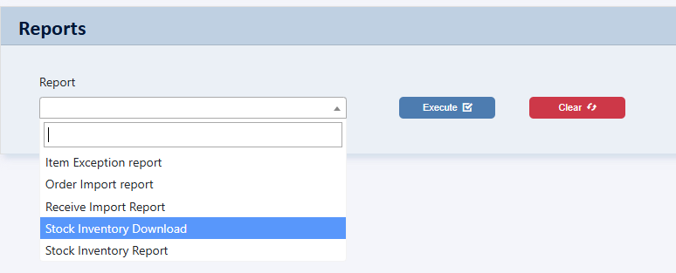
Stockcount – Inventory taking application
Stock Inventory Report will give details of Stockcount data imported in Elixir.
Admin can check and confirm the accuracy and credibility of the data captured by Stockcount
Admin can make changes in the excel and import again using Stockcount import. Make sure remove staging_id field from the excel.
Stock Inventory Download report will give inventory data at location that is in Elixir and in Stockcount
User can compare Stockcount data and Elixir
This excel report will be then send to Elixir Support
Elixir Suppor team will perform the adjustment
Once adjustment is done, Elixir will have data sent
Notes:
Close: the system does some validations, but users are responsible for data integrity, data cleanliness and data validations.

