Slide 1

Financial Activity Dashboard
This presentation outlines a financial activity dashboard built using Python and the Streamlit library. The dashboard leverages powerful data processing, anomaly detection, and visualization tools to provide valuable insights from bank transaction data.

Slide 2
Introduction to the Dashboard
This dashboard serves as a comprehensive tool for analyzing financial activity, helping users identify trends, anomalies, and key metrics. It combines data processing, visualization, and reporting capabilities to deliver actionable insights.
1
User-Friendly Interface
2
Interactive Visualizations
The dashboard is designed with an intuitive interface for easy navigation and data exploration.
Users can interact with charts and graphs to delve deeper into the data and uncover hidden patterns.

Slide 3
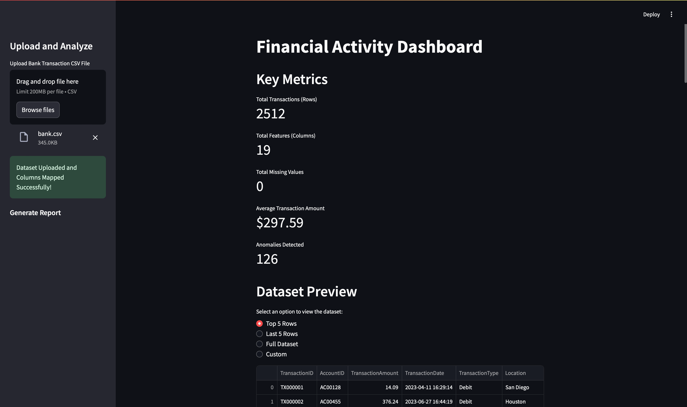

Slide 4
Data Processing: Mapping Columns, Handling Missing Values
The dashboard begins by processing raw bank transaction data. This step involves mapping columns to meaningful labels and handling missing values using appropriate imputation techniques.
Column
Description
Transaction ID
Unique identifier for each transaction
Date
Date of the transaction
Amount
Value of the transaction

Slide 5



Calculating Key Metrics: Total Transactions, Average Amounts
The dashboard calculates crucial metrics, such as the total number of transactions and the average transaction amount, providing a comprehensive understanding of the financial activity.
Total Transactions
Average Amounts
Anomaly Scores
The dashboard calculates the total number of transactions within a specified time period.
The dashboard calculates the average amount of transactions, providing a measure of typical spending patterns.
The dashboard assigns anomaly scores to each transaction, indicating the likelihood of it being an outlier.

Slide 6
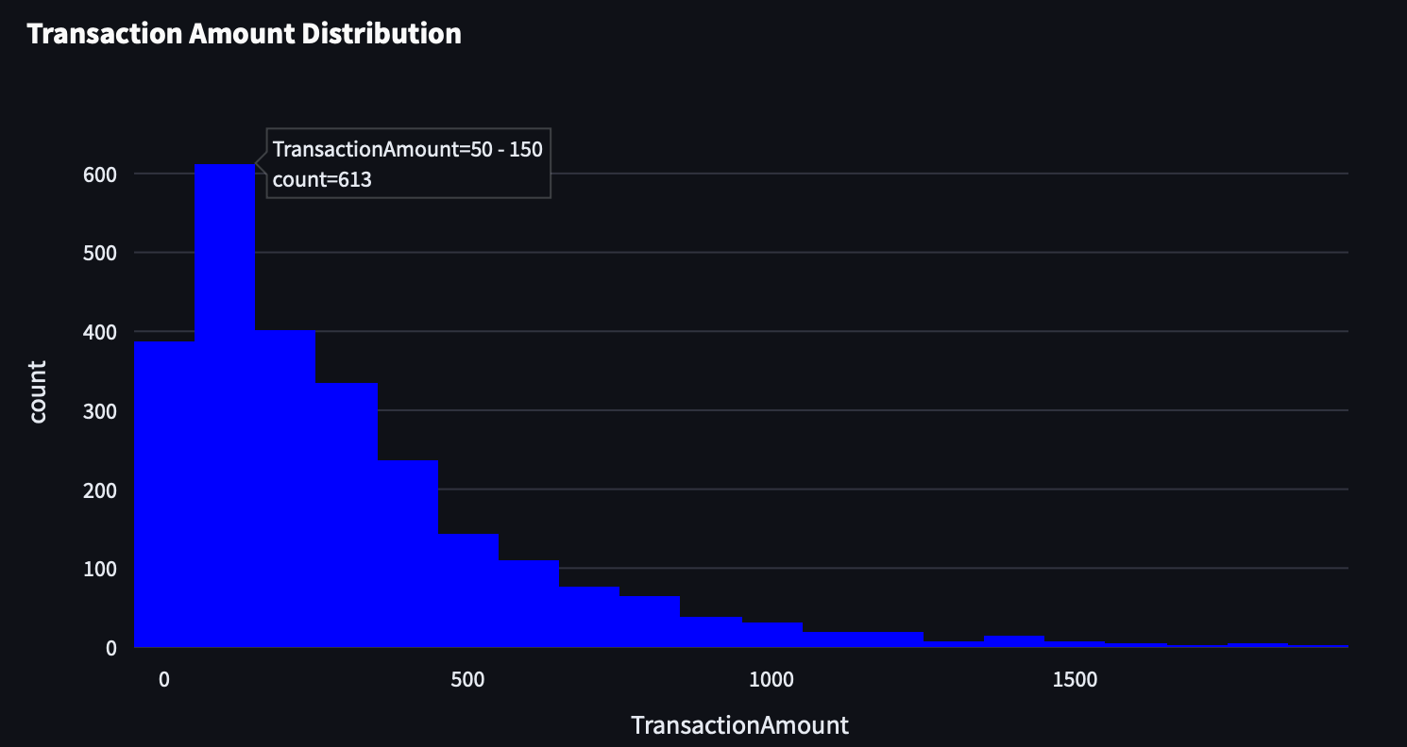
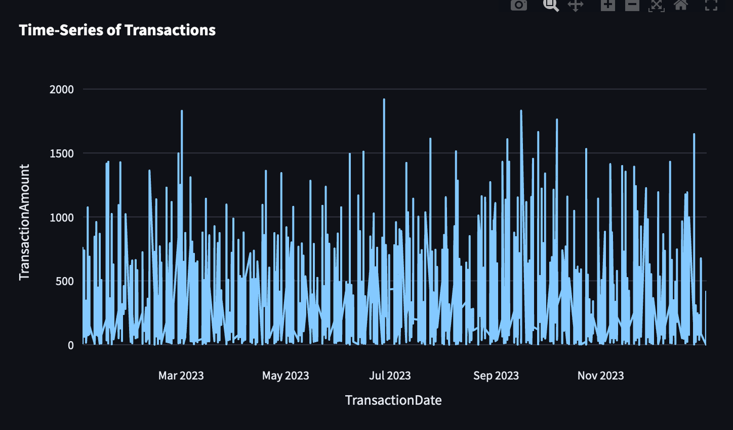
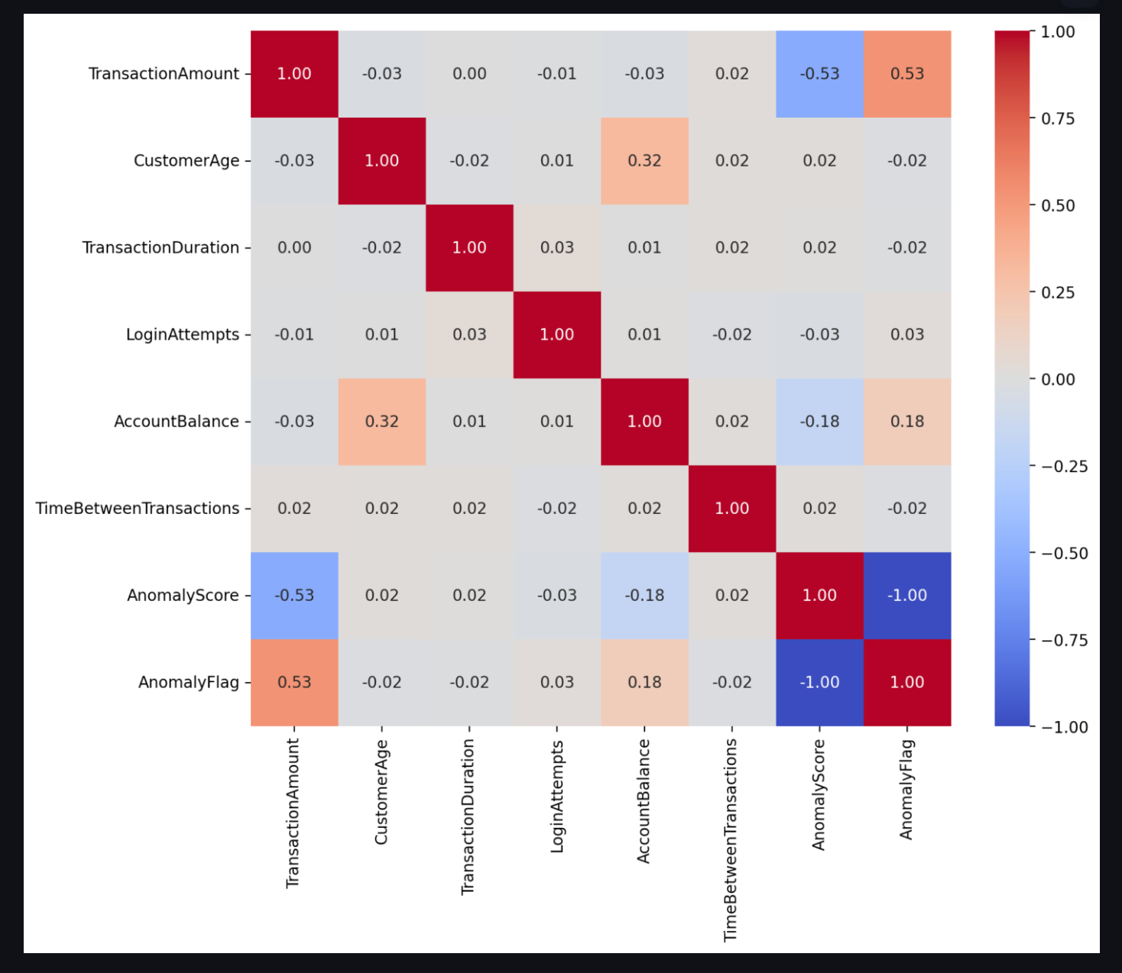
Visualizations: Histograms, Time-Series, Heatmaps
The dashboard leverages various visualization techniques, including histograms, time-series plots, and heatmaps, to visually represent the financial activity and highlight key patterns and trends.
Transaction Amount Distribution
Transaction Volume Trend
Variable Correlations
Time-series plots track transaction volume over time, revealing trends and seasonal patterns.
Heatmaps illustrate correlations between different financial variables, helping identify potential relationships.
Histograms provide insights into the distribution of transaction amounts.

Slide 7
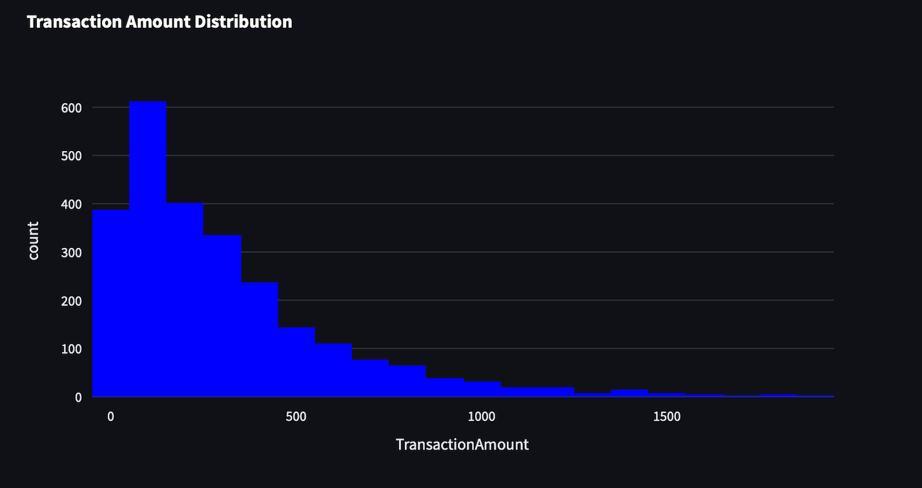

Slide 8
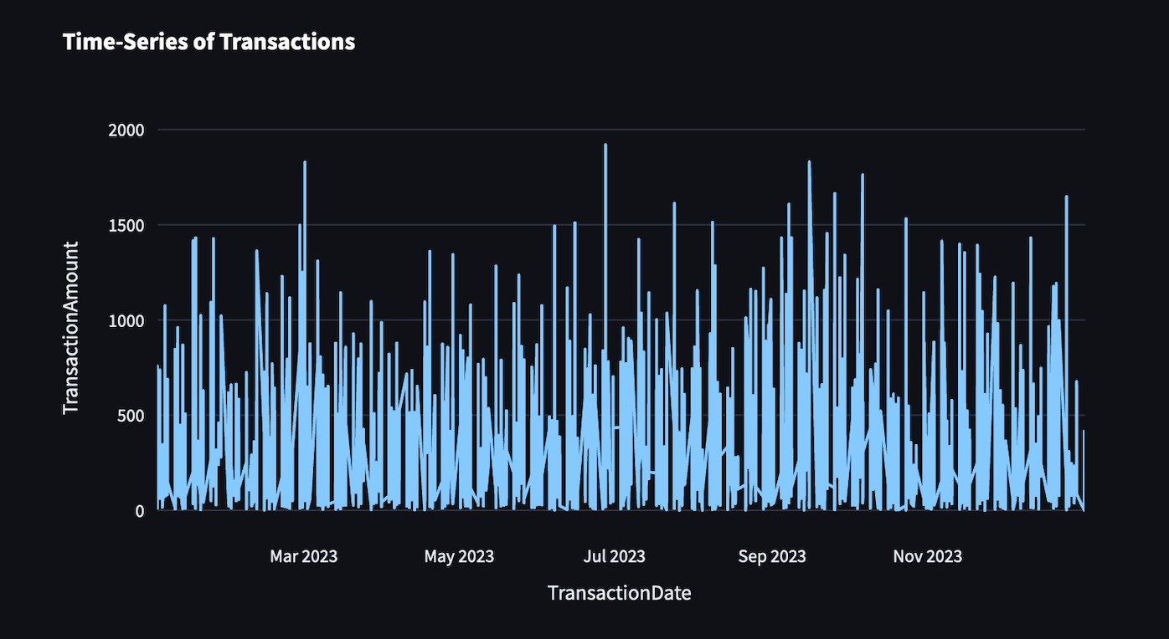

Slide 9
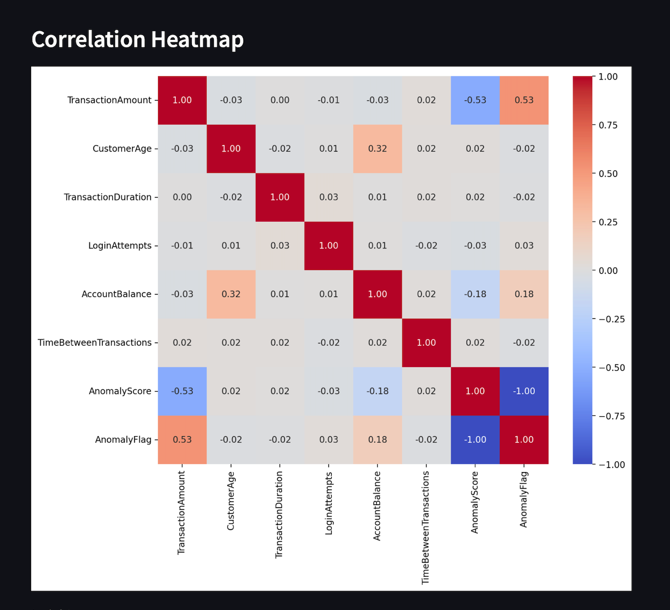

Slide 10
Anomaly Detection with IsolationForest
The IsolationForest algorithm is employed to identify anomalies or outliers within the transaction data. The algorithm isolates anomalies by randomly partitioning the data space, effectively identifying data points that lie outside the typical distribution.
Anomaly Detection
Outlier Identification
The IsolationForest algorithm is used to detect anomalies in the transaction data.
Anomalies are identified as data points that are significantly different from the rest of the data.

Slide 11
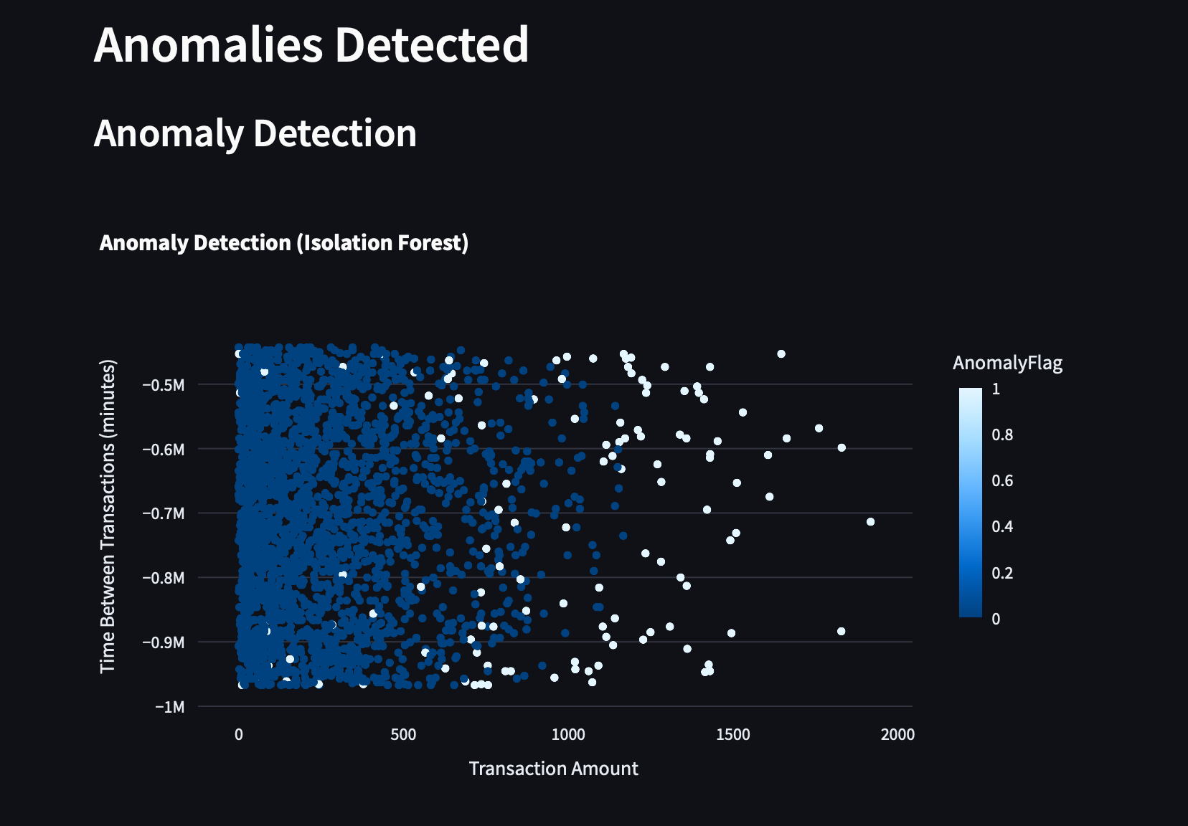
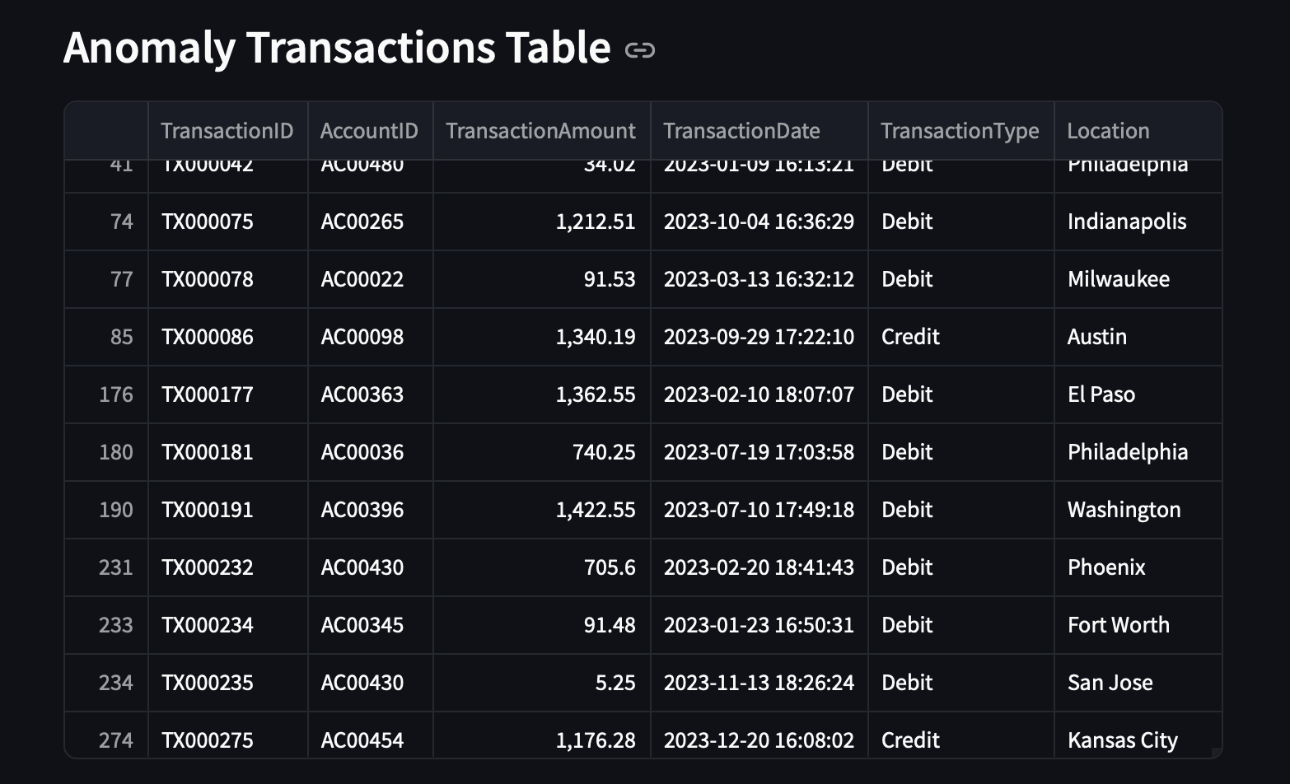

Slide 12
Generating Downloadable Reports
The dashboard enables users to generate detailed reports in various formats, including PDF and CSV, for further analysis and sharing. These reports provide a comprehensive overview of the financial activity, including key metrics, visualizations, and any identified anomalies.
PDF Reports
CSV Reports
The dashboard can generate downloadable PDF reports containing visualizations and detailed analyses.
CSV reports allow users to export the processed data for further analysis in other applications.

Slide 13
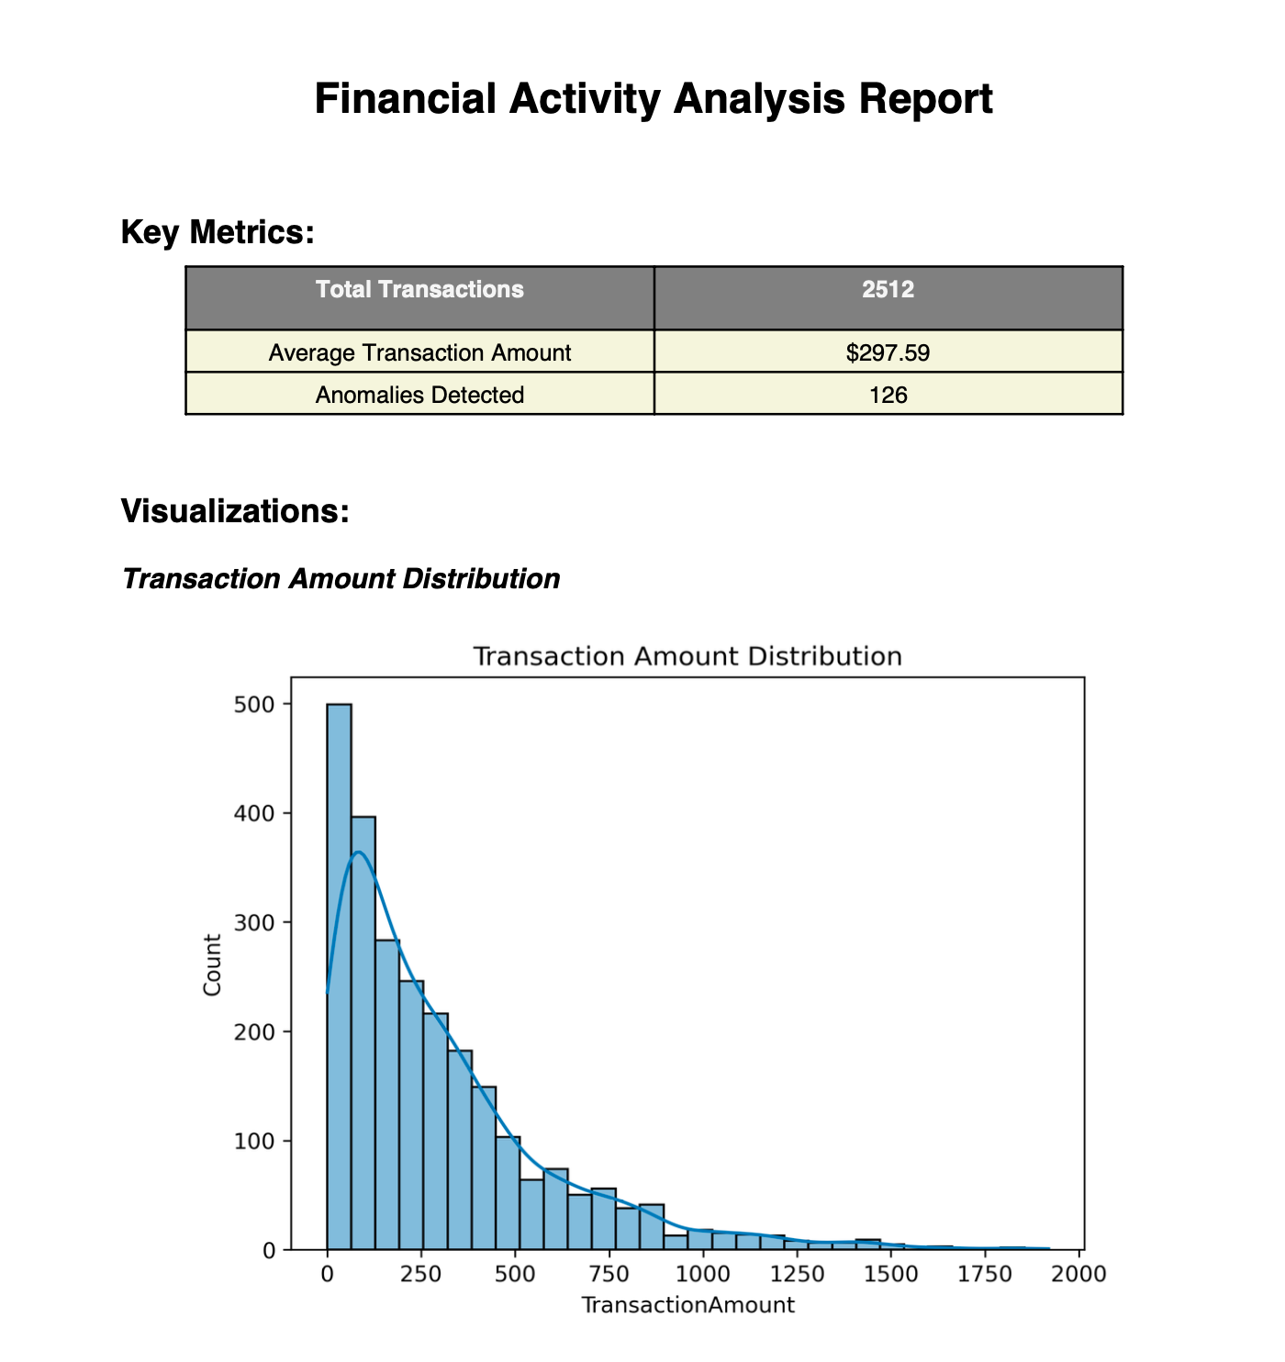
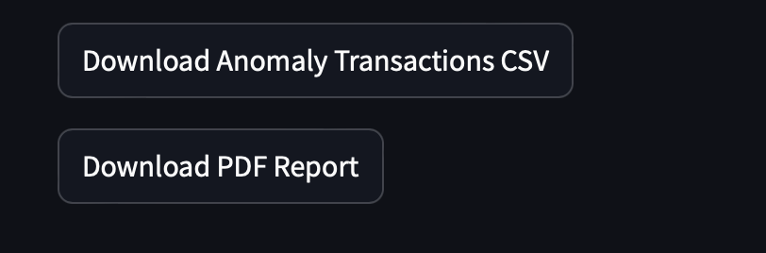

Slide 14
Benefits of the Dashboard
This financial activity dashboard offers numerous benefits to users, including enhanced financial insights, efficient anomaly detection, and improved decision-making capabilities.
1
Early Anomaly Detection
The dashboard's anomaly detection capabilities allow for early identification of unusual financial activities, potentially preventing fraud or financial irregularities.
2
Data-Driven Insights
The dashboard provides data-driven insights into financial trends, allowing users to make informed decisions based on real-time data.
3
Improved Efficiency
The dashboard streamlines financial analysis processes, saving time and resources.

Slide 15
Conclusion and Next Steps
The financial activity dashboard empowers users with comprehensive insights into their financial data, enabling better decision-making and proactive risk management.
1
Future Enhancements
2
Integration with Other Systems
Future development plans include incorporating machine learning models for more sophisticated anomaly detection and predictive analytics.
The dashboard can be integrated with other financial systems, providing a more holistic view of financial activity.

Slide 16
THANK YOU

