Slide 1
God Creates the World and Man
Song: God is so good.
https://www.youtube.com/watch?v=VSktHtMLP-Q
Foundation Verse
In the beginning God created the heavens and the earth.
Genesis 1:1

Slide 2




Today We Will Learn:
•God created the world.
•God created everything by His word.
•God made people special.
•God saw that His creation was good.
•Teacher note: Ask: “What are some things in God’s creation that you enjoy?”

Slide 3
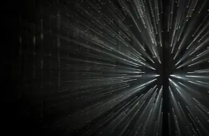
Before the World Began
•Before there was the world, there was God.
•No sky
•No land
•No animals
•No people
•Only God
•Key Truth:
•God has always existed.

Slide 4
God Spoke
•God spoke, and creation began.
•God said, “Let there be light.”
•Light came into the darkness.
•God has power over all creation.
•Key Verse:
•In the beginning God created the heaven and the earth.
•Genesis 1:1

Slide 5
Hook: Light switch
(Walk over to the light switch.)
Turn on/off! Turn on/off! Turn on/off!
I can’t just make the light go on/off by talking to it.
My words are not strong.
Would you like me to tell you about Someone whose words are very, very strong?

Slide 6
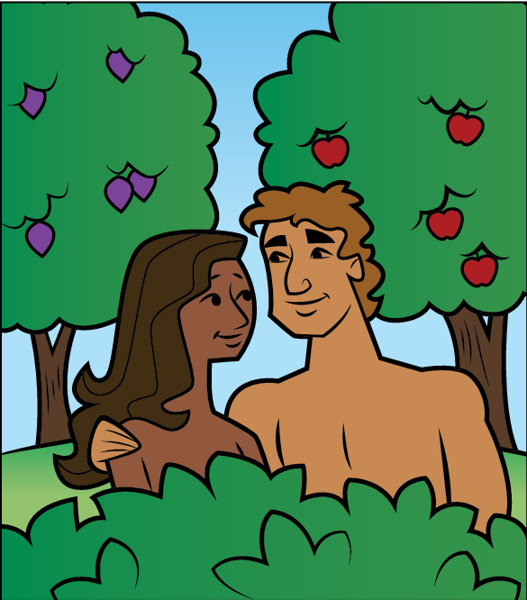
Look: Visual Lesson
(Show the Coloring Book)
Here is a picture of some of the things God made.
What do you see in the picture?
(As children mention each item, ask...) Is the item good?
Everything God made is good.
God makes good things because God is good.
Our good God made good [item]. Our good God made good [item]...God is good!
God is very happy about all the good things He made.
Let’s sing about how good God is!
(Sing the song “God Is So Good.”)

Slide 7
God Creates the World and Man
Verse:
In the beginning God created the heavens and the earth.
Genesis 1:1
Song: https://www.youtube.com/watch?v=VSktHtMLP-Q
Video: https://www.youtube.com/watch?v=teu7BCZTgDs

Slide 8
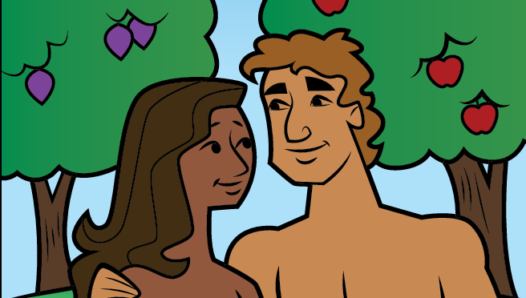
God Creates the World and Man
Before there was the world, there was God.
God created (made) the world from nothing just by speaking.
Everything that God created is good.
God’s most special creation is man and woman (male and female), whom He created different than the rest of creation.
God created people to know Him in a special way.
On the seventh day God rested—His work of creation was done.
Notes:
NOTE: To change images on this slide, select a picture and delete it. Then click the Insert Picture icon in the placeholder to insert your own image.

Slide 9

God Created on
LIGHT
DAY 1
Notes:
NOTE: To change images on this slide, select a picture and delete it. Then click the Insert Picture icon in the placeholder to insert your own image.

Slide 10

God Created on
SKY
DAY 2
Notes:
NOTE: To change images on this slide, select a picture and delete it. Then click the Insert Picture icon in the placeholder to insert your own image.

Slide 11

God Created on
Trees
DAY 3
Notes:
NOTE: To change images on this slide, select a picture and delete it. Then click the Insert Picture icon in the placeholder to insert your own image.

Slide 12

God Created on
SUN, Moon, Stars
DAY 4
Notes:
NOTE: To change images on this slide, select a picture and delete it. Then click the Insert Picture icon in the placeholder to insert your own image.

Slide 13

God Created on
Fish & Birds
DAY 5
Notes:
NOTE: To change images on this slide, select a picture and delete it. Then click the Insert Picture icon in the placeholder to insert your own image.

Slide 14

God Created on
Man – Male & Female
DAY 6
Notes:
NOTE: To change images on this slide, select a picture and delete it. Then click the Insert Picture icon in the placeholder to insert your own image.

Slide 15
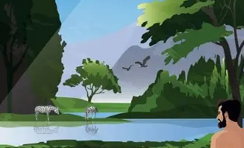
Then the LORD God formed a man from the dust of the ground and breathed into his nostrils the breath of life, and the man became a living being.
•God made man from the dust of the ground.
•God gave man life.
•God made man in His image.
•People are special to God.
God Created Man
Genesis 2:7

Slide 16

So the LORD God caused the man to fall into a deep sleep; and while he was sleeping, he took one of the man’s ribs and then closed up the place with flesh. Then the LORD God made a woman from the rib he had taken out of the man, and he brought her to the man.
•God created woman to be a helper and companion for man.
•God made woman special.
•God created man and woman.
•Both are important to God.
God Created Woman
Genesis 2:21–22

Slide 17

God Created on
REST
DAY 7
Notes:
NOTE: To change images on this slide, select a picture and delete it. Then click the Insert Picture icon in the placeholder to insert your own image.

Slide 18

God’s Creation Is Good
•God looked at everything He had made.
•It was very good!
•The sky is good.
•The trees are good.
•The animals are good.
•People are God’s special creation.

Slide 19
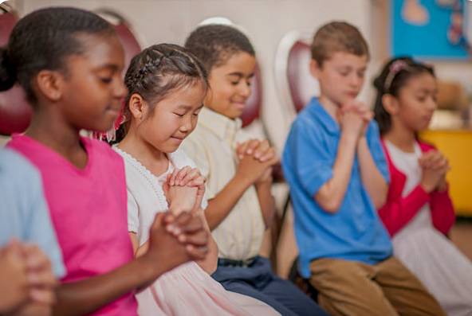
Closing Prayer
•Thank You, God
•“Dear God, thank You for creating the world.
•Thank You for the sky, land, plants, animals, and people.
•Help us love and care for Your beautiful creation.
•Amen.”

Slide 20
• Class Question:
• What is your favorite thing God created?
Send Home/Class
Coloring Book
  https://letsliveforjesus.github.io/bible/color-puzzle.html
Creation Dot
  https://letsliveforjesus.github.io/bible/creation-dots.html
Creation Adventure
  https://letsliveforjesus.github.io/bible/creation.html

