Slide 1
Wheat Crop Segmentation
🌾
in Field Images Under Diverse Conditions
Group "Vision Pro" · Chenci Liu · Jianyu Zhou · Junwen Xue · Liuyunan He · Mengyang Yuan

Slide 2
OUTLINE
01
02
Introduction & Dataset
Literature Review
EWS dataset, task definition
Related methods for crop segmentation
03
04
Methods (M1 / M2 / M3 / M3-R)
Experiments & Results
Classical · ML · Deep Learning · Improvement
Main comparison, robustness, data reduction
05
Discussion & Conclusion
Analysis, limitations, future work

Slide 3
INTRODUCTION
Why Wheat Segmentation?
Key Challenges
Supports crop monitoring across growing seasons
Enables early detection of pest and disease
Separates wheat plants from soil/background automatically
Foundation for yield estimation and phenotyping
Varying illumination & cast shadows
Soil and plant colours can be similar
Seasonal appearance changes (Feb – May)
Overlapping stems and partial occlusions
Task: Given a 350×350 RGB wheat field image → output a binary mask (plant = 1, soil = 0)

Slide 4
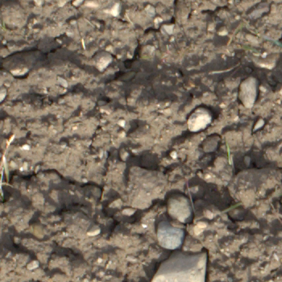
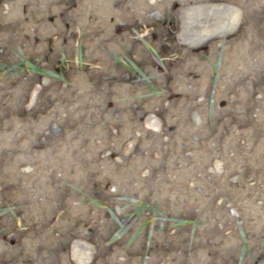
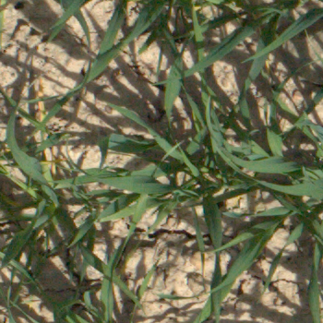
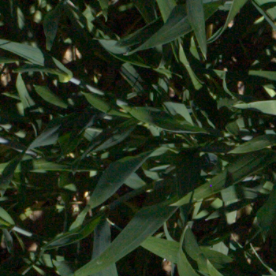
DATASET: EWS (Eschikon Wheat Segmentation)
190
350 × 350
142 / 24 / 24
Binary
Total Images
Pixels (RGB)
Train / Val / Test
Plant vs Soil Masks
Dataset Properties
ETH Zurich Eschikon field station; training spans 2017–2020 (Nov–Apr, no May); val/test from 2017 only (Feb–May)
Diverse illumination: early morning, midday, overcast, shadows
Manual binary annotation: wheat plant (foreground) vs soil/ground (background)
Official train/val/test split — never mixed to prevent data leakage
Feb
Mar
Apr
May

Slide 5
LITERATURE REVIEW
Classical Methods
Machine Learning
Watershed algorithm (marker-based)
GrabCut — iterative graph-cut refinement
Vegetation indices: ExG, ExR, ExGR
Handcrafted feature descriptors
Random Forest pixel classifier
Colour spaces: RGB, HSV, chromaticity
OpenCV · SIGGRAPH 2004
scikit-learn
Deep Learning
Crop-Specific Work
U-Net encoder-decoder architecture
Dice + BCE segmentation loss
Data augmentation (flips, colour jitter, Gaussian noise)
EWS dataset (Zenkl et al. 2022)
Depth-informed pseudo-label segmentation
Ronneberger et al. 2015
Frontiers Plant Science

Slide 6
METHOD 1: Watershed + GrabCut (Unsupervised)
Core Idea
Pipeline
Exploit the fact that wheat is greener than soil.
Compute a per-pixel vegetation score → seed-based Watershed segmentation (Watershed variant selected for speed).
1
Compute ExG & vegetation score map
2
Build foreground / background seed masks
Vegetation Score Formulas
Watershed: S = 1.7·ExG + 0.9·GreenDom + 0.4·Sat − 0.15·|∇|
GrabCut: S = 1.5·ExG + 0.9·GreenDom + 0.35·Sat
3
Run Watershed segmentation
4
Morphological post-processing (opening + closing + remove < 96 px)
Two variants tested on val set: Watershed (IoU=0.444) vs GrabCut (IoU=0.472). Watershed selected: comparable accuracy, much faster tuning.

Slide 7
METHOD 2: Handcrafted Features + Random Forest
Random Forest Settings
26-Dimensional Feature Vector (per pixel)
n_estimators:
250 trees
RGB values (3)
HSV values (3)
Chromaticity (3)
max_depth:
20
R, G, B channel values
Hue, Saturation, Value
Normalised r, g, b
class_weight:
balanced_subsample
Local RGB mean (3)
Local HSV mean (3)
Veg. indices (3)
9×9 window average
9×9 window average
ExG, ExR, ExGR
threshold:
tuned on validation set
ExG statistics (3)
Greyscale stats (3)
Gradient (2)
candidates:
[0.35 … 0.65] (7 values)
ExG mean, var, ExGR mean
Grey, local mean/var
Grey gradient, ExG gradient
random_state:
42 (reproducible)
Post-processing: morphological closing (2×2) + remove components < 96 px

Slide 8
METHOD 3: Lightweight U-Net (Deep Learning)
Architecture (base_channels = 16, ≈ 490 K parameters)
Training Settings
Down 2
32 ch
Down 3
64 ch
Bottle
128 ch
Loss:
Dice + BCE
Input
3 ch
Down 1
16 ch
Optimizer:
Adam
← skip connections
LR:
0.001
Output
1 ch
Up 1
16 ch
Up 2
32 ch
Up 3
64 ch
Epochs:
20
Batch size:
4
Channels:
16 (base)
Threshold:
tuned on val set
Augmentation:
Flip + colour jitter + Gaussian noise
Post-processing: closing (2×2) + remove components < 96 px

Slide 9
M3-R: Robustness Improvement (Advanced Method Development)
1
Problem Identified
2
Improvement Designed
3
Result Achieved
Robustness benchmark reveals:
M3 on Low-contrast ×0.4:
IoU 0.874 → 0.596
ΔIoU = −0.278 (worst drop)
Root cause:
Contrast reduction flattens colour differences, making plant and soil pixels look similar
Distortion augmentation during training (p = 0.70):
• Gaussian noise σ ∈ [10, 45]
• Gaussian blur σ ∈ [1.0, 3.5]
• Brightness × [0.35, 0.75]
• Contrast × [0.35, 0.75]
Only distortion_augment: true added to config — all other hyperparameters unchanged
Low-contrast ×0.4:
M3 → 0.596
M3-R → 0.762 (+0.166)
Clean images:
M3 → 0.874
M3-R → 0.861 (−0.013)
Acceptable accuracy/robustness trade-off

Slide 10
EXPERIMENTAL SETUP
Evaluation Metrics
Three Experiments
IoU
TP / (TP+FP+FN)
Primary metric
1
Main Comparison
Train all 3 methods on full training set; evaluate on test set; report 5 metrics + train/infer time.
F1 Score
2·Precision·Recall / (P+R)
Harmonic mean
Precision
TP / (TP+FP)
Positive predictive value
2
Robustness Benchmark
Recall
TP / (TP+FN)
Detection rate
Train once on clean data; test under 9 distortion conditions; compare M3 vs M3-R.
Pixel Acc.
(TP+TN) / total
Overall accuracy
3
Data Reduction
Train at 25%/50%/75%/100% of training data; evaluate test IoU; M1 flat baseline.

Slide 11
RESULTS: Method Comparison
Key Findings
M3 (U-Net) best IoU = 0.874, outperforms M1 by +0.459
M2 (RF) competitive at 0.850 — much simpler architecture
M1 limited at 0.415 — colour heuristics fail on diverse conditions
M3 trains in similar time to M2 (119 s vs 126 s) — 11.6× faster inference (0.028 vs 0.325 s/img)
Method | IoU | F1 | Prec. | Recall | Train(s) | Infer(s/img)
M1 Watershed | 0.415 | 0.553 | 0.574 | 0.585 | 34 | 0.021
M2 Rand. Forest | 0.850 | 0.916 | 0.915 | 0.926 | 126 | 0.325
M3 U-Net ★ | 0.874 | 0.931 | 0.922 | 0.941 | 119 | 0.028

Slide 12
RESULTS: Seasonal Performance
Key Findings
Month | n | M1 IoU | M2 IoU | M3 IoU
Feb | 2 | 0.713 | 0.977 | 0.977
Mar | 8 | 0.573 | 0.923 | 0.926
Apr | 7 | 0.292 | 0.817 | 0.863
May | 7 | 0.272 | 0.763 | 0.796
All | 24 | 0.415 | 0.850 | 0.874
▸ M1 (Watershed) collapses seasonally: Feb 0.713 → May 0.272 (−0.441)
▸ M2 (RF) declines moderately: Feb 0.977 → May 0.763 (−0.214)
▸ M3 (U-Net) most robust: Feb 0.977 → May 0.796 (−0.181)
▸ Cause: dense May canopy raises background ExG;
Watershed seeds become unreliable
⚠ Worst May image (20170505): M1 IoU = 0.086 (near-total failure)
▸ Training has NO May images — learning-based methods still generalise above IoU 0.76

Slide 13
RESULTS: Robustness Benchmark
M3 drops 0.874→0.596 on low-contrast ×0.4 | M3-R recovers to 0.762 (+0.166) | M1 improves under noise (0.415→0.541) but drops under blur

Slide 14
RESULTS: Training Data Reduction
Key Observations
M1 flat at 0.415 — unsupervised, ignores training data
M2 at 25% (35 imgs) already reaches 0.848 ≈ full-data 0.850 — highly sample-efficient
M3 improves steadily: 0.852 → 0.874 (+0.022)
M3 shows diminishing returns beyond 50%; M2 dips at 50% due to sample variance
Random seed = 42 ensures reproducibility
M2 generalises well from limited labelled data; M3 benefits from full data but the gain is modest on this 142-image dataset.

Slide 15
DISCUSSION
Why M3 outperforms M2?
Why M1 underperforms?
U-Net learns spatial context across entire image, not per-pixel features
Skip connections capture both local texture and global structure
End-to-end optimisation targets boundary quality directly
Vegetation score assumes consistent colour — fails under shadows / lighting change
Watershed seed placement breaks when background ExG rises and canopy coverage grows in May
No learning from data — cannot adapt to dataset-specific appearance
Why M2 is surprisingly strong?
M3-R robustness trade-off
26-dim features span colour spaces, local statistics, vegetation indices
Random subspace selection makes RF robust to irrelevant features
Only 35 images needed to reach 0.848 — very sample-efficient
Distortion augmentation closes the 0.278 contrast-gap to 0.112 (+0.166 IoU)
Clean performance drops only −0.013 — acceptable trade-off
Simple augmentation strategy effective for distribution shift

Slide 16
CONCLUSION
Summary
Future Work
Three meaningfully different methods: classical (M1), ML (M2), DL (M3)
M3 U-Net achieves best test IoU = 0.874
Identified robustness weakness: M3 IoU drops to 0.596 under low contrast
Designed M3-R with distortion augmentation → restored to 0.762 (+0.166)
Data reduction: M2 sample-efficient; M3 benefits from full 142-image set
Larger backbone (ResNet encoder U-Net)
Semi-supervised learning for unlabelled data
Test-time augmentation for robustness
Multi-season temporal modelling
Foundation model adaptation (SAM, DepthCropSeg++)

