Slide 1

DECENTRALIZED DELAY-TOLERANT MESSAGING
RelayMesh
Messages find a way.
Even when networks fail.
Encrypted fragments travel across opt-in devices. Useful relays earn RLY only after delivery.
WORKING MVP • SOLIDITY • WEB CRYPTO
RELAYMESH / 3RD WEB HACK
01

Slide 2
THE PROBLEM
Networks fail exactly when communication matters most.
Centralized messaging has three brittle dependencies:
01
A live route
No cellular or internet path means no delivery.
02
A trusted platform
A single provider can fail, censor, or disappear.
03
Free relay labor
Strangers have no reason to carry encrypted traffic.
RelayMesh removes all three.
RELAYMESH / 3RD WEB HACK
02

Slide 3
HOW IT WORKS
Encrypt → fragment → relay → reconstruct → reward
1
2
3
4
Encrypt locally
Scatter fragments
Find the receiver
Settle useful work
→
→
→
AES-256-GCM; plaintext never reaches a relay.
Shuffled ciphertext takes independent store-carry-forward paths.
Phrase-derived rotating tags avoid a permanent public identity.
Receiver-signed receipt releases escrowed RLY.
RELAYMESH / 3RD WEB HACK
03

Slide 4
RECEIVER DISCOVERY
The phrase is a key and a private map.
PBKDF2
→
AES KEY
→
ROUTING TAGS
Shared phrase + random salt
Only the receiver can decrypt
Rotate by time window; no stable identity
Relays can match temporary hints. They cannot derive plaintext, the full bundle, or a permanent receiver address.
RELAYMESH / 3RD WEB HACK
04

Slide 5
WEB3 INCENTIVE
RelayCoin pays for delivery, not noise.
S
→
R
→
✓
→
RLY
Sender
Relay nodes
Receiver
Contract
Escrows RLY
Carry fragments
Signs receipt
Releases RLY
No delivery, no reward. Sender-funded escrow and receipt-based settlement make spam expensive and useful carrying valuable.
RELAYMESH / 3RD WEB HACK
05

Slide 6
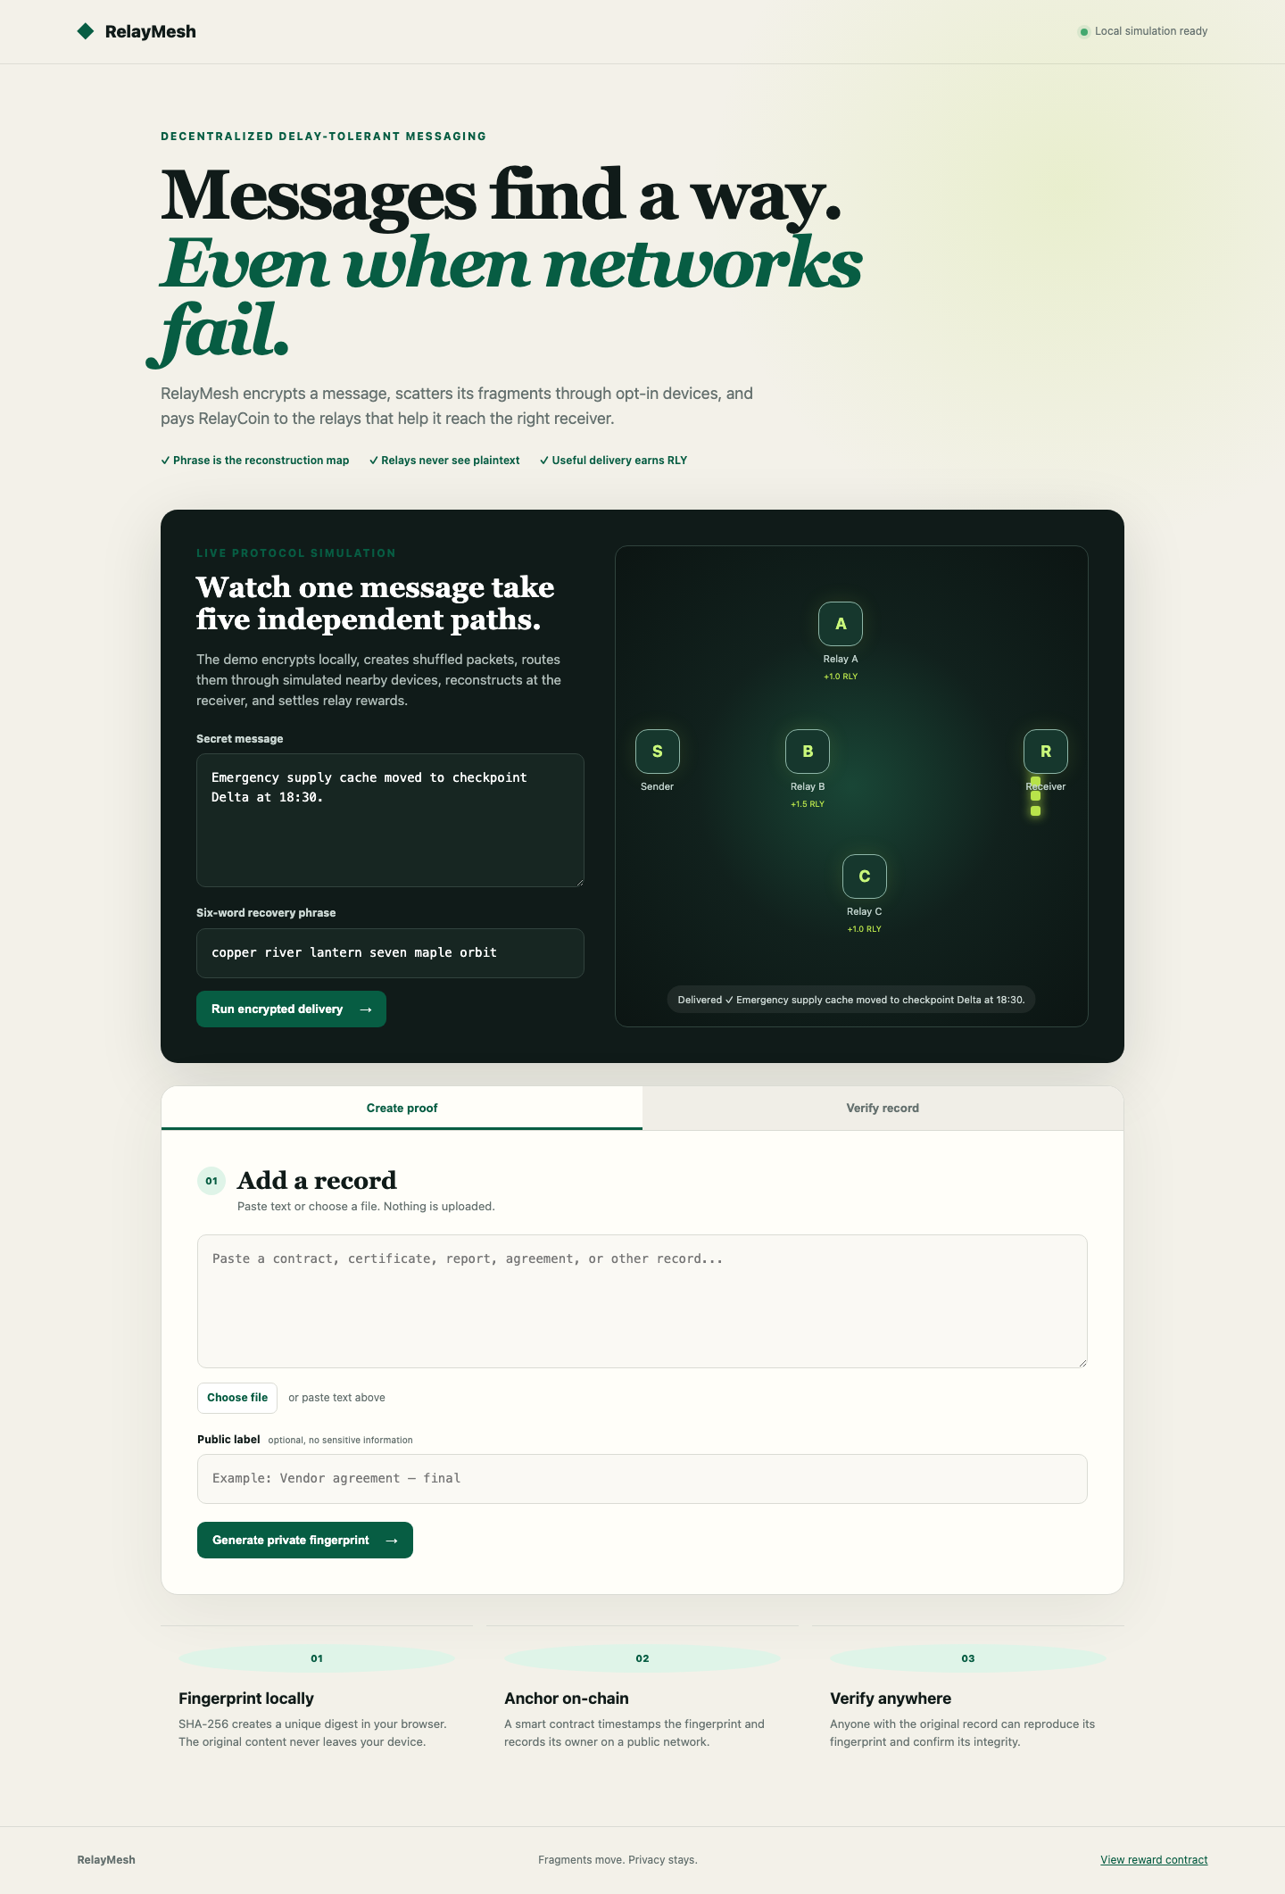
LIVE DEMO
A working cryptographic MVP today.
What runs now
PBKDF2 phrase-derived key
AES-256-GCM encryption
Five shuffled ciphertext fragments
Independent relay animation
SHA-256 integrity check
Wrong-phrase + tamper rejection
RLY reward settlement simulation
RELAYMESH / 3RD WEB HACK
06

Slide 7
ROADMAP
The protocol travels farther than the internet.
NOW
NEXT
FIELD
SCALE
Browser MVP
Real mesh
Remote range
Open network
→
→
→
Crypto core + Solidity reward contracts
libp2p, Bluetooth, Wi-Fi Direct
LoRa bridge + erasure coding
Testnet incentives + audited clients
RelayMesh turns disconnected devices into a privacy-preserving delivery network — and makes successful delivery worth something.
RELAYMESH / 3RD WEB HACK
07

