Slide 1
A Deep Learning Based Approach For Farm Boundary Detection
Presenting By
Koushik Karmakar

Slide 2
Model
UNET Architecture
VGG and Resnet block
Pytorch implementation
Model Quantization
Quantization
Quantization and Dequantization
Types of Quantization
INT8 Bit Quantization procedure (Python implementation)

Slide 3
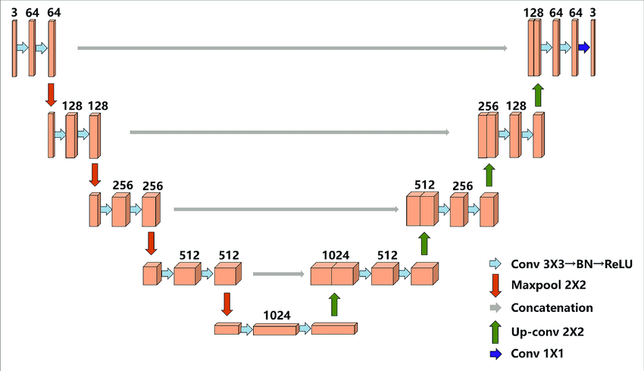
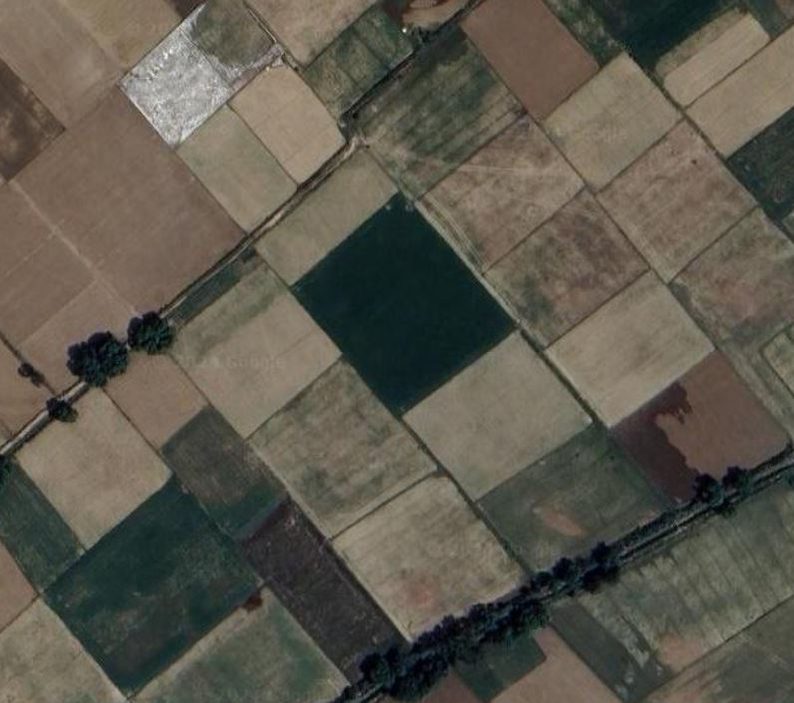
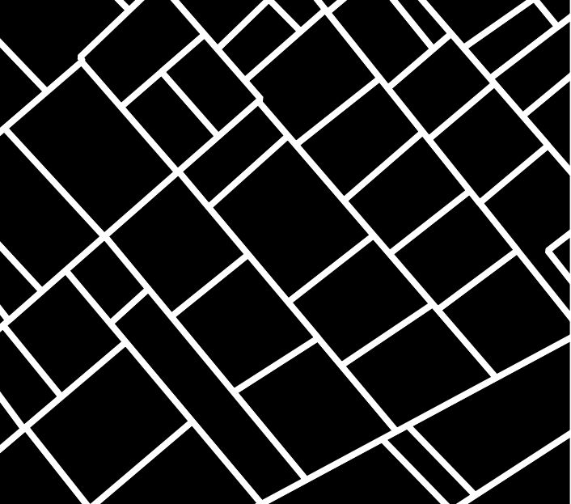
Model Architecture (UNET)
Encoder
With Four Encoder Block (VGG)
Decoder With Four Decoder Block
Input :
Batch = n_batch,
Channel = 3,
Height = 256,
Width = 256
[n_batch , 3, 256, 256]
Input :
Batch = n_batch,
Channel = 4,
Height = 256,
Width = 256
[n_batch , 4, 256, 256]
RGB Image
Binary Image
Bottle Neck

Slide 4
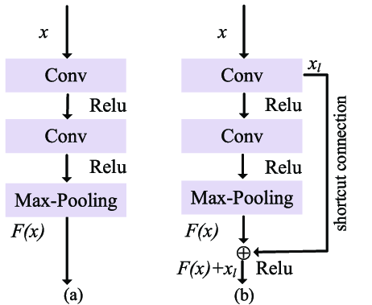
VGG and Resnet block
VGG Resnet
ResNet Block: Pros include effective handling of the vanishing gradient problem through residual connections, enabling very deep networks. The main con is the increased architectural complexity.
VGG Block: Pros include simplicity and ease of implementation due to its uniform and straightforward design. The main con is susceptibility to the vanishing gradient problem when scaling to deeper networks.

Slide 5
import torch.nn as nn
class VGGBlock(nn.Module):
def __init__(self, in_channels, out_channels):
super(VGGBlock, self).__init__()
self.conv1 = nn.Conv2d(in_channels, out_channels, kernel_size=3, padding=1)
self.relu = nn.ReLU(inplace=True)
self.conv2 = nn.Conv2d(out_channels, out_channels, kernel_size=3, padding=1)
self.pool = nn.MaxPool2d(kernel_size=2, stride=2)
def forward(self, x):
out = self.relu(self.conv1(x))
out = self.relu(self.conv2(out))
out = self.pool(out)
return out

Slide 6
import torch.nn as nn
class ResNetBlock(nn.Module):
def __init__(self, in_channels, out_channels, stride=1):
super(ResNetBlock, self).__init__()
self.conv1 = nn.Conv2d(in_channels, out_channels, kernel_size=3, stride=stride, padding=1)
self.bn1 = nn.BatchNorm2d(out_channels)
self.relu = nn.ReLU(inplace=True)
self.conv2 = nn.Conv2d(out_channels, out_channels, kernel_size=3, padding=1)
self.bn2 = nn.BatchNorm2d(out_channels)
self.shortcut = nn.Sequential()
if stride != 1 or in_channels != out_channels:
self.shortcut = nn.Sequential(
nn.Conv2d(in_channels, out_channels, kernel_size=1, stride=stride),
nn.BatchNorm2d(out_channels)
)
def forward(self, x):
out = self.relu(self.bn1(self.conv1(x)))
out = self.bn2(self.conv2(out))
out += self.shortcut(x)
out = self.relu(out)
return out

Slide 7
Model Quantization
Quantization
Model quantization is a technique used in deep learning to reduce the computational and memory resources.
Make the model ready to run on edge devices or in resource-constrained environments.
The primary goal of quantization is to reduce the precision of the model's weights and activations from floating-point (typically 32-bit) to lower bit-width representations, such as 8-bit integers, without significantly compromising the model's accuracy.

Slide 8


Quantize and Dequantize
Quantization parameters
UINT8 (0 - 255)
INT8 (-128 to 127)

Slide 9
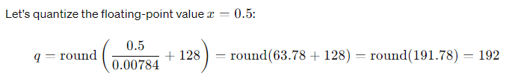

Quantization Error
|0.5 - 0.50176| = 0.00175

Slide 10
Types of Quantization
Post-Training Quantization (PTQ): This approach involves quantizing a pre-trained model without further training. It is straightforward but may lead to a slight degradation in accuracy.
Quantization-Aware Training (QAT): This involves simulating quantization effects during the training process. The model is trained with quantization in mind, leading to better accuracy compared to PTQ.

Slide 11
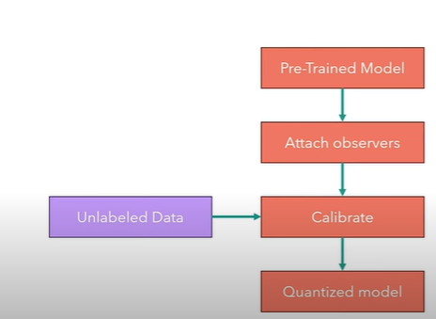
PTQ
Calculate quantization parameters

Slide 12
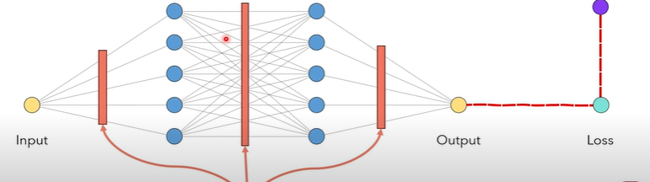
QAT
Target
Quantization-> INT8 space -> dequantization

Slide 13
Thank You

