Slide 1
Kaggle https://www.kaggle.com/jessemostipak/hotel-booking-demand
Hotel Booking Cancellation prediction

Slide 2
Problem Statement:
Determining the chances of cancellation of a booking using dataset containing booking information for a city hotel and a resort hotel, and includes information such as when the booking was made, length of stay, the number of adults, children, and/or babies, and the number of available parking spaces, and so on.
Approach:
Build an ML model to predict cancellation probability of a hotel booking using top relevant feature variables.

Slide 3
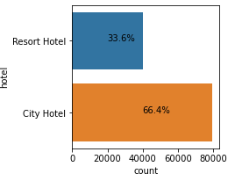
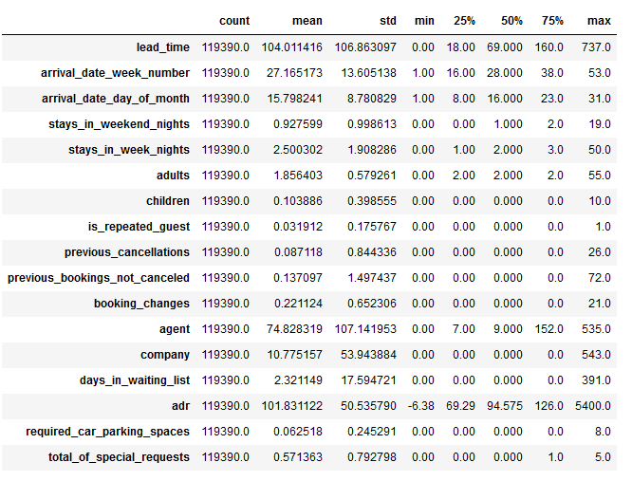
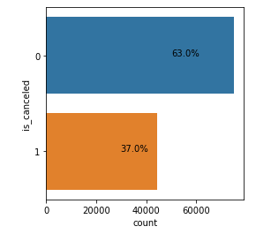
Data Exploration and Preprocessing:
Data Set: Contains all records of booking information for a city hotel and a resort hotel.
Basic Statistical Measures:
All numerical attributes
Target Variable: is_cancelation

Slide 4
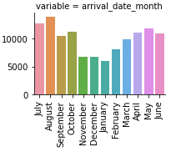
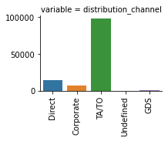
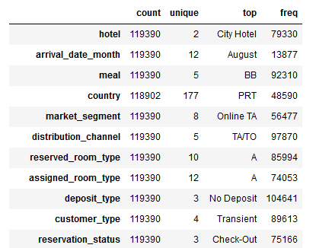
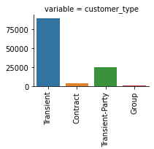
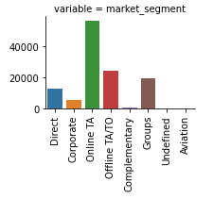
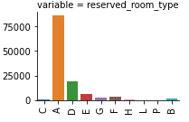
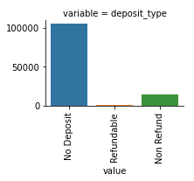
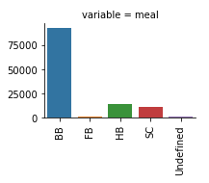
All categorical attributes

Slide 5
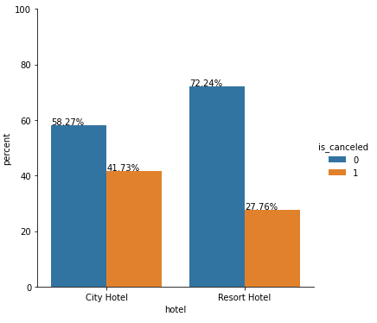
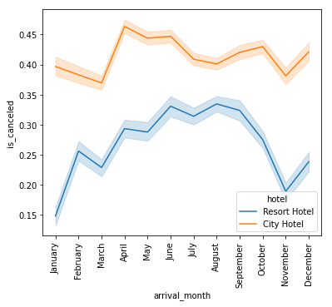
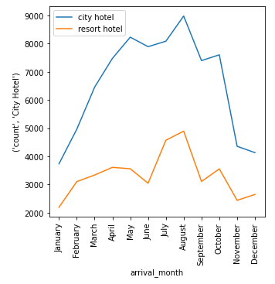
Exploratory Analysis
Cancellation is rate in city hotel is relatively higher than
resort hotel.
In terms of the cancellation rate, the cancellation rate
of the two hotels in winter is relatively low.
Both hotels have high no of guests in the months
from july to august, while city hotel has higher no
of total guests compared to resort hotels.

Slide 6
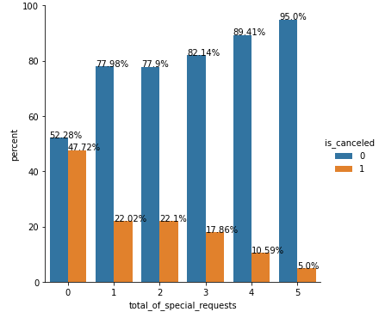
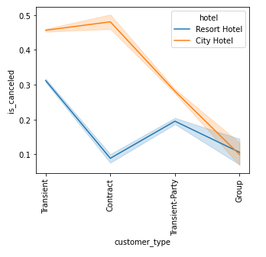
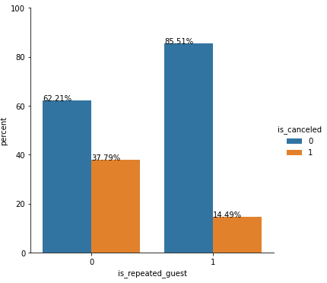
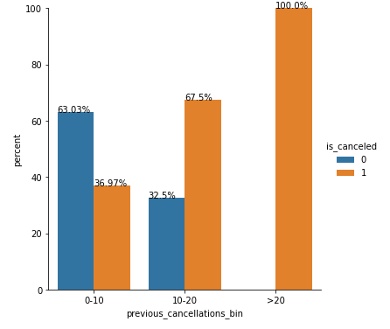
Cancellation rate for customer type group
is low.
Higher no of total special requests has lower
cancellation rate as hotels are able to meet
special needs.
Guests with high previous booking cancellations have higher cancellation rate.
Repeat guest has lower cancellation rate than new guests.

Slide 7
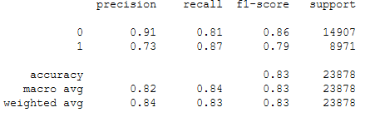
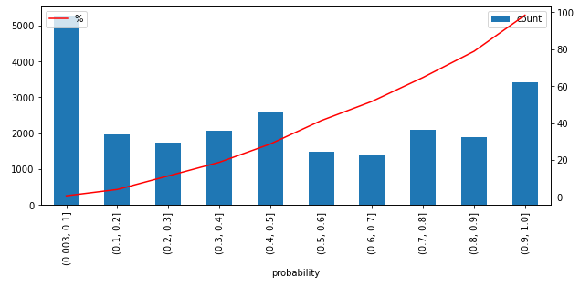
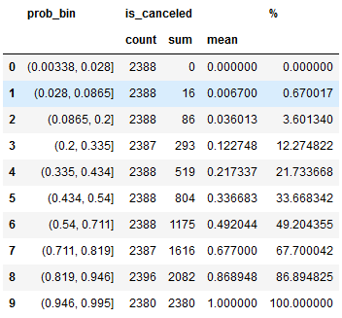
Model Building and Evaluation
Classification Report
Performance evaluation metrics:
Top predictors include:
market_segment, customer_type
required_car_parking_spaces,
country, total_of_special_requests
Predicted probability and cancellation %
Deciles: Equal Frequency

