Slide 1
NUTRIWISE
Upload a grocery receipt.
Get one smarter thing
to buy next time.
Onboard
Pantry
Check off
A receipt-first nutrition assistant — your pantry works for you: tap what you eat, don't type it.
Insights
Jennifer Rake · Speaker 2 Stuart Kasemeier · Speaker 1
AI Product Management Capstone · Midterm Presentation · Version 1
Notes:
[Both — Speaker 1 opens]
Speaker 1 (Stuart) opens with the one-liner: 'Upload a grocery receipt, get one smarter thing to buy next time.' Introduce both presenters. Set expectations: ~10–12 min, high-level, plus a short live demo. This is v0 of our final. Speaker 2 (Jennifer) takes the data/model half after the demo.

Slide 2
THE PROBLEM
Eating well shouldn't require a spreadsheet
Health-conscious adults (25–45) want to eat better — but every tool asks them to log every meal by hand.
That habit dies within weeks. People give up — or they guess.
Meanwhile the one honest record of what they actually eat already exists — the grocery receipt.
WHY IT MATTERS
1
Manual logging is the #1 reason nutrition apps get abandoned
2
Receipts are passive — zero extra effort for the user
3
One clear “next cart” decision beats another dashboard to ignore
NutriWise · V1
02 / 14
Notes:
[Speaker 1]
Frame the pain: people want to eat better, but manual logging (MyFitnessPal-style) is exhausting and gets abandoned. Target user = health-conscious 25–45. Key insight: the receipt is a passive, honest proxy for what people actually buy — no logging required. That's our wedge.

Slide 3
THE SOLUTION
One receipt in → a pantry that works for you
STEP 1
STEP 2
STEP 3
STEP 4
Upload
Your Pantry
Check off
Gaps + pick
›
›
›
Snap or paste a receipt — on-device OCR builds your pantry. Private, no API, offline.
See what's in the house, sorted by freshness — no manual food logging.
One tap logs what you actually ate — that's your real intake signal.
Weekly gaps → “use what you have” + one Next Cart buy, each with a plain-language why.
Every output is labeled “estimates from your groceries + what you tap in.” Not medical advice.
NutriWise · V1
03 / 14
Notes:
[Speaker 1]
Walk the real loop: upload builds the pantry → you tap to log what you ate → weekly gaps → two recommendations ('use what you have' + one Next Cart buy). The product bet: a living pantry plus one clear decision beats a food diary. Trust framing: estimates from groceries + your taps, not medical advice.

Slide 4
THE PRODUCT TODAY
From receipt to a daily habit — the user journey
NutriWise
Dein Vorrat
Tages-Log
Insights
Dein Ziel?
EMPFOHLEN
🥛 Trink deine Buttermilch
72
Protein 62 / 120 g
Gesünder essen
Wochen-Score · Gut
›
🍗 Hähnchenbrust
1 Tag
›
›
Ballaststoffe 11 / 30 g
Protein
niedrig
Ballastst.
niedrig
Wenig
Mittel
Hoch
🥛 Buttermilch
2 Tage
Kalorien 1.340 / 2.100
Zucker
ok
Kalorien
ok
🥦 Brokkoli
frisch
1 · Onboarding chat
conversational profile
2 · Your Pantry
home · expiry-aware
3 · Daily log
1 tap = 1 portion
4 · Insights
weekly gaps + picks
Fully clickable prototype — sage-green corporate design, light & dark.
NutriWise · V1
04 / 14
Notes:
[Speaker 1 or 2]
Show the real product shape in one glance: a conversational onboarding sets targets; the Pantry is the home you return to (sorted by expiry); a single tap in the Daily Log records what you ate; Insights turns a week of taps into gaps and two recommendations. A fully clickable prototype exists if the audience wants to see it live.

Slide 5
SUCCESS CRITERIA & KPIS
How we'll know it works
Core hypothesis: do users trust a receipt-inferred recommendation enough to act — and does the check-off habit stick?
Week 1
Check-off sticks?
the make-or-break — does tapping survive novelty
30%
Behaviour shift
adjust their next cart to our suggestion
>20%
Recommendation acted on
marked “done”, not dismissed unread
<2 min
Time to value
from upload to first personalised result
The check-off habit gates everything. If tapping doesn't survive week 1, the pantry and its recommendations go stale — so we prove that loop first, then layer in the full 10-KPI funnel across behaviour, business and satisfaction.
NutriWise · V1
05 / 14
Notes:
[Speaker 1]
The make-or-break LEADING indicator is check-off retention — does the daily tap survive novelty? If not, the whole pantry model dies, so we prove it first. North-star: ≥30% change their next purchase without manual logging. Supporting: action rate >20%, time-to-value <2 min. Full 10-KPI framework behind it.

Slide 6
ROADMAP & MILESTONES
Where we are
DONE
Weeks 1–2
IN PROGRESS
Now — Week 3
NEXT
Post-midterm
✓
On-device OCR → pantry → gaps → recommendation
▸
1-tap portion — cut check-off friction
•
Advanced matching model (embeddings) past 70 %
✓
Daily check-off log + expiry-aware pantry
▸
Sharper matching (learned Tier-0 + normalization)
•
Instrument the 10-KPI funnel
✓
Recipes, easy swaps, progress tracking
▸
A/B test: when to ask “what did you eat?”
•
Weekly / monthly trends
✓
Nutri-Coach + transparent empty states
▸
Live user testing + check-off retention
✓
GDPR export/erasure · engagement banner · DE/EN
NutriWise · V1
06 / 14
Notes:
[Speaker 1]
Three-week sprint. DONE: the whole core loop runs end-to-end. IN PROGRESS: smarter matching + first 5 user tests. NEXT: recipes, pushing accuracy past 70%, KPI instrumentation. And rather than just tell you — let me show you the current build.

Slide 7
LIVE DEMO — THE CURRENT BUILD
See it run, end-to-end, on a real receipt
1
Chat onboarding — conversational profile — goal, needs, exclusions
NutriWise · Your results
2
Upload receipts — on-device OCR — private, no quota, offline
Estimates from your groceries + daily log — not medical advice
3
Your Pantry — what's in the house, expiry-aware — the home screen
YOUR NEXT CART
+ Red lentils (dried)
4
Daily log — one tap to check off what you actually ate
Closes your fiber & plant-protein gap — and it's peanut-free.
5
Insights — weekly gaps + “use what you have” + Next Cart
Fiber
Protein
Sugar
low
ok
ok
6
Nutri-Coach + erase — plain-language why · GDPR erase anytime
illustrative — shown live in the demo
NutriWise · V1
07 / 14
Notes:
[Speaker 1 → hands to Speaker 2]
LIVE DEMO (~2 min). Say the positioning line first, then: chat onboarding (profile) → upload a receipt (on-device OCR — highlight: private, no API quota, works offline) → land on the Pantry (the home) → tap-to-log something eaten → Insights: weekly gaps + the “use what you have” pantry pick + Next Cart → Nutri-Coach phrasing + GDPR erase. NOTE: receipts no longer depend on Gemini, so there is no quota risk there. Only the Nutri-Coach uses Gemini (phrasing only) — if the free-tier daily limit is hit, the numbers and recommendation still work, only the conversational text degrades. Then hand to Speaker 2: 'that recommendation is only as good as the data behind it.'

Slide 8
EVALUATION METRIC
The hard part: turning cryptic receipt text into a real food
“AB Bud 6x0,3l MW” → ?
Every receipt line must become a real food with real nutrients. There is no ground-truth label for “what food is this, really?”
This is a rule-based / LLM-hybrid, not a trained ML model — so we built our own evaluation: an LLM-judge panel.
3 independent judges rate every match — correct / partial / wrong / no-match — majority verdict wins.
WHAT WE MEASURE
Precision
Match quality
% judged correct — or usable (correct + partial)
Agreement
Judge reliability
% of items where all 3 judges agree
NutriWise · V1
08 / 14
Notes:
[Speaker 2]
Speaker 2 (Jennifer) takes over. Be explicit: this is NOT a classic supervised-ML project — it's a rule-based / LLM-hybrid. The core task is matching messy receipt text like 'AB Bud 6x0,3l MW' to a real food. No ground truth exists, so our evaluation is an LLM-judge panel: 3 independent judges, majority vote. Two numbers: precision (correct/usable) and inter-judge agreement (do we trust the metric itself). Product bar to hit: ≥70% of items usable.

Slide 9
DATA — SOURCES, SHAPE & CHALLENGES
Three data worlds, stitched together
Grocery receipts
Open Food Facts
BLS 4.0 table
Real German receipts (Lidl / Netto / Edeka) → on-device OCR (Tesseract) → items. Private: no receipt data leaves the device.
Crowd-sourced branded-product API + local cache. First-line identity match; sparse per field.
German federal food-composition DB. ~7,140 rows × 418 cols — 7 macros + 11 micros extracted.
EVALUATION SET (shape)
HONEST DATA CHALLENGES
76 unique items · 227 line-item occurrences
13 columns: raw & normalized name, category, occurrences,
off/bls matched-name · verdict · agreement · n_judges
• Cryptic OCR / branded-vs-generic (“Budweiser” → “Pilsner Bier”)
• OFF sugar = total, not free sugar; BLS has no NOVA rating
• Thin per-nutrient coverage → track few nutrients well, not many poorly
NutriWise · V1
09 / 14
Notes:
[Speaker 2]
Three data worlds: (1) real German receipts → on-device OCR (Tesseract) → items — private, no API, no quota, (2) Open Food Facts as first-line identity match, (3) the German federal BLS 4.0 table (7,140 rows, we pull 7 macros + 11 micros) for authoritative nutrients. Eval set: 76 unique items from 227 real occurrences, 13 columns. The challenges ARE the story — cryptic OCR, branded-vs-generic, OFF's sugar is total not free sugar, BLS has no processing rating, and coverage is thin, so we deliberately track a few nutrients well.

Slide 10
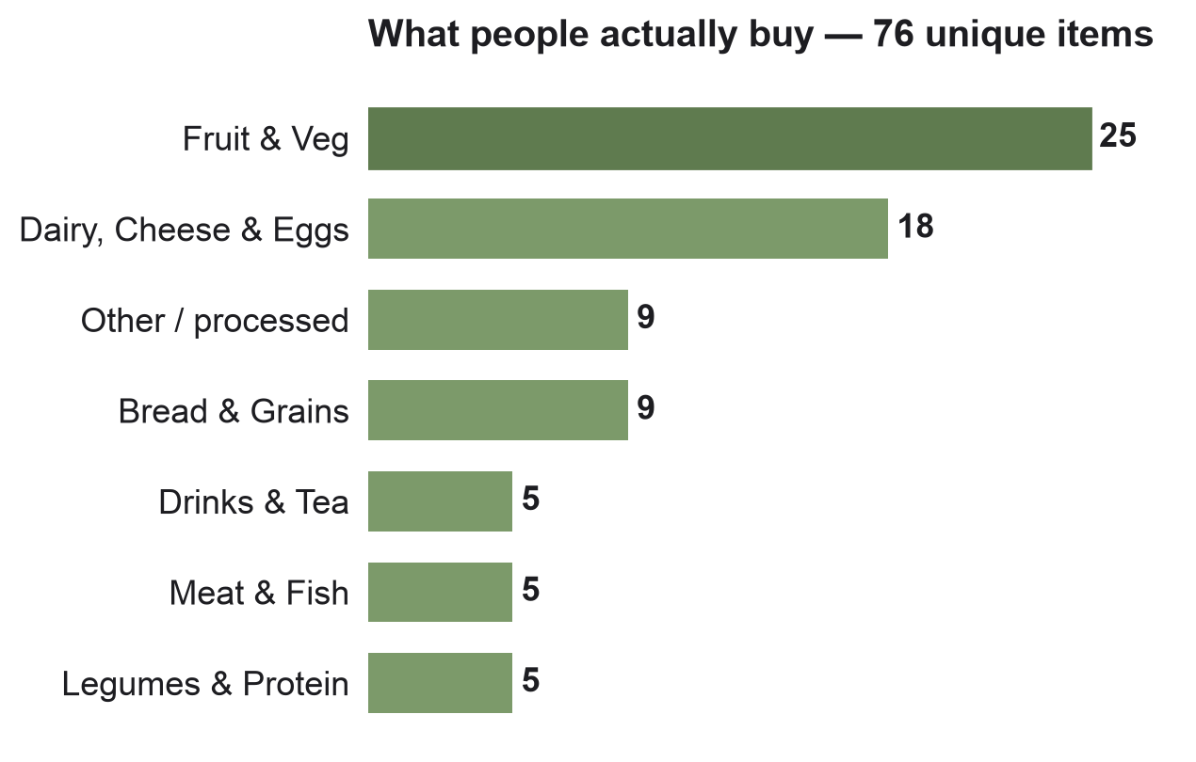
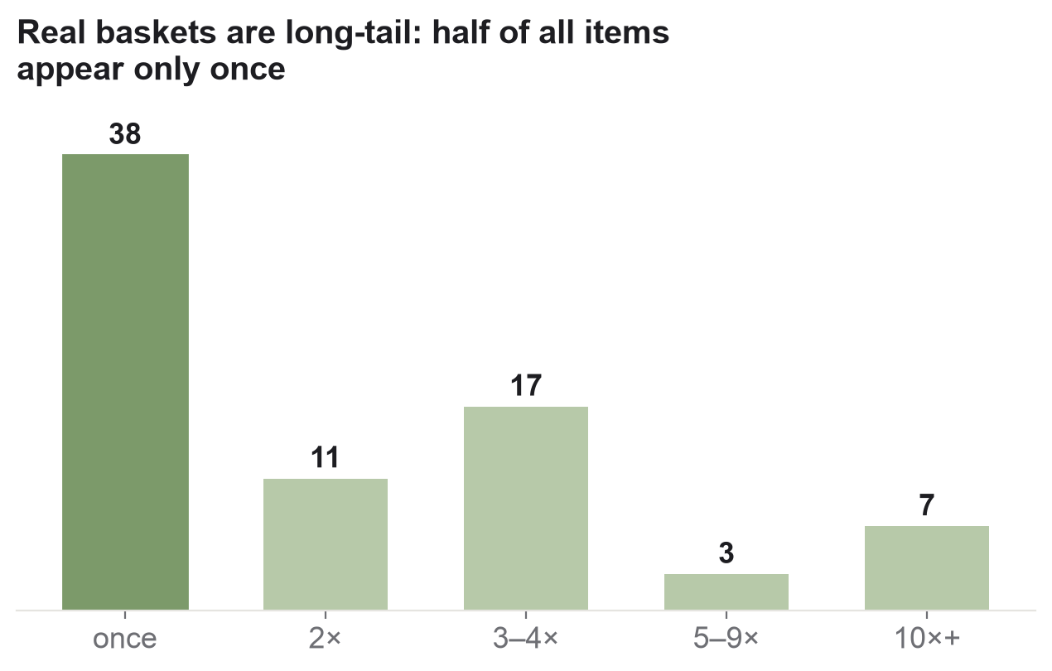
EXPLORATORY DATA ANALYSIS
What real baskets actually look like
Takeaway: baskets are produce- and dairy-heavy, but the long tail is brutal — half the items appear only once, so the matcher must generalise, not memorise.
NutriWise · V1
10 / 14
Notes:
[Speaker 2]
Note honestly: these plots didn't exist in the repo — we built them from the evaluation data for this deck. Two findings: left, purchases skew to produce & dairy (the basics); right, it's a long tail — 50% of items appear only once. So we can't memorise frequent items; the matcher must generalise to one-off, oddly-abbreviated products. That shaped the whole pipeline design.

Slide 11
ML WORKFLOW / DATA PIPELINE
A tiered resolver — cheap & certain first, fallback last
Receipt
→
Extract
→
Normalize
→
image / text
on-device OCR → items
strip qty · price · non-food
Tier 0
Learned verified matches
human-confirmed · conf 1.0
OUTPUT
Tier 1
OpenFoodFacts + fuzzy match
→ BLS bridge for DE nutrients
• Nutrients (macros + micros)
• Confidence label
Tier 1b
BLS whole-food (raw produce)
guarded by food-type agreement
• Data-source citation
Tier 3
Category fallback
low confidence · flagged “unknown”
• → Gaps + Next Cart
Rule-based on purpose — no fitted model — so the logic stays transparent and trustworthy for the MVP.
NutriWise · V1
11 / 14
Notes:
[Speaker 2]
Given that long tail, we don't use one model — we use a tiered resolver. Receipt → on-device OCR (Tesseract, replaced Gemini — private, no quota) → normalization. Then four tiers, cheapest/most-certain first: Tier 0 human-verified, Tier 1 OFF fuzzy match bridged to German BLS nutrients, Tier 1b raw-produce, Tier 3 honest low-confidence category fallback. Every output carries nutrients + confidence + source. Say it plainly: this is rule-based on purpose — rules are more transparent and trustworthy than a black box for a health MVP. No fitted model in the matching path; the only LLM (Gemini) is the Nutri-Coach, and it only phrases the numbers, never invents them.

Slide 12
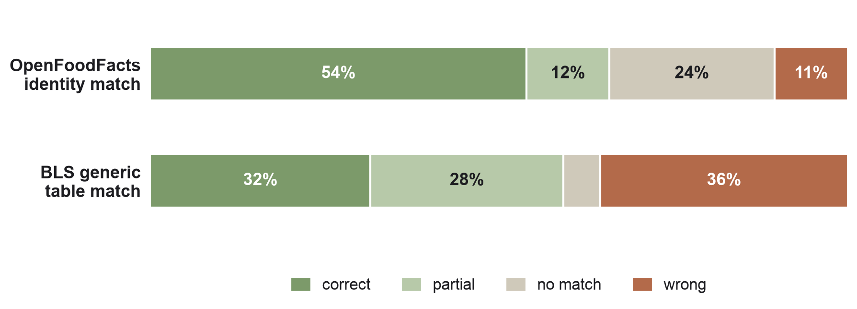
BASELINE MODEL & PERFORMANCE
Two matching strategies, judged head-to-head
66%
OFF usable
correct + partial — our baseline
2×
OFF beats BLS
54% vs 32% correct on identity
96%
Judge agreement
3/3 unanimous — metric is reliable
Why the architecture: OFF wins on identity, so it leads. BLS matches worse (~⅓ wrong-food), so its nutrients are only borrowed under a guard — never used as the primary matcher. 66% usable is just below our 70% bar.
NutriWise · V1
12 / 14
Notes:
[Speaker 2]
Important framing correction: these are two INDEPENDENT matching strategies compared head-to-head, NOT a cumulative improvement. Judged by the panel: OpenFoodFacts identity match = 54% correct / 66% usable; the BLS generic table matched on its own = only 32% correct, 36% wrong. Judge agreement is 96% unanimous, so we trust the number. This head-to-head is exactly WHY the architecture uses OFF for identity and only borrows BLS nutrients under a type-agreement guard — a loose bridge would reintroduce BLS's ~33% wrong-food problem. 66% usable is just under our 70% bar — that gap is what the learned Tier-0 store is built to close.

Slide 13
NEXT WEEK & BEYOND
From baseline to trustworthy
Sharper matching
Validate & grow
→
Fuzzy baseline 66% → semantic-embedding re-ranker, target >70% usable
→
Live user testing — does the check-off habit stick?
→
Learned Tier-0 store keeps improving from every correction
→
A/B test: the best moment to ask “what did you eat?”
→
Personalized portion & consumption estimation (ML)
→
Instrument the 10-KPI funnel (upload → insight → retention)
Principle: ML where rules can't generalise (matching, portions) — gaps & recommendations stay rule-based and transparent.
NutriWise · V1
13 / 14
Notes:
[Speaker 2]
Two tracks next week. Matching: turn the resolver into a learning system — every user correction feeds the Tier-0 store — plus better normalization, to push past 70% usable. Product: start live user testing and instrument the KPI funnel, so we validate the trust hypothesis with real behaviour, not just a rising accuracy number.

Slide 14
NUTRIWISE
Thank you.
Upload a grocery receipt. Get one smarter thing to buy next time.
Jennifer Rake & Stuart Kasemeier
NutriWise · AI PM Capstone · Midterm V1 — Questions & feedback welcome
Notes:
[Both]
Close on the one-liner and invite questions. If pushed on accuracy: honest baseline (OFF 66% usable), clear plan (learned Tier-0) to close the gap — and the harder validation question is trust / behaviour, which live user testing answers next.

