Slide 1
NUTRIWISE
Upload a grocery receipt.
Get one smarter thing
to buy next time.
Onboard
Pantry
Check off
A receipt-first nutrition assistant — your pantry works for you: tap what you eat, don't type it.
Insights
Jennifer Rake · Speaker 2 Stuart Kasemeier · Speaker 1
AI Product Management Capstone · Midterm Presentation · Version 2
Notes:
[Both — Speaker 1 opens]
One line to open: 'Take a photo of your shopping receipt, and we tell you one smart thing to buy next time.' Say the two names. Tell them the plan: about 10 minutes, kept simple, with a quick live demo in the middle. Speaker 1 does the product half; Speaker 2 does the data half after the demo.

Slide 2
THE PROBLEM
Eating well shouldn't require a spreadsheet
Health-conscious adults (25–45) want to eat better — but every tool asks them to log every meal by hand.
That habit dies within weeks. People give up — or they guess.
Meanwhile the one honest record of what they actually eat already exists — the grocery receipt.
WHY IT MATTERS
1
Manual logging is the #1 reason nutrition apps get abandoned
2
Receipts are passive — zero extra effort for the user
3
One clear “next cart” decision beats another dashboard to ignore
NutriWise · V2
02 / 13
Notes:
[Speaker 1]
Simple version: people want to eat healthier, but every app makes them type in every meal — that's boring, so they quit. Our trick: the shopping receipt already shows what they bought, and they didn't have to do anything extra. That's our way in. Target user: health-minded people aged 25–45.

Slide 3
THE SOLUTION
One receipt in → a pantry that works for you
Upload › Your Pantry › Check off what you ate › Weekly gaps + 2 picks
NutriWise
Dein Vorrat
Tages-Log
Insights
Dein Ziel?
EMPFOHLEN
🥛 Trink deine Buttermilch
72
Protein 62 / 120 g
Gesünder essen
›
›
›
Wochen-Score · Gut
🍗 Hähnchenbrust
1 Tag
Ballaststoffe 11 / 30 g
Protein
niedrig
Ballastst.
niedrig
Wenig
Mittel
Hoch
🥛 Buttermilch
2 Tage
Kalorien 1.340 / 2.100
Zucker
ok
Kalorien
ok
🥦 Brokkoli
frisch
1 · Onboarding chat
conversational profile
2 · Your Pantry
home · expiry-aware
3 · Daily log
1 tap = 1 portion
4 · Insights
weekly gaps + picks
Fully clickable prototype — light & dark. Estimates from your groceries + taps — not medical advice.
NutriWise · V2
03 / 13
Notes:
[Speaker 1]
The whole loop in one picture. First you chat a little so we learn your goal. Then a photo of your receipt fills your 'pantry' — the list of food in your house. Every day you tap what you ate (one tap, no typing). At the end of the week we show what's missing and two easy fixes. Say plainly: these are friendly estimates, not a doctor's advice. A real clickable app exists if they want to see it.

Slide 4
HONEST BY DESIGN
We show only what your data actually supports
The more you track, the more we can say — and we never pretend to know more than we do.
DAY 0
1ST RECEIPT
FEW TAPS
1 WEEK
30–90 DAYS
Your targets
›
Your basket
›
Early signs
›
Weekly score
›
Trends
What to aim for, from your profile. No eating data yet.
The mix of what you bought — labeled “basket,” never “diet.”
Soft hints + a “3 / 7 days tracked” bar. No hard score yet.
Your main number: gaps per nutrient, allowing for meals eaten out.
Are you improving over time — a line, not a single badge.
Never a confident wrong number. A coverage floor holds the score back until enough days are tracked, and “your basket” is never relabeled “your diet.” Honesty is the feature.
NutriWise · V2
04 / 13
Notes:
[Speaker 1]
Think of a new friend who cooks for you. On day one they only know your goal, so they just say what to aim for. After your first shop they can say what's in your kitchen — but that's shopping, not what you actually ate, so we call it 'your basket,' not 'your diet.' Once you start tapping meals they get a feel for it, and after a week they can honestly say 'you're a little low on fibre.' After a month or two they can show if you're getting better. The rule: if you've only tracked 2 days, we say 'still learning' instead of guessing a wrong number. That honesty is on purpose.

Slide 5
SUCCESS CRITERIA & KPIS
How we'll know it works
Core hypothesis: do users trust a receipt-inferred recommendation enough to act — and does the check-off habit stick?
Week 1
Check-off sticks?
the make-or-break — does tapping survive novelty
30%
Behaviour shift
adjust their next cart to our suggestion
>20%
Recommendation acted on
marked “done”, not dismissed unread
<2 min
Time to value
from upload to first personalised result
The check-off habit gates everything. Prove the weekly tap sticks first, then layer in the full 10-KPI funnel across behaviour, business and satisfaction.
NutriWise · V2
05 / 13
Notes:
[Speaker 1]
The one number that makes or breaks us: do people keep tapping after week 1? If the daily tap dies, the whole thing dies — so we test that first. Our north star: at least 3 in 10 people change what they buy next time, without any manual food diary. Plus: more than 1 in 5 act on our tip, and they see something useful in under 2 minutes. A bigger 10-KPI scorecard sits behind these.

Slide 6
ROADMAP & MILESTONES
Where we are — and what's next
DONE
Weeks 1–2
IN PROGRESS
Now — Week 3
NEXT
Post-midterm
✓
On-device OCR → pantry → gaps → recommendation
▸
1-tap portion — cut check-off friction
•
Embedding re-ranker to push Recall@5 past 70%
✓
Daily check-off log + expiry-aware pantry
▸
Sharper matching (learned Tier-0 + text cleanup)
•
Personalised portion & consumption ML
✓
Recipes, easy swaps, progress tracking
▸
A/B test: when to ask “what did you eat?”
•
Instrument the 10-KPI funnel
✓
Nutri-Coach + honest empty states
▸
Live user testing + check-off retention
•
Weekly / monthly trend views
✓
GDPR export/erasure · DE/EN
NutriWise · V2
06 / 13
Notes:
[Speaker 1]
Three weeks of work. DONE: the whole loop already runs end to end. IN PROGRESS: smarter matching and our first real user tests. NEXT (after today): a smarter matching model to push accuracy past 70%, personalised portions, and the full success-scorecard. Rather than just tell you it works — let me show you the live app now.

Slide 7
LIVE DEMO — THE CURRENT BUILD
See it run, end-to-end, on a real receipt
1
Chat onboarding — goal, needs, exclusions
NutriWise · Your results
2
Upload receipt — on-device OCR — private, offline
Estimates from your groceries + daily log — not medical advice
3
Your Pantry — what's in the house, expiry-aware
YOUR NEXT CART
+ Red lentils (dried)
4
Daily log — one tap = what you ate
Closes your fiber & plant-protein gap — and it's peanut-free.
5
Insights — weekly gaps + “use what you have” + Next Cart
Fiber
Protein
Sugar
low
ok
ok
6
Nutri-Coach + erase — plain-language why · GDPR erase
illustrative — shown live in the demo
NutriWise · V2
07 / 13
Notes:
[Speaker 1 → hands to Speaker 2]
LIVE DEMO, about 2 minutes. Quick tour: chat to set the goal → snap a receipt (say: it reads on the phone itself, private, works offline, no quota) → land on the Pantry → tap one thing you ate → Insights shows the week's gaps plus two tips → the coach explains it in plain words, and you can erase everything anytime. If the coach text ever stops (free daily limit), the numbers and the tip still work — only the wording gets plainer. Then hand to Speaker 2: 'a tip is only as good as the data behind it — here's how we made that data trustworthy.'

Slide 8
EVALUATION METRIC
The hard part: cryptic receipt text → a real food
“AB Bud 6x0,3l MW” → ?
Every receipt line must become a real food with real nutrients — but there is no answer key for “what food is this, really?”
So we built one: a human-verified gold set of 180 real receipt lines, each labeled against the full 7,140-food corpus.
Our metric: Recall@5 — is the correct food in the top 5 the app shows?
WHAT WE MEASURE
Recall@5
Right food shortlisted
% where the correct food is in the top 5
3%
Label-error rate
human spot-check of the gold labels
NutriWise · V2
08 / 13
Notes:
[Speaker 2]
Speaker 2 here. This is not a normal 'train a model' project — the real puzzle is turning messy receipt text like 'AB Bud 6x0,3l MW' into an actual food. Nobody handed us an answer key, so we made one: 180 real receipt lines, and for each we found the true match by searching all 7,140 foods — not just a shortlist, or the score would be fake. A human double-checked the labels; only 3% were off. Our score: when the app shows its top 5 guesses, is the right food in there? That's Recall@5.

Slide 9
DATA — SOURCES, SHAPE & CHALLENGES
Three data worlds, stitched together
Grocery receipts
Open Food Facts
BLS 4.0 table
Real German receipts (Lidl / Netto / Edeka) → on-device OCR (Tesseract) → items. Private: nothing leaves the phone.
Crowd-sourced branded-product data. Fallback for products the BLS structurally lacks.
German federal food database — ~7,140 foods. Our primary source of reliable nutrients.
THE GOLD SET (matching test)
HONEST DATA CHALLENGES
45 → 180 real receipt lines · 152 unique
Earlier EDA sample: 76 items across 227 purchases.
Each line labeled vs. the full 7,140-food corpus.
• Cryptic OCR, brand-vs-generic (“Budweiser” → “Pilsner Bier”)
• Real receipts are harder than clean text (brand, size, “bio”)
• USDA tested & rejected — blind to German foods (Quark, Schmand)
NutriWise · V2
09 / 13
Notes:
[Speaker 2]
Three data worlds. One: real German receipts, read on the phone itself — private, no cloud. Two: Open Food Facts, a big crowd list of branded products, as a backup. Three: the official German food table, 7,140 foods, our trusted source for nutrients. For testing we grew our answer key from 45 to 180 real receipt lines. Honest hurdles: receipt text is cryptic; real receipts are harder than tidy text; and we tried the US food database but dropped it — it simply doesn't know German foods like Quark or Schmand.

Slide 10
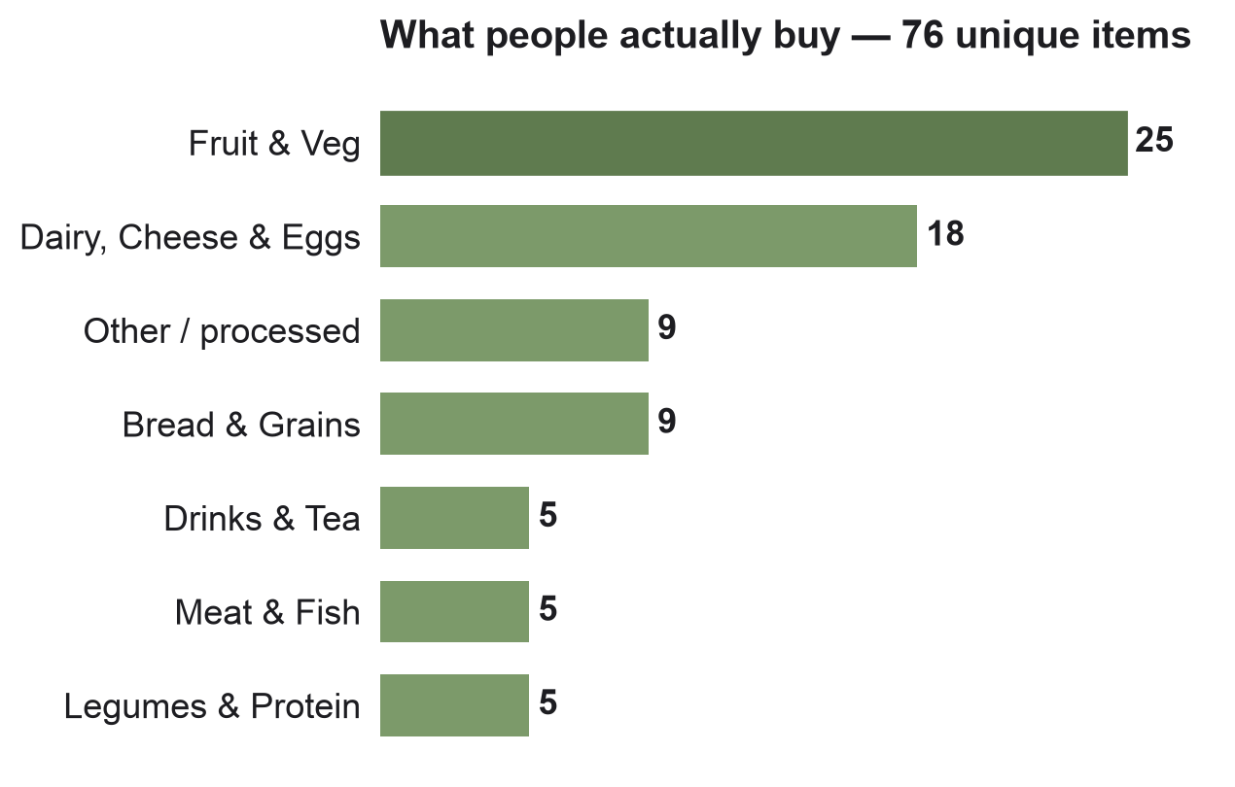
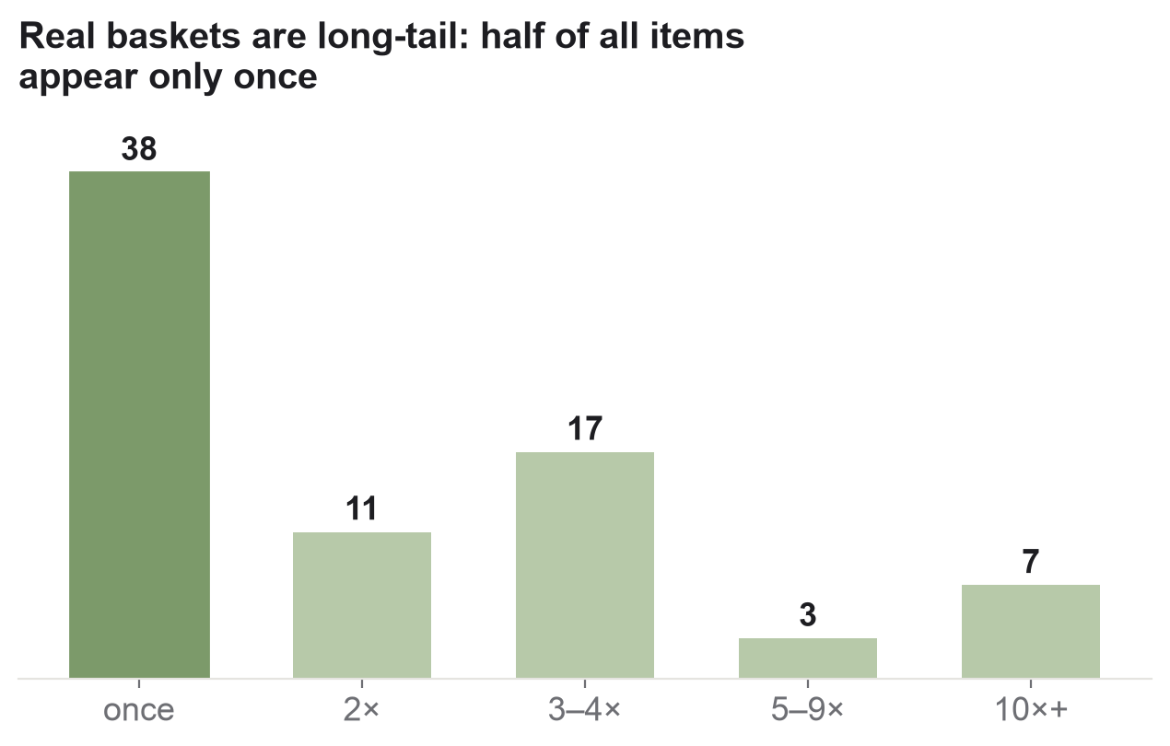
EXPLORATORY DATA ANALYSIS
What real baskets actually look like
Takeaway: baskets are produce- and dairy-heavy, but the long tail is brutal — half the items appear only once, so the matcher must generalise, not memorise.
NutriWise · V2
10 / 13
Notes:
[Speaker 2]
Two quick pictures. Left: most shopping is fruit, veg and dairy — the basics. Right: but there's a long tail — half the items show up only once. So we can't just memorise the popular foods; the matcher has to handle weird, one-off, badly-abbreviated names it has never seen. That shaped our whole design.

Slide 11
ML WORKFLOW / DATA PIPELINE
A tiered matcher — cheap & certain first, fallback last
Receipt
→
Extract
→
Clean
→
image / text
on-device OCR → items
strip qty · price · brand
Tier 0
Learned verified matches
human-confirmed · always trusted
OUTPUT
Tier 1
BLS 4.0 — German nutrients
primary source · 174 of 180 lines
• Nutrients (macros + micros)
• Confidence label
Tier 2
Open Food Facts fallback
branded gaps · 4 of 180 lines
• Data-source citation
open
Left honest / unresolved
2 ambiguous lines — not guessed
• → Gaps + Next Cart
Rule-based on purpose — the embedding only breaks ties, so the logic stays transparent for a health MVP.
NutriWise · V2
11 / 13
Notes:
[Speaker 2]
One important note first: these matching tiers are about linking receipt text to a food — different from the honesty tiers earlier, which were about the score. Here it's a ladder: read the receipt, clean it up, then try the safest match first. Tier 0: matches a human already confirmed. Tier 1: the German food table — our main source, it handled 174 of 180 lines. Tier 2: Open Food Facts for the few branded gaps. And if it's genuinely unclear (2 lines), we leave it open instead of guessing. It's rules on purpose — trustworthy for a health app — and the smart 'embedding' only breaks ties.

Slide 12
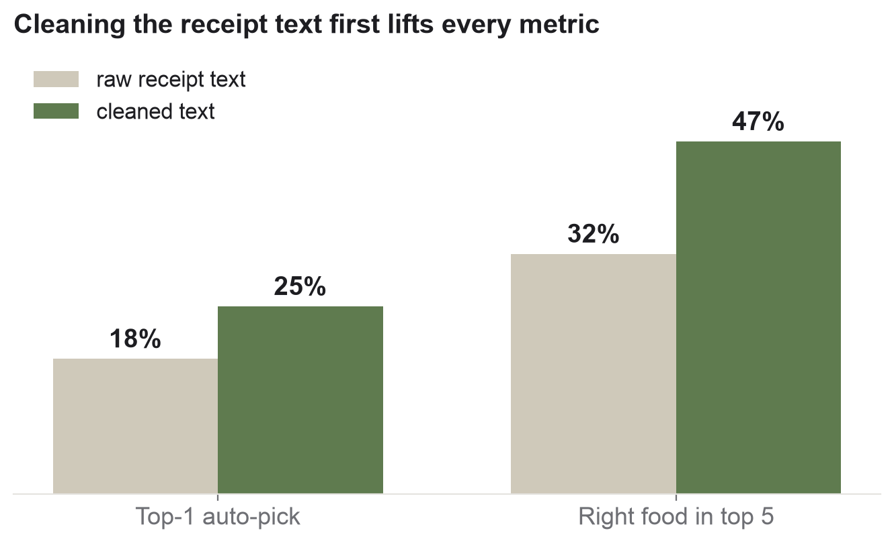
BASELINE MODEL & PERFORMANCE
Measured honestly on real receipts
99%
Lines resolved
174 BLS · 4 OFF · 2 left open, of 180
47%
Recall@5 (cleaned)
right food in top 5 — up from 32% raw
56% → 47%
Real is harder
clean 45 vs. real receipts (Recall@5)
The honest finding: on raw text, simple fuzzy beats the “smart” hybrid — so the embedding is a tie-breaker, not the main matcher. Cleaning the text is the real lever; the learned Tier-0 store closes the rest.
NutriWise · V2
12 / 13
Notes:
[Speaker 2]
Our honest scorecard. First, we found a match for 99% of lines — 174 from the German table, 4 from Open Food Facts, and 2 we left open on purpose. Second, the big lever is cleaning the receipt text: the right food lands in the top 5 about 47% of the time after cleanup, up from 32% on raw text. Third, honesty: real receipts are harder than the tidy 45 we started with (56% → 47%), and a plain 'fuzzy' search actually beats our fancy one on messy text — so the AI part only breaks ties for now. The plan to close the gap: every user correction is saved and reused. (Backup slide has our earlier pilot numbers if asked.)

Slide 13
NUTRIWISE
Thank you.
Upload a grocery receipt. Get one smarter thing to buy next time.
Jennifer Rake & Stuart Kasemeier
NutriWise · AI PM Capstone · Midterm V2 — Questions & feedback welcome
Notes:
[Both]
Close on the one-liner and invite questions. If pushed on accuracy: we measure honestly on real receipts (Recall@5 47% after cleanup, 99% of lines resolved), the clear next lever is the learned match store, and the deeper question — do people trust it and keep tapping — is what live user testing answers next.

Slide 14
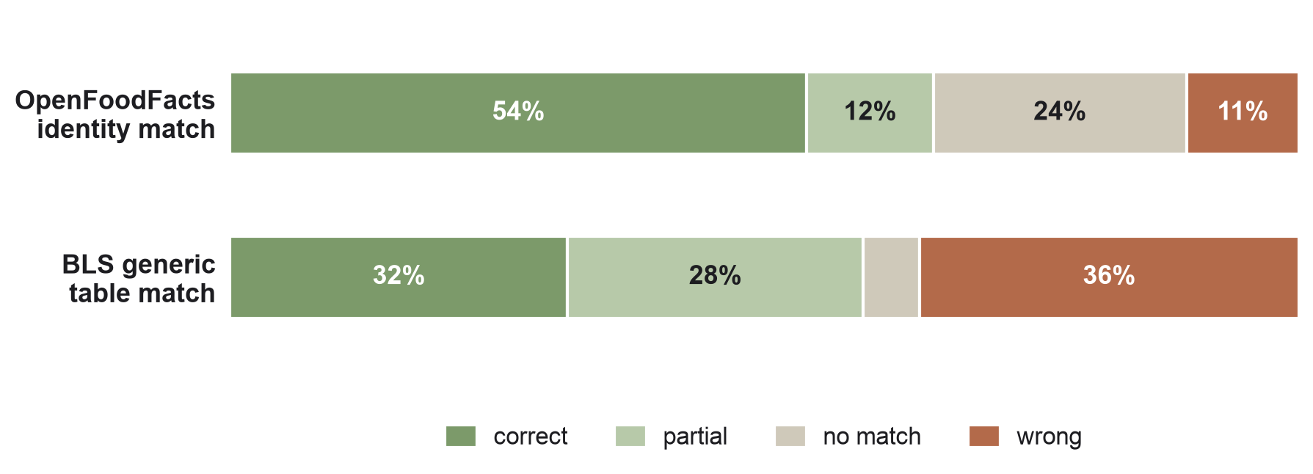
BACKUP — EARLIER PILOT MEASUREMENT
Pilot: OFF vs BLS, judged head-to-head
Different method than Recall@5 — an earlier LLM-judge pilot on 76 items. Not directly comparable; kept for context.
66%
OFF usable (pilot)
correct + partial, LLM-judged
2×
OFF beats BLS
54% vs 32% correct on identity
96%
Judge agreement
3/3 unanimous — pilot metric
Why it still matters: it's why BLS leads and OFF is only a fallback — and why we moved to the stricter, human-verified Recall@5.
Notes:
[Speaker 2 — only if asked]
Backup for questions. This was our earlier pilot on 76 items, judged by an LLM panel — a different method, so don't compare its 66% to the 47% Recall@5. What it told us: Open Food Facts wins on identity, the German table matched worse on its own — which is exactly why the table leads for nutrients only, and why we then built the stricter, human-checked Recall@5 test.

