Slide 1
Notes:
J: Just a moment! //
I'm quickly logging my lunch / in my food app.
[...]
Upload
Datei vs. manuell
Korrektur
Match
Unit/Menge
Insights
kcal, makro, micro, top lebensmittel
Profile (+ Onboarding-Chat nennen)
Daten zum berechnen oder bei Neuanmeldung
Pantry
Was vorhanden
Gegessen/entfernen aus anderen Gründen → Slider
Sortierung nach Länge im Lager/ geschätze Haltbarkeit vs. nach Kategory
Recipts
Suche nach Rezepten anahnd Präferenzen + Feedback
S: Pretty cool!

Slide 2

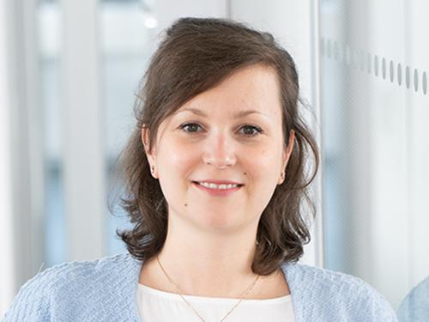
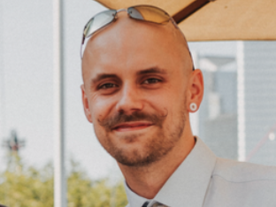
NUTRIWISE
Upload your
supermarket receipts.
Gain nutritional insights.
Jennifer Rake
Stuart Kasemeier
A receipt-first nutrition assistant.
Spiced Academy x neue fische Capstone · AI Project Management · July 31, 2026
Notes:
🔵 Our whole idea in one sentence: / you upload a supermarket ri-SIIT, / and you get honest nju-TRISH-nl feedback. //
A receipt-first nutrition assistant. //
________________________________
🔵 Hi everyone //
we're NutriWise. / I'm Jennifer Rake, / and this is Stuart Kasemeier. //
________________________________
🔵 Quick plan: / I'll cover the problem and architecture, / Stuart shows how we made the data solid, / and I'll close with where we're headed. //
Warum und wie
________________________________
🔵 Let's start with why this matters. //

Slide 3

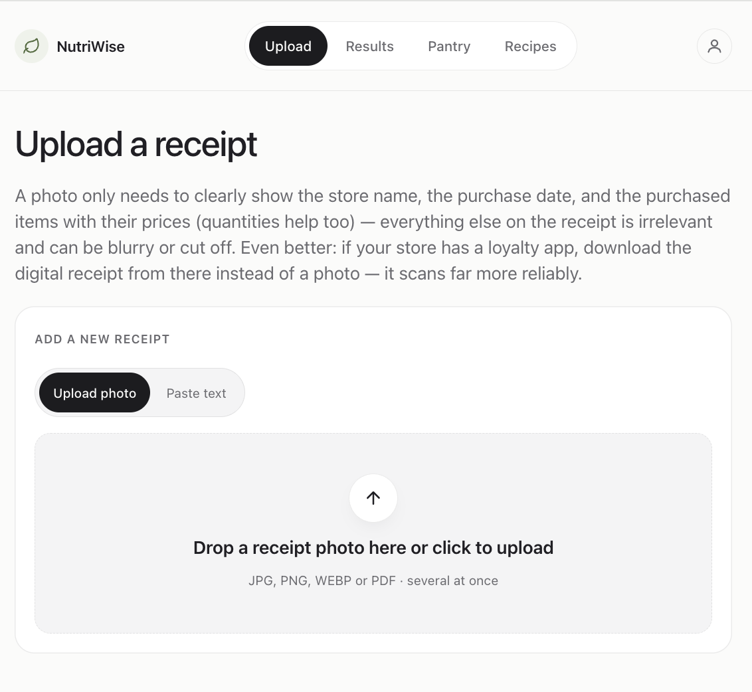
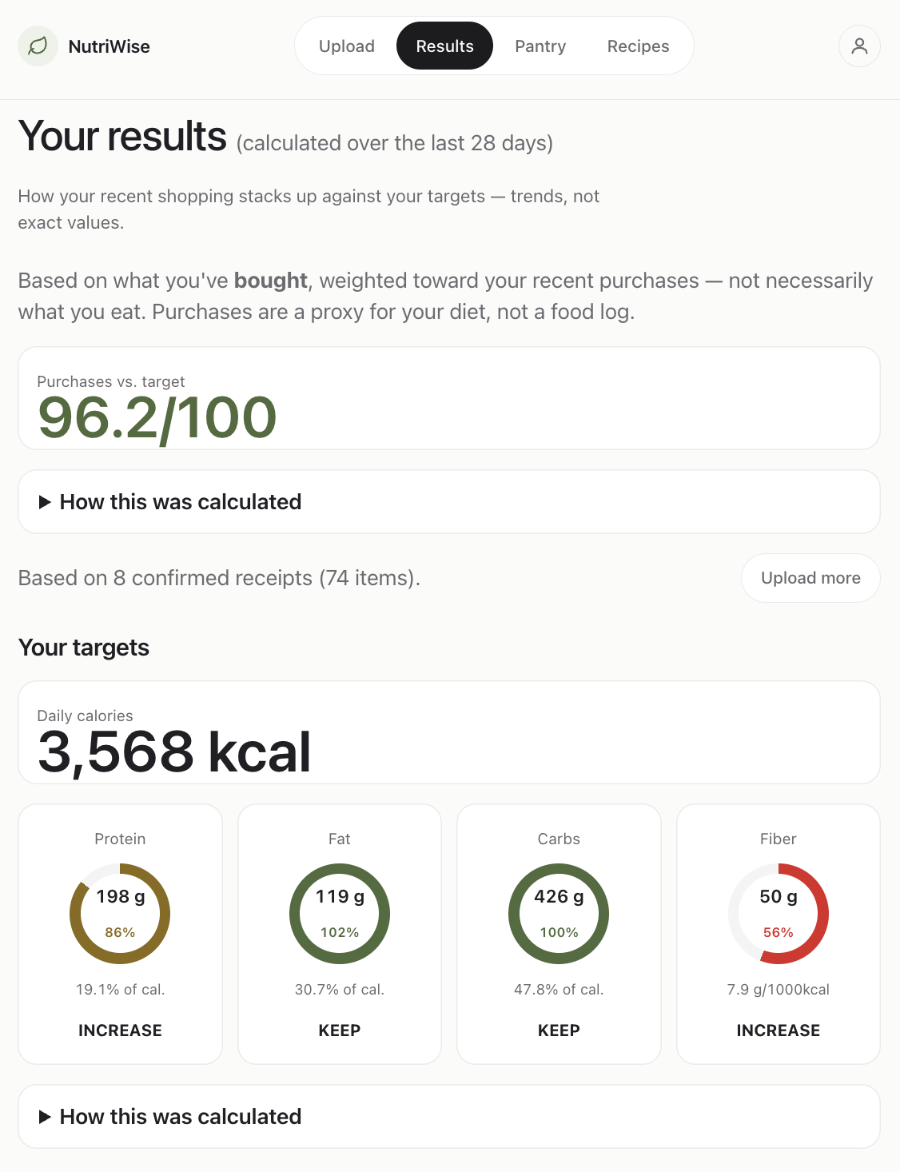
PROBLEM & SOLUTION
The gap we close
VISION
Eating better, zero extra effort
l
PROBLEM
SOLUTION
Logging kills the habit
Receipts log for you
›
Every app = type in every meal
›
Snap receipt → pantry auto-fills
MISSION
›
Habit dies in weeks → people quit
›
Tap what you ate, no typing
Turn receipts into nutritional insights
›
No effortless record of eating
›
Gaps + recipes
02 /09
NutriWise
Notes:
Most of us want to eat a little better. / So we download an app. //
And every one asks us to type in every meal, / every day.
________________________________
🔵 Be honest: / who's still doing that after two weeks? //
Nobody. The habit dies. / We quit.
________________________________
🔵 The real problem isn't willpower WILL-pau-er. / It's effort. //
There's no easy record of what we really eat. //
________________________________
🔵 Except / there already is one. //
It's your supermarket ri-SIIT. //
The one honest record of what you bought / and you get it for free, / every shop.
________________________________
🔵 So we flipped it around. //
You snap your ri-SIIT. / Your pantry fills itself. / You tap what you ate / no typing. //
At the end, / you see where your nutrition has gaps. / And you get a couple of easy RESS-i-piis to close them. //
________________________________
➡️ 🔵 Our vision and mission is simple: / eating better with zero extra effort / turning a ri-SIIT you already have into nutritional nju-TRISH-nl insights. //

Slide 4
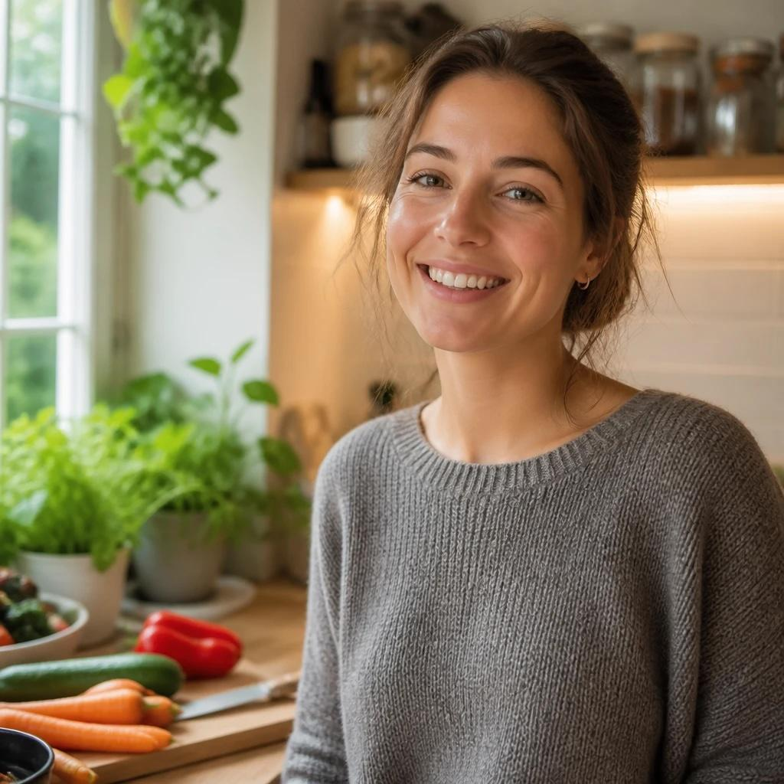

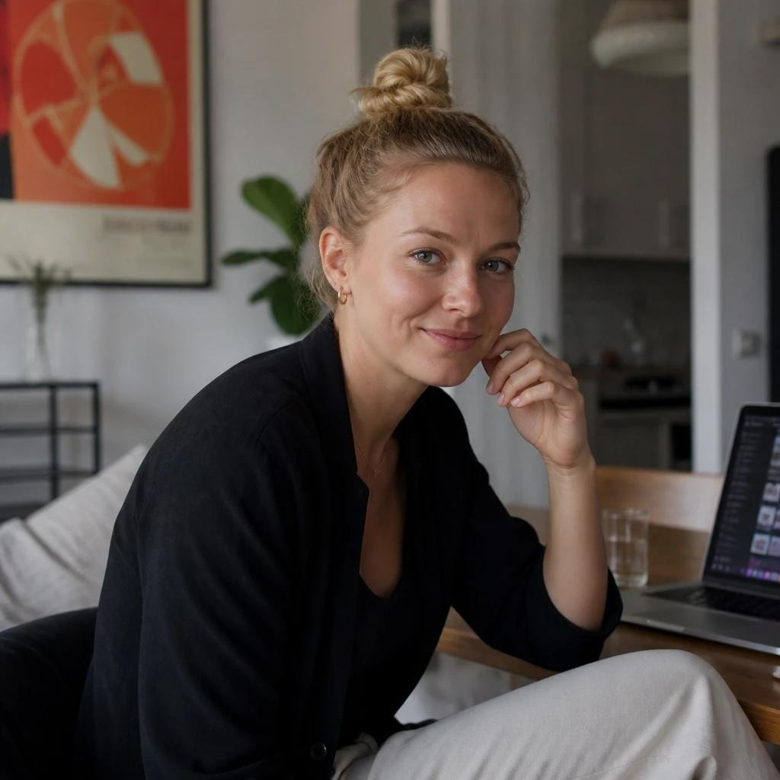
TARGET GROUP
Who it's for
🌱
⏱️
✨
DIETARY RESTRICTOR
BUSY PROFESSIONAL
EARLY ADOPTER
Proof it works
No time, low friction
Feel "enough"
Sara, 25 · vegan
Tobias, 38 · 2 kids
Lena, 29 · gym 3×/wk
›
Vegan/veggie/allergies
›
"Just tell me what to do"
›
Design quality = dealbreaker
›
"Vegan = default, not checkbox"
›
Hates daily input
›
Hates calorie counting
›
Unsure on iron, omega-3, B12
›
Pays for time, not complexity
›
Wants control, not a 2nd job
Examples above · Core group: Health-minded adults, 25-60+, in Germany.
NutriWise
03 / 09
Notes:
So / who is this for? //
Let me introduce three people. //
________________________________
🔵 Sara is vegan. / She's not counting calories. / She wants proof her diet works. //
________________________________
🔵 Tobias has two kids / and no time. / He just wants to be told what to do. //
________________________________
🔵 Lena works out. / But food feels like too much / and a bit shaming. //
She wants to feel she's doing enough, / without a second job. //
________________________________
➡️ 🔵 Three different people. / The same need: / eat better without the effort. //
And these are just examples. //
Our core group is broader: / health-minded adults, / twenty-five and up, / here in Germany. //

Slide 5
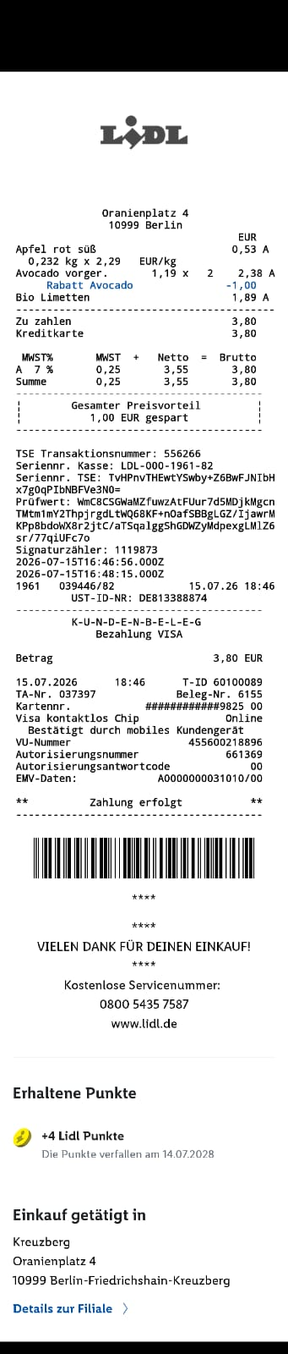
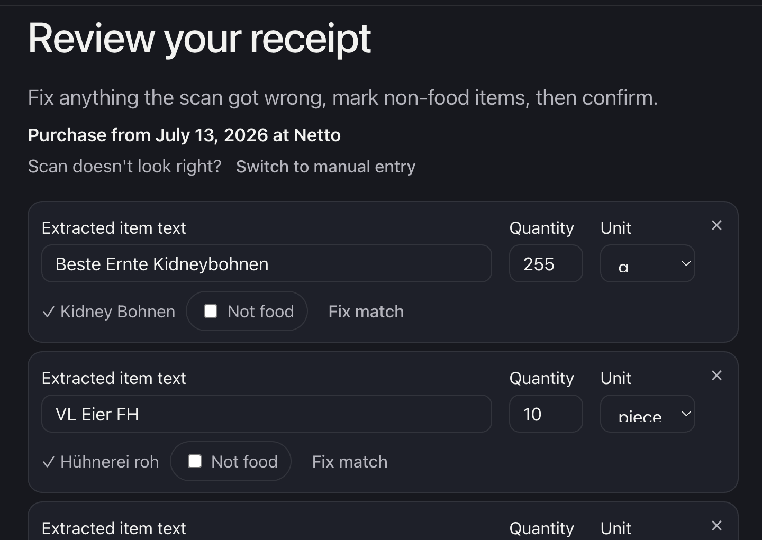
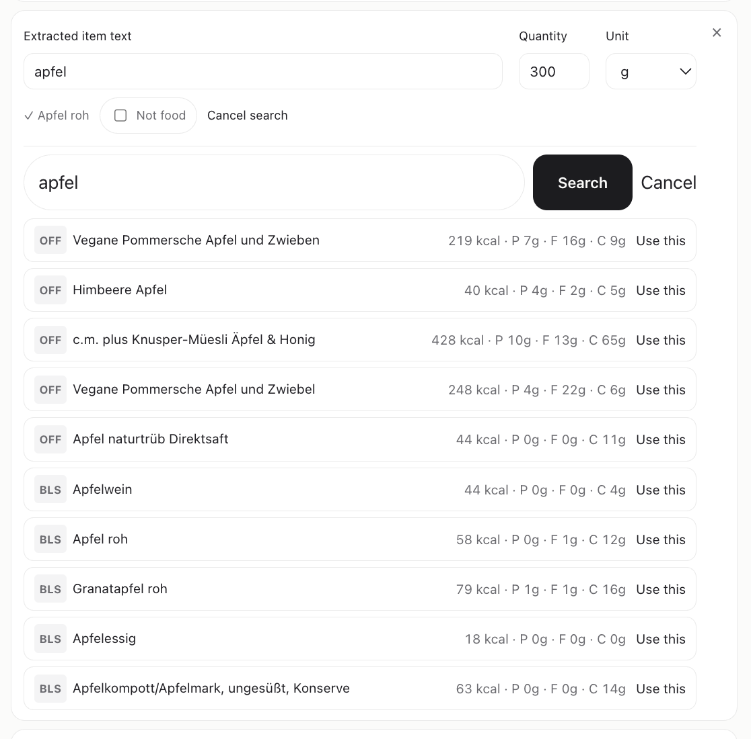
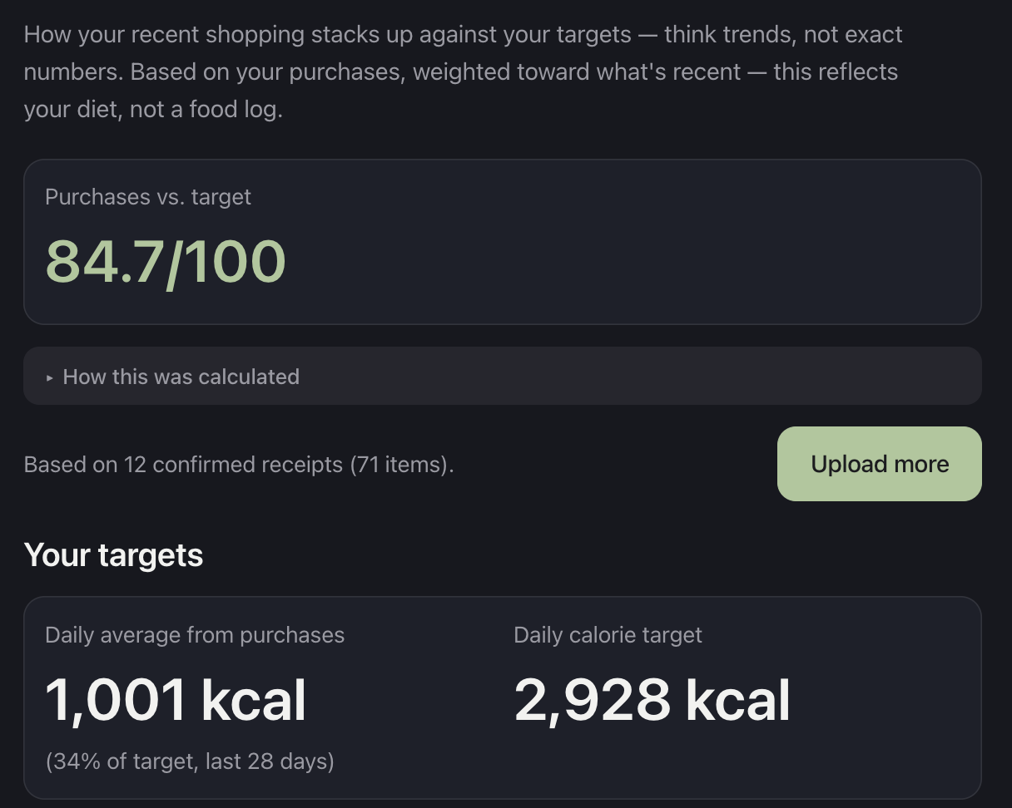
ARCHITECTURE
From a photo to smart recipes
Bild
→
→
→
Capture
Extract
Match
Advise
Receipt photo or PDF.
Read text on our server - offline, no 3rd-party AI.
Tiered, safest-first - falls back to category, never guesses.
Gaps + recipes
React · Vite
FastAPI · Tesseract
verified → OFF → BLS → fallback
nutrition engine
Privacy by design: OCR runs on our own backend - receipts never touch a third-party AI · per-user data isolation · GDPR account deletion. Matching is 100 % rule-based and fully auditable - no AI guesswork.
NutriWise
04 / 09
Notes:
So how does it work? //
Four simple steps. //
________________________________
🔵 One: / you capture your ri-SIIT / a photo or a PDF. //
Two: / we read the items. //
Three: / we match each one / to a trusted, / official German food database. //
Four: / we turn that into feedback / your gaps, / and RESS-i-piis.
________________________________
➡️ 🔵 Two things we're proud of. / Both are about trust. //
🔵 First, / privacy. / Your ri-SIIT is processed on our server. / It never leaves it. / And you can delete everything with one tap. //
🔵 Second, / we don't guess. / When we're not sure, / we tell you / instead of inventing a number.
In health, / that honesty is the whole point. //
________________________________
➡️ 🔵 All of that depends on getting the data right. / And that's not easy. //
So I'll hand over to Stuart.
[... exactly look like]

Slide 6
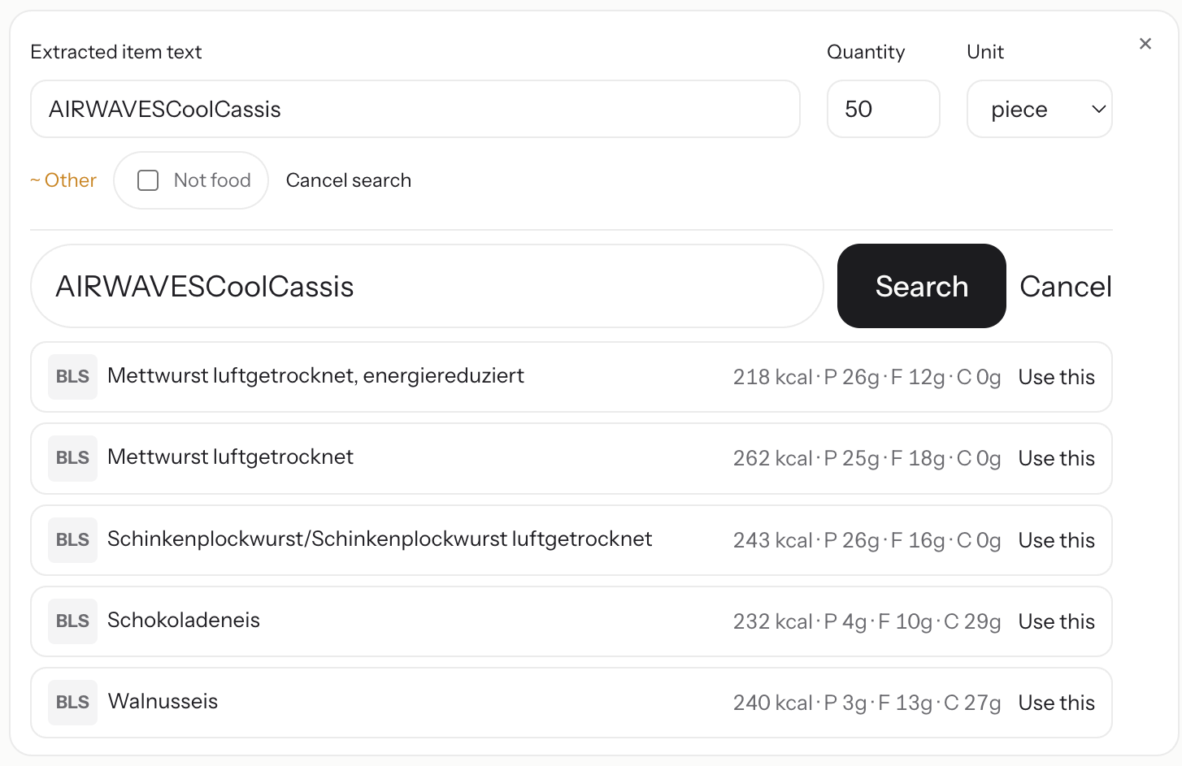
Data flow
Matching Problem
NutriWise
05 / 09
Notes:
[...investigation]

Slide 7
Data flow
Matching Investigation
Extracted items
119
Fallback matches
41 %
OFF matches
35 %
BLS matches
34 %
correct
72 %
incorrect
28 %
include user-verification
expand fallback categories (from 7 to 87)
search in verified matches first, then use OFF/BLS, then fallback
NutriWise
06 / 09
Notes:
[..]

Slide 8
OUTLOOK
What runs today
LIVE · THE LOOP
LIVE · THE ENGINE
LIVE · PERSONAL
The loop, end to end
Data you can trust
Yours & private
›
Receipt → auto-filled pantry
›
Offline OCR on our server
›
Onboarding chat: goals & diet
›
One-tap check-off (what you ate)
›
Tiered BLS 4.0 match, verified-first
›
Household / multi-user
›
Gaps → AI recipes to close them
›
Nutrient gaps vs DGE reference values
›
One-tap delete-all
›
Freshness-aware pantry
›
Plant-diversity score
NutriWise
07 / 09
Notes:
Thanks, Stuart. //
So / where are we?
________________________________
🔵 Everything in this first column runs today. / That's the loop you just saw in the demo.
// It works, / end to end. //
________________________________
➡️ 🔵 What's next? // Four things. / A friendly AI coach you can ask questions. / Native iPhone and Android apps. / A shopping list built from this week's supermarket deals. / And sharper ri-SIIT reading, / so more items land correctly. //
________________________________
🔵 For growth, / the ri-SIIT opens real doors here in Germany: / health-insurance in-SCHUR-ens bonuses, / corporate health, / and retail partners. //
________________________________
➡️ 🔵 But here's our honest bet. //
Do people trust a receipt-based tip enough to change what they buy next? //
And does the check-off habit stick? //
That's what this version is all about.

Slide 9
OUTLOOK
Where we're headed
NEXT · PRODUCT
NEXT · GROWTH
Broaden & sharpen
Partnerships
›
Nutritional AI coach
›
Statutory-insurer bonus programs (prevention, GDPR-fit)
›
Native iOS & Android apps
›
Corporate health / BGMs
›
Shopping list from store offers
›
Retail: user offers (affiliate, privacy-safe)
›
Smarter matching: verified-first + more categories
›
Dietician sign-off
The bet: Do people trust a receipt-based tip enough to change what they buy next? Does the check-off habit stick?
NutriWise
08 / 09

Slide 10
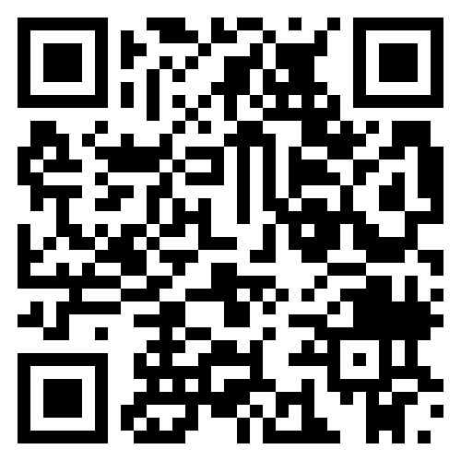

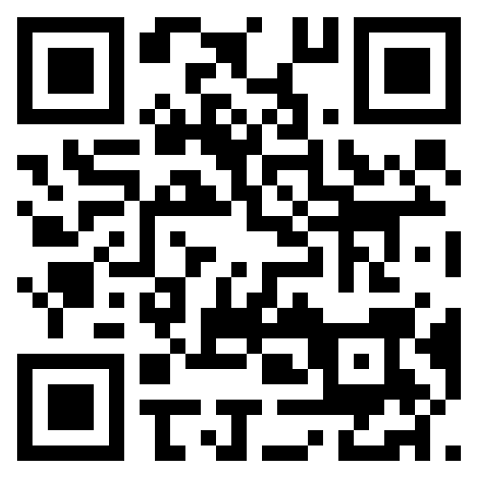
NUTRIWISE
Thank you. Any questions?
Upload your supermarket receipts. Gain nutritional insights.
TEAM
PROJECT & APP
Jennifer
Rake
Stuart
Kasemeier
GitHub
WebApp
Appendix: Personas · Tech Stack · Data Flow · Business Model
Notes:
That's NutriWise: / upload a ri-SIIT, / get nju-TRISH-nl insights. //
________________________________
🔵 🔵 The qr-codes on screen take you to our app and the repo. / You can connect with us on LinkedIn. / And there's an appendix with the details. //
________________________________
🔵🔵 Thank you / we'd love your questions. //

Slide 11
APPENDIX · PERSONA
Sara Bauer, 25
Master's student · Munich · Vegan 2 years
Dietary Restrictor
DAILY WORKFLOW
PSYCHOLOGICAL DRIVERS
·
Cooks most meals (ethics + budget)
·
Diet = identity & values
·
~8-dish rotation, narrow
·
"Am I actually healthy?"
·
Reads labels · B12 (unsure of dose)
·
Reacts badly to preachy apps
DECISION-MAKING
BIGGEST FRUSTRATIONS
·
Researches ethics + privacy policies
·
"Vegan = checkbox, not default"
·
Active in vegan groups & Reddit
·
Constant chicken protein recs
·
Rejects "vegan filter" apps
·
Iron/omega-3/zinc — contradictory answers
SECRET MOTIVATION
Shut down "but where do you get your protein?" — with data proving she's healthier than they are.
NutriWise
appendix
Notes:
[Appendix — persona 1]
Sara, the dietary restrictor. Vegan by values; wants proof she's healthy; hates preachy apps.

Slide 12
APPENDIX · PERSONA
Tobias Kramer, 38
Project Manager · Hamburg · Married, 2 kids, no time
Busy Professional
DAILY WORKFLOW
PSYCHOLOGICAL DRIVERS
·
Out 7:30–19:00 · kids need dinner
·
Good role model, no life overhaul
·
Leftovers or fast food; desk sandwich
·
Runs work life in Notion — likes systems
·
Cooks only weekends (2 of 14 meals)
·
Would engage if friction is low
DECISION-MAKING
BIGGEST FRUSTRATIONS
·
Buys on trusted recommendation
·
"No 2 hours to figure out eating well"
·
Too busy to research
·
Quit MyFitnessPal after 4 days
·
Pays for time — complexity is the barrier
·
Hates apps needing daily input
SECRET MOTIVATION
Scared of getting sick — dad's heart attack at 55. The cholesterol comment landed hard. Wants to hear he'll be fine.
NutriWise
appendix
Notes:
[Appendix — persona 2]
Tobias, the busy professional. No time, responds to systems. Secret: scared of getting sick like his dad.

Slide 13
APPENDIX · PERSONA
Lena Müller, 29
UX Designer · Berlin · Lives alone, gym 3×/week
Early Adopter
DAILY WORKFLOW
PSYCHOLOGICAL DRIVERS
·
Skips breakfast · lunch near office
·
Control without a second job
·
Tracks workouts in Strava, never a macro
·
"Someone who works out" = identity
·
Meal-preps ~monthly · saves unused recipes
·
Nutrition feels overwhelming, shameful
DECISION-MAKING
BIGGEST FRUSTRATIONS
·
Tries 3 apps free before committing
·
"Eat healthy but always tired"
·
Reads reviews obsessively
·
Hates calorie counting
·
Ugly app = instant no
·
Apps feel built for bodybuilders / ED
SECRET MOTIVATION
Stop feeling guilty about food and still look good. An app that makes her feel she's doing enough is the win.
NutriWise
appendix
Notes:
[Appendix — persona 3]
Lena, the early adopter. Design-led; nutrition feels shameful. Secret: stop feeling guilty, feel she's doing enough.

Slide 14
APPENDIX · TECH STACK
What it's built with
Frontend
React 19 · React Router 7 · TypeScript · Vite 8
Backend
FastAPI · Uvicorn · Pydantic v2 · Python 3.11
OCR
Tesseract · PyMuPDF · OpenCV · offline on our server
Matching / data
BLS 4.0 · OpenFoodFacts · tiered resolver
Storage
Supabase · PostgreSQL · per-user isolation
AI (optional)
Gemini 2.5 Flash · recipes only
Deploy / Infra
Docker · Render · GitHub Actions CI
Tooling / CI
pytest · ruff · ESLint · Prettier · pre-commit · GitHub Actions
NutriWise
appendix

Slide 15
Data flow
Collected Data & Processing
USER INTERACTION
INTERNAL PROCESSES
OUTPUTS
Onboarding Chat
Biometrics & household
once
Profile edits
anytime
Receipts + Manual Pantry
every shopping trip
Pantry removal
anytime
Item extraction & matching
Ideal Targets BMR to TDEE to macros
Purchase analysis, Diversity, Gaps
Health score Purchase vs Targets Plant Diversity
Recipe chat
Dietary style & feedback
Recipe input (time, servings, cuisine)
on demand
Recipe Generation
NutriWise
appendix

Slide 16
APPENDIX · BUSINESS MODEL
Business Model Canvas
KEY PARTNERS
KEY ACTIVITIES
VALUE PROPOSITIONS
CUSTOMER RELATIONSHIPS
CUSTOMER SEGMENTS
· BLS 4.0 (food table)
· Nutrient-gap analysis
· Personalized, not one-size
· AI coach (chat)
· Health-minded customer
· Open Food Facts
· Coaching & recipes
· Instant nutrient-gap analysis
· Check-ins & nudges
· Nutrition goals
· Hosting (Supabase)
· Personalization loop
· Auto shopping list to goals
· Gamification: streaks/goals
· Vegan/veggie/allergy
· LLM (Google Gemini)
· GDPR data handling
· Respects allergies & diets
· Self-service onboarding
· Busy professionals
· Health insurers (future)
· Privacy-first, fully GDPR
KEY RESOURCES
CHANNELS
· BLS 4.0 + OFF data
· Web app (React)
· Tiered matching resolver
· Health/fitness social
· Nutrition/gap engine
· Word-of-mouth
· 2-person team
· Later: app store
COST STRUCTURE
REVENUE STREAMS
· Gemini API (token) · Hosting (Supabase) · Postgres · Dev (capstone 0€) · GDPR setup · Marketing (organic)
· Freemium → Premium · B2B insurer licensing
· Affiliate grocery commissions · Corporate wellness
Reflects the built product stack — BLS 4.0 · Open Food Facts · Supabase · Gemini · React.
NutriWise
appendix

