Slide 1
NUTRIWISE
Upload a grocery receipt.
Get one smarter thing
to buy next time.
Onboard
Pantry
Check off
A receipt-first nutrition assistant — your pantry works for you: tap what you eat, don't type it.
Insights
Jennifer Rake · Product & business Stuart Kasemeier · Data & model
AI Product Management Capstone · Final Presentation · Version 0
Notes:
[Both — Jennifer opens]
Open on the one line: 'Take a photo of your shopping receipt, and we tell you one smart thing to buy next time.' Say both names and who does what. Plan for the room: about 10 minutes, kept simple, and we'll show the real app in about a minute so you can see it before we explain anything.

Slide 2
SEE IT FIRST — 30-SECOND DEMO
One receipt in → one smart pick out
1
Snap your receipt
a photo — that's the only input
NutriWise · Your results
Estimates from your groceries + daily log — not medical advice
2
Your pantry fills itself
the food in your house, no typing
YOUR NEXT CART
+ Red lentils (dried)
3
Tap what you ate
one tap = one portion
Closes your fiber & plant-protein gap — and it's peanut-free.
4
Get one smart pick
the single best thing to buy next
Fiber
Protein
Sugar
low
ok
ok
shown live now — the app runs end-to-end on a real receipt
NutriWise · Final · V0
02 / 14
Notes:
[Jennifer — do the live demo here (~1 min)]
Before any slides about how it works, show it. Snap a receipt → the pantry fills → tap one thing you ate → the app shows this card: your week's gaps and ONE thing to buy next time. Keep it to a minute. Say plainly: these are friendly estimates from your shopping, not a doctor's advice. If the live app hiccups, this card is exactly what they'd see. Now that they've seen it — here's the problem it solves.

Slide 3
THE PROBLEM
Eating well shouldn't require a spreadsheet
Meet Anna, 34. She wants to eat better — but every app asks her to log every meal by hand.
That habit dies within weeks. She gives up — or she guesses.
Meanwhile the one honest record of what she actually eats already exists — her grocery receipt.
WHO IT'S FOR · WHY IT HURTS
1
Health-minded adults 25–45 who want to eat better
2
Manual logging is the #1 reason nutrition apps get abandoned
3
Receipts are passive — zero extra effort for the user
4
One clear “next cart” decision beats another dashboard to ignore
NutriWise · Final · V0
03 / 14
Notes:
[Jennifer]
Simple version: people want to eat healthier, but every app makes them type in every meal — that's boring, so they quit. Our way in: the shopping receipt already shows what they bought, with zero extra effort. Target user: health-minded people aged 25–45.

Slide 4
WHAT WE'RE BUILDING & WHY
Vision, mission — and the one line we live by
VISION
MISSION
Eating better takes no extra effort
Turn the receipt into one kind nudge
A world where your everyday shopping quietly does the tracking for you — no diary, no willpower tax.
Take the honest record people already create — the grocery receipt — and turn it into one clear, trustworthy step toward a healthier cart.
OUR SLOGAN
“Upload a receipt. Get one smarter thing to buy next time.”
NutriWise · Final · V0
04 / 14
Notes:
[Jennifer]
In one breath: our vision is that eating better takes no extra effort — your shopping does the work. Our mission is to turn the receipt everyone already gets into one clear, kind nudge. And the slogan we keep coming back to: upload a receipt, get one smarter thing to buy next time.

Slide 5
THE SOLUTION
One receipt in → a pantry that works for you
Upload › Your Pantry › Check off what you ate › Weekly gaps + 2 picks
NutriWise
Dein Vorrat
Tages-Log
Insights
Dein Ziel?
EMPFOHLEN
🥛 Trink deine Buttermilch
72
Protein 62 / 120 g
Gesünder essen
›
›
›
Wochen-Score · Gut
🍗 Hähnchenbrust
1 Tag
Ballaststoffe 11 / 30 g
Protein
niedrig
Ballastst.
niedrig
Wenig
Mittel
Hoch
🥛 Buttermilch
2 Tage
Kalorien 1.340 / 2.100
Zucker
ok
Kalorien
ok
🥦 Brokkoli
frisch
1 · Onboarding chat
conversational profile
2 · Your Pantry
home · expiry-aware
3 · Daily log
1 tap = 1 portion
4 · Insights
weekly gaps + picks
Fully clickable prototype — light & dark. Estimates from your groceries + taps — not medical advice.
NutriWise · Final · V0
05 / 14
Notes:
[Jennifer]
The whole loop in one picture. First a short chat so we learn your goal. Then a photo of your receipt fills your 'pantry' — the food in your house. Every day you tap what you ate (one tap, no typing). At the end of the week we show what's missing and two easy fixes. Friendly estimates, not a doctor's advice.

Slide 6
HONEST BY DESIGN
We show only what your data actually supports
The more you track, the more we can say — and we never pretend to know more than we do.
DAY 0
1ST RECEIPT
FEW TAPS
1 WEEK
30–90 DAYS
Your targets
›
Your basket
›
Early signs
›
Weekly score
›
Trends
What to aim for, from your profile. No eating data yet.
The mix of what you bought — labeled “basket,” never “diet.”
Soft hints + a “3 / 7 days tracked” bar. No hard score yet.
Your main number: gaps per nutrient, allowing for meals eaten out.
Are you improving over time — a line, not a single badge.
Never a confident wrong number. A coverage floor holds the score back until enough days are tracked, and “your basket” is never relabeled “your diet.” Honesty is the feature.
NutriWise · Final · V0
06 / 14
Notes:
[Jennifer]
Think of a new friend who cooks for you. Day one they only know your goal, so they just say what to aim for. After your first shop they can say what's in your kitchen — but that's shopping, not what you ate, so we call it 'your basket,' not 'your diet.' Once you tap meals they get a feel for it, and after a week they can honestly say 'you're a little low on fibre.' If you've only tracked 2 days, we say 'still learning' instead of guessing. That honesty is on purpose — it's how you earn trust in health.

Slide 7
SUCCESS CRITERIA & KPIS
How we'll know it works
Core question: do users trust a receipt-based recommendation enough to act — and does the check-off habit stick?
Week 1
Check-off sticks?
the make-or-break — does tapping survive novelty
30%
Behaviour shift
adjust their next cart to our suggestion
>20%
Recommendation acted on
marked “done”, not dismissed unread
<2 min
Time to value
from upload to first personalised result
The check-off habit gates everything. Prove the weekly tap sticks first, then layer in the full 10-KPI funnel across behaviour, business and satisfaction.
NutriWise · Final · V0
07 / 14
Notes:
[Jennifer]
The one number that makes or breaks us: do people keep tapping after week 1? If the daily tap dies, the whole thing dies — so we test that first. Our north star: at least 3 in 10 people change what they buy next time, with no manual food diary. Plus: more than 1 in 5 act on our tip, and they see something useful in under 2 minutes.

Slide 8
ROADMAP & MILESTONES
Where we are — and what's next
DONE
Phase 1 · done
IN PROGRESS
Phase 2 · now
NEXT
Phase 3 · next
✓
Receipt → pantry → gaps → recommendation
▸
1-tap portion — cut check-off friction
•
Smarter matching to push accuracy higher
✓
Daily check-off log + expiry-aware pantry
▸
Sharper matching + text cleanup
•
Personalised portion & consumption
✓
Recipes, easy swaps, progress tracking
▸
A/B test: when to ask “what did you eat?”
•
Instrument the 10-KPI funnel
✓
Nutri-Coach + honest empty states
▸
Live user testing + retention
•
Weekly / monthly trend views
✓
GDPR export/erasure · DE/EN
NutriWise · Final · V0
08 / 14
Notes:
[Jennifer → hands to Stuart]
Three phases. DONE: the whole loop already runs end to end. NOW: smarter matching and our first real user tests. NEXT: better accuracy, personalised portions, and the full success-scorecard. And here's the honest bit — a tip is only as good as the data behind it. So I'll hand to Stuart to show how we made that data trustworthy.

Slide 9
HOW WE MEASURE SUCCESS
The hard part: cryptic receipt text → a real food
“AB Bud 6x0,3l MW” → ?
Every receipt line has to become a real food with real nutrients — but there was no answer key for “what food is this, really?”
So we built one: a human-checked test set of 180 real receipt lines.
Our simple test: is the correct food among the top 5 the app shows you?
WHAT WE MEASURE
Top 5
Right food shortlisted
is the correct food in the 5 we show?
3%
Label-error rate
human spot-check of our test answers
Technical name: “Recall@5” — see backup.
NutriWise · Final · V0
09 / 14
Notes:
[Stuart]
Stuart here. This isn't a normal 'train a model' project — the real puzzle is turning messy receipt text like 'AB Bud 6x0,3l MW' into an actual food. Nobody handed us an answer key, so we made one: 180 real receipt lines, matched to the true food. A person double-checked; only 3% were off. Our test in plain words: when the app shows its top 5 guesses, is the right food in there? (The technical name is Recall@5 — it's in the backup if anyone wants it.)

Slide 10
DATA — SOURCES, SHAPE & CHALLENGES
Three data worlds, stitched together
Grocery receipts
Open Food Facts
BLS 4.0 table
Real German receipts (Lidl / Netto / Edeka), read on the phone itself → items. Private: nothing leaves the device.
Crowd-sourced branded-product data. Backup for products the official table doesn't have.
German federal food database — ~7,140 foods. Our primary source of reliable nutrients.
OUR TEST SET (for matching)
HONEST DATA CHALLENGES
45 → 180 real receipt lines · 152 unique
Earlier EDA sample: 76 items across 227 purchases.
Each line checked against all 7,140 foods.
• Cryptic text, brand-vs-generic (“Budweiser” → “Pilsner Bier”)
• Real receipts are harder than clean text (brand, size, “bio”)
• US food database tried & rejected — blind to German foods (Quark, Schmand)
NutriWise · Final · V0
10 / 14
Notes:
[Stuart]
Three data worlds. One: real German receipts, read on the phone itself — private, no cloud. Two: Open Food Facts, a big crowd list of branded products, as a backup. Three: the official German food table, 7,140 foods, our trusted source for nutrients. For testing we grew our answer key from 45 to 180 real receipt lines. Honest hurdles: receipt text is cryptic; real receipts are harder than tidy text; and we tried the US food database but dropped it — it doesn't know German foods like Quark or Schmand.

Slide 11
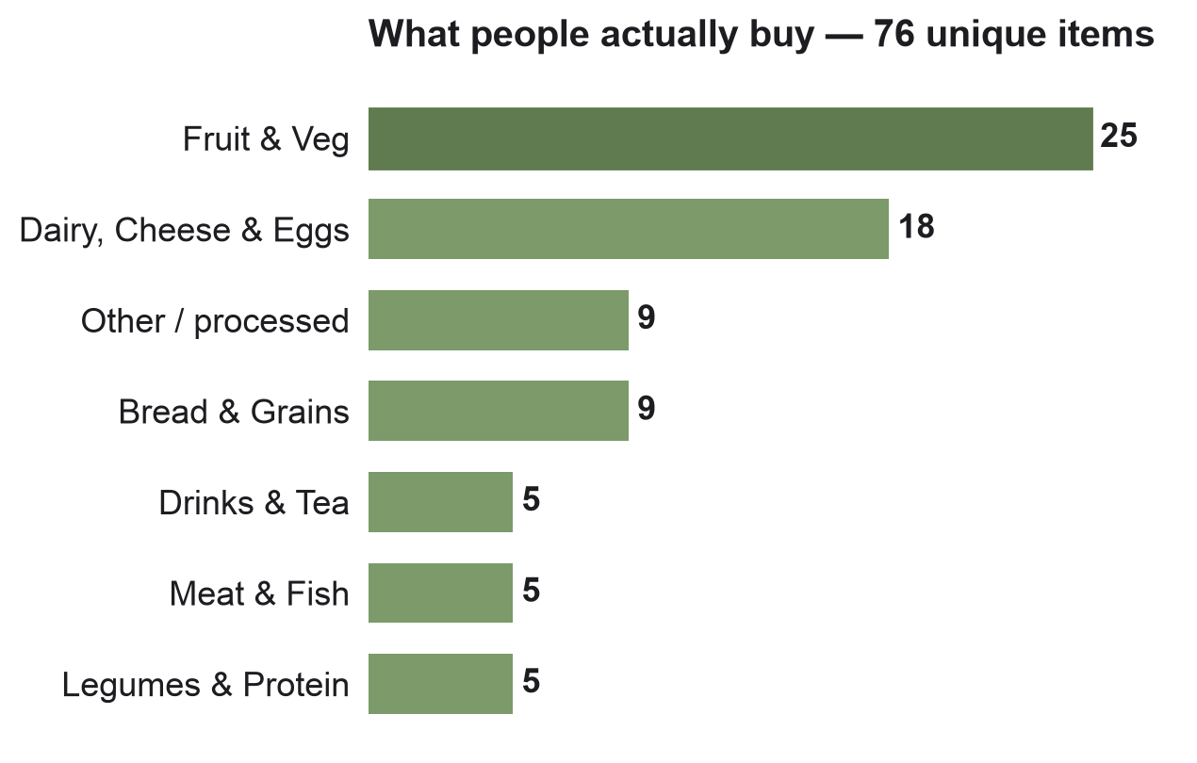
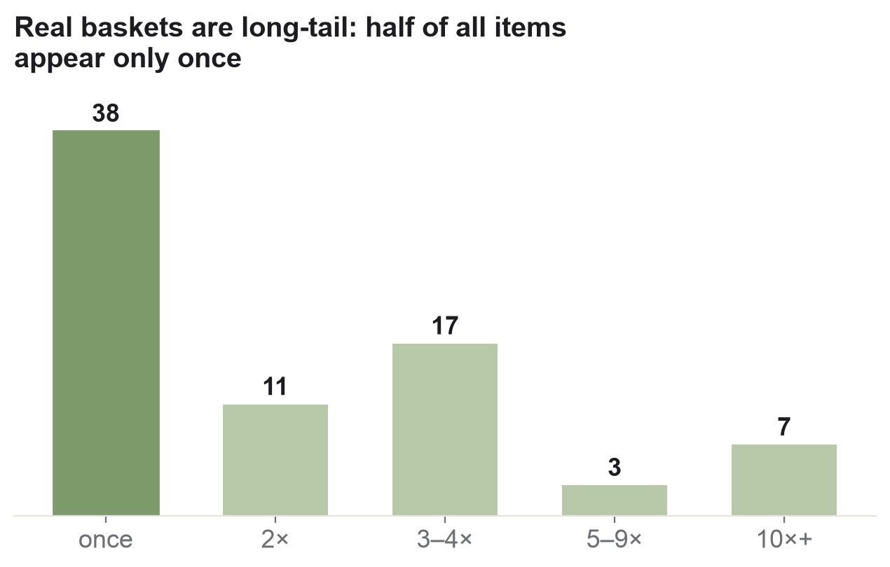
EXPLORATORY DATA ANALYSIS
What real baskets actually look like
Takeaway: baskets are produce- and dairy-heavy, but the long tail is brutal — half the items appear only once, so the matcher must generalise, not memorise.
NutriWise · Final · V0
11 / 14
Notes:
[Stuart]
Two quick pictures. Left: most shopping is fruit, veg and dairy — the basics. Right: but there's a long tail — half the items show up only once. So we can't just memorise the popular foods; the matcher has to handle weird, one-off, badly-abbreviated names it has never seen. That shaped our whole design.

Slide 12
HOW WE DID IT
A simple ladder — safest match first, fallback last
Receipt
→
Read it
→
Clean it up
→
photo or text
on the phone → items
drop price · size · brand
Known
A match we've confirmed before
always trusted
OUT COMES
German table
The official food database
our main source · almost every line
• Nutrients (per food)
• A confidence label
Branded
Open Food Facts fallback
only for branded gaps
• Where the number came from
Unsure
Left honest, not guessed
a few lines we don't force
• → Gaps + Next Cart
Rule-based on purpose — transparent and trustworthy for a health MVP; the “smart” part only breaks ties.
NutriWise · Final · V0
12 / 14
Notes:
[Stuart]
It's a ladder: read the receipt, clean it up, then try the safest match first. Known: a match we've confirmed before. German table: the official food database — our main source, it handled almost every line. Branded: Open Food Facts for the few branded gaps. And if it's genuinely unclear, we leave it open instead of guessing. Rules on purpose — you can see exactly why each number is there, which matters for a health app. The clever AI part only breaks ties.

Slide 13
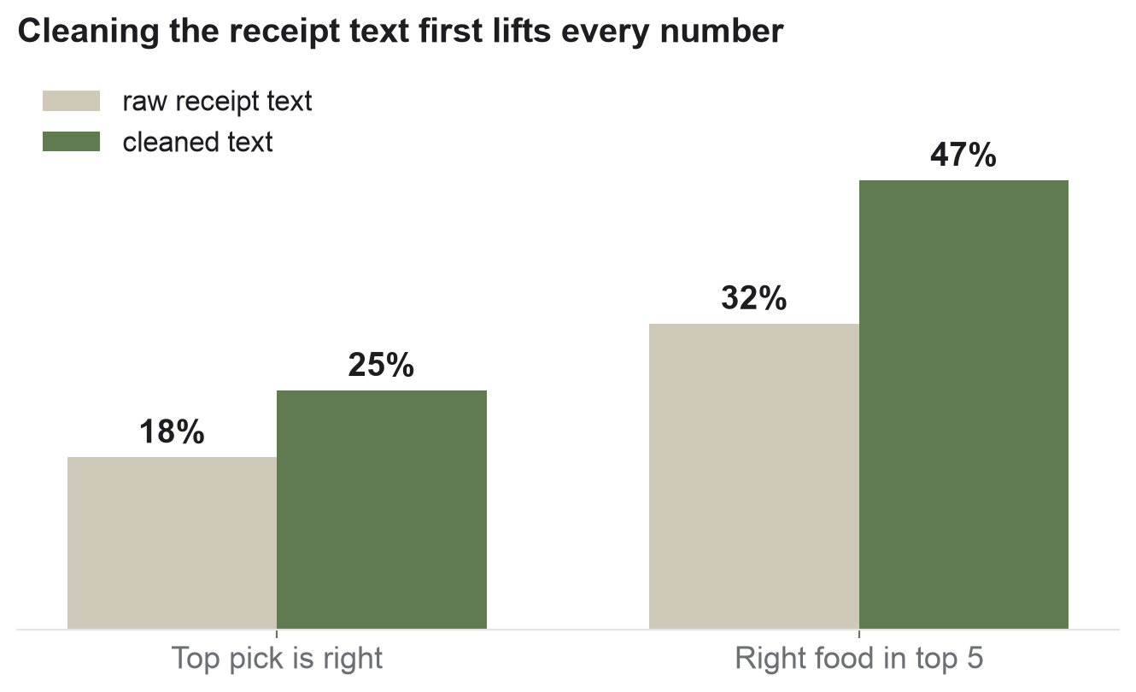
BASELINE MODEL & PERFORMANCE
Measured honestly on real receipts
99%
Lines resolved
174 German table · 4 branded · 2 left open, of 180
~half
Right food in top 5
47% after cleanup — up from 32% on raw text
56% → 47%
Real is harder
clean names vs. messy real receipts
The honest finding: cleaning the receipt text is the real lever, and every user correction we save makes the next match better. Simple and transparent beats a black box here.
NutriWise · Final · V0
13 / 14
Notes:
[Stuart]
Our honest scorecard. First, we found a match for 99% of lines — 174 from the German table, 4 from Open Food Facts, and 2 we left open on purpose. Second, the big lever is cleaning the receipt text: the right food lands in the top 5 about 47% of the time after cleanup, up from 32% on raw text. Third, honesty: real receipts are harder than the tidy names we started with. The way we close the gap: every user correction is saved and reused. (Earlier pilot numbers are in the backup if you want them.)

Slide 14
NUTRIWISE
Thank you.
Upload a grocery receipt. Get one smarter thing to buy next time.
Jennifer Rake & Stuart Kasemeier
NutriWise · AI PM Capstone · Final · Version 0 — Questions & feedback welcome
Notes:
[Both]
Close on the one-liner and invite questions. If pushed on accuracy: we measure honestly on real receipts (right food in the top 5 about 47% of the time after cleanup, 99% of lines resolved), the clear next lever is saving every user correction, and the deeper question — do people trust it and keep tapping — is what live user testing answers next. Backup slides have the technical detail.

Slide 15
BACKUP — THE METRIC IN TECHNICAL TERMS
Recall@5 on a human-verified gold set
For the technically curious — the plain-language version is on the main slides.
Gold set
Metric — Recall@5
180 real receipt lines (grown from 45); 152 unique. Each labeled against the full 7,140-food BLS corpus — not a shortlist, or the score would be inflated.
Share of lines where the correct food is in the top-5 candidates the matcher returns. Also track Top-1 (auto-pick) and lines-resolved coverage.
Label quality
Resolver tiers
Human spot-check: ~3% label-error rate on the gold labels; verdicts cross-checked.
Tier 0 learned/confirmed → Tier 1 BLS 4.0 → Tier 2 Open Food Facts fallback → left open. Embedding similarity is a tie-breaker only, not the primary matcher.
NutriWise · Backup
appendix
Notes:
[Stuart — only if asked]
Technical backstop. Gold set of 180 receipt lines labeled against all 7,140 foods. Metric is Recall@5 — correct food in the top 5. ~3% label error. Resolver is tiered; the embedding only breaks ties.

Slide 16
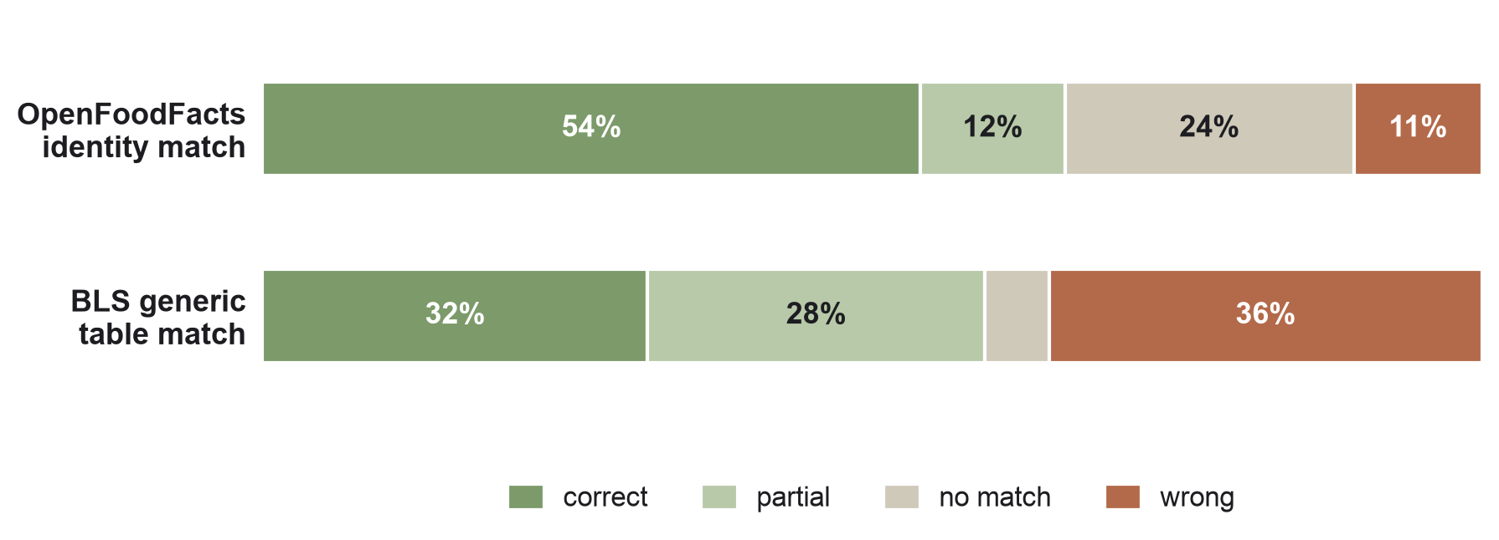
BACKUP — EARLIER PILOT MEASUREMENT
Pilot: OFF vs BLS, judged head-to-head
Different method than Recall@5 — an earlier LLM-judge pilot on 76 items. Not directly comparable; kept for context.
66%
OFF usable (pilot)
correct + partial, LLM-judged
2×
OFF beats BLS
54% vs 32% correct on identity
96%
Judge agreement
3/3 unanimous — pilot metric
Why it still matters: it's why BLS leads for nutrients and OFF is only a fallback — and why we moved to the stricter, human-verified Recall@5.
NutriWise · Backup
appendix
Notes:
[Stuart — only if asked]
Backup for questions. Earlier pilot on 76 items, judged by an LLM panel — a different method, so don't compare its 66% to the 47% Recall@5. It told us Open Food Facts wins on identity, the German table matched worse on its own — which is why the table leads for nutrients only, and why we then built the stricter, human-checked Recall@5 test.

