Slide 1
NUTRIWISE
Upload a grocery receipt.
Get one smarter thing
to buy next time.
Onboard
Pantry
Check off
A receipt-first nutrition assistant — your pantry works for you: tap what you eat, don't type it.
Insights
Jennifer Rake · Stuart Kasemeier ·
AI Project Management Capstone · Midterm Presentation · Version 17.07.2025
Notes:
Hi everyone. We're NutriWise - a product of Stuart Kasemeier and myself, Jennifer Rake .
Our idea in one sentence: you upload a grocery receipt, and we optimize your consumption.
It's a receipt-first nutrition assistant — the whole point is that your pantry works for you: you tap what you eat, you don't type it.
Over the next few minutes I'll walk you through the problem we're solving,
our solution,
how we measure whether it actually works,
the data behind it,
and our results —
and then we'll finish with a short live demo."

Slide 2
THE PROBLEM
Eating well shouldn't require a spreadsheet
Every tool makes you log every meal by hand — that habit dies in weeks. So people guess.
Personal needs differ: what your body eats is important for training, weather, blood donation or a woman's cycle.
The receipt already knows what you bought — we turn it into concrete picks: use what's in your pantry + one smart buy.
WHY IT MATTERS
1
Manual logging → the #1 reason nutrition apps get abandoned
2
Needs shift constantly - most people lose track of where they stand
3
Passive receipt → a concrete answer: eat this from your pantry, buy that next
NutriWise ·
02 / 13
Notes:
"Let's start with the problem.
Almost every nutrition app asks you to log every single meal by hand.
It's hard, so that habit dies within a few weeks — and people either give up or just guess.
In fact, manual tipping is the number-one reason these apps get abandoned.
But what your body eats is important because of getting a healthier lifestyle, training, the weather or blood donation.
So our approach is passive: the receipt is already an honest record of what you bought — and we turn it into concrete picks, telling you what to eat from what you already have, plus smart things to buy next."

Slide 3
THE SOLUTION
Receipts in → a pantry that works for you
Upload › Your Pantry › Check off what you ate › Weekly gaps + 2 picks
NutriWise
your pantry
Daily-Log
Insights
Your Goal?
EMPFOHLEN
🥛 Drink dyour milk
72
Protein 62 / 120 g
Eat healthier
›
🍗 Chicken Breast
1 Tag
›
›
Week-Score · Good
Fibre 11 / 30 g
Protein
low
Fibre.
low
low
medium
high
🥛 Milk
2 Tage
Calories 1.340 / 2.100
Sugra
ok
Calories
ok
🥦 Broccoli
frisch
1 · Onboarding chat
conversational profile
2 · Your Pantry
home · expiry-aware
3 · Daily log
1 tap = 1 portion
4 · Insights
Gaps + picks
Fully clickable prototype. Estimates from your groceries + taps — not medical advice.
NutriWise ·
03 / 13
Notes:
"Our solution is one simple loop.
First, a short chat so we learn your goal — eat healthier, more protein, whatever it is.
Then a photo of your receipt fills your pantry — the food actually in your house, sorted by what expires first, so nothing goes to waste.
Every day, you tap what you ate — one tap per portion, no typing at all.
At last Insights turns those taps into something useful: your nutrient gaps, plus around two clear picks — one thing to use from your pantry, and one smart thing to buy next time.
But we're careful with the framing: everything is an estimate from your groceries and your taps — not medical advice."

Slide 4
HONEST BY DESIGN
We show only what your data actually supports
The more you track, the more we can say — and we never pretend to know more than we do.
DAY 0
1ST RECEIPT
FEW TAPS
1 WEEK
30–90 DAYS
Your targets
›
Your pantry
›
Early signs
›
Weekly score
›
Trends
What to aim for, from your profile. No eating data yet.
The mix of what you bought — labeled “pantry,” never “diet.”
Soft hints + a “3 / 7 days tracked” bar. No hard score yet.
Your main number: gaps per nutrient, allowing for meals eaten out.
Are you improving over time — a line, not a single badge.
Never a confident wrong number. A coverage floor holds the score back until enough days are tracked, and “your pantry” is never relabeled “your diet.” Honesty is the feature.
NutriWise ·
04 / 13
Notes:
Stuart:
Think of a new friend who cooks for you. On day one they only know your goal, so they just say what to aim for. After your first shop they can say what's in your kitchen — but that's shopping, not what you actually ate, so we call it 'your basket,' not 'your diet.' Once you start tapping meals they get a feel for it, and after a week they can honestly say 'you're a little low on fibre.' After a month or two they can show if you're getting better. The rule: if you've only tracked 2 days, we say 'still learning' instead of guessing a wrong number. That honesty is on purpose.

Slide 5
SUCCESS CRITERIA & KPIS
How we'll know it works
Core hypothesis: do users trust a receipt-inferred recommendation enough to act — and does the check-off habit stick?
Week 1
Check-off sticks?
the make-or-break — does tapping survive novelty
30%
Behaviour shift
adjust their next cart to our suggestion
>20%
Recommendation acted on
marked “done”, not dismissed unread
<2 min
Time to value
from upload to first personalised result
The check-off habit gates everything. Prove the weekly tap sticks first, then layer in the full 10-KPI funnel across behaviour, business and satisfaction.
NutriWise ·
05 / 13
Notes:
Stuart
The one number that makes or breaks us: do people keep tapping after week 1? If the daily tap dies, the whole thing dies — so we test that first. Our north star: at least 3 in 10 people change what they buy next time, without any manual food diary. Plus: more than 1 in 5 act on our tip, and they see something useful in under 2 minutes. A bigger 10-KPI scorecard sits behind these.

Slide 6
ROADMAP & MILESTONES
Where we are — and what's next
DONE
Weeks 1–2
IN PROGRESS
Now — Week 3
NEXT
Later
✓
On-device OCR → pantry → gaps → recommendation
▸
1-tap portion — cut check-off friction
•
Embedding re-ranker to push Recall@5 past 70%
✓
Daily check-off log + expiry-aware pantry
▸
Sharper matching (learned Tier-0 + text cleanup)
•
Personalised portion & consumption ML
✓
Recipes, easy swaps, progress tracking
▸
user testing
•
Instrument the 10-KPI funnel
✓
Nutri-Coach + states
•
Recipe generation
✓
GDPR export/erasure · DE/EN
NutriWise ·
06 / 13
Notes:
Stuart
Two weeks of work. DONE: the whole loop already runs end to end. IN PROGRESS: smarter matching and more user tests. NEXT (after today): a smarter matching model to push accuracy past 70%, personalised portions, and the full success-scorecard. Rather than just tell you it works — let me show you the live app now.

Slide 7
EVALUATION METRIC
The hard part: Turning cryptic receipt text into a real food
“AB Bud 6x0,3l MW” → ?
First link: OCR. The phone must read the photo into text. Misread a word here, and nothing downstream can fix it.
Every line must become a real food with real nutrients.
There's no answer key — so we built one: a human-spot-checked gold set, 180 real receipt lines, matched against about 7,140 foods from BLS and more of 4 million foods of Open Food Facts.
Our metric = Recall@5: the app shows its 5 best guesses, you tap the right one. We ask — is the correct food in those 5?
WHAT WE MEASURE
Recall@5
Right food shortlisted
% where the correct food is in the top 5
3%
Label-error rate
human spot-check of the gold labels
NutriWise ·
07 / 13
Notes:
"So how do we know the matching actually works?
It's really a chain, and the very first link is OCR — the phone has to read the photo into text.
If it misreads a word there, only manuell correction by the user can fix it.
Then, even read correctly, the text is cryptic — something like 'AB Bud 6x0,3l MW' — and it still has to become a real food with real nutrients. The hard part: there's no official answer key for that. So we built our own — a human-spot-checked gold set of 180 real receipt lines, each matched against all 7,140 foods. in the spot-checked only 3% were wrong.
Our metric is Recall@5: when the app shows its five best guesses, is the correct food in there?"

Slide 8
OCR
Receipt processing pipeline — upstream of the matching
Gemini Vision removed, so no card PANs / transaction IDs / PAYBACK numbers leave the device.
1
2
3
4
OCR / extraction
Parsing → fields
Normalize & categorize
Validate & store
local_extractor.py
receipt_text_parser.py
units · categories · non_food
receipts.py
• PDF → PyMuPDF reads the text layer (exact, instant); scanned PDF → 300 dpi render + OCR.
• Images → Tesseract (deu, LSTM, --psm 6).
• OpenCV prep: EXIF-rotation fix, greyscale, upscale ~2000px; phone photos: denoise + adaptive threshold.
• Unreadable file → HTTP 422.
• One parser for OCR / PDF / pasted text.
• Auto-detects layout: Inline (price at line end) vs Block (name / price on separate lines).
• Per item: name, original_text, quantity, unit, price, category, uncertain.
• Filters totals / tax / TSE / loyalty; splits non-food (Pfand, Rabatt, bag fees).
• Units → canonical {g, kg, ml, l, piece}; piece→grams table (egg 60 g, bread 500 g).
• Category from German keyword maps → drives per-100 g nutrition fallback.
• Learns items the user marked “Not food” on earlier receipts.
• Validated against Pydantic schema; 0 items → 422.
• Stores raw_text + store + purchase_date; item confidence 0.9 (explicit) / 0.5 (inferred).
• Feeds the pantry; original image kept temporarily, deleted after review.
• Later GET /receipts/{id}/mapping → OpenFoodFacts / BLS.
→
→
→
Appendix
This pipeline is upstream of the matching evaluated in this deck — OCR recall is the ceiling on what matching can reach (see ml/ocr_eval.py).
Notes:
Here you can see the OCR process to turn our receipts from image to text,
I won’t go into any more detail here because of time, but if you’re interested, feel free to ask any questions later.

Slide 9
EXPLORATORY DATA ANALYSIS
Two worlds that don't line up
QUERY SIDE · REAL RECEIPTS → short, cryptic, brand-heavy
TARGET SIDE · BLS 4.0 → long and finely graded
180 lines · 27 receipts · 7 German chains
7,140 names · avg 34.9 chars · DE + EN
LIDL
68
fried
958
Netto
55
raw
722
ALDI
22
frozen
676
EDEKA
20
boiled
508
others
15
Many near-duplicates from preparation & fat levels (raw/boiled/fried …).
Vegetable-/dairy-/fruit-heavy (veg 60 · dairy 23 · fruit 22).
Only 1 / 180 receipt lines sits verbatim in the BLS · 79% need cleanup → exact lookup dead, fuzzy + semantic required.
Auxiliary data reviewed: Groceries (38,765 transactions) → consumption prediction · Instacart (49,688 products) → documented dead-end.
08 / 13
Notes:
"When we looked at the data, we found two worlds that just don't line up.
On one side, the receipts: short, cryptic, brand-heavy text — 180 lines from 27 receipts across seven German chains, mostly vegetables, dairy and fruit.
On the other, the official food table: 7,140 long, finely-graded names, full of near-duplicates — the same food listed raw, boiled, and fried.
And the gap between them is the whole story: only one of our 180 receipt lines appears word-for-word in the table, and 79% need cleanup before they'll match.
That's why a simple exact lookup is dead on arrival — we need fuzzy matching plus semantic search.

Slide 10
DATA — SOURCES, SHAPE & CHALLENGES
Three data worlds, stitched together
Grocery receipts
BLS 4.0 table
Open Food Facts
Real German receipts (Lidl / Netto / Edeka) → on-device OCR (Tesseract) → items.
Private: nothing leaves the phone.
German federal food database — ~7,140 foods. Our primary source of reliable nutrients.
Crowd-sourced branded-product data. Fallback for products the BLS structurally lacks.
THE GOLD SET (matching test)
HONEST DATA CHALLENGES
178 → 180 real receipt lines · 152 unique
Each line labeled vs. the full 7,140-food corpus.
• Cryptic OCR, brand-vs-generic (“Budweiser” → “Pilsner Bier”)
• Real receipts are harder than clean text (brand, size, “bio”)
• some product is missing in data base (147 in BLS + 4 in OFF correct)
• USDA tested & rejected — blind to German foods (Schmand, Bergkäse)
NutriWise ·
09 / 13
Notes:
Behind that sit three data sources, stitched together.
First, real German receipts, read on the phone itself with on-device OCR — private, nothing ever leaves the device.
Second, the German federal food database — around 7,140 foods — our primary, trusted source for reliable nutrients.
And third, Open Food Facts, a big crowd-sourced list of branded products, as a fallback for what the official table structurally doesn't cover. For testing, our gold set is 180 real lines, 152 of them unique, each labeled against the full table.
And to be honest about what didn't work:
we tested the US food database and rejected it — it's essentially blind to German foods like Schmand or Bergkäse."

Slide 11
ML WORKFLOW / DATA PIPELINE
A tiered matcher — cheap & certain first, fallback last
Receipt
→
Extract
→
Clean
→
image / text
on-device OCR → items
strip qty · price · brand
Tier 0
Learned verified matches
human-confirmed · always trusted
OUTPUT
Tier 1
BLS 4.0 — German nutrients
primary source · 174 of 180 lines
• Nutrients (macros + micros)
• Confidence label
Tier 2
Open Food Facts fallback
branded gaps · 4 of 180 lines
• Data-source citation
open
Left honest / unresolved
2 ambiguous lines — not guessed
• → Gaps + Next Cart
Rule-based on purpose — the embedding only breaks ties, so the logic stays transparent for a health MVP.
NutriWise ·
10 / 13
Notes:
"The matcher itself is a tiered ladder — cheapest and most certain first, - fallback only if needed.
We read the receipt, clean the text — stripping quantities, prices and brand noise — then match.
Tier 0 is any match a human already confirmed; we always trust those.
Tier 1 is the German food table, our primary source — it handled 174 of 180 lines on its own.
Tier 2 is Open Food Facts, for a few branded gaps. And two genuinely ambiguous lines, we left open instead of guessing.
Every result comes with its nutrients, a confidence label, and where it came from. It's rule-based on purpose, so a health app stays transparent — the AI only steps in to break ties."

Slide 12
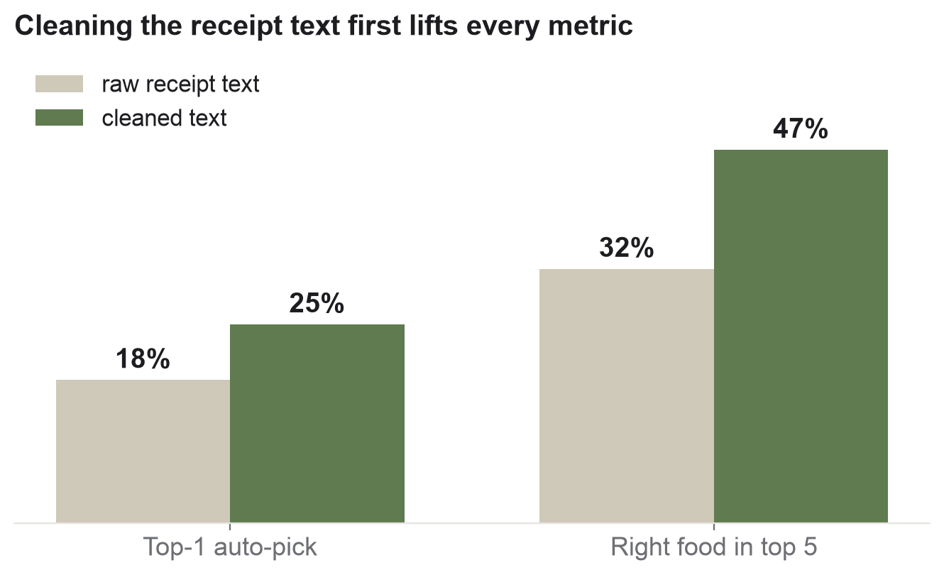
BASELINE MODEL & PERFORMANCE
Measured honestly on real receipts
99%
Lines resolved
174 BLS · 4 OFF · 2 left open, of 180
47%
Recall@5 (cleaned)
right food in top 5 — up from 32% raw
The honest finding: on messy text, a simple search beats the “smart” AI — so AI only breaks ties for now. Cleaning the receipt text is the real lever, and every user correction we save closes the rest.
NutriWise ·
11 / 13
Notes:
So how does it actually perform — honestly?
First, coverage:
we resolved 99% of the lines — 174 from the German table, 4 from Open Food Facts, and 2 left open on purpose.
Second, accuracy:
the biggest lever turned out to be simply cleaning the receipt text —
after cleanup, the correct food is in the top five 47% of the time, up from 32% on raw text.
Now the most important: So for now the AI just breaks ties, and every user correction we save closes the remaining gap.

Slide 13

LIVE DEMO — THE CURRENT BUILD
See it run, end-to-end, on a real receipt
1
Chat onboarding — goal, needs, exclusions
2
Upload receipt — on-device OCR — private, offline
3
Your Pantry — what's in the house, expiry-aware
4
Daily log — one tap = what you ate
5
Insights — weekly gaps + “use what you have” + Next Cart
6
Nutri-Coach + erase — plain-language why · GDPR erase
NutriWise ·
12 / 13
Notes:
Now let Stuart show it live!

Slide 14
NUTRIWISE
Thank you.
Upload a grocery receipt. Get one smarter thing to buy next time.
Jennifer Rake & Stuart Kasemeier
NutriWise · AI PM Capstone · Midterm V0 — Questions & feedback welcome
Notes:
[Both]
Close on the one-liner and invite questions. If pushed on accuracy: we measure honestly on real receipts (Recall@5 47% after cleanup, 99% of lines resolved), the clear next lever is the learned match store, and the deeper question — do people trust it and keep tapping — is what live user testing answers next.

Slide 15
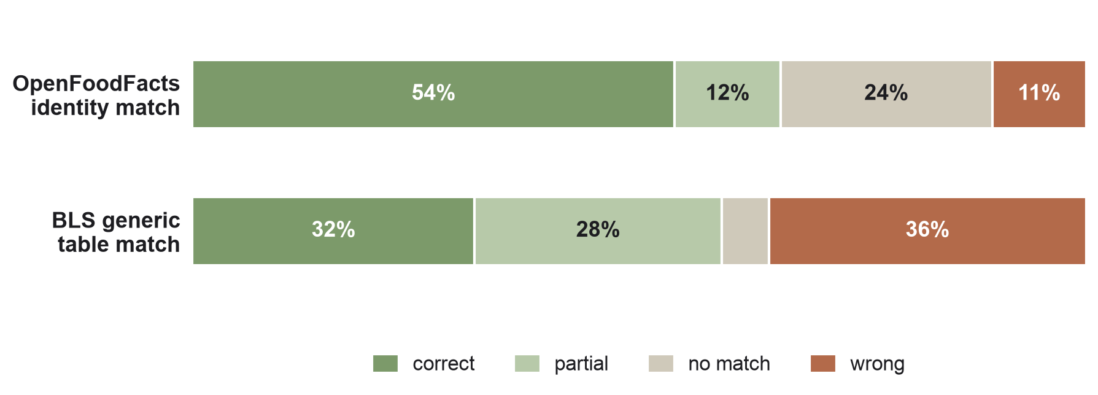
BACKUP — EARLIER PILOT MEASUREMENT
Pilot: OFF vs BLS, judged head-to-head
Different method than Recall@5 — an earlier LLM-judge pilot on 76 items. Not directly comparable; kept for context.
66%
OFF usable (pilot)
correct + partial, LLM-judged
2×
OFF beats BLS
54% vs 32% correct on identity
96%
Judge agreement
3/3 unanimous — pilot metric
Why it still matters: it's why BLS leads and OFF is only a fallback — and why we moved to the stricter, human-verified Recall@5.
Notes:
[Speaker 2 — only if asked]
Backup for questions. This was our earlier pilot on 76 items, judged by an LLM panel — a different method, so don't compare its 66% to the 47% Recall@5. What it told us: Open Food Facts wins on identity, the German table matched worse on its own — which is exactly why the table leads for nutrients only, and why we then built the stricter, human-checked Recall@5 test.

Slide 16
NUTRIWISE · MIDTERM · ML STEP 2
From cryptic receipt text to a
verified gold set
Matching test set extended from 45 curated pairs to the real receipts — every line judged against the full BLS corpus, then human spot-checked. No trained model, but an honestly measured rule/hybrid pipeline.
178 / 180
3 %
45 → 180
Receipt lines with a verified match (99% coverage)
Label-error rate (1 / 29 human-checked)
Gold set nearly quadrupled (152 unique queries)

Slide 17
THE EXTENDED GOLD SET
Labeled against the full corpus — not inflated
The hybrid ranker proposes the Top-5; we find the correct label in the entire 7,140-name corpus — otherwise the gold would sit in the shortlist by construction and recall would be an artificial 100%.
BLS · reliable German nutrition — 174
Open Food Facts · branded fallback — 4
unresolved (counter fish, ambiguous) — 2
Process: Proposal (deterministic hybrid ranker) → Judgment (independent, full corpus) → Spot-check (human) → honest error rate.

Slide 18
THE CLEANUP EFFECT
Cleaning the receipt line first pays off measurably
Same hybrid pipeline with raw (name_original) vs. cleaned (name_standard) query — against the same gold. Quantifies the value of OCR post-processing.
raw (name_original)
cleaned (name_standard)
47%
32%
25%
18%
ExpTop-1 (fair auto-pick)
Recall@5 (shortlist)
Cleaning lifts ExpTop-1 18% → 25% and Recall@5 32% → 47% — but doesn't close the gap alone.

Slide 19
THE HONEST FINDING
The embedding is a tie-breaker, not the main matcher
On raw receipt lines, pure fuzzy beats the hybrid. Noise tokens (brand, “organic”, “500 g”) mislead the embedding.
Real receipts are harder than the curated 45. Brand/quantity/organic tokens + raw-vs-prepared granularity push down the rate.
Hybrid (raw)
18%
Curated 45
56%
Fuzzy (raw)
22%
Real receipts
47%
ExpTop-1 on raw queries — higher is better.
Recall@5, hybrid — reported separately, never mixed.
Product consequence: a shortlist (Top-3/5) + learned, confirmed matches beat any single auto-pick on noisy lines.

Slide 20
TIERED MATCHING
Cheap & safe first, fallback last
Architecture actually implemented and cleanly separated via gold_source — OFF crowd nutrition is never silently mixed with the BLS lab data.
174
4
∞
1 · BLS 4.0
2 · Open Food Facts
3 · Learned matches
Reliable German nutrition (lab data). First choice.
Branded/barcode coverage for products the BLS lacks (chewing gum, spices).
User confirmations become verified pairs — path to real training (1k–10k pairs).

Slide 21
HONESTY AS A FEATURE
What we deliberately did not do
✓
Didn't guess. 2 lines (unspecified counter fish) stay open — ambiguity, not a database gap.
✓
Sources separated. BLS and OFF matches tagged; differing nutrient quality isn't mixed.
✓
Alternative tested & rejected. USDA: strong on generic English foods (BLS covers them), blind to German products (Quark, Schmand, Bergkäse → 0 hits).
✓
Limits named. Error rate open, α-overfitting stated, real receipts kept separate from the 45.
✓
No trained model faked. Inference with a pre-trained embedding + rules — no more, no less.
ANutriWise · AI PM Capstone · Midterm · Jennifer Rake & Stuart Kasemeier · 2026-07-17

