Slide 1

Retail Rental Society
Beatriz Fernandes Final Project Ironhack Bootcamp April 2026

Slide 2
The Unsustainable Loop
Production
- Large scale - Often
Retail
- Medium scale - Less often
Purchase
- Small scale - Esporadically

Slide 3
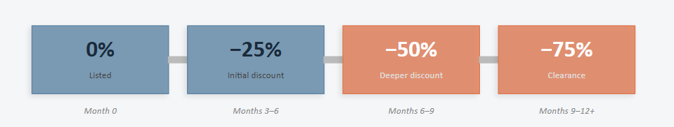
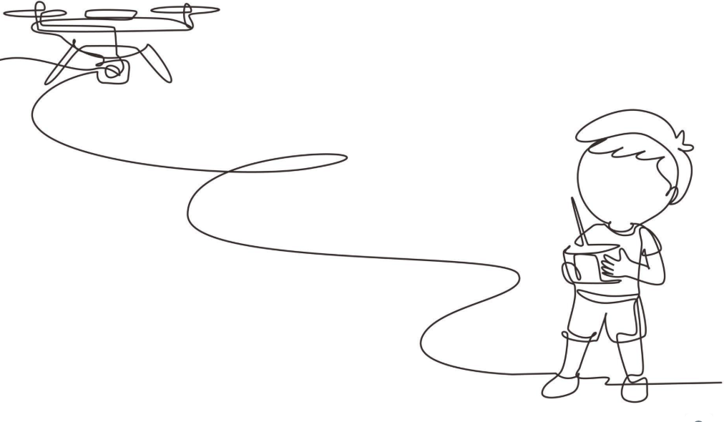
What does this mean?
Markdown, Clearance, Discount
Items unsold for months
Lose revenue on stale inventory
E-Waste
Recycle can’t keep up
Don’t buy enough
Get deals from older models
Can a Rental Culture flip the script?
Unleashed Production
Punished Acquisition
Conscious Revenue
Less e-waste
Incentive for more durability
Earn instead of losing
Rental Culture
Use, enjoy, recycle
Get experiences they wouldn’t otherwise
Conscious Production
Conscious Buyers Renters
Enshitification stops when products need to last longer to be rented more.

Slide 4
The Rental Culture and Data Setup
Entirely synthetic - 8 interconnected tables
~1,600 rental transactions
Real world and business rules
~500 products across 14 electronics categories
Eligibility Rule – 12 months unsold
Markdown Benchmarks - 40–75% (published NRF)
Rental Economics – various models
~2,000 synthetic customers with segmented behavior

Slide 5
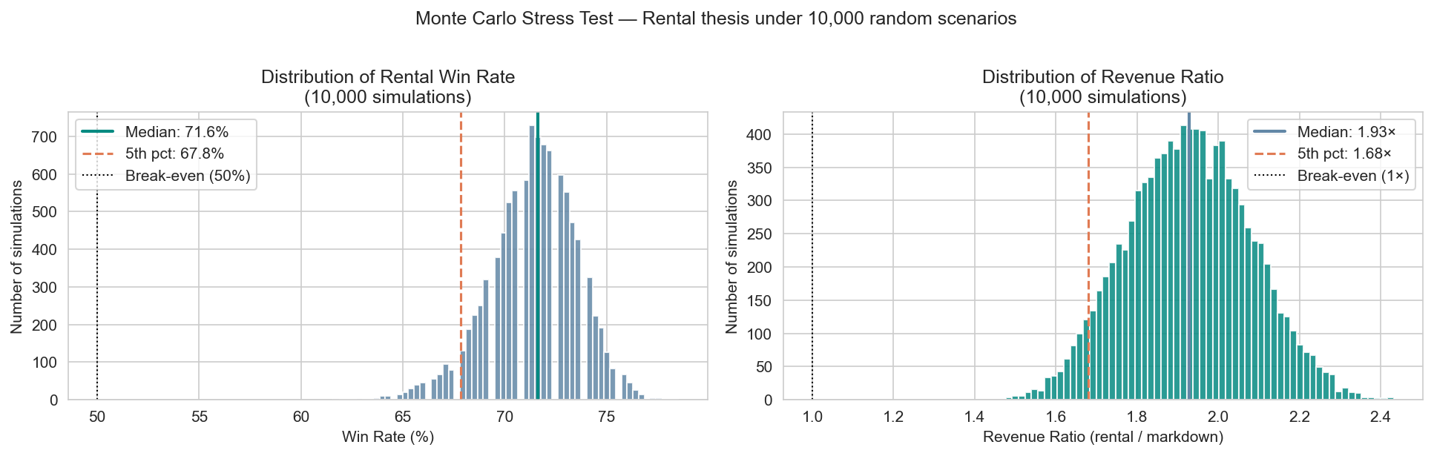
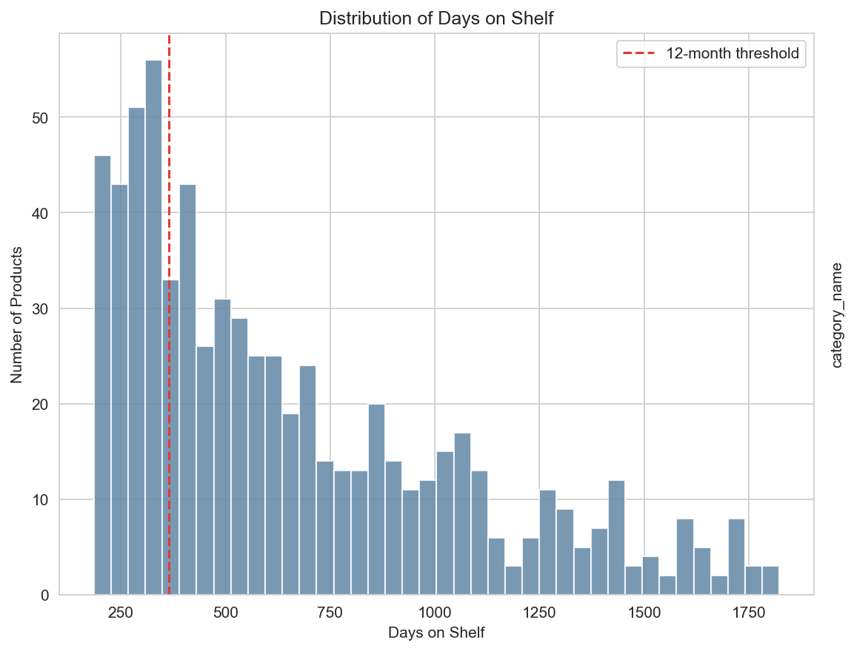
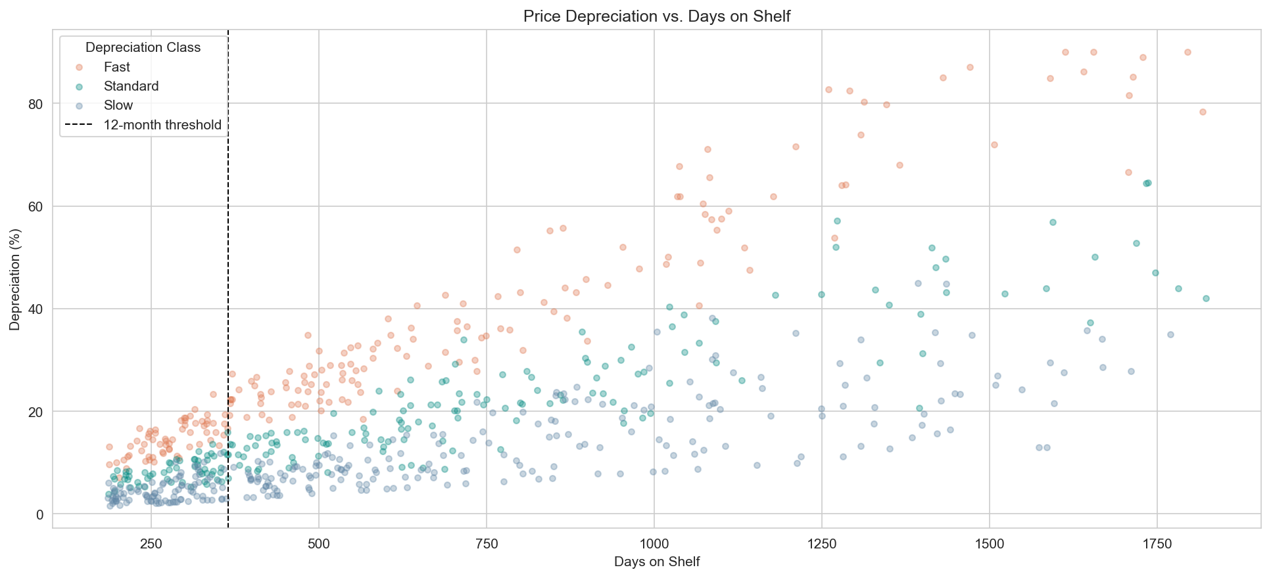
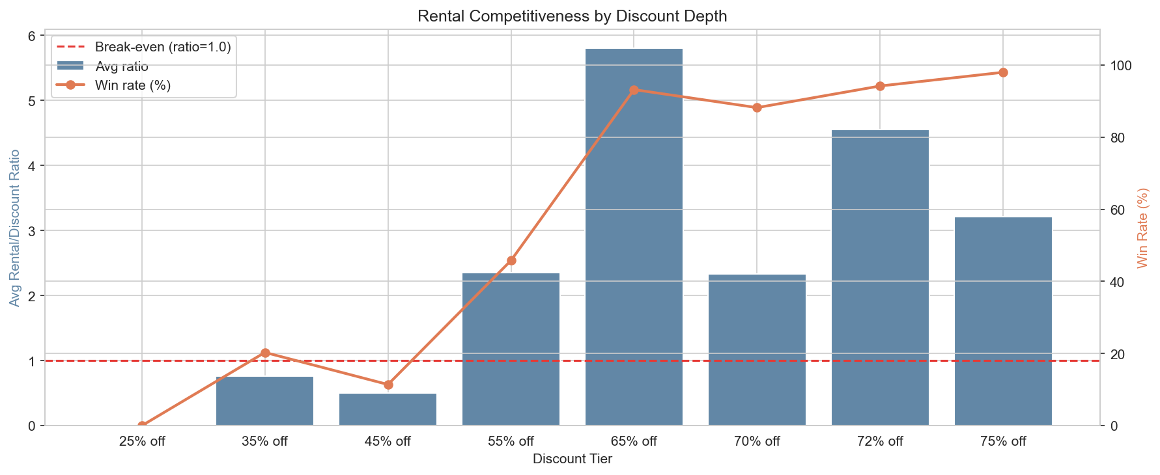
Does Rental beat Markdown?

Slide 6
The Full Stack
Python
DataFrames
SQL
PowerBI
Manual Feed
Live Feed
Customers
Products
Industries
Vertical Proof

Slide 7
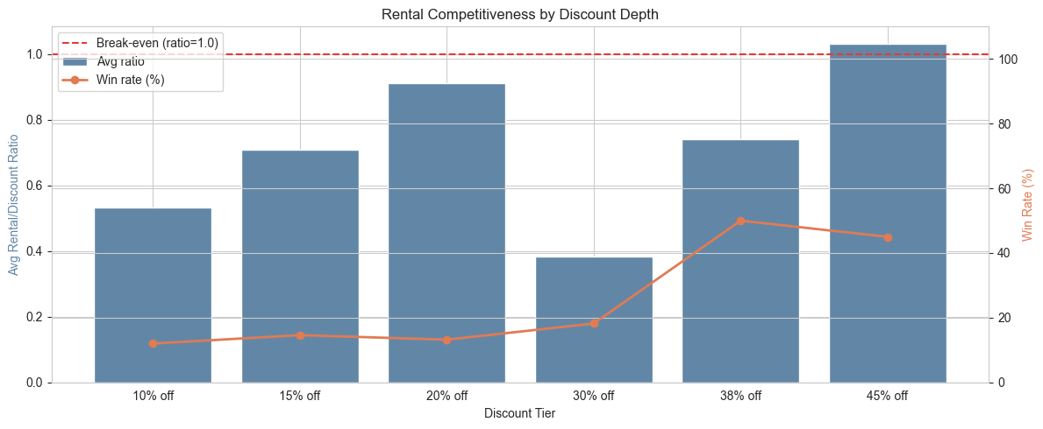
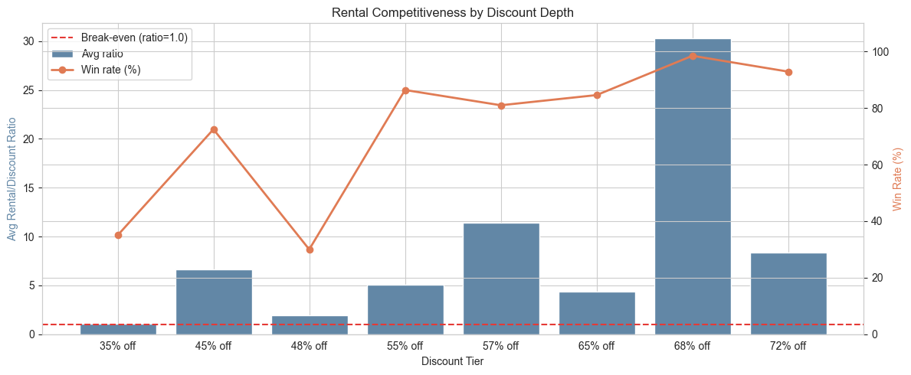
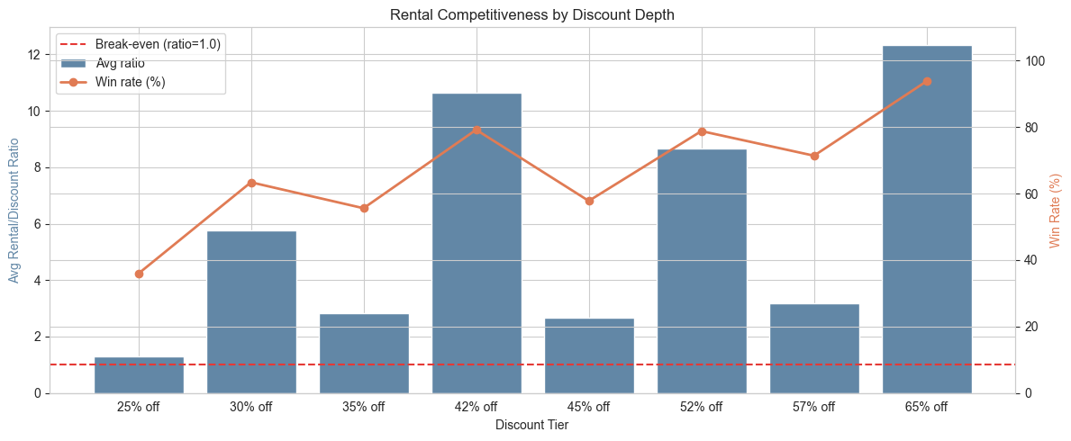
Same Architecture. Different Rules. Same pipeline.
Luxury Items Dataset
Maternity Dataset
Furniture Dataset

Slide 8

Considerations Thoughts Conclusion
A question
A working flow between tools
Renting can be Sexy! Just like renting a DVD once was.

