Slide 2
Data
 | Train | Test
Bruise | 421(31.0%) | 250(37.7%)
Cuts | 134(9.8%) | 78(11.7%)
Ulcer | 274(20.2%) | 141(21.2%)
Mouth | 335(24.7%) | 89(13.4%)
Scrape | 192(14.1%) | 104(15.7%)
Total | 1356 | 662

Slide 3
Data

Slide 4
Model
Input
SENet-154
fc128
SE-resNet152
resNet-152
DenseNet-201
SE_resNeXt101
fc128
fc128
fc128
fc128
5
5
5
5
5
fc128
5

Slide 5
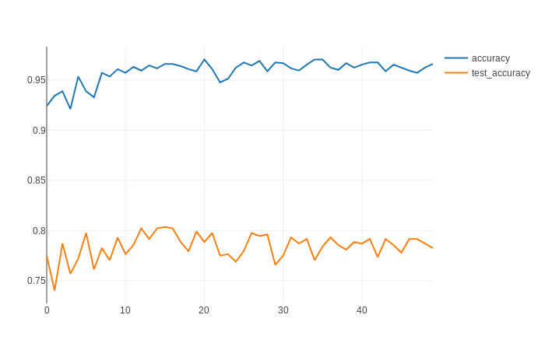
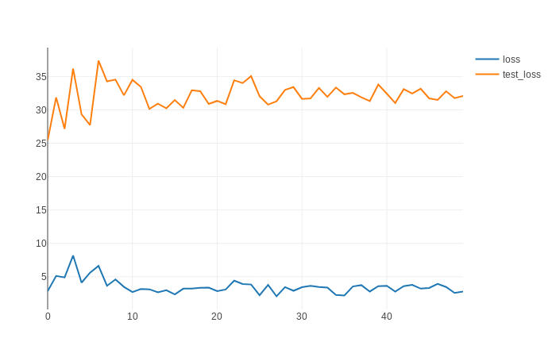
Result

Slide 6
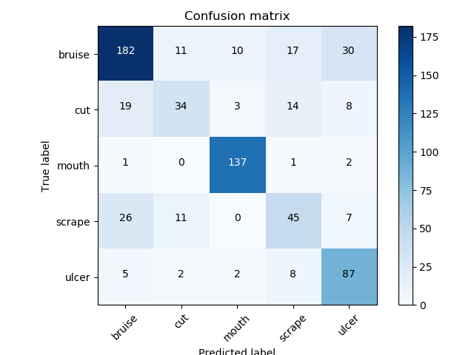
Confusion Matrix

Slide 7
Model
Input
SENet-154
fc128
SE-resNet152
resNet-152
DenseNet-201
SE_resNeXt101
fc128
fc128
fc128
fc128
5
5
5
5
5
fc64
5

Slide 8
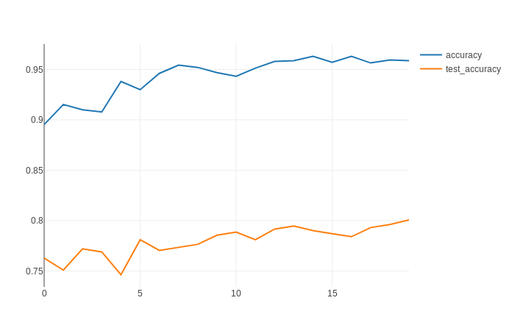
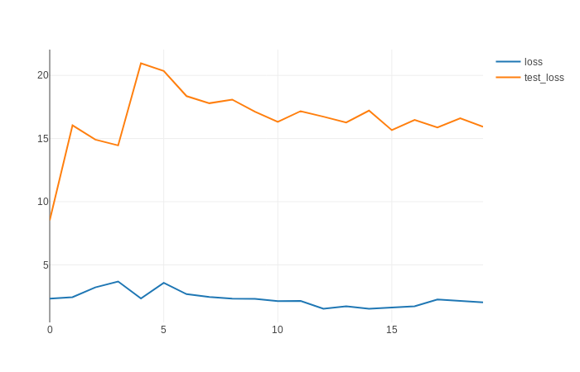
Result

Slide 9
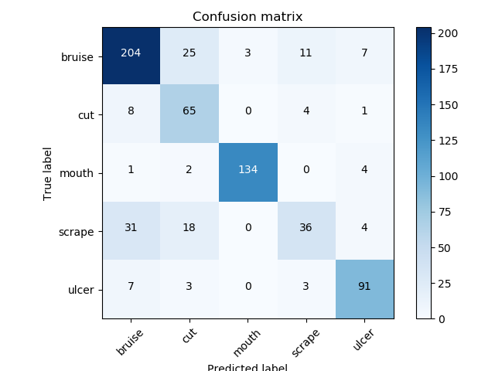
Confusion Matrix

Slide 10
Model
fc512
5
640
Input
SENet-154
fc128
SE-resNet152
resNet-152
resNet-101
SE_resNeXt101
fc128
fc128
fc128
fc128

Slide 11
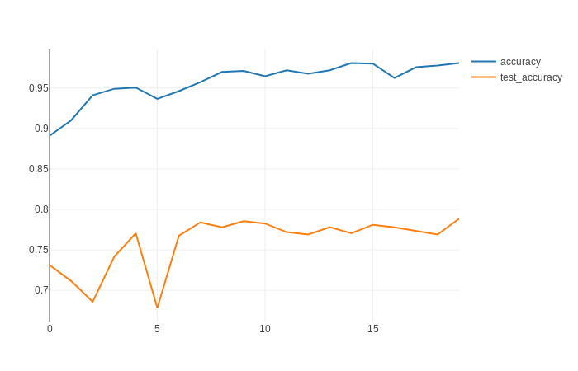
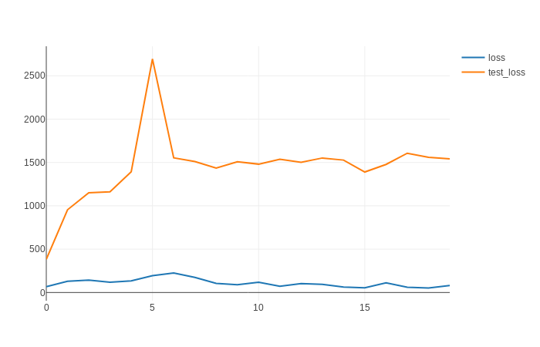
Result

Slide 12
Confusion Matrix

Slide 13
Model
fc4096
5
10240
fc4096
fc512
Input
SENet-154
2048
SE-resNet152
resNet-152
SE_resNeXt101
2048
2048
2048
2048
resNet-101

