Slide 1
An experiment of micro-services to overcome challenges of tracking-searching problem
MUM tech-talk July 09, 2019

Slide 2
Syllabus
Tracking-searching problem
Geo-based sharding
MongoDb-based implementation of Geo-based sharding
Micro-services-based implementation of Geo-based sharding
Live demo
Some tips to work with Micro-services
Conclusions
Future research.

Slide 3

Tracking-searching problem (like Uber)
Need to tracking location of multiple providers
Need to search providers based on locations and range (with additional criteria)

Slide 4
Tracking-searching problem - challenges
Huge volume of search requests.
170,000 daily rides in San Francisco
230,000 rides every hour or an average of 5.5 million rides a day
Massive volume of tracking requests.
67,000 active drivers in the Chicago city
3.9 million drivers worldwide
Real-time.
Unequal distribution
→ Need asynchronous, scaling, sharding

Slide 5
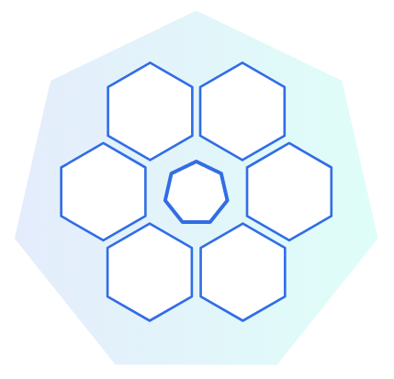
Tracking-searching problem - challenges
Scaling is not enough
Requests can be processed by any node
(Every single tracking request have to be processed by all nodes)

Slide 6
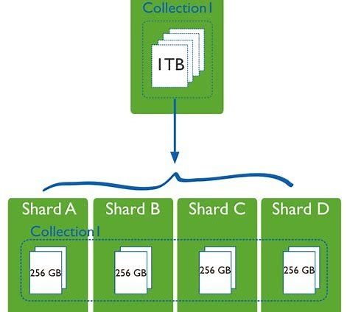
Tracking-searching problem - challenges
Field-based sharding is not efficient
Every single search request have to be processed by all nodes
Provider moving across shardings
→ Question: can we have relationships between sharding collections so that search requests are served efficiently?

Slide 7
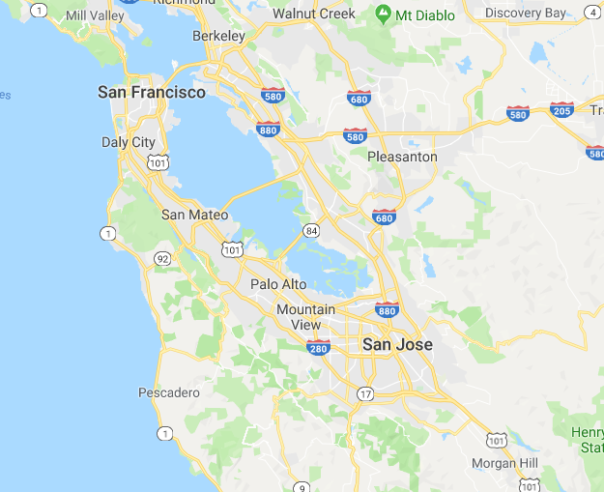
Geo-based sharding
Each area is a hub
Provider tracking sharded by hubid
For tracking-requests, attach associate hubid
For query-requests, query with related hubids

Slide 8
Geo-based sharding - Tracking
Hubs structure is a tree
1 Global node
Country nodes
State/Citi nodes
Areas inside city
Find associated hub by top-down go thru the hub tree.
At each level, chose the (only 1) in-range & closest hub
→ complexity is log(n)

Slide 9
Geo-based sharding - Search
Find all related hubs by top-down go thru the hub tree.
At each level, chose those hubs are in-range

